Slide 1

Device Interfacing with Python and ZIO
vijaykumar@zilogic.com
Zilogic Systems

Slide 2
Overview
Introduction to ZIO
Interfacing Devices
Demo Projects

Slide 3
Device Interfacing
Parallel Port
Limitations
  Only Digital IO
  Phased out

Slide 4

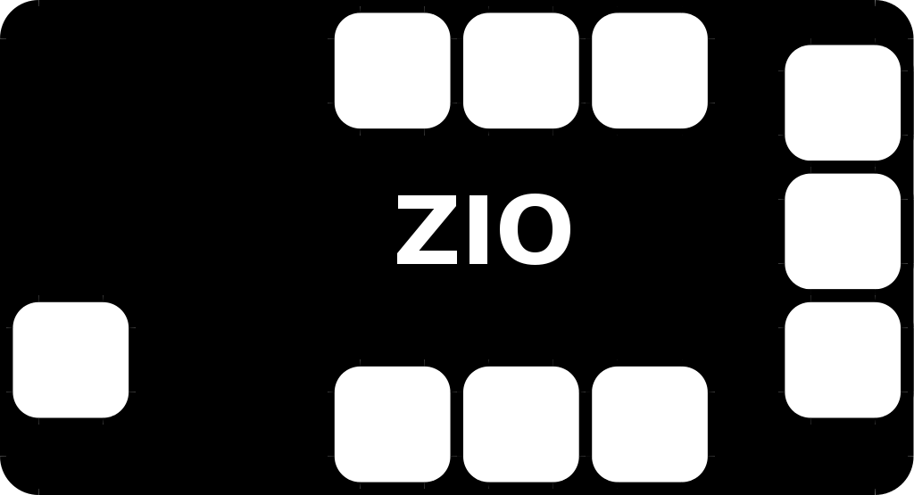
ZIO Architecture
USB based IO board
Digital I/O
Analog Input
PWM Output
I²C Bus
SPI Bus
Sensors
Transistors
Relays
LEDs
Switches
I²C Devices
DC Motors
IR receivers
...
PC – The Universal Platform
API to communicate with ZIO

Slide 5
ZIO Agent
ZIO Motherboard is powered by a ARM processor.
ZIO Agent
  Receives commands from PC through USB
  Manipulates the interfaces based on the commands

Slide 6
Ports
GPIO
  LEDs, Relays, Switches, MOSFETs, Optocouplers, ...
Sensor
  Tempature, Potentiometer, Light, Pressure, Humidity, ...
PWM
  DC Motor, Servo Motor, LED Brightness Control, ...
I2C/SPI
  RTCs, LCDs, IR Receivers, Sensors, Phone Line Interface ...

Slide 7
Ports (Contd.)
Each Port has 6 signals
Example GPIO port
  +5V Power
  GND
  2 Outputs
  2 Inputs
Terminated in RJ12 connector

Slide 8
Demo Board
ZIO Motherboard
Bread Board
RJ12 Breakout Board
Devices Board
Temp. Sensor Board

Slide 9
LED
Simple output devices
Used for status indication, displays, lighting ...

Slide 10
LED (Contd.)

Slide 11
Interface LED to ZIO
GPIO Port
Signals
  2 Outputs, 2 Inputs
  +5V Supply, GND
Setting Output to True, outputs 5V
Setting Output to False, outputs 0V

Slide 12
Interface LED to ZIO (Contd.)
GPIO outputs have a built-in series resistor
Eliminates series resistors on external circuit

Slide 13
Interface LED to ZIO (Contd.)
from zio import *
agent = Agent(“/dev/ttyUSB0”)
gpio = GPIO(agent)
gpio.write_output_pin(0, True)
gpio.write_output_pin(0, False)

Slide 14
Voltage Divider

Slide 15
Switch
Simple input device
Switch is closed
  Vout = 0V
Switch is open
  Vout = 5V
Switch state can be determined, by measuring Vout.

Slide 16
Interface Switch to ZIO
GPIO Input signals can test for a 0V or 5V.
Input > 2V
  Read as True
Input < 0.8V
  Read as False

Slide 17
Interface Switch to ZIO (Contd.)
GPIO inputs have built-in pull-ups resistors
Eliminates pull-ups on external circuits

Slide 18
Interface Switch to ZIO (Contd.)
import time
from zio import *
agent = Agent(“/dev/ttyUSB0”)
gpio = GPIO(agent)
while True:
  print gpio.read_input_pin(0)
  time.sleep(1)

Slide 19
Light Sensor (LDR)
LDR – Light Dependent Resistor
Resistance decreases with increase in light intensity
Voltage Vout decreases with increase in light intensity

Slide 20
Interface LDR to ZIO
Sensor port
  measure voltages between 0 – 3V
Signals
  +5V, GND
  2 Sensor Inputs
Read the voltage at Sensor 0

Slide 21
Interface LDR to ZIO (Contd.)
Sensor inputs have built-in pull-up resistors
Eliminates pull-ups on external circuits
Pull-ups connected to 3V, the max voltage that can be measured by sensor port.

Slide 22
Interface LDR to ZIO (Contd.)
import time
from zio import *
agent = Agent(“/dev/ttyUSB0”)
sensor = Sensor(agent)
while True:
  print sensor.read_pin(0)
  time.sleep(1)

Slide 23
DC Motor
Examples
  CPU Fan
  Wheels of a Robot
  CDROM drives
  Printers
DC motor controlled by a human operated switch

Slide 24
DC Motor (Contd.)
Replace switch by a MOSFET
Vcontrol = 5V
  Motor turns ON
Vcontrol = 0V
  Motor turns OFF

Slide 25
DC Motor (Contd.)
GPIO port - motor ON and OFF
Motor speed can be controlled
DC motor speed is propotional to the supply voltage
Speed control can be acheived by varying the averaging voltage delivered to the motor

Slide 26
DC Motor (Contd.)
Rapidly turn motor on and off
Duty cycle
  (ON time / Period) * 100
Duty cycle 100%
  Average voltage - 12V
Duty cycle 50%
  Average voltage - 6V

Slide 27
Interface DC Motor to ZIO
pwm = PWM(agent)
pwm.set_freq([0], 25)
pwm.set_duty([0], 100)
pwm.start([0])
pwm.set_duty([0], 50)
pwm.set_duty([0], 25)
D
S

Slide 28
Temperature Sensor
Temperature Sensors
  Resistive Sensors
  Non-ratiometric Sensors
  I2C / SPI Sensors
I2C
  kind of very simplified USB
  connect devices to CPU
  EEPROMs, RTCs, Accelerometers, Sensors ...

Slide 29
I2C Bus

Slide 30
Temperature Sensor
i2c = I2C(agent)
i2c.config(100)
while True:
  temp = i2c.read(0x48, 1)
  print temp[0]
  time.sleep(1)

Slide 31
Demo Projects
Laser Pointer Presentation Control
Light Bulb Control

Slide 32
Laser Pointer Demo
Control presentation with input from the laser pointer.
ZIO + LDR + Laser Pointer + Software Magic
User shines laser on the LDR
Software detects drop in the input voltage
Software generates a key (Space) to active window (the presentation)

Slide 33
Controlling a Light Bulb

Slide 34
Controlling a Light Bulb (Contd.)
Relay is a mechanical switch controlled by a electro magnet
If Vin = 0V then bulb turns off
If Vin = 5V then bulb turns on

Slide 35
Questions

Slide 36
Credits
Behind the scenes Zilogic Team
  PG <pg AT zilogic DOT com>
  Kannan <kannan AT zilogic DOT com>
  Development of Demo boards, Add-ons, ...
Software Tools
  Dia
  Open Office

