Slide 1

Device Interfacing with Python and ZIO
vijaykumar@zilogic.com
Zilogic Systems

Slide 2
Overview
ZIO Architecture
ZIO Ports
LED
Switch
Light Sensor
DC Motor
Temp Sensor
TV Remote Receiver
Color Sensor
Light Bulb

Slide 3

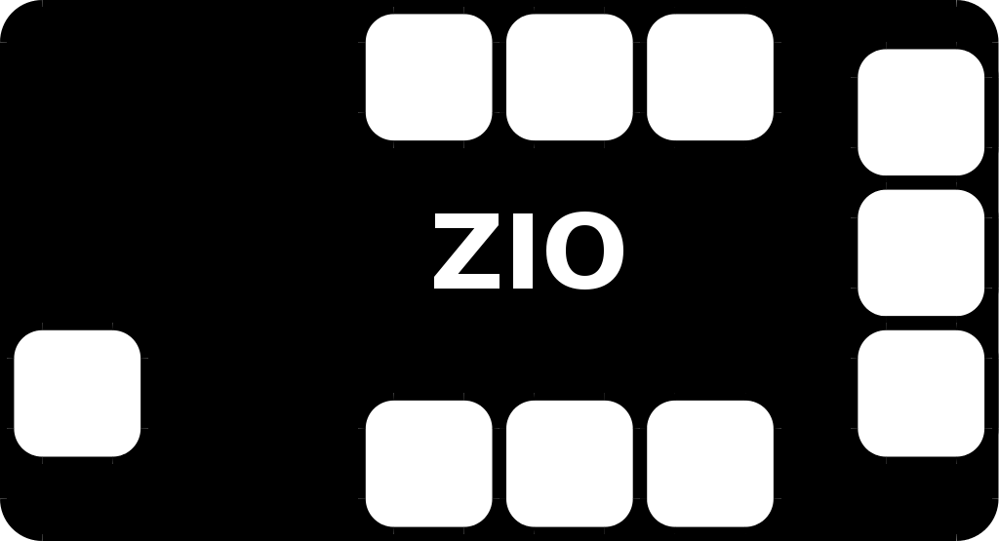
ZIO Architecture
USB based IO board
Digital I/O
Analog Input
PWM Output
I²C Bus
SPI Bus
Sensors
Transistors
Relays
LEDs
Switches
I²C Devices
DC Motors
IR receivers
...
PC – The Universal Platform
API to communicate with ZIO

Slide 4
Ports
GPIO
  LEDs, Relays, Switches, MOSFETs, Optocouplers, ...
Sensor
  Tempature, Potentiometer, Light, Pressure, Humidity, ...
PWM
  DC Motor, Servo Motor, LED Brightness Control, ...
I2C/SPI
  RTCs, LCDs, IR Receivers, Sensors, Phone Line Interface ...

Slide 5
LED
Simple output devices
Used for status indication, displays, lighting ...

Slide 6
LED (Contd.)

Slide 7
Interface LED to ZIO
GPIO Port
Signals
  2 Outputs, 2 Inputs
  +5V Supply, GND
Setting Output to True, outputs 0V
Setting Output to False, outputs 5V

Slide 8
Interface LED to ZIO (Contd.)
GPIO outputs have a built-in series resistor
Eliminates series resistors on external circuit

Slide 9
Interface LED to ZIO (Contd.)
from zio import *
agent = Agent(“/dev/ttyUSB0”)
gpio = GPIO(agent)
gpio.write_output_pin(0, True)
gpio.write_output_pin(0, False)

Slide 10
Voltage Divider

Slide 11
Switch
Simple input device
Switch is closed
  Vout = 0V
Switch is open
  Vout = 5V
Switch state can be determined, by measuring Vout.

Slide 12
Interface Switch to ZIO
GPIO Input signals can test for a 0V or 5V.
Input > 2V
  Read as True
Input < 0.8V
  Read as False

Slide 13
Interface Switch to ZIO (Contd.)
GPIO inputs have built-in pull-ups resistors
Eliminates pull-ups on external circuits

Slide 14
Interface Switch to ZIO (Contd.)
import time
from zio import *
agent = Agent(“/dev/ttyUSB0”)
gpio = GPIO(agent)
while True:
  print gpio.read_input_pin(0)
  time.sleep(1)

Slide 15
Light Sensor (LDR)
LDR – Light Dependent Resistor
Resistance decreases with increase in light intensity
Voltage Vout decreases with increase in light intensity

Slide 16
Interface LDR to ZIO
Sensor port
  measure voltages between 0 – 3V
Signals
  +5V, GND
  2 Sensor Inputs
Read the voltage at Sensor 0

Slide 17
Interface LDR to ZIO (Contd.)
Sensor inputs have built-in pull-up resistors
Eliminates pull-ups on external circuits
Pull-ups connected to 3V, the max voltage that can be measured by sensor port.

Slide 18
Interface LDR to ZIO (Contd.)
import time
from zio import *
agent = Agent(“/dev/ttyUSB0”)
sensor = Sensor(agent)
while True:
  print sensor.read_pin(0)
  time.sleep(1)

Slide 19
DC Motor
Examples
  CPU Fan
  Wheels of a Robot
  CDROM drives
  Printers
DC motor controlled by a human operated switch

Slide 20
DC Motor (Contd.)
Replace switch by a MOSFET
Vcontrol = 5V
  Motor turns ON
Vcontrol = 0V
  Motor turns OFF

Slide 21
DC Motor (Contd.)
GPIO port - motor ON and OFF
Motor speed can be controlled
DC motor speed is propotional to the supply voltage
Speed control can be acheived by varying the averaging voltage delivered to the motor

Slide 22
DC Motor (Contd.)
Rapidly turn motor on and off
Duty cycle
  (ON time / Period) * 100
Duty cycle 100%
  Average voltage - 12V
Duty cycle 50%
  Average voltage - 6V

Slide 23
Interface DC Motor to ZIO
pwm = PWM(agent)
pwm.set_freq([0], 25)
pwm.set_duty([0], 100)
pwm.start([0])
pwm.set_duty([0], 50)
pwm.set_duty([0], 25)

Slide 24
Temperature Sensor
Temperature Sensors
  Resistive Sensors
  Non-ratiometric Sensors
  I2C / SPI Sensors
I2C
  kind of very simplified USB
  connect devices to CPU
  EEPROMs, RTCs, Accelerometers, Sensors ...

Slide 25
I2C Bus

Slide 26
Temperature Sensor
i2c = I2C(agent)
i2c.config(100)
while True:
  temp = i2c.read(0x10, 1)
  print temp[0]

Slide 27
Demo Projects
TV Remote Receiver
Light Bulb
Color Sensor

