Slide 1
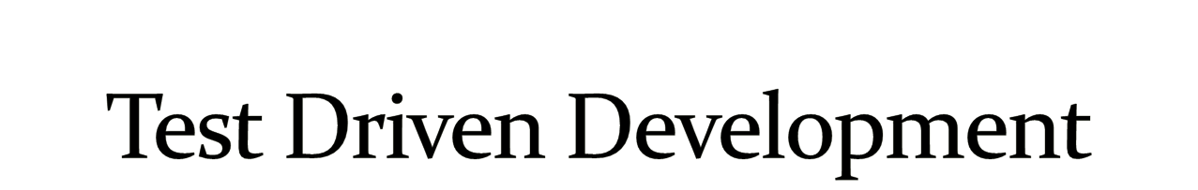
--Gayatri
--Madhubala

Slide 2

Black box testing
Load testing
White box testing
Stress testing
Unit testing
Performance testing
Incremental integration testing
Usability testing
Integration testing
Install/uninstall testing
Functional testing
Recovery testing
System testing
Security testing
End-to-end testing
Compatibility testing
Sanity testing
Comparison testing
Regression testing
Alpha testing
Acceptance testing
Beta testing

Slide 3

Unit Testing Tools
  Unittest
  Unittest2
  Nose
Mock Testing Tools
  Mock
  PyMock
  svnMock....
Fuzz Testing Tools
  Pester
  PeachFuzzer....
CodeCoverage Tools
  Coverage
Gui Testing Tools
  Pywinauto
  Gui auto
  …
Web Testing Tools
  windmill
  Selenium
  ....
Integration Testing Tools
  Buildout
  bitten...
Source codechecking Tools
  pylint

Slide 4

..run completely by itself, without any human input. Unit testing is about automation.
...determine by itself whether the function it is testing has passed or failed, without a human interpreting the results.
...run in isolation, separate from any other test cases (even if they test the same functions). Each test case is an island
Goal -
Isolate each part of the program and show that the individual parts are correct.
Benifits
..A unit test provides a strict, written contract that the piece of code must satisfy. As a result, it affords several benefits. Unit tests find problems early in the development cycle
Limitations--
-Testing cannot be expected to catch every error in the program

Slide 5

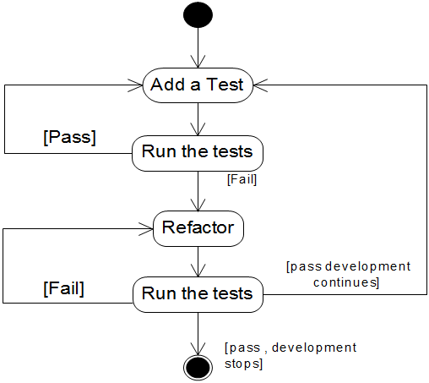

Slide 6

TDD can lead to more modularized, flexible, and extensible code
Clean code
Leads to better design
Better code documentation
More productive
Good design

Slide 7

    Requirements:
    toRoman should return the Roman numeral representation for all integers 1 to 3999.
    fromRoman should take a valid Roman numeral and return the number that it represents.
    toRoman should always return a Roman numeral using uppercase letters.
    fromRoman should only accept uppercase Roman numerals (i.e. it should fail when given lowercase input).

Slide 8

    #roman.py
"""Convert to and from Roman numerals"""
#Define exceptions
class RomanError(Exception): pass
class OutOfRangeError(RomanError): pass
class NotIntegerError(RomanError): pass
class InvalidRomanNumeralError(RomanError): pass
def toRoman(n):
"""convert integer to Roman numeral"""
pass
def fromRoman(s):
"""convert Roman numeral to integer"""
pass

Slide 9

    Unittest: testRoman.py
    """Unit test for roman.py"""
    import roman
    import unittest
    knownValues = ( (1, 'I'),.,.,.,..,(3999, 'MMMCMXCIX'))
    class TestToRoman(unittest.TestCase):
    def testToRomanGood(self):
    """toRoman should give known result with known input"""
    for integer, numeral in knownValues:
    result = roman.toRoman(integer)
    self.assertEqual(numeral, result)
    def testNonInteger(self):
    """toRoman should fail with non-integer input"""
    self.assertRaises(roman.NotIntegerError, roman.toRoman, 0.5)

Slide 10

    class TestFromRoman(unittest.TestCase):
    def setup(self):
    pass
    def tesrdown(self):
    pass
    def test_knownValues(self):
    """fromRoman should give known result with known input"""
    for integer, numeralin knownValues:
    result = roman.fromRoman(numeral)
    self.assertEqual(integer, result)
    def testTooManyRepeatedNumerals(self):
    """fromRoman should fail with too many repeated numerals"""
    for s in ('MMMM', 'DD', 'CCCC', 'LL', 'XXXX', 'VV', 'IIII'):
    self.assertRaises(roman.InvalidRomanNumeralError, roman.fromRoman, s)

Slide 11
    """Convert to and from Roman numerals"""
    #Define exceptions
    class RomanError(Exception): pass
    class OutOfRangeError(RomanError): pass
    class NotIntegerError(RomanError): pass
    class InvalidRomanNumeralError(RomanError): pass
    #Define digit mapping
    romanNumeralMap = (('M', 1000), ('CM', 900), ('D', 500),('CD', 400), ('C', 100), ('XC', 90), ('L', 50),('XL', 40), ('X', 10), ('IX', 9), ('V', 5), ('IV', 4), ('I', 1))
    def toRoman(n):
    """convert integer to Roman numeral"""
    if not (0 < n < 4000):
    raise OutOfRangeError, "number out of range (must be 1..3999)"
    if int(n) <> n:
    raise NotIntegerError, "non-integers can not be converted"
    result = ""
    for numeral, integer in romanNumeralMap:
    while n >= integer:
    result += numeral
    n -= integer
    return result
    def fromRoman(s):
    """convert Roman numeral to integer"""
    pass

Slide 12
    def fromRoman(s):
    """convert Roman numeral to integer"""
    result = 0
    index = 0
    for numeral, integer in romanNumeralMap:
    while s[index:index+len(numeral)] == numeral:
    result += integer
    index += len(numeral)
    return result

Slide 13

The nose.tools module provides a number of testing aids that you may find useful, including decorators for restricting test execution time and testing for exceptions, and all of the same assertX methods found in unittest.TestCase (only spelled in pep08 fashion, so assert_equal rather than assertEqual).
  nose.tools.raises(*exceptions)
      Test must raise one of expected exceptions to pass.
      Example use:
  @raises(TypeError, ValueError)
  def test_raises_type_error():
  raise TypeError("This test passes")
  nose.tools.assert_equal
      Fail if the two objects are unequal as determined by the ‘==’ operator.
  nose.tools.assert_false
      Fail the test if the expression is true.

Slide 14


