Slide 1
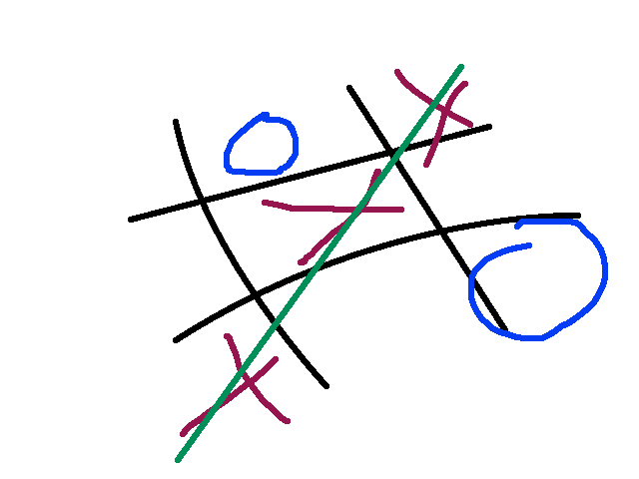
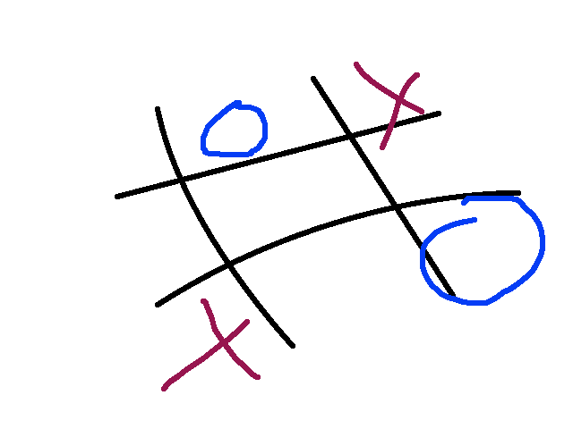
2to3
porting summarized - issues, workflows and solutions

Slide 2
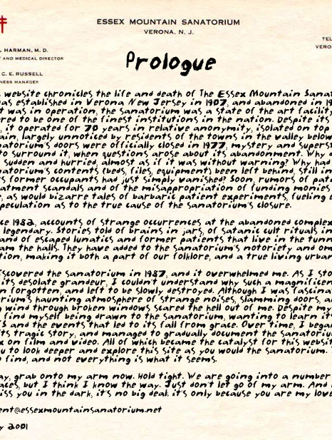
today we`ll be talking about ...
how different is py3k?
d2, configobj
workflow
how to contribute
under-the-hood

Slide 3


how different are they???

Slide 4
LOTS OF SMALL DIFFERENCES!!!
http://docs.python.org/release/3.0.1/whatsnew/3.0.html

Slide 5
and a few major ones ...
All strings are UNICODE
(integers, long) -> integers

Slide 6
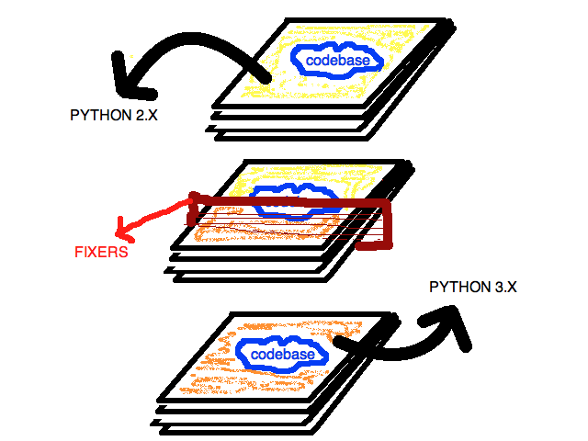
2to3 - the tool

Slide 7
d2 porting
more than 60 files -> maybe around 7200 lines approx.
d2 has the same codebase for 2.x and 3.x
run 2to3
make sure the tests work. fix stuff if they don`t

Slide 8
single vs. multiple codebases
Single codebase
  apply bug-fixes once
  codebase becomes messier as you try to increase compatibility with different version

Slide 9
single vs. multiple codebases
multiple codebase
  neater codebase
  apply your bug-fixes on two branches
  you probably have to do this if you intend to re-design your APIs

Slide 10
single vs. multiple codebases
expecting rapid development soon?
  use a single branch for now, use another branch when you feel you have enough time to apply patches to 2 branches

Slide 11
porting configobj
convert the repo over to mercurial
run tests which fail
make tests work

Slide 12

helping the community
stdlib/3rd party library?
web-frameworks?
python-porting ML
PSF sponsored sprints

Slide 13
Unicode and Py3k

Slide 14
long -> integer

Slide 15

doubts, anyone?

Slide 16

well, c u around then!

