Slide 1
Deployment to large server farms using Fabric and BitTorrent.
Manoj S Mahalingam
Shyam Sundar CS

Slide 2
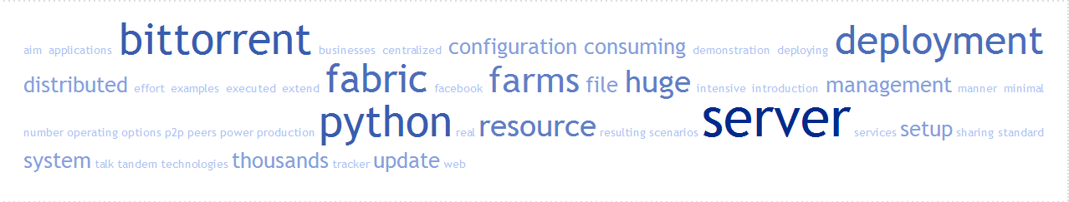
Let’s begin with defining each of the keywords in our talk’s title!

Slide 3

Deployment

Slide 4
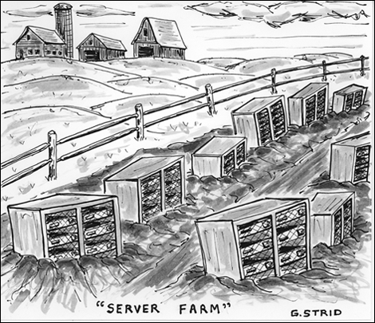
Server Farm

Slide 5
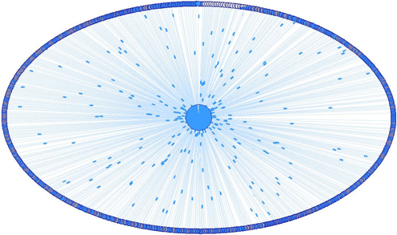
BitTorrent

Slide 6

….and Fabric

Slide 7

Why

Slide 8
Fabric
Why So Serial??

Slide 9

BitTornado

Slide 10
Fabric extension - tdeploy
Import the tldeploy extension
from fabric.contrib import tdeploy

Slide 11
Fabric extension - tdeploy
Define Fabric tasks for creating torrent
env.roledefs={‘create’:[‘localhost’]}
@roles(‘create’)
def make_torrent():
tdeploy.create(“sample.torrent”,”sample.tar.gz”,”tracker.torrent.com:54321”)

Slide 12
Fabric extension - tdeploy
Tasks to start and stop the torrent tracker
@hosts(‘tracker’)
def start_tracker():
tdeploy.start_tracker()
@hosts(‘tracker’)
def stop_tracker():
tdeploy.stop_tracker()

Slide 13
Fabric extension - tdeploy
Tasks to start and stop the seeding
@hosts(‘seeder01’,’seeder02’)
def start_seeding():
tdeploy.start_seeding()
@hosts(‘seeder01’,’seeder02’)
def stop_seeding():
tdeploy.stop_seeding()

Slide 14
Fabric extension - tdeploy
Start the tracker and seeding and then start client at peers
env.roledefs={‘peers’:[‘node01’, ‘node02’, ‘node03’]}
@roles(‘peers’)
def start_deploy():
tdeploy.start()

Slide 15
Fabric extension - tdeploy
Make use of roles
env.roledefs={‘peers’:[‘node01’, ‘node02’, ‘node03’],
‘seeds’:[‘seeder01’],
‘tracker’:[‘tracker’]
}
tdeploy can automatically look for these roles and run the appropriate jobs on the hosts

Slide 16
Fabric extension - tdeploy
Once roles are defined, and tasks decorated with the correct roles call each job for the entire workflow
fab make_torrent start_tracker start_seeding start_deploy

Slide 17
Demo and a look at the source

Slide 18
Q & A

