Slide 1
Machine Learning
With
Python
Sreejith.S
Jaganadh.G

Slide 2
Machine Learning
Sub field of Artificial Intelligence.
Algorithms that allow computers to learn.
Trains a model,in order to generalize.
Rely heavily on Mathematics & Statistics
Limitations

Slide 3
Real Life examples
Searching & Ranking System
  Google
Recommendation System
  Amazon , Netflix
Other Areas
  Bio-technology , Financial fraud detection , Machine Vision
  Stock Market Analysis , National Security etc..

Slide 4
Collaborative Filtering
Filter information based on user preference
Similar users like similar things.
Creates a ranked list of collections
Searching a large set of people and finding a smaller set with tastes similar to you
Two types
  User based
  Item based

Slide 5
User Based
Looks for users who share the same rating patterns with the
query user
Use the ratings from like-minded users to calculate a prediction
for the query user
Item Based
Build an item-item matrix determining relationships between
pair of items.
Using the matrix,and the data on the current user,infer taste

Slide 6
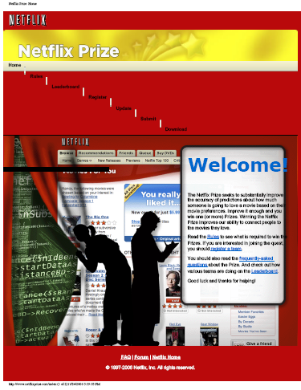
Every day Examples
Netflix Movie Recommendation
“The netflix prize seeks to substantially improve the accuracy of predictions about how much some one is going to love a movie based on their movie preference”

Slide 7
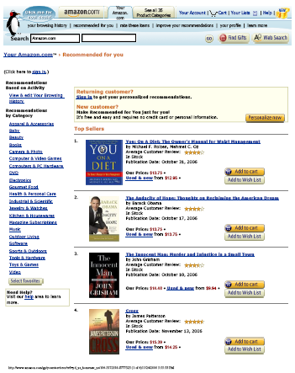
Amazon.com Book Recommendation
If amazon.com doesn't know me then i get generic recommendations
As I make purchases,click items,rate items make lists my recommendations “better”

Slide 8
DEMO

Slide 9
Searching & Ranking
Allow people to search a large set of documents for a list of words
Rank results according to how relevant the documents are to those words

Slide 10
What's in a Search Engine
Develop a way to collect the documents
This will involve crawling
After you collect the documents, they need to be indexed
The final step is,returning a ranked list of documents from a query.
Finally, need to build a neural network for ranking queries.

Slide 11
DEMO

Slide 12
Document Classification
Filing document is hard work
Route email messages in to folders
Route help-desk enquirers to correct staff
Add new documents to topic hierarchy

Slide 13
DEMO

Slide 14
Thank You

