Slide 1
Deadly Combo
PyCon India 2010
Kushal Das
http://fedoraproject.org

Slide 2
About me
Fedora Ambassador & packager & ...
http://kushaldas.in
Upstream author for Boog

Slide 3
What is It ?

Slide 4
Python + Newt

Slide 5
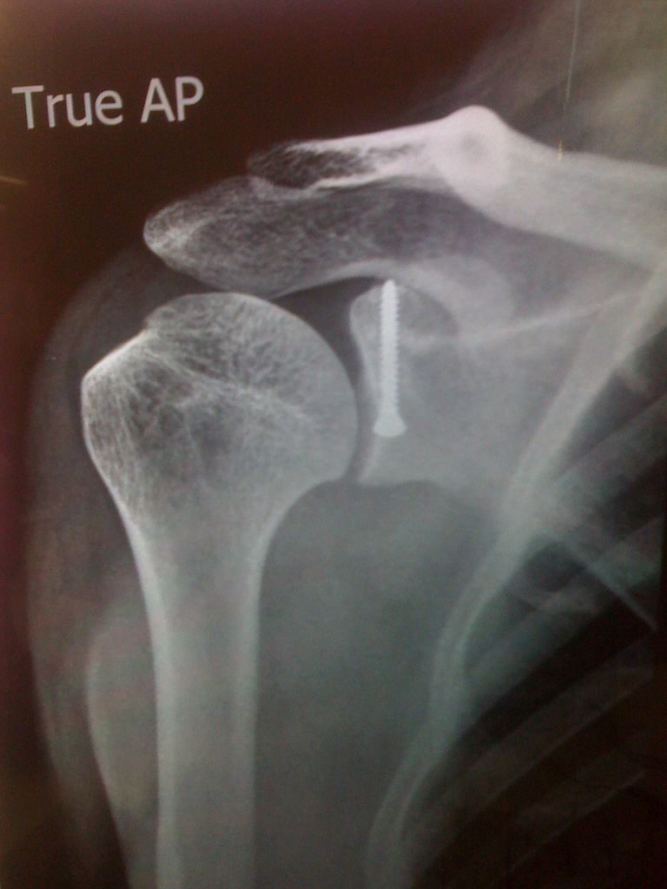
Why Python ?

Slide 6
Newt
Light weight
Easy to use

Slide 7
How does it look ?
Let us see some real life example

Slide 8
Python-newt
From snack import *

Slide 9
Classes
CheckBox
ListBox
Entry
TextBox
RadioGroup
...

Slide 10
Example codes

Slide 11
Where to read more ?
https://fedorahosted.org/newt/

Slide 12
?

Slide 13
Thank you

