Slide 1

PDF Accessibility with Python
Anand B Pillai <abpillai@gmail.com>

Slide 2
A few terms
*definitions from Wikipedia
Accessibility – *“Accessibility is a general term used to describe the degree to which a product, device, service, or environment is accessible by as many people as possible.”
Web Accessibility - *“Web accessibility refers to the inclusive practice of making websites usable by people of all abilities and disabilities.”
Document Accessibility – Accessibility principles applied to documents such as PDF, Word, Openoffice etc.

Slide 3
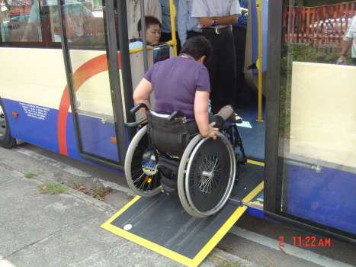
Accessible

Slide 4
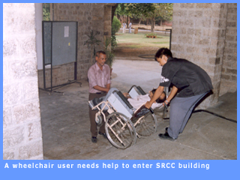
Not Accessibile

Slide 5
Web/Document Accessibility
Accessibility techniques help disabled users to interpret web pages or documents with the help of technologies such as screen readers.
For this, web sites/documents need to be written in keeping with accessibility guidelines.
Web content accessibility guidelines – WCAG 1.0 (earlier) and WCAG 2.0
Document accessibility – No “official” guidelines, but general guidelines and techniques available.

Slide 6
PDF
Rapid growth on the web
In creasing use by governments, banks and other agents.
  Example: Mobile Bills, Bank Statements, IT returns etc.
In India, the usage is just taking off now
In western countries, a lot of e-governance transactions use PDF documents by default.

Slide 7
PDF and Accessibility
Very easy to create inaccessible PDF!
Before Acrobat 5 (2001), PDF was not very accessible
Acrobat 5 and later introduced ability to “tag” content like HTML documents, which greatly improved accessibility
W3C doesn't recognize PDF as a standard format since it requires a browser plug-in. So WCAG guidelines don't consider PDF as fully accessible yet.

Slide 8
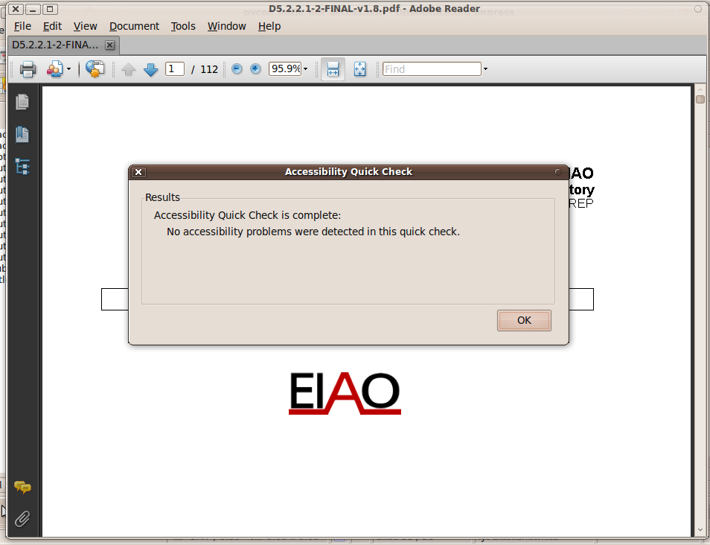
Using Acrobat for quick accessibility check
Go to Document->Accessibility Quick Check

Slide 9
5 ways of creating inaccessible PDF !
Scanned PDF
Embedding multimedia such as video or audio files
Embedding interactive forms
Disabling access to PDF structure to accessibility technologies (screen readers etc) using encryption
Multi-columned pages

Slide 10

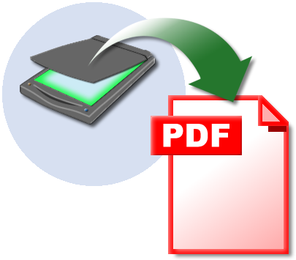
Scanned PDF
=

Slide 11
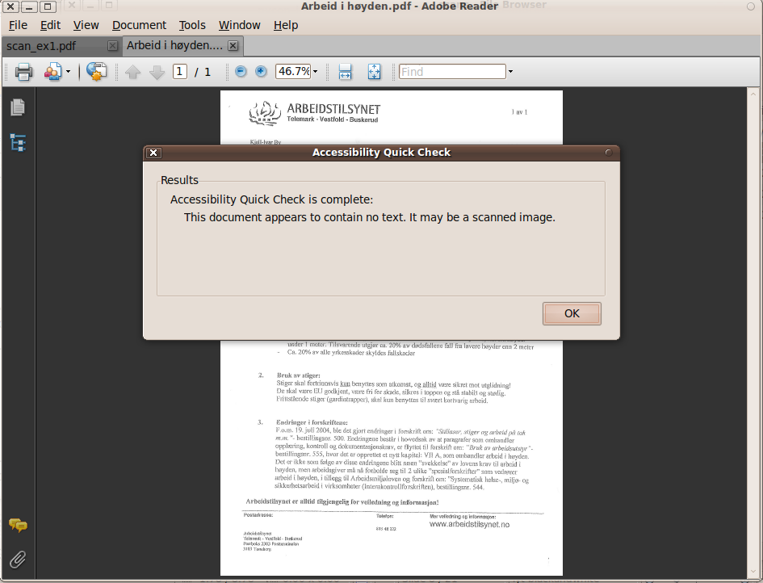
Checking scanned PDF accessibility in Acrobat

Slide 12
Why scanned PDF is Evil
Scanned PDF is one big raster image – a big binary blob
One loses all structure in the original scanned document
Assistive technologies completely fail on scanned PDF documents since there is no meta or structure information to process
If you use scanned PDF, you are creating accessibility barriers for the disabled who might use your documents

Slide 13
Other PDF Evils
Multiple columns – Makes it very difficult for screen readers to process the document (tends to read text on two columns as a single line)
Interactive Forms – Forms are meant for HTML pages, not PDF documents. Defer from using them unless there is a clearly defined need.
Not defining natural language – Define a natural language for the document. Otherwise screen readers could use wrong speech engines. (Egs: English engine for spanish document)
No document title – Defining a meaningful title for the document might seem like a small thing, but for the visually disabled, this is a major barrier to accessibility

Slide 14
Python and PDF
A handful of open source libraries
PyPDF - http://pybrary.net/pyPdf/
  Pretty good PDF parser and writer, very extensible (last rel, 1.12, Sep 2008)
PDFMiner-http://www.unixuser.org/~euske/python/pdfminer/index.html
  Robust PDF parser, well maintained (last rel Aug 2010)
Reportlab - http://www.reportlab.com/
  Professional PDF reporting toolkit

Slide 15
Egovmon.no
A project based in Norway to measure e-governance indicators in the areas of Accessibility, Transparency, Efficiency & Impact funded by Research Council of Norway.
Part of the project is an onlne PDF accessibility evaluator web service
PDF web accessiblity module (WAM) is written in Python using pyPdf as the back-end.
http://accessibility.egovmon.no/en/pdfcheck/?

Slide 16
PDF WAM Checks
Tests a PDF document for the following
  Valid document title
  Natural language definition
  Presence of tags (document structure)
  Multiple columns present or not
  Consistent document structure (headers in correct order etc)
  Embedded multimedia
  Interactive forms
  Bookmarks
  Scanned PDF
  Document permissions (encryption etc)

Slide 17
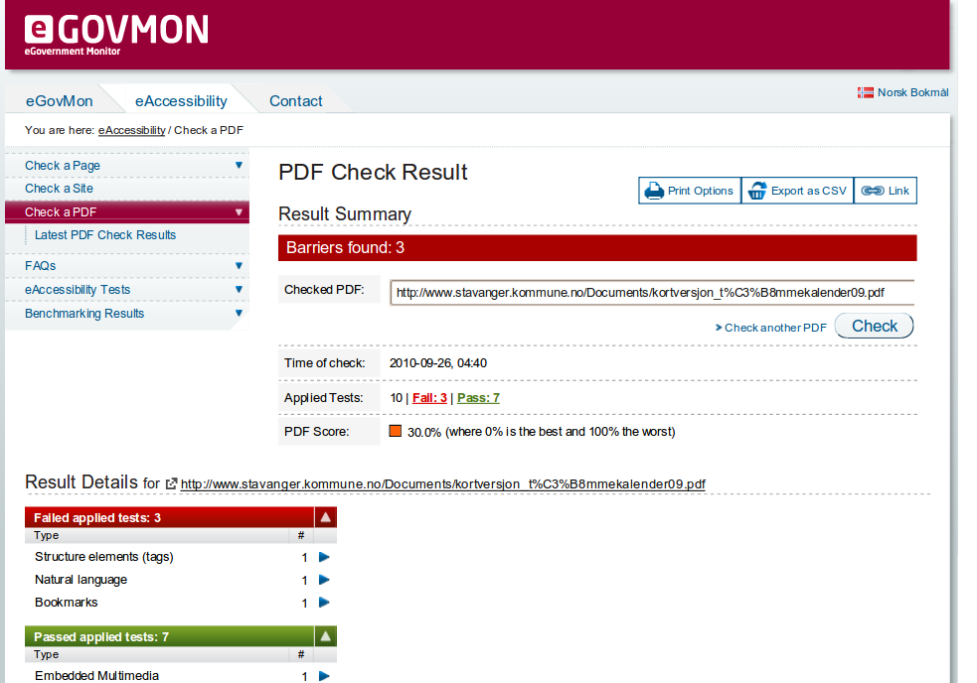

Slide 18
PDF WAM
Provides a SOAP web-service at port 8893 for evaluating PDF URLs or content
Returns a Python dictionary of results after processing the PDF which is processed by the front-end to display accessibility data.

Slide 19
PDF WAM Output (Server Log)
Evaluating: http://harvestmanontheweb.com/files/pdf/287.pdf
#Pages => 23
Producer=> Adobe PDF Scan Library 1.0.0
Creator=> "PFU ScanSnap Manager"
Title=> (None)
Version=> 1.3
Has structure tree=> False
Has forms=> False
Has bookmarks=> False
Scan check: found scan producer!
Warning: document has no headers!
Processed in 0.05 seconds
{'EIAO.A.15.3.1.4.PDF.1.1': {(0, 1): 1}, 'EIAO.A.15.1.1.4.PDF.1.1': {(0, 1): 0}, 'EIAO.A.0.0.0.4.PDF.5.1': {(0, 1): 0}, 'EIAO.A.0.0.0.4.PDF.8.1': {(0, 1): 0}, 'EIAO.A.10.3.1.4.PDF.1.1': {(0, 1): 0}, 'EIAO.A.10.4.1.4.PDF.1.1': {(0, 1): 0}, 'EIAO.A.0.0.0.4.PDF.9.1': {(0, 1): 0}, 'EIAO.A.10.3.2.4.PDF.1.1': {(0, 1): 0}, 'EIAO.A.0.0.0.4.PDF.1.1': {(0, 1): '1.3'}, 'EIAO.A.0.0.0.4.PDF.2.1': {(0, 1): u'"PFU ScanSnap Manager"'}, 'EIAO.A.0.0.0.4.PDF.7.1': {(0, 1): 0}, 'EIAO.A.0.0.0.4.PDF.6.1': {(0, 1): 0}, 'EIAO.A.10.13.3.4.PDF.1.1': {(0, 1): 0}, 'EIAO.A.10.10.3.4.PDF.1.1': {(0, 1): 1}, 'EIAO.A.10.3.5.4.PDF.1.1': {(0, 1): 1}, 'EIAO.A.10.8.1.4.PDF.1.1': {(0, 1): 1}, 'EIAO.A.0.0.0.4.PDF.3.1': {(0, 1): u'Adobe PDF Scan Library 1.0.0'}, 'EIAO.A.15.2.1.4.PDF.1.1': {(0, 1): 1}}

Slide 20
Source Code
Open-source, released under GNU GPL
Subversion
  http://svn.egovmon.no/svn/eGovMon/trunk/WAMs/pdf-wam
Compatible with Python <=2.6.x
pyPDf is packaged along, so no need to download it separately.
Provides a command line checker called “pdfchecker.py”

Slide 21
Links
Web AIM, defining PDF accesibility: http://webaim.org/techniques/acrobat
Creating accessible PDF files: http://www.adobe.com/enterprise/accessibility/pdfs/acro6_pg_ue.pdf
Egovmon : http://www.egovmon.no
Egovmon PDF accessibility checker: http://accessibility.egovmon.no/en/pdfcheck/
A list apart – Facts and opinions about PDF accessibility: http://www.alistapart.com/articles/pdf_accessibility

Slide 22

Questions ?
Thank you!

