Slide 1
Enhance your SIEM with Sysmon​
Wes Stahler, CISSP, MCSD
The Ohio State University Wexner Medical Center

Slide 2
What is it?
A host-level tracing tool, which can assist you in detecting advanced threats on your network.
Performs system activity deep monitoring, and log high-confidence indicators of advanced attacks.
Sysmon is using a device driver and a service that is running in the background and loads very early in the boot process.
Deploy via Group Policy
Can push this to your SIEM via agent, NXLog or Event Forwarding
At a minimum, deploy it on your endpoints.

Slide 3
Overview (from https://docs.microsoft.com/en-us/sysinternals/downloads/sysmon)
Logs process creation with full command line for both current and parent processes.
Records the hash of process image files using SHA1 (the default), MD5, SHA256 or IMPHASH.
Multiple hashes can be used at the same time.
Includes a process GUID in process create events to allow for correlation of events even when Windows reuses process IDs.
Include a session GUID in each events to allow correlation of events on same logon session.
Logs loading of drivers or DLLs with their signatures and hashes.
Logs opens for raw read access of disks and volumes
Optionally logs network connections, including each connection’s source process, IP addresses, port numbers, hostnames and port names.
Detects changes in file creation time to understand when a file was really created. Modification of file create timestamps is a technique commonly used by malware to cover its tracks.
Automatically reload configuration if changed in the registry.
Rule filtering to include or exclude certain events dynamically.
Generates events from early in the boot process to capture activity made by even sophisticated kernel-mode malware.

Slide 4
Where do I get it?
Part of Sysinternals suite: https://docs.microsoft.com/en-us/sysinternals/downloads/sysinternals-suite
Sysmon: https://docs.microsoft.com/en-us/sysinternals/downloads/sysmon

Slide 5
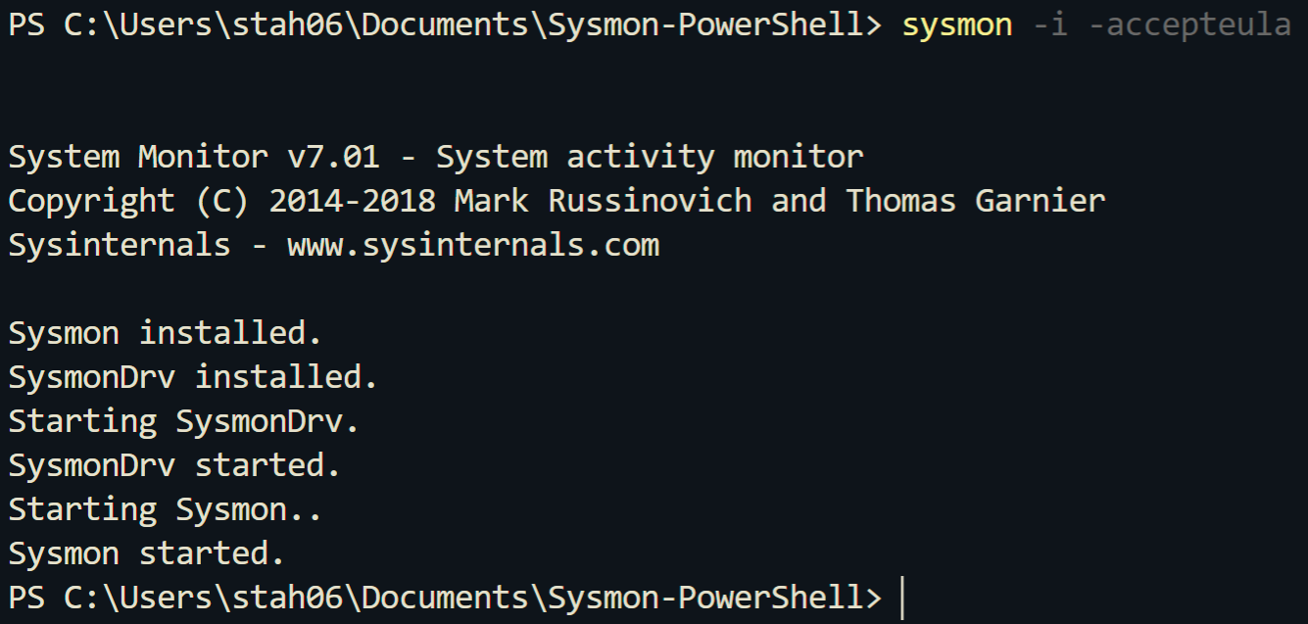
Getting started (base install)
Open a command line as an administrator
Enter sysmon –AcceptEULA -i

Slide 6
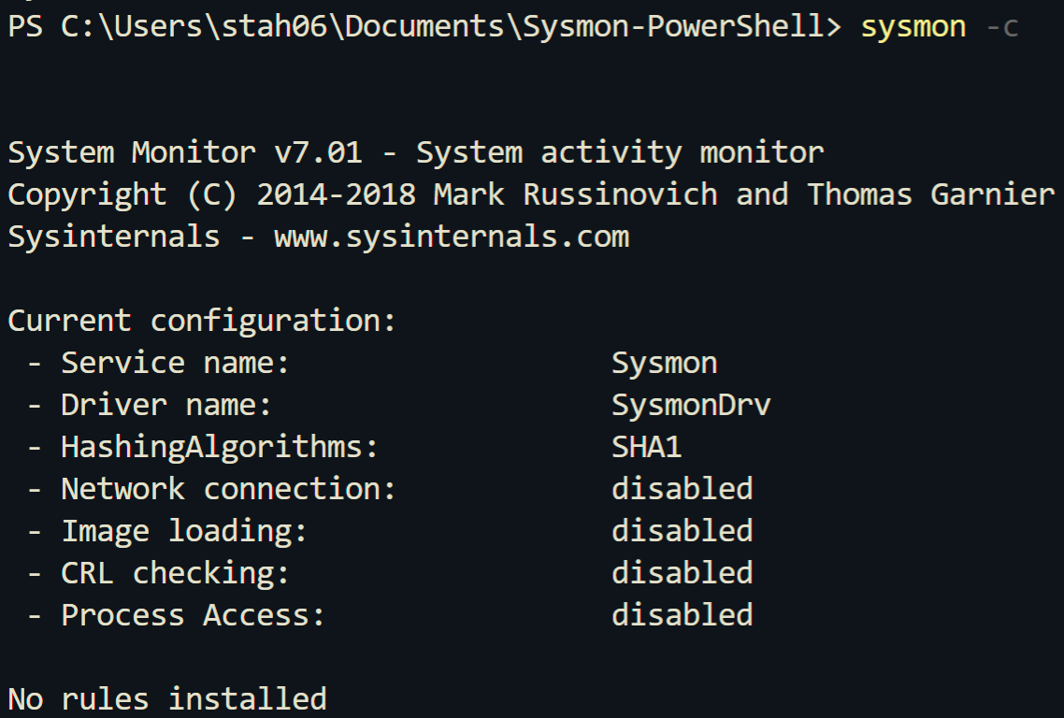
Sysmon configuration
There are command line switches to set up what is monitored, however, I recommend we fire up an XML editor and create a config file.
To see what is currently configured: Enter Sysmon –c

Slide 7
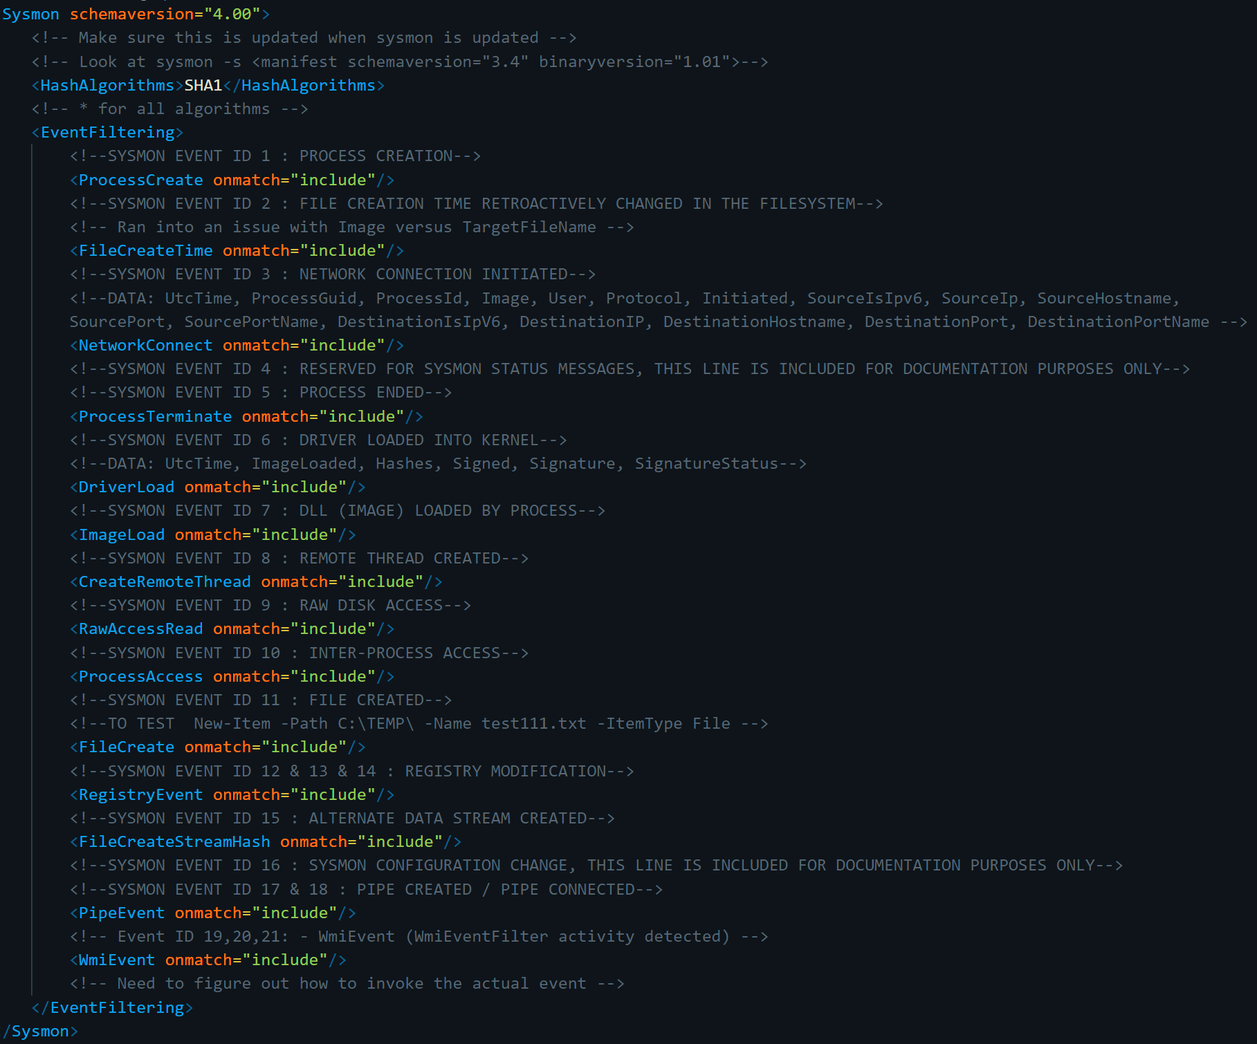
My base config
We will go through this line by line…. Fun!
First line – absolutely necessary to watch the schemaversion with any upgrades
Specify the hash algorithms used for image identification * for all hashes (SHA1, MD5, SHA256,IMPHASH)
Include / Exclude

Slide 8
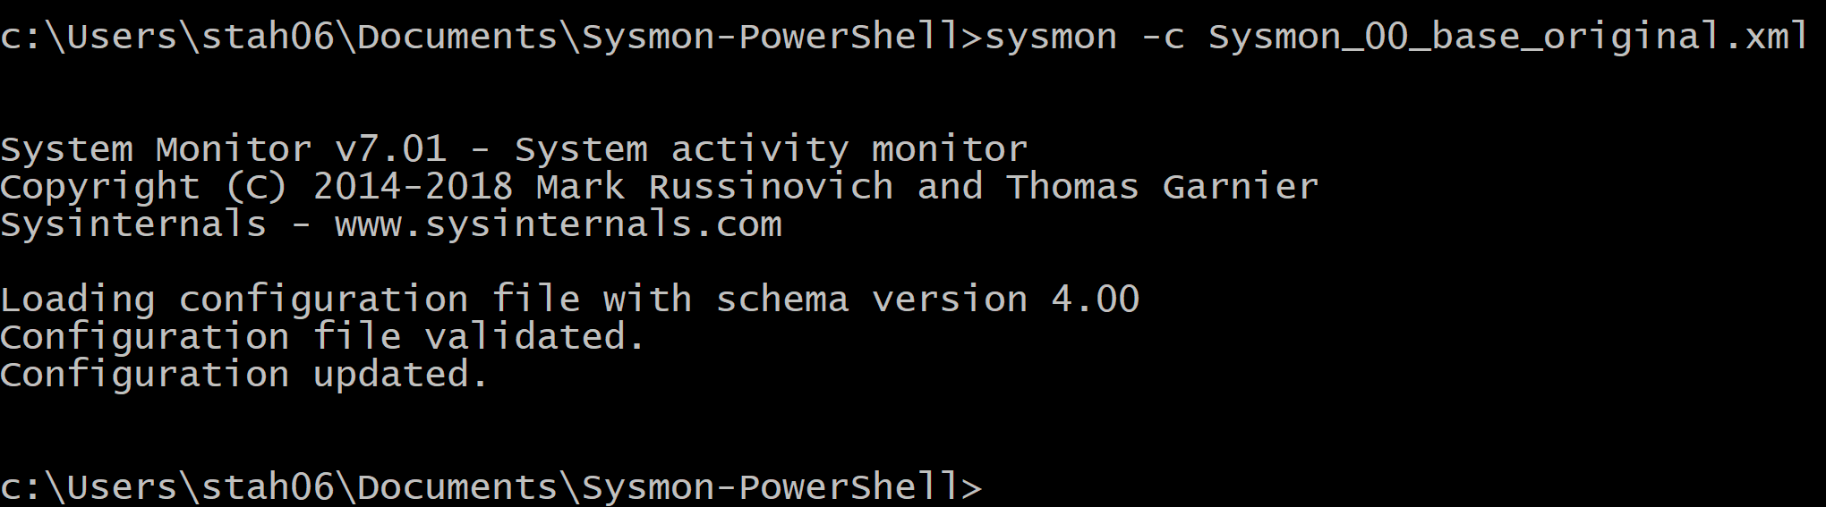
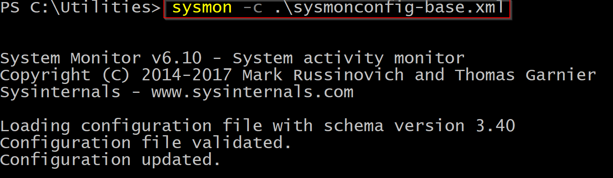
Apply the base config

Slide 9
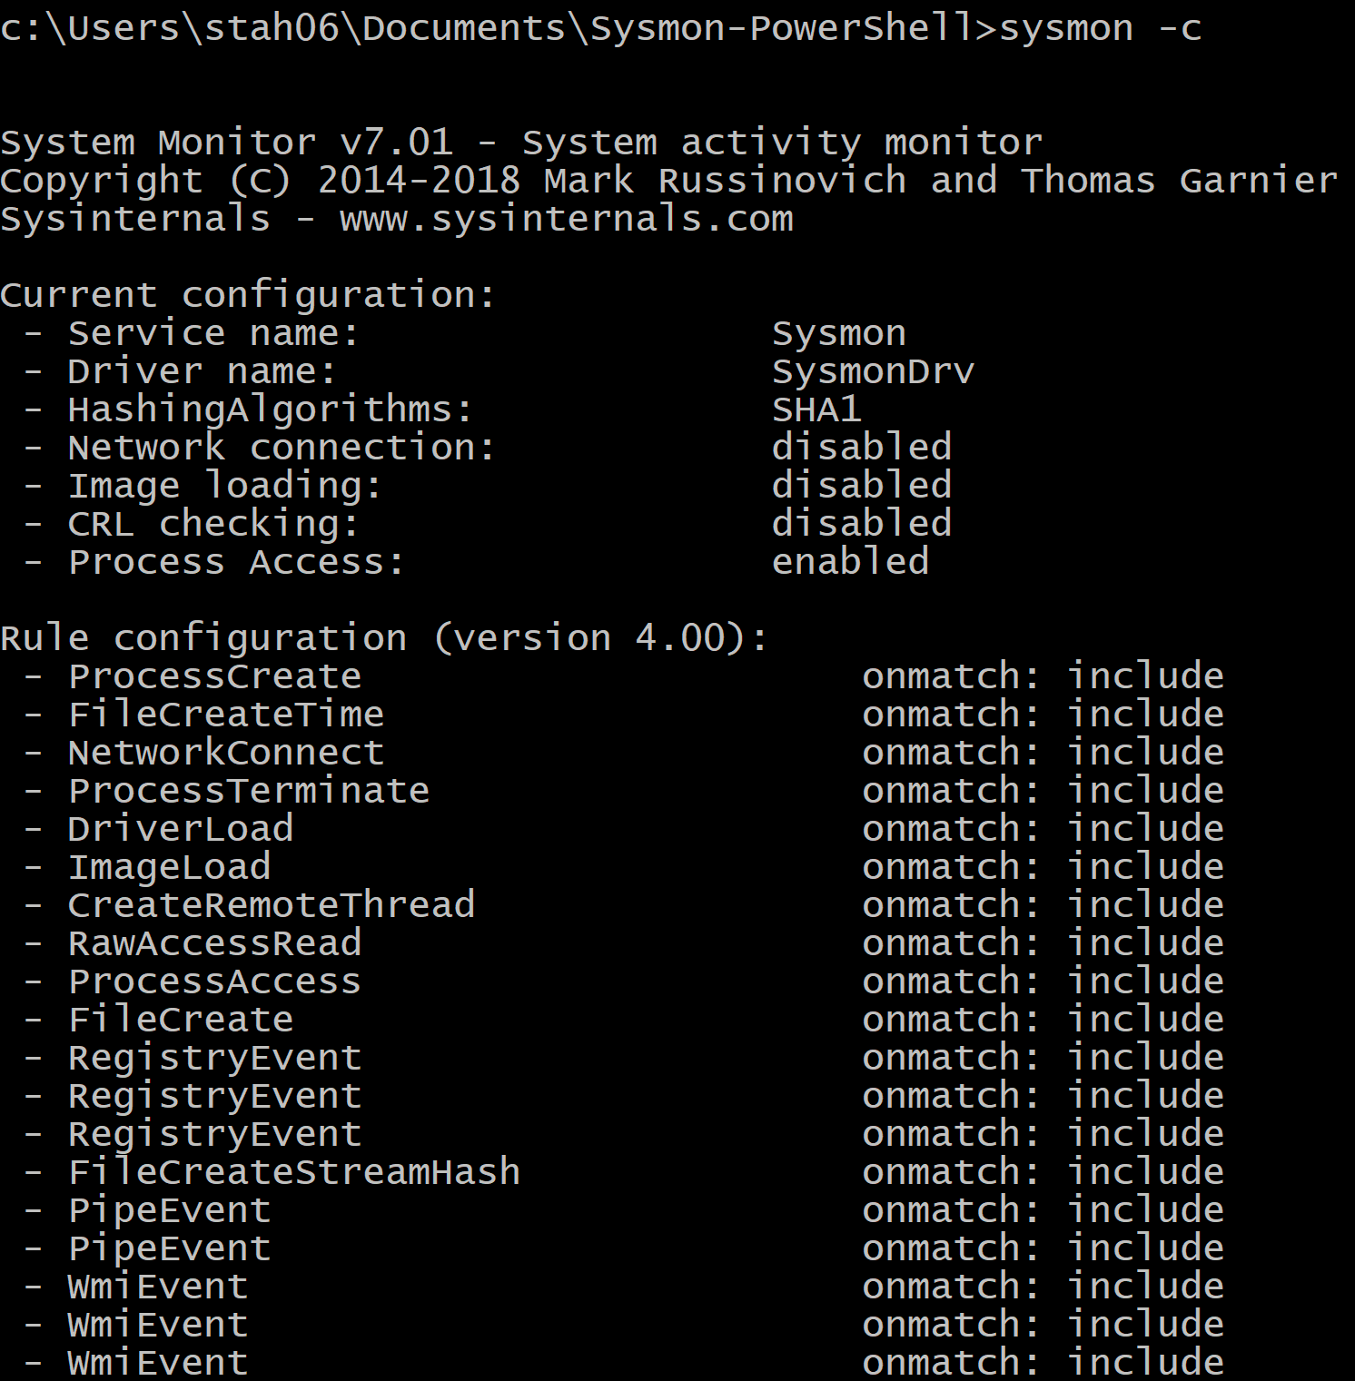
Let’s check the config

Slide 10
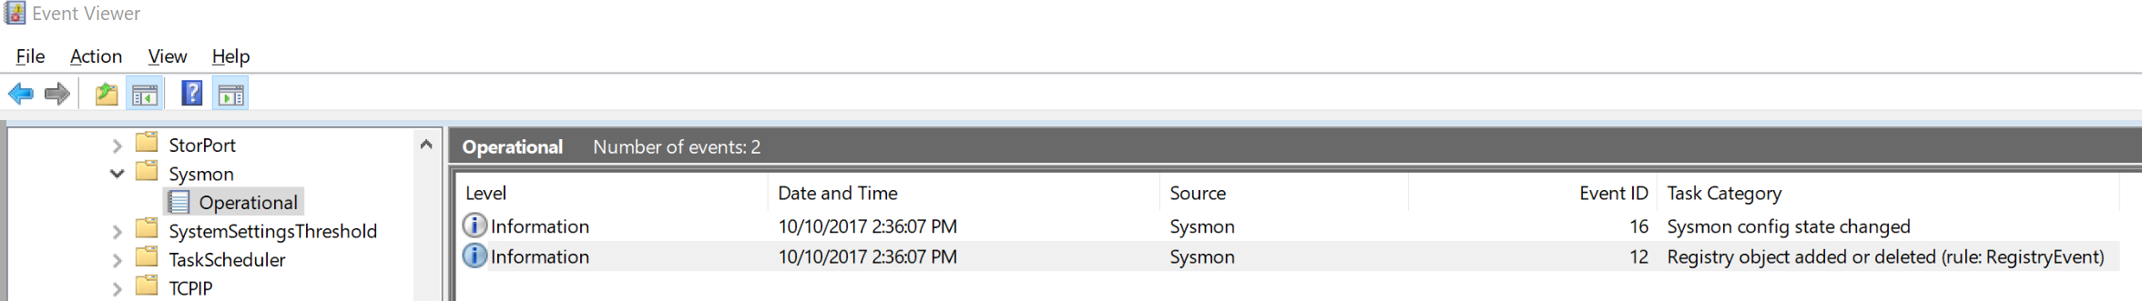
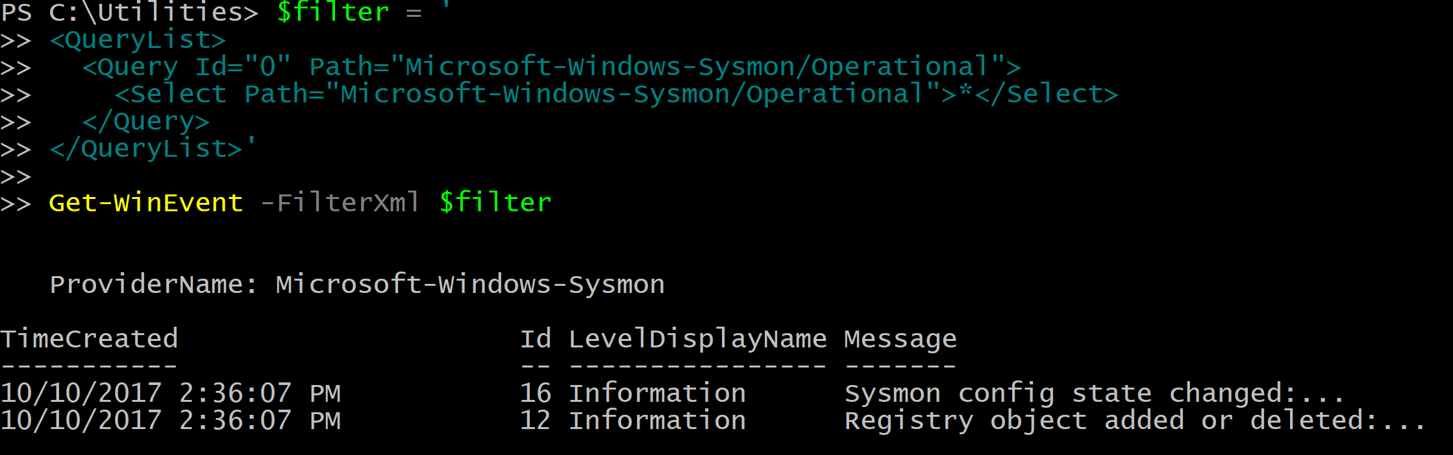
Where do I see the info? (Event Viewer or PowerShell)
Notes:
Show FL

Slide 11
Event ID 1: Process Creation
Right now, the config has <!--SYSMON EVENT ID 1 : PROCESS CREATION--> <ProcessCreate onmatch="include"/>
This means include all of the following, and since the list is empty, we get nothing.
If we change it to <ProcessCreate onmatch=“exclude"/> We will get everything – to much!
Lets change it to: <ProcessCreate onmatch="include"> <Image condition="is">C:\Windows\System32\WindowsPowerShell\v1.0\powershell.exe</Image> </ProcessCreate>
Cmd/Word/Excel starting PowerShell
Bonus Code: Grab hashes
Notes:
Show error notification on XML image/Image
Grab hashes?
Virus Total / known bad hashes

Slide 12
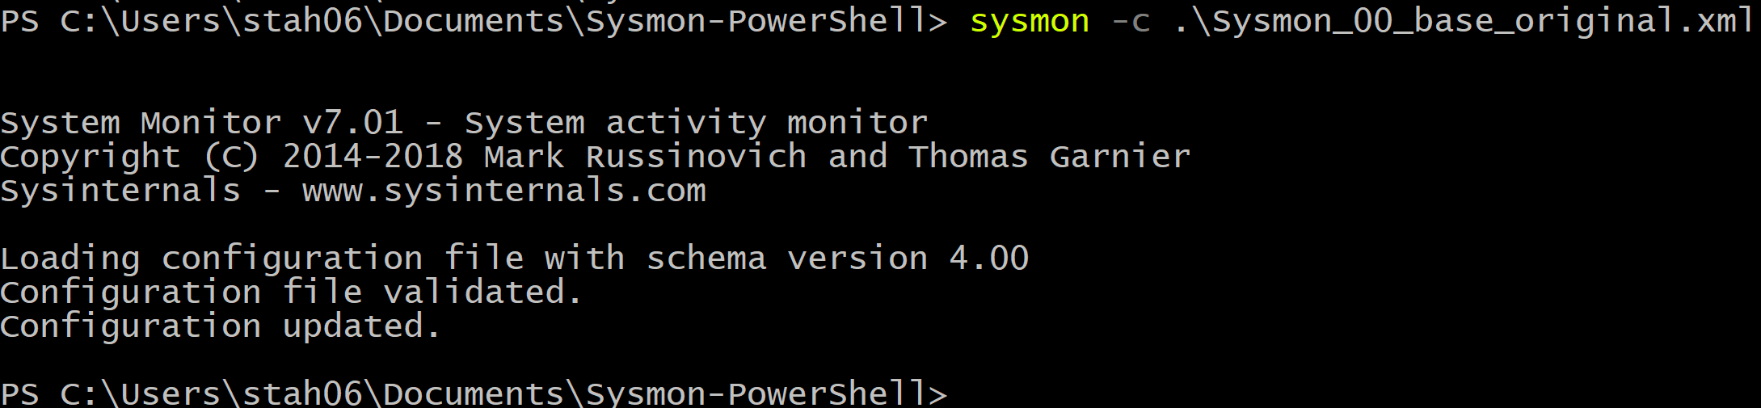
Reapply the config

Slide 13
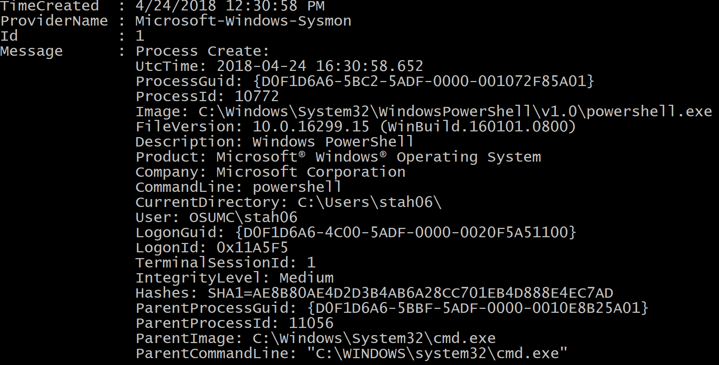
And confirm…..

Slide 14
Status check!
So at this point we have:
Downloaded and Installed sysmon on an endpoint
Created a base XML config file and applied
Modified the XML config file to look for all process creations
Modified the XML config file to look specifically for a process
Reapply config
Reviewed the config
Invoked process
Verified that it is in the event log.

Slide 15
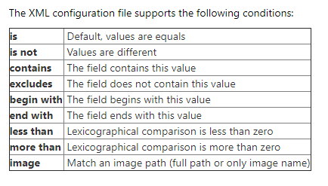
Before we continue…..
How do you know what the filters are and
What can be filtered?
Sysmon –s | more

Slide 16
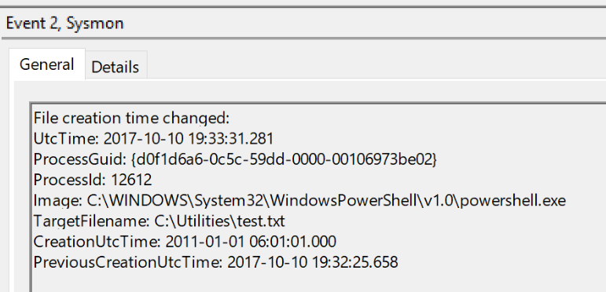
Event ID 2: File Creation Time Retroactively changed in filesystem
Let’s change it to <FileCreateTime onmatch="exclude"/>
Reapply config
Test by manually setting a create date New-Item -Name test1.txt -Path . -Type File (Get-Item .\test.txt).CreationTime = '01/01/2011 1:01:01 AM‘
Verify
Notes:
Note – there are many processes that intentionally time-stomp.

Slide 17
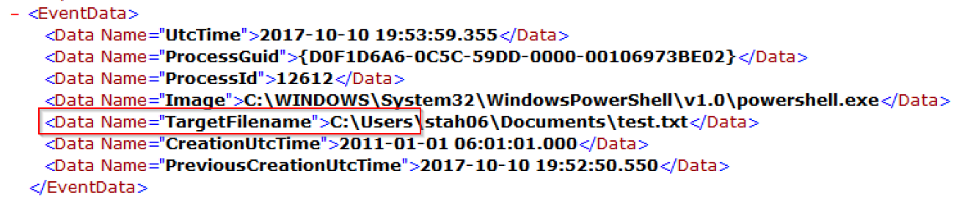
Event ID 2: File Creation time continued
You will end up seeing a lot of Event 2 in the sysmon event log, so we can tune it a bit.
Let’s look for only filetime-stopping in c:\users <FileCreateTime onmatch="include"> <TargetFilename condition="begin with">C:\users</TargetFilename> </FileCreateTime>
Reapply, check – you know the drill now

Slide 18
Event ID 3: Network Connection Initiated
Oh boy…….
For fun, let’s turn it on for everything (don’t do this on a production server) <!--SYSMON EVENT ID 3 : NETWORK CONNECTION INITIATED--> <NetworkConnect onmatch="exclude"/>
How quickly the events roll in…..

Slide 19
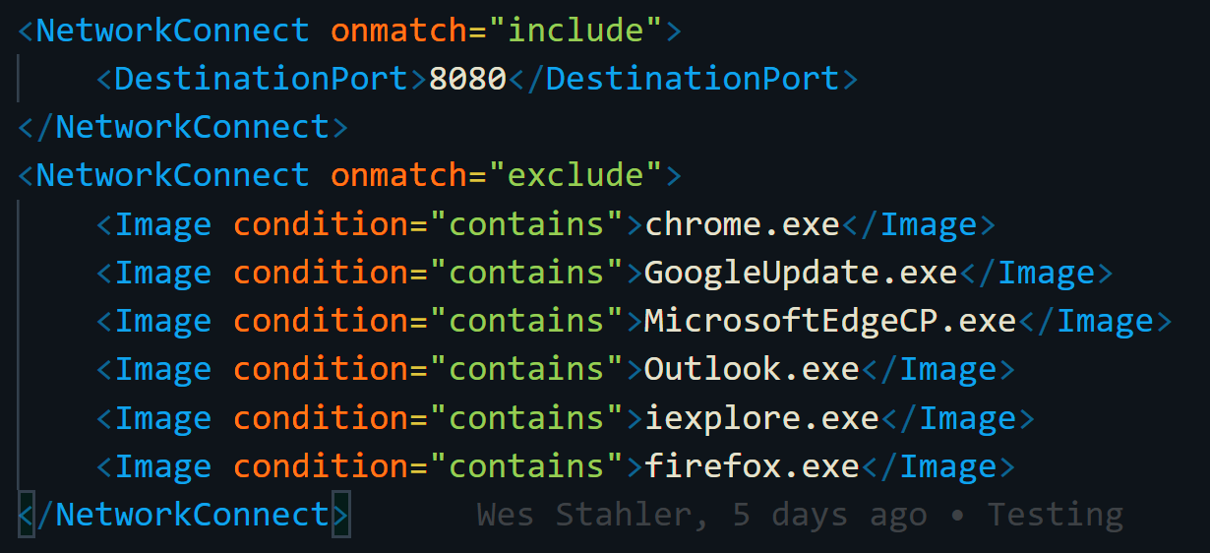
Event ID 3: Network Connection Initiated
Any idea what we are doing here?

Slide 20
Event ID 4: Reserved for sysmon messages
Service state changes with sysmon
No modifications required, but if you see this turned off, it is worth looking into.
Test it by stopping the service and looking at the event log. Get-Service -Name sysmon | Stop-Service

Slide 21
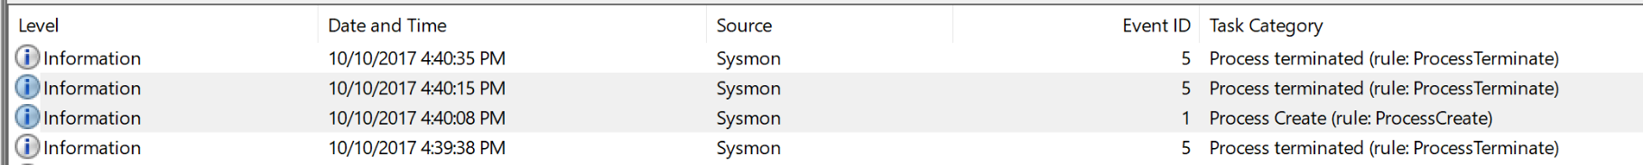
Event ID 5: Process ended
For now, grab everything (maybe tune later) <!--SYSMON EVENT ID 5 : PROCESS ENDED--> <ProcessTerminate onmatch="exclude"/>
As an exercise, start PowerShell, timestop and stop PowerShell, query on Process Guid to see the chain
Notes:
ProcesGuid
Get-WinEvent -ListLog * | Where logname -Match 'sysmon‘
D0F1D6A6-2521-5AC9-0000-0010FD942910'

Slide 22
Event ID 6: Driver loaded
Records what drivers are being loaded on the system.
Bad drivers can be used to escalate to kernel permissions
Low volume, grab it all except maybe: <DriverLoad onmatch="exclude"> <!--COMMENT: Because drivers with bugs can be used to escalate to kernel permissions, be extremely selective about what you exclude from monitoring. Low event volume, little incentive to exclude.--> <Signature condition="contains">microsoft</Signature> <!--Exclude signed Microsoft drivers--> <Signature condition="contains">windows</Signature> <!--Exclude signed Microsoft drivers--> <Signature condition="begin with">Intel </Signature> <!--Exclude signed Intel drivers--> </DriverLoad>

Slide 23
Event ID 7: Image loaded
Good for detecting DLL injection and unsigned DLL loading
Can be extremely noisy, be careful

Slide 24
Event ID 7: Image loaded
Setting it like so: <!-- Log all images except if it's Microsoft or Windows signed -->
<ImageLoad onmatch="exclude">
<Signature condition="is">Microsoft Windows</Signature>
<Signature condition="is">Microsoft Corporation</Signature>
</ImageLoad>
<!-- log only images loaded from user profile directory, clear some noise and also monitor what is loaded on lsass.exe> -->
<ImageLoad onmatch="include">
<Image condition="end with">lsass.exe</Image>
<Image condition="contains">C:\Users</Image>
</ImageLoad>

Slide 25
Event ID 8: Remote Thread Created
Detects when a process creates a thread in another process
Good for detecting code injections used by malware
Credential theft tools also use this technique to inject their code into the LSASS process

Slide 26
Event ID 8: Remote Thread Created
<CreateRemoteThread onmatch="exclude">
<!--COMMENT: Monitor for processes injecting code into other processes. Often used by malware to cloak their actions.
Exclude mostly-safe sources and log anything else.-->
<SourceImage condition="is">C:\Windows\System32\wbem\WmiPrvSE.exe</SourceImage>
<SourceImage condition="is">C:\Windows\System32\svchost.exe</SourceImage>
<SourceImage condition="is">C:\Windows\System32\wininit.exe</SourceImage>
<SourceImage condition="is">C:\Windows\System32\csrss.exe</SourceImage>
<SourceImage condition="is">C:\Windows\System32\services.exe</SourceImage>
<SourceImage condition="is">C:\Windows\System32\winlogon.exe</SourceImage>
<SourceImage condition="is">C:\Windows\System32\audiodg.exe</SourceImage>
<StartModule condition="is">C:\windows\system32\kernel32.dll</StartModule>
<TargetImage condition="end with">Google\Chrome\Application\chrome.exe</TargetImage>
</CreateRemoteThread>

Slide 27
Event ID 9: RawAccessRead
The RawAccessRead event detects when a process conducts reading operations from the drive using the \\.\ denotation. This technique is often used by malware for data exfiltration of files that are locked for reading, as well as to avoid file access auditing tools. The event indicates the source process and target device. <RawAccessRead onmatch="include"> <!--COMMENT: Monitor for raw sector-level access to the disk, often used to bypass access control lists or access locked files. Disabled by default since including even one entry here activates this component. Reward/performance/rule maintenance decision. Encourage you to experiment with this feature yourself.--> <!--COMMENT: You will likely want to set this to a full capture on domain controllers, where no process should be doing raw reads.--> </RawAccessRead>

Slide 28
Event ID 10: ProcessAccess
The process accessed event reports when a process opens another process, an operation that’s often followed by information queries or reading and writing the address space of the target process. This enables detection of hacking tools that read the memory contents of processes like Local Security Authority (Lsass.exe) in order to steal credentials for use in Pass-the-Hash attacks. Enabling it can generate significant amounts of logging if there are diagnostic utilities active that repeatedly open processes to query their state, so it generally should only be done so with filters that remove expected accesses. <!--SYSMON EVENT ID 10 : INTER-PROCESS ACCESS--> <!--DATA: UtcTime, SourceProcessGuid, SourceProcessId, SourceThreadId, SourceImage, TargetProcessGuid, TargetProcessId, TargetImage, GrantedAccess, CallTrace--> <ProcessAccess onmatch="include"> <!--COMMENT: Monitor for processes accessing other process' memory. This can be valuable, but can cause a huge number of events.--> </ProcessAccess>

Slide 29
Event ID 11: FileCreate
File create operations are logged when a file is created or overwritten. This event is useful for monitoring autostart locations, like the Startup folder, as well as temporary and download directories, which are common places malware drops during initial infection.
We add a lot of excludes and includes for this one, take a look at the sample config. <FileCreate onmatch="include"> <TargetFilename condition="end with">.txt</TargetFilename> </FileCreate>

Slide 30
Event ID 12, 13, 14: Registry Modification
Event 12 is for Registry Key and value create and deletions
Event 13 is for Registry value modifications
Event 14 is for Registry key and value rename
High volume (especially modify) any guesses?
We will look at some simple examples then use a provided config for this section.
Notes:
Count Name
----- ----
4848 12
67889 13
10 minutes

Slide 31
Event ID 15: FileCreateStreamHash
This event logs when a named file stream is created, and it generates events that log the hash of the contents of the file to which the stream is assigned (the unnamed stream), as well as the contents of the named stream. There are malware variants that drop their executables or configuration settings via browser downloads, and this event is aimed at capturing that based on the browser attaching a Zone.Identifier “mark of the web” stream.
We will use the sample config for this as well.
Look at example PowerShell code.

Slide 32
Event ID 16: Sysmon Config changes
Can’t be filtered
You will see this when you update a config

Slide 33
Event ID 17 & 18: Pipe Created/Connected
This event generates when a named pipe is created. Malware often uses named pipes for interprocess communication.
This event logs when a named pipe connection is made between a client and a server.
Grabbing all these for now
[System.IO.Directory]::GetFiles("\\.\\pipe\\")
https://gbegerow.wordpress.com/tag/powershell-named-pipes/
https://labs.portcullis.co.uk/blog/windows-named-pipes-there-and-back-again/
Notes:
[System.IO.Directory]::GetFiles("\\.\\pipe\\")
https://gbegerow.wordpress.com/tag/powershell-named-pipes/
https://labs.portcullis.co.uk/blog/windows-named-pipes-there-and-back-again/

Slide 34
Event ID 19, 20, 21: WMI Events
Event ID 19: When a WMI event filter is registered, which is a method used by malware to execute, this event logs the WMI namespace, filter name and filter expression.
Event ID 20: This event logs the registration of WMI consumers, recording the consumer name, log, and destination
Event ID 21: When a consumer binds to a filter, this event logs the consumer name and filter path.
Notes:
See PowerShell file for invocation
https://learn-powershell.net/2013/08/14/powershell-and-events-permanent-wmi-event-subscriptions/
https://gist.github.com/mattifestation/aff0cb8bf66c7f6ef44a

Slide 35
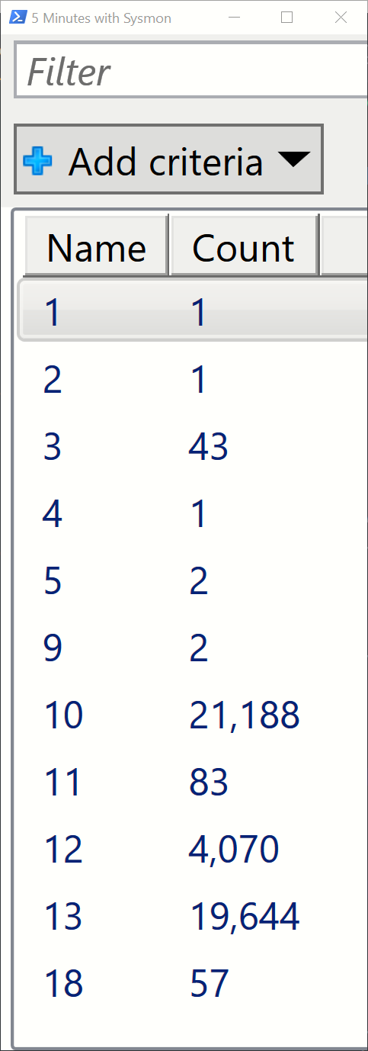
No tuning count
Get-WinEvent -LogName 'Microsoft-Windows-Sysmon/Operational' | Group-Object -Property ID -NoElement | Select @{N='Name';E={$_.Name -as [int]}}, Count | Sort-Object Name | Out-GridView -Title "5 Minutes with Sysmon (all events)"

Slide 36
Resources
https://docs.microsoft.com/en-us/sysinternals/downloads/sysmon
https://github.com/SwiftOnSecurity/sysmon-config
https://blogs.technet.microsoft.com/motiba/2016/10/18/sysinternals-sysmon-unleashed/
https://www.darkoperator.com/blog/2017/10/15/sysinternals-sysmon-610-tracking-of-permanent-wmi-events
https://www.rsaconference.com/writable/presentations/file_upload/hta-w05-tracking_hackers_on_your_network_with_sysinternals_sysmon.pdf

Slide 37
Contact Info
https://github.com/stahler/Sysmon_PowerShell
Twitter: @stahler
Wes.Stahler@gmail.com

