Slide 1
HISTORY OF THE CPU
C3G6 KEVIN (#44), LEO (#8)

Slide 2
1971 – INTEL 4004
First ever microprocessor
→ every single PC still has a microprocessor like it

Slide 3
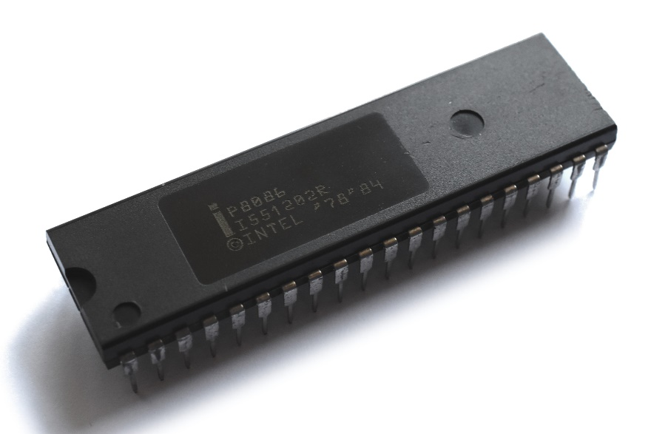
x86 – THE BEGINNING
1978 – Intel 8086
Introducing the x86 framework
IBM started to make personal computers a reality with the enhanced version – Intel 8088
Still, every CPU is based on this one

Slide 4
1978 – INTEL 8086
Introducing the x86 framework
IBM started to make personal computers a reality
→ with the enhanced Intel 8088
Still, every CPU uses this architecture

Slide 5
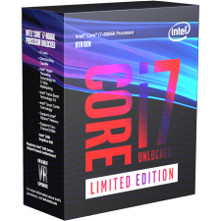
8086: 1978-2018
BONUS: To honor the original 8086, Intel released a 40th
anniversary version of the CPU, the Core i7-8086K.

Slide 6

x64 – THE BIG CHANGE
2020
2003

Slide 8
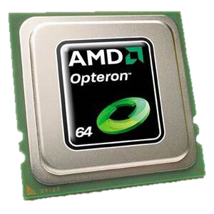
2003 – AMD “OPTERON”
Introducing the x64 framework
→ what modern computers are based on
Originally based on the K8 architecture
(And yes, it’s still updated regularly to this day)

Slide 10
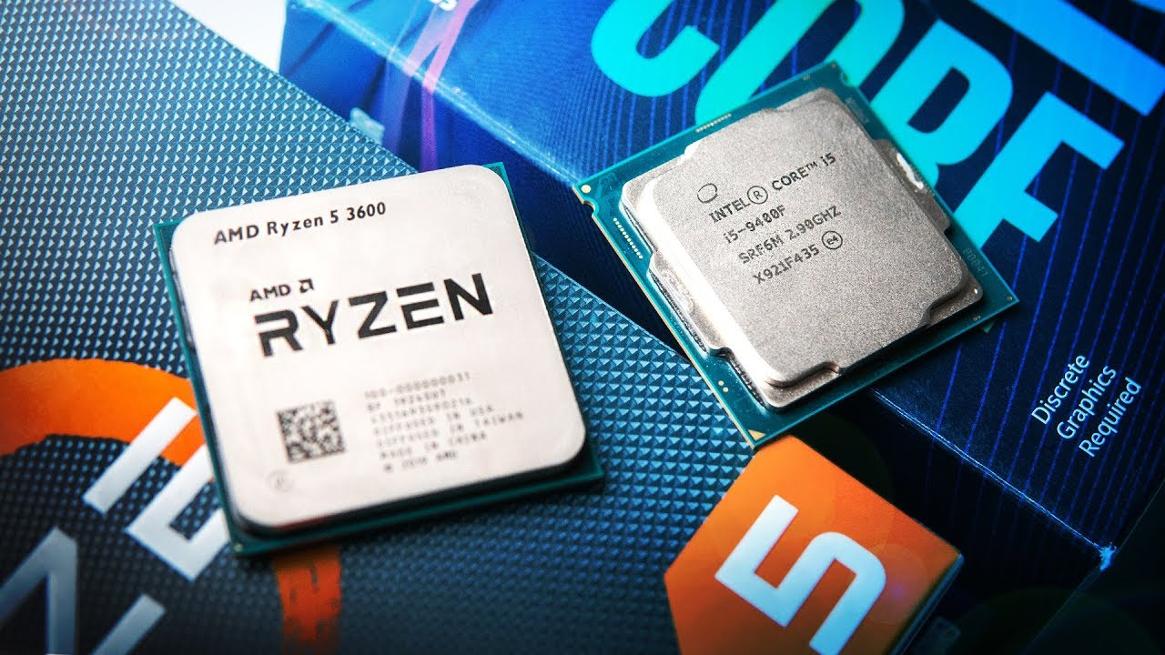

Slide 11
THANKS FOR WATCHING!
or rather, thanks for listening to two nerds trying to explain stuff you don’t understand (yet!)

