Slide 1
HISTORY OF THE CPU
C3G6 KEVIN (#44), LEO (#8)

Slide 2
1971 – INTEL 4004
First ever microprocessor
→ every single PC still has a microprocessor like it

Slide 3
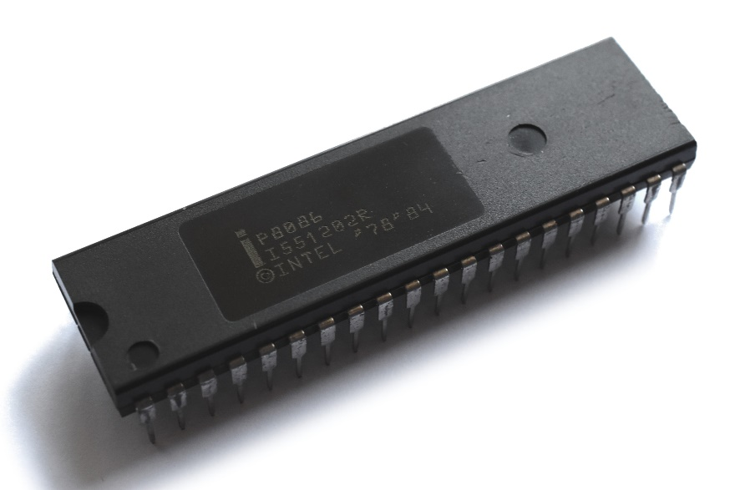
x86 – THE BEGINNING
1978 – Intel 8086
Introducing the x86 framework
IBM started to make personal computers a reality with the enhanced version – Intel 8088
Still, every CPU is based on this one

Slide 4
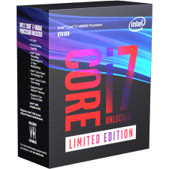
8086: 1978-2018
BONUS: To honor the original 8086, Intel released a 40th
anniversary version of the CPU, the Core i7-8086K.

Slide 5

x64 – THE BIG CHANGE
2020
2003

Slide 7
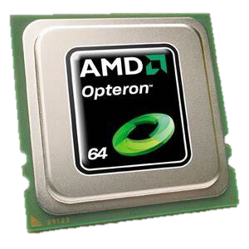
2003 – AMD “OPTERON”
Introducing the x64 framework
→ what modern computers are based on
Originally based on the K8 architecture
(And yes, it’s still updated regularly to this day)

Slide 9
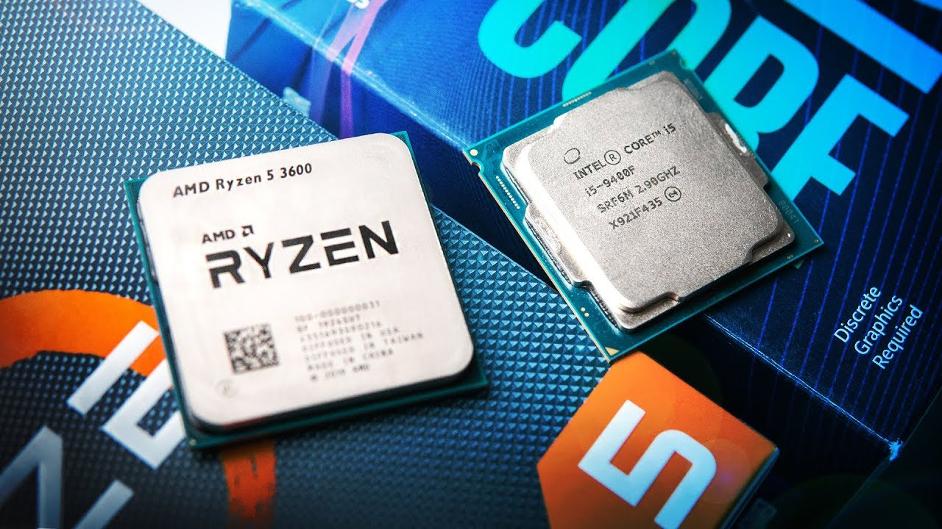

Slide 10
THANKS FOR WATCHING!
or rather, thanks for listening to two nerds trying to explain stuff you don’t understand (yet!)

