Slide 1
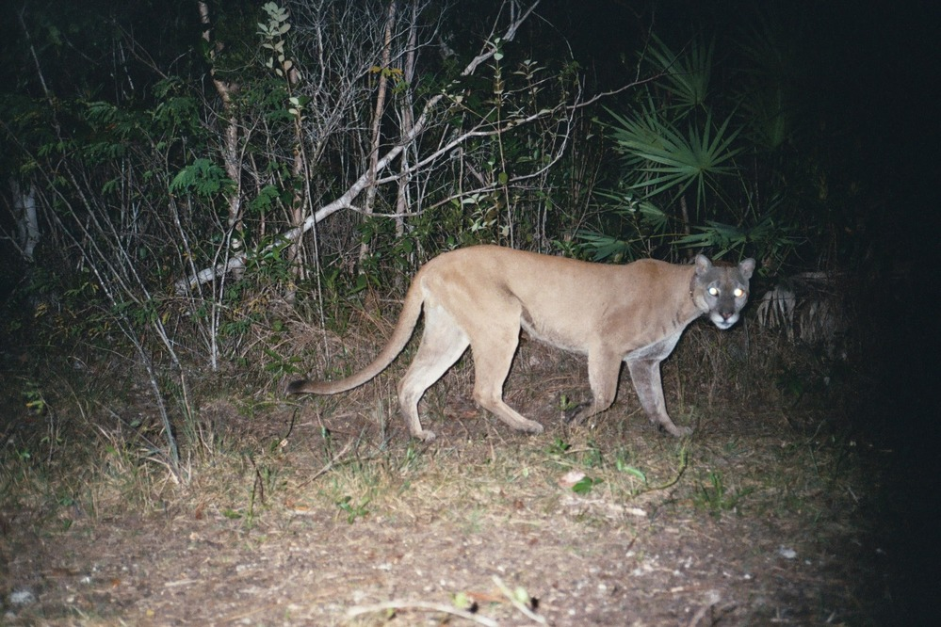
Florida Panther Range Reduction
An analysis of Puma concolor coryi range in the state of Florida

Slide 2
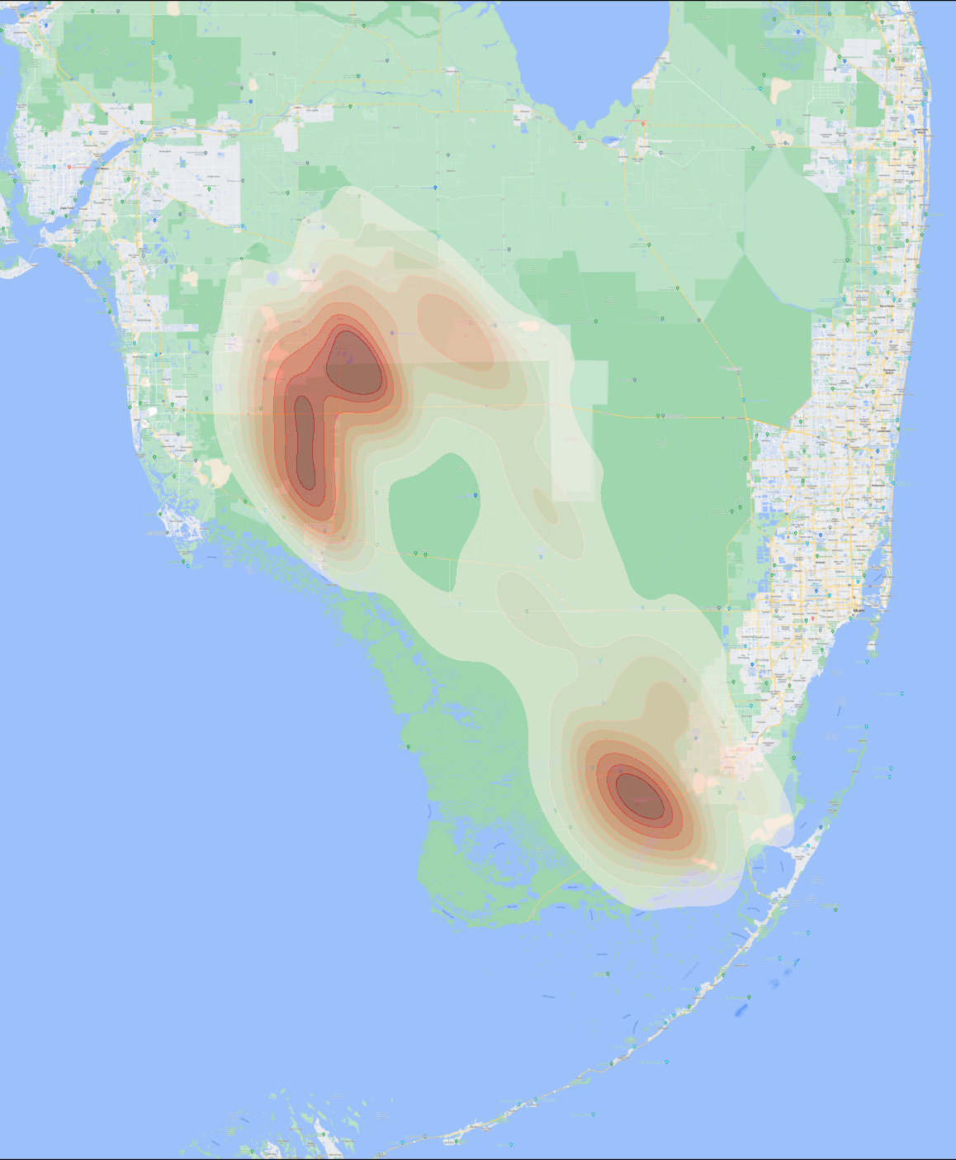
Importance and Historical Status
Recent historical range density (1981-2020)
Could historically be found from Louisiana to Florida
First listed as endangered in 1967
Estimates put wild individuals at less than 150
Males can claim 200-250 sq miles as territory
Our analysis shows the historical P.c.coryi range at approx. 1693 sq. mi. (1981 – 2020)
Blakemore, V. (2017). Florida Panthers. National Wildlife Federation. https://www.nwf.org/Educational-Resources/Wildlife-Guide/Mammals/Florida-Panther
Panther Facts. (n.d.). Friends - FL Panther. Retrieved October 6, 2022, from https://www.floridapanther.org/panther-facts

Slide 3
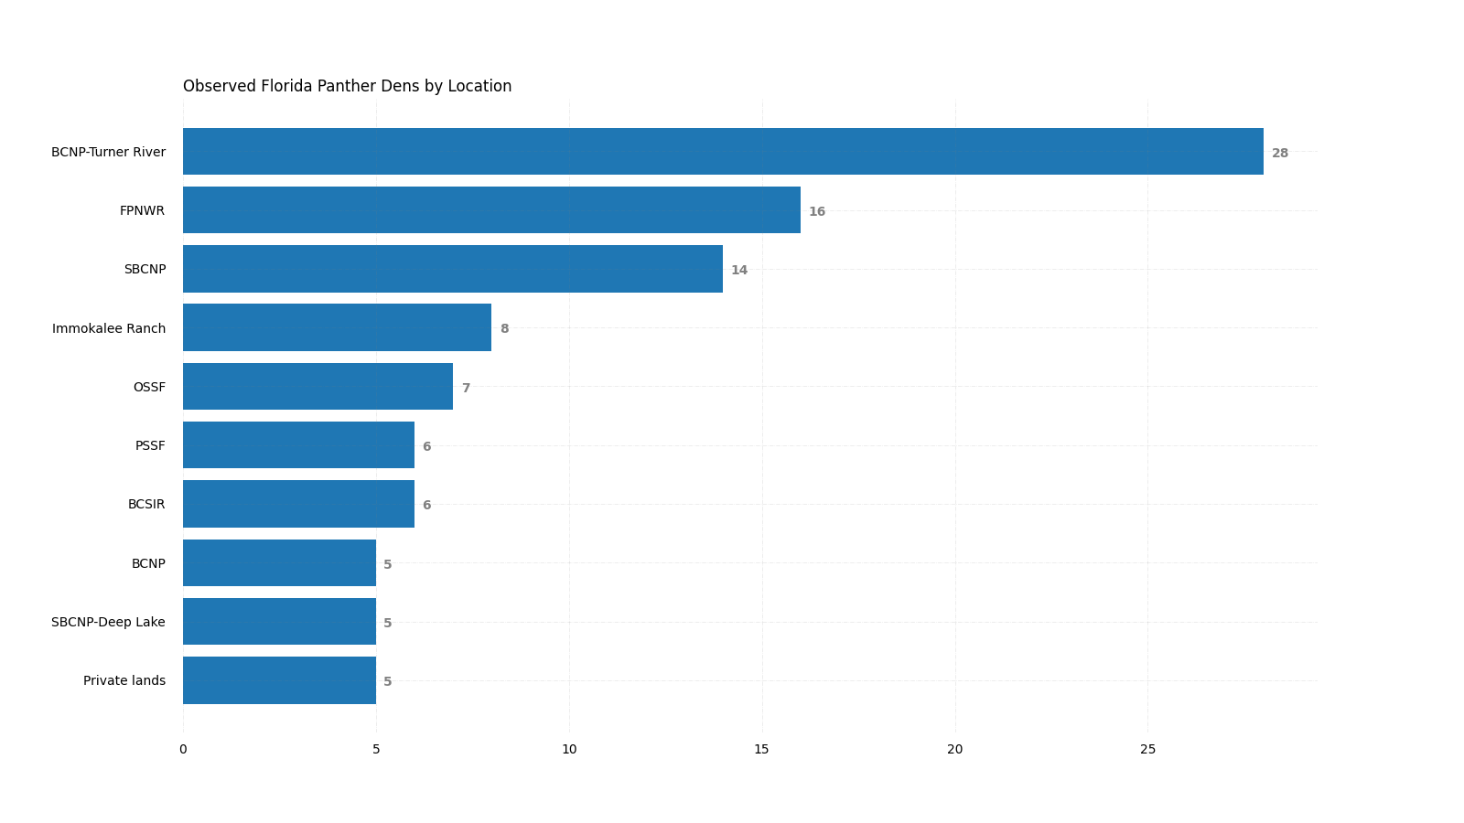
Denning Site Analysis
Critical to species survivability is successful breeding
Data was analyzed from all known denning sites observed by Florida Wildlife Commission
Big Cypress National Preserve is the dominant denning area for female panther
Florida Panther National Wildlife Preserve is also a preferred denning site

Slide 4
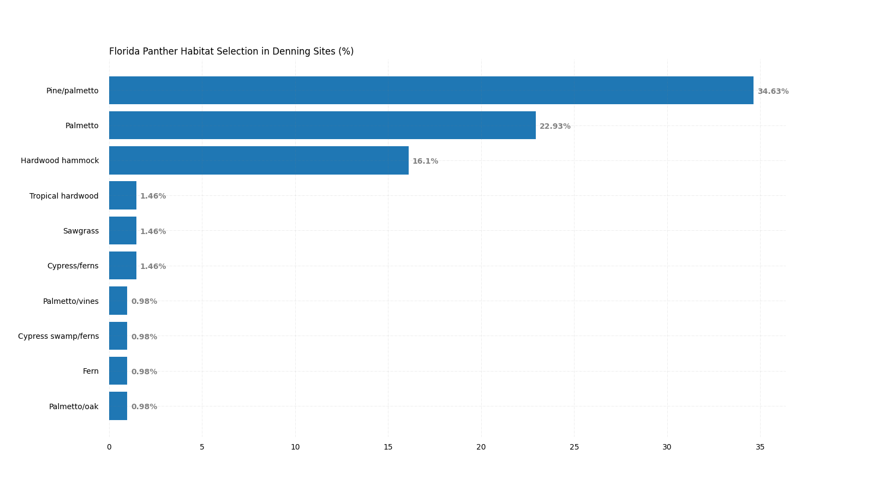
Denning Site Analysis
Pine and palmetto mixed habitat type was the preferred type for dens
Palmetto and hardwood hammocks were also important types
These habitats warrant protection within the current P.c.coryi range.

Slide 5
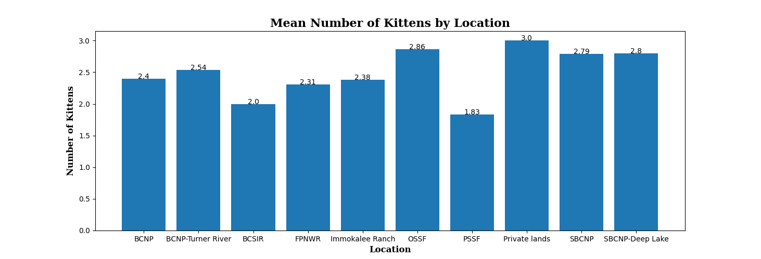
Denning Site Analysis
Mean number of kittens by location was calculated
Private lands followed by Okaloacoochee Slough State Forest showed the highest kitten production from females
South Big Cypress Nation Preserve and SBCNP – Deep Lake track also showed promising production

Slide 6
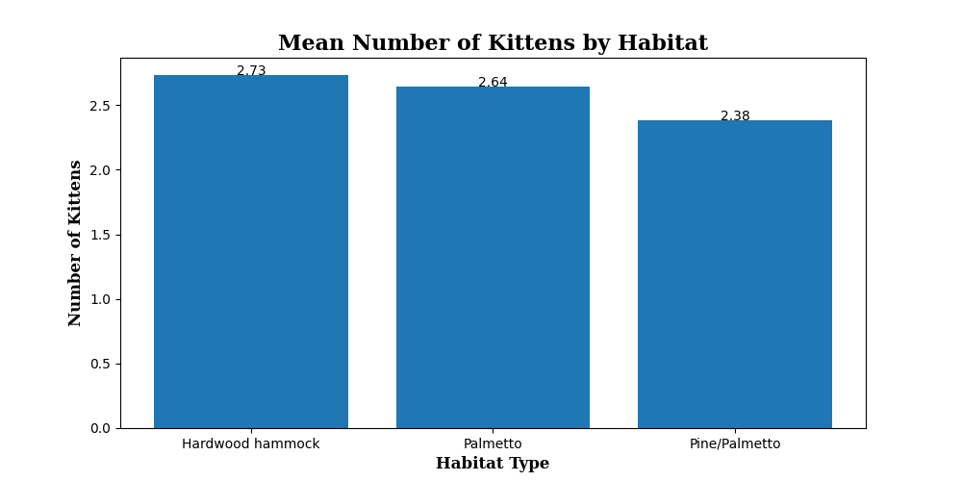
Denning Site Analysis
Of the observed habitat types, hardwood hammocks showed the highest mean kitten production
The most common type selected by females, Pine/palmetto mix, showed the lowest mean kitten production of the top 3 habitat types

Slide 7
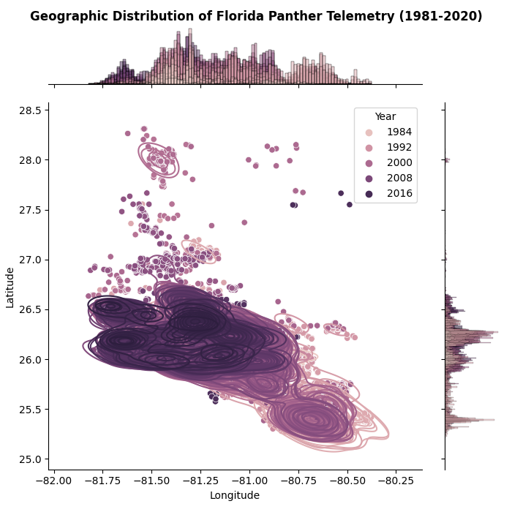
Range and Range Reduction
Extreme localized density was observed within Big Cypress National Preserve and Everglades National Park
Outliers were from a select group of individuals that ultimately perished by various means
Shrinking density is observed in later years, which led to the further analysis in this project

Slide 8
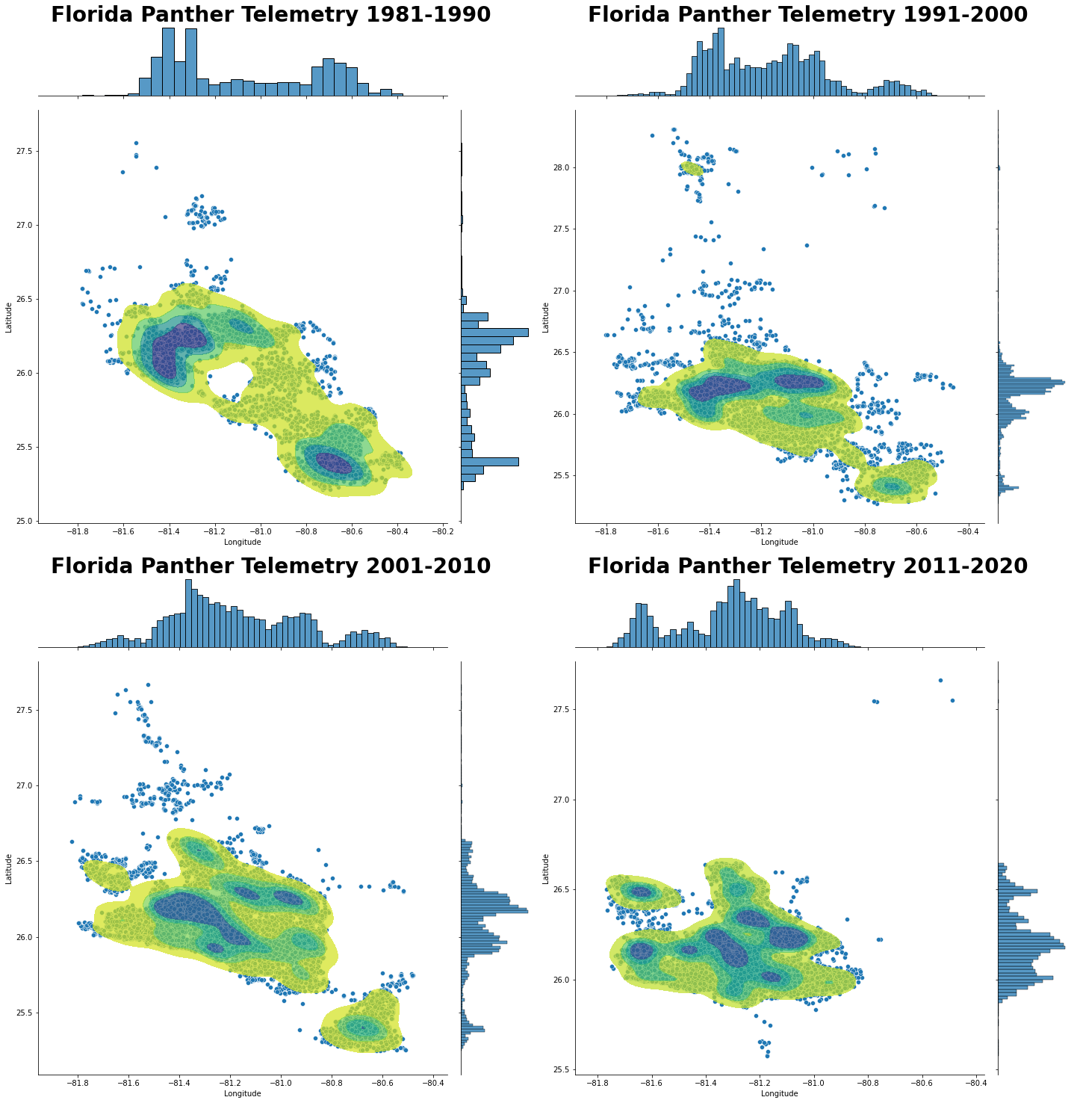
Range and Range Reduction
As observed, individuals in the southeast quadrat of P.c.coryi range have diminished to near zero in later years
A general southward trend is also observed in later years
A working hypothesis is this is due to the effects of urban sprawl in the Miami and Tampa metro areas which directly border these areas of the observed range

Slide 9
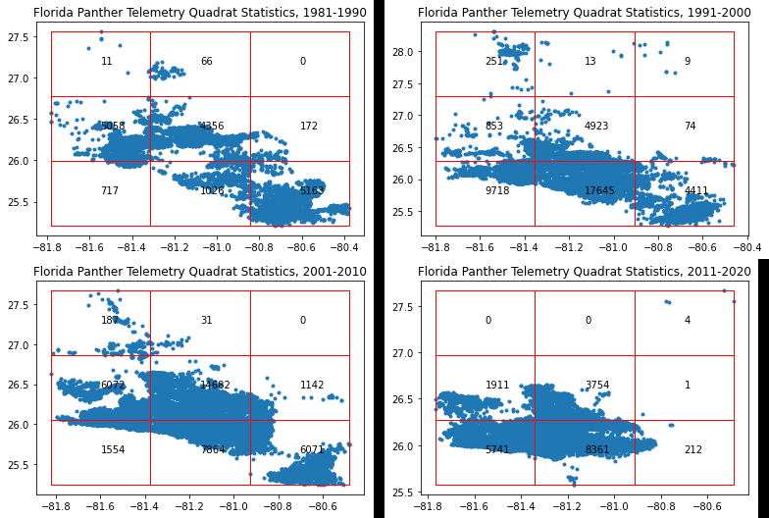
Range and Range Reduction
Quadrat Statistical Analysis shows the previous assumptions made from KDE were supported
Further correlation analysis with population and urban sprawl is warranted

Slide 10
Linear Regression Model to Predict Range Reduction
In order to predict range reduction, telemetry data were grouped by year
These data were then grouped into a Minimum Convex Hull polygon and the area in hectares was measured
After calculating error on several models, an Autoregressive Moving Average model was chosen
Root Mean Square Error for the ARMA model on these data was approx. 15% after tuning parameters
Output shows a mean reduction of range of 6,250 hectares per year over the predicted 6-year span

Slide 11
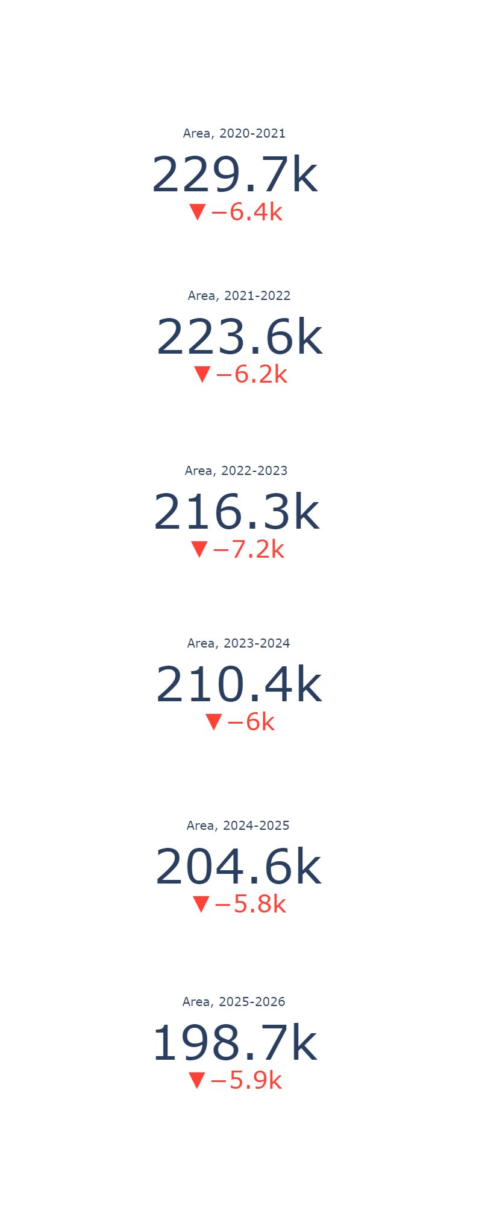
Model Results
Mean range reduction of 6,250 hectares year-to-year
At this modeled rate, P.c.coryi will completely disappear in ~37 years
This rate is alarming and warrants further investigation into the causes behind this range reduction
Note: Telemetry data ended in 2019 with outliers excluded, as such, 2020-current year were modeled. As further telemetry data is released, we intend to compare with model results.

Slide 12
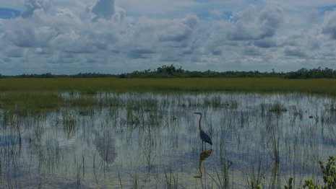
Interpreting Results and The Future of the Florida Panther
At the current rate of reduction predicted by this model, the habitat of the Florida Panther will disappear in ~37 years
Measures should be taken to minimize human influence on these areas to avoid further reduction in range
Denning sites and denning habitats should be prioritized in conservation efforts
Partnerships with private landowners are essential to the success of the Florida Panther

Slide 13
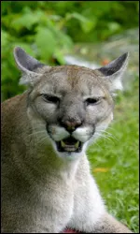

Acknowledgements
We would like to thank Dr. Mark Lotz of the Florida Fish and Wildlife Commission for providing data for this project
We would like to thank Christy Pearson for her assistance in this project and its development
Lastly, thanks to all the conservation organizations that work tirelessly to preserve the Florida Panther.

Slide 14

References and Code Used in this Project
Autoregressive Moving Average (ARMA): Sunspots data — statsmodels. (n.d.). Statsmodels.org. Retrieved October 6, 2022, from https://www.statsmodels.org/dev/examples/notebooks/generated/tsa_arma_0.html
Blakemore, V. (2017). Florida Panthers. National Wildlife Federation. https://www.nwf.org/Educational-Resources/Wildlife-Guide/Mammals/Florida-Panther
Home — Geographic Data Science with Python. (n.d.). Geographicdata.Science. Retrieved October 6, 2022, from https://geographicdata.science/book/intro.html
Maklin, C. (2019, May 25). ARIMA model Python example — time series forecasting. Towards Data Science. https://towardsdatascience.com/machine-learning-part-19-time-series-and-autoregressive-integrated-moving-average-model-arima-c1005347b0d7
Panther Facts. (n.d.). Friends - FL Panther. Retrieved October 6, 2022, from https://www.floridapanther.org/panther-facts
Point Pattern Analysis (pointpats) — pointpats v2.1.1 Manual. (n.d.). Readthedocs.Io. Retrieved October 6, 2022, from https://pointpats.readthedocs.io/en/latest/
https://github.com/pythonpandas303/Florida-Panther-Code

Slide 15
Photo Credits
All photos sourced from National Parks Service Florida Panther and Everglades National Park websites.
Everglades National Park (U.S. National Park Service). (n.d.). Nps.gov. https://www.nps.gov/ever/index.htm
Florida Panther Photo Gallery (U.S. National Park Service). (n.d.). Nps.gov. https://www.nps.gov/media/photo/gallery.htm?pg=1020357&id=28F514C7-1DD8-B71C-07852C9393999925

Slide 16
Data Sources
All data used for den site analysis was requested by the project owners from Dr. Mark Lotz at FWC. These data are not public and all requests should be directed to Dr. Lutz (mark.lotz@myfwc.com).
Telemetry data can be found at: https://geodata.myfwc.com/datasets/myfwc::florida-panther-telemetry/about

