Slide 1
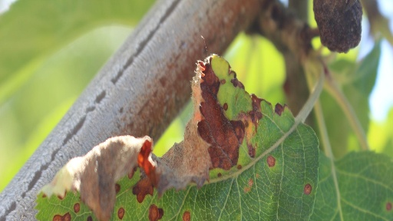
Better Agriculture Through Computer Vision
Plant Disease Identification

Slide 2
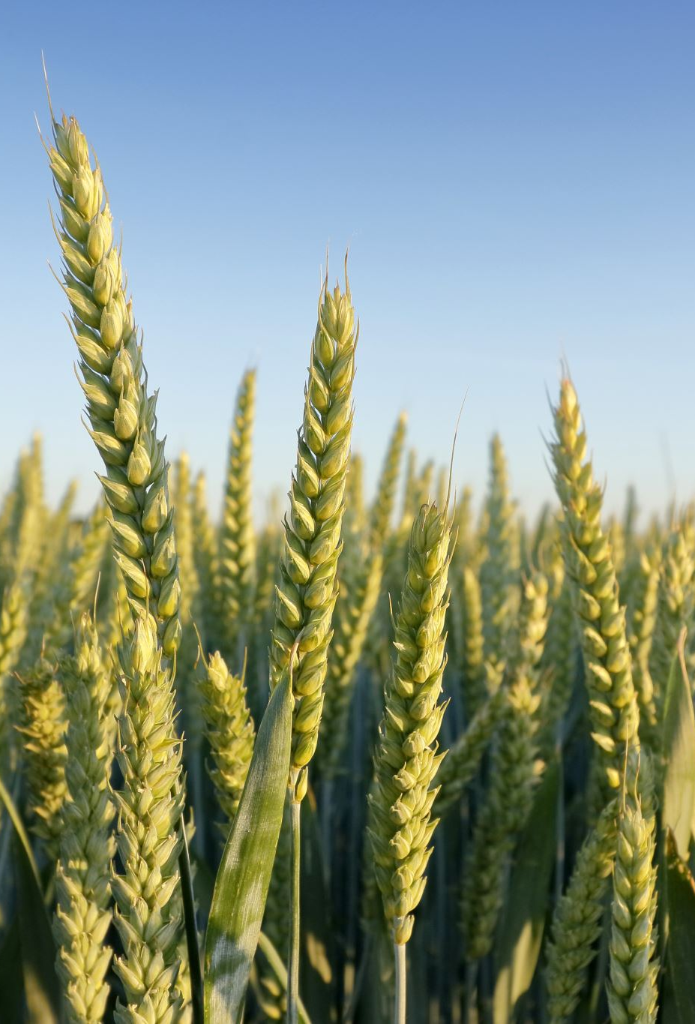
Traditional Methods
According to the USDA, plant pathogens and destructive insects cause $40 billion in damages annually (USDA, 2022).
Traditional methods have employed manual inspection and identification from a plant pathologist (Riley et. al., 2002).
Advances in deep learning methods present an opportunity to both reduce costs and increase application of this process.

Slide 3
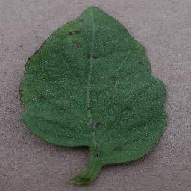
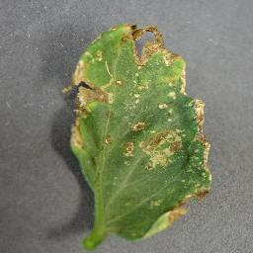
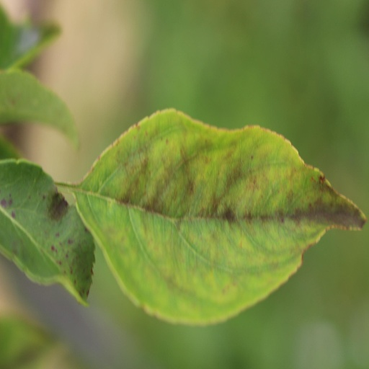
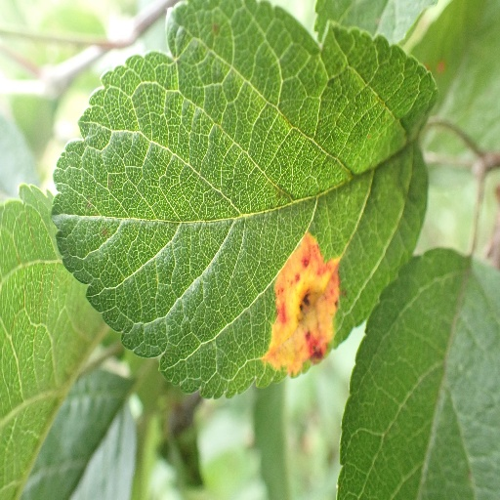
Methods
A deep learning algorithm known as a Convolution Neural Network was used in this project. A classification approach was taken. This works by classifying images into predetermined classes, or labels.
The data consisted of two sets (general plant and tomato specific) and a total of 44,469 individual pictures and 23 classes.
Some methods included to increase model accuracy were data augmentation and auto-tuning of parameters.
The general plant data were initially fed into a relatively simply model to assess the viability of this approach. Following somewhat lackluster results, a more robust model was developed, and the tomato data set was used.

Slide 4
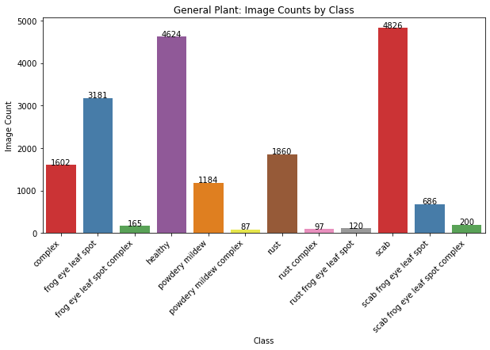
General Plant Class Distribution

Slide 5
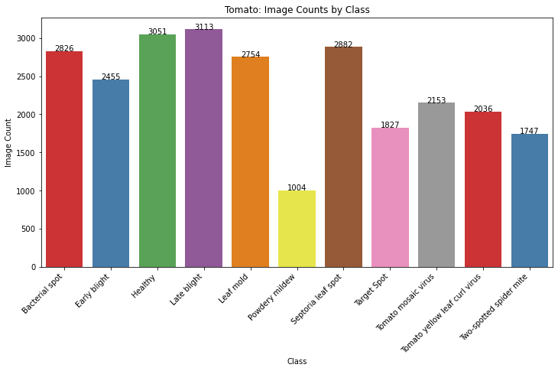
Tomato Class Distribution

Slide 6
A note on class distribution
A lack of balance between data in classes can lead to less accurate predictions
This is one of the reasons why the Tomato data set performed better in modeling, as will be shown in the following results section of this report.

Slide 7
Results
Initial accuracy of the model on the General Plant dataset showed about 66% accuracy on the validation data. Auto-tuning of parameters was employed, and accuracy improved slightly to 78%.

Slide 8
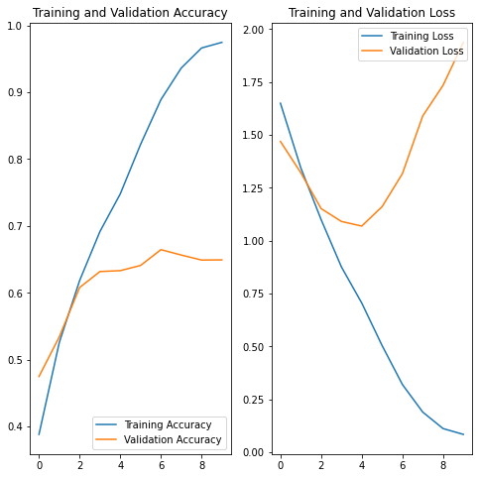
Results
Graph showing the first training run on the General Plant dataset.

Slide 9
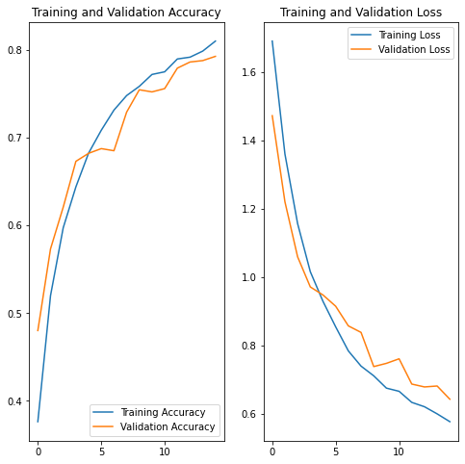
Results
After some further tuning, along with data augmentation, results improved slightly to 78% on validation data.

Slide 10
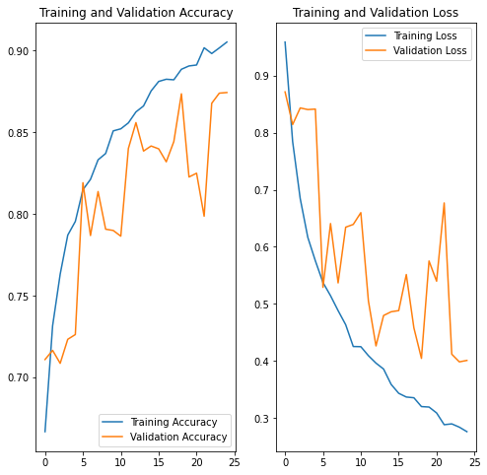
Results
Initial training on Tomato data set
showed significant noise in validation

Slide 11
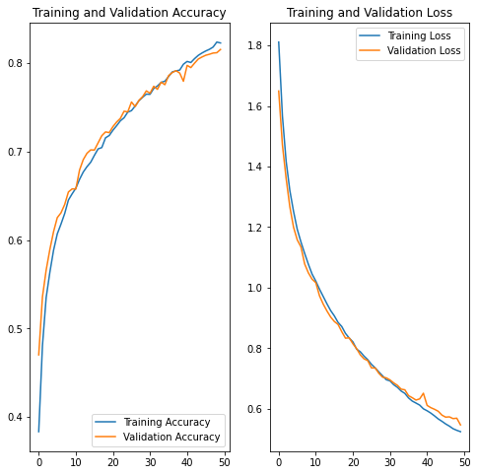
Results
After some parameter tuning, noise was decreased with a small drop in peak accuracy.

Slide 12
Results
Initial training of a more robust model architecture on the Tomato dataset yielded results of ~88%.
These results showed erratic accuracy in validation data initially. This was likely a result of noise in predictions.
To remedy this problem, dropout layers were introduced, and the learning rate was decreased. This did appear to have some effect on the noise issue.
Further training on more robust hardware would likely yield the desired results. Considering the data set size, processing time when the number of epochs were increased resulted in hardware issues.

Slide 13
Conclusion
With the implementation of field hardware, this method represents a viable option to monitor and offer rapid alerts to assist in plant pathology concerns.
There are other options in packages that should be explored, such as PyTorch for image classification.
Hardware should be considered when processing equipment is chosen. Cloud options may prove to be beneficial, but would come with an increase in cost.
Field deployment should be explored. Cloud solutions and TFLite are options to explore. IoT sensors, such as a connected group of cameras are options worth considering.

Slide 14
References
Bi, L., & Hu, G. (2020). Improving image-based plant disease classification with generative adversarial network under limited training set. Frontiers in Plant Science, 11, 583438. https://doi.org/10.3389/fpls.2020.583438
Mohanty, S. P., Hughes, D. P., & Salathé, M. (2016). Using deep learning for image-based plant disease detection. Frontiers in Plant Science, 7, 1419. https://doi.org/10.3389/fpls.2016.01419
Paymode, A. S., & Malode, V. B. (2022). Transfer learning for multi-crop leaf disease image classification using convolutional neural network VGG. Artificial Intelligence in Agriculture, 6, 23–33. https://doi.org/10.1016/j.aiia.2021.12.002
Riley, M., Williamson, M., & Maloy, O. (2002). ​​​Plant Disease Diagnosis. Plant Health Instructor. https://doi.org/10.1094/phi-i-2002-1021-01
USDA APHIS. (2022, April 5). Usda.gov. https://www.aphis.usda.gov/aphis/newsroom/news/sa_by_date/sa-2022/protect-plants

Slide 15

Contact
tteasdale@regis.edu

