Slide 1
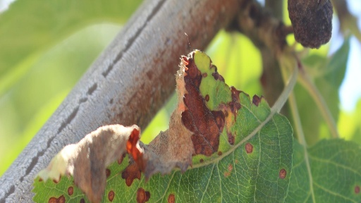
Better Agriculture Through Computer Vision
Plant Disease Identification

Slide 2
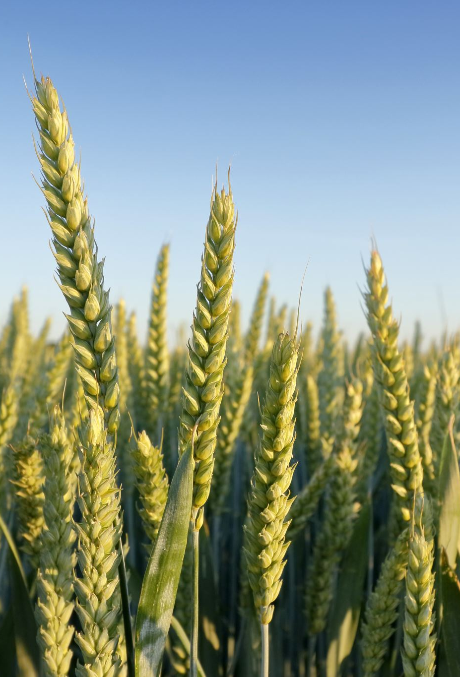
Traditional Methods
According to the USDA, plant pathogens and destructive insects cause $40 billion in damages annually (USDA, 2022).
Traditional methods have employed manual inspection and identification from a plant pathologist (Riley et. al., 2002).
Advances in deep learning methods present an opportunity to both reduce costs and increase application of this process.

Slide 3
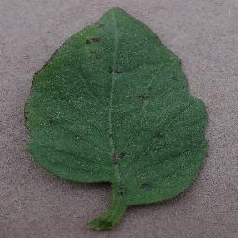
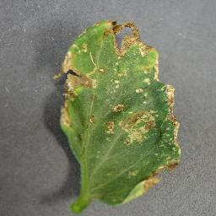
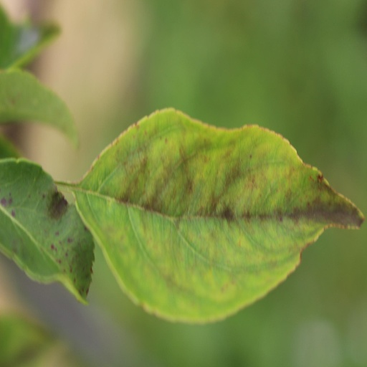
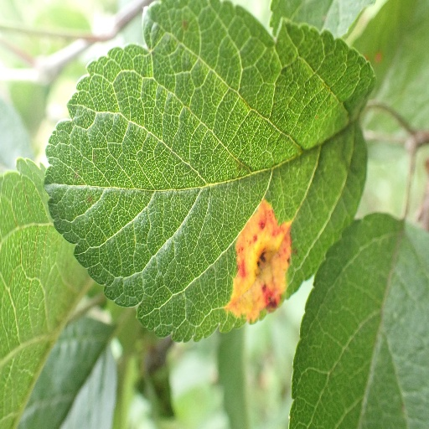
Methods
A deep learning algorithm known as a Convolution Neural Network was used in this project. A classification approach was taken. This works by classifying images into predetermined classes, or labels.
The data consisted of two sets (general plant and tomato specific) and a total of 44,469 individual pictures and 23 classes.
The general plant data were initially fed into a relatively simply model to assess the viability of this approach. Following somewhat lackluster results, a more robust model was developed, and the tomato data set was used.

Slide 4
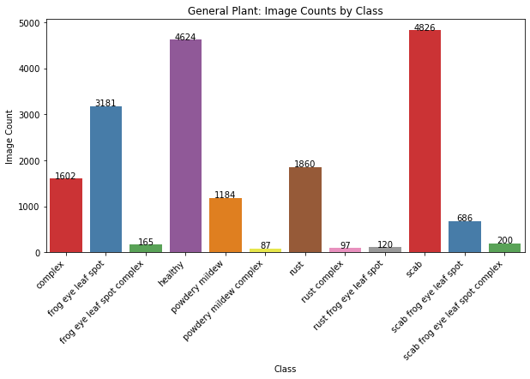
General Plant Class Distribution

Slide 5
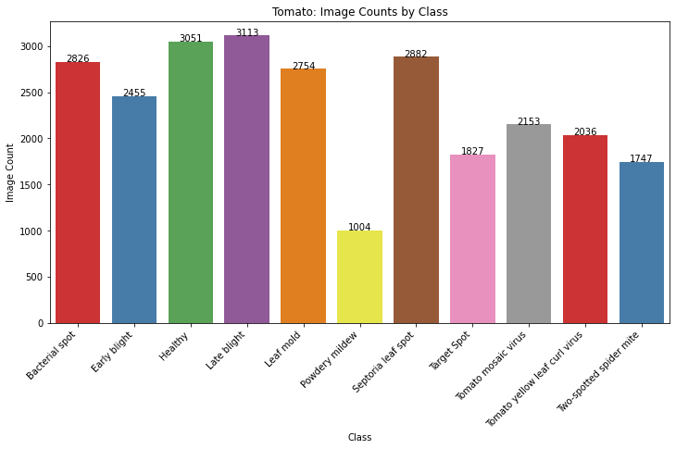
Tomato Class Distribution

Slide 6
A note on class distribution
A lack of balance between data in classes can lead to less accurate predictions
This is one of the reasons why the Tomato data set performed better in modeling.

Slide 7
References
USDA APHIS. (2022, April 5). Usda.gov. https://www.aphis.usda.gov/aphis/newsroom/news/sa_by_date/ sa-2022/protect-plants

Slide 8

Contact
tteasdale@regis.edu

