Slide 1
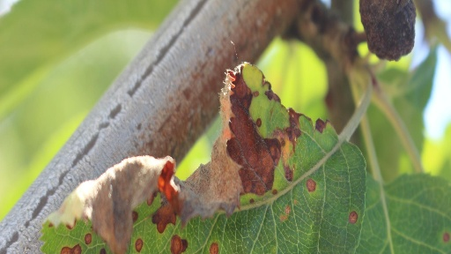
Plant Disease Identification with Computer Vision
A Deep Learning Approach

Slide 2
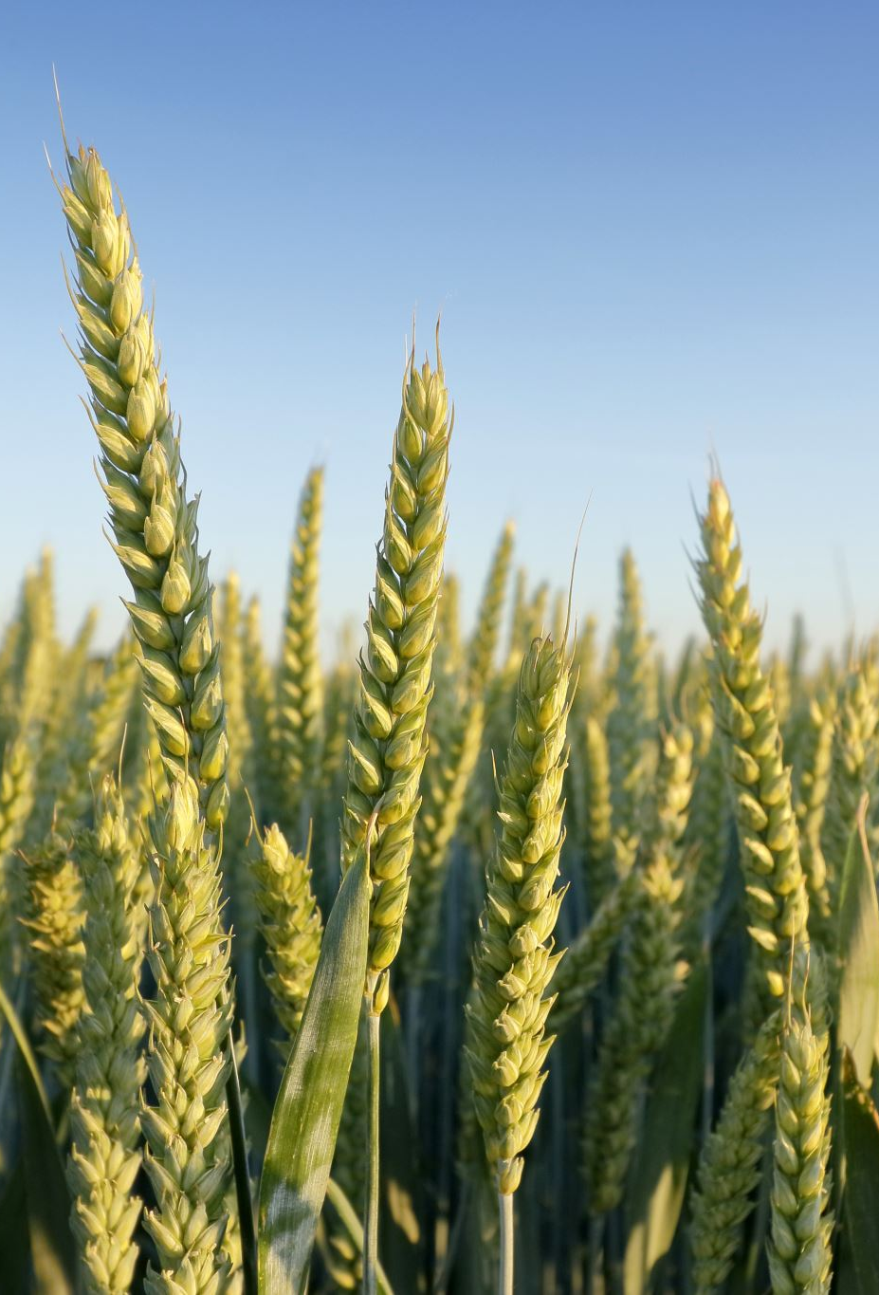
Problem: Extraordinary Cost, Time Consuming Manual Methods.
According to the USDA, plant pathogens and destructive insects cause $40 billion in damages annually (USDA, 2022).
Currently accepted methods include the manual inspection and classification of diseased plants.
Often requires a specialist in the field, coming at a high cost for agricultural producers.

Slide 3
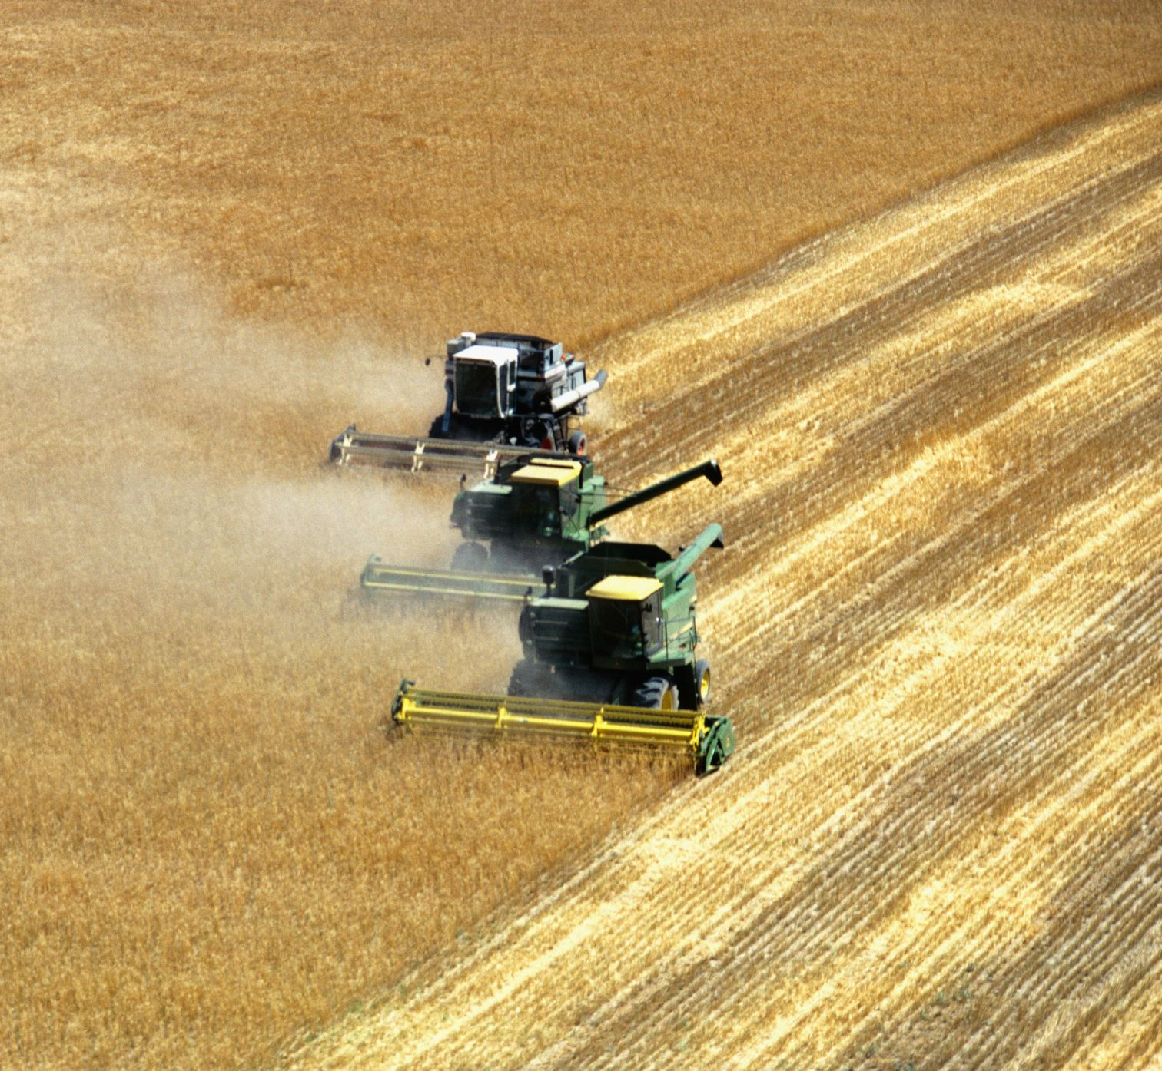
Research Question
Can machine/deep learning methods assist in the identification and classification of agriculturally significant pathogens present on food crops?

Slide 4
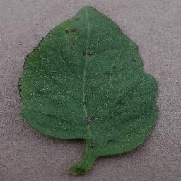
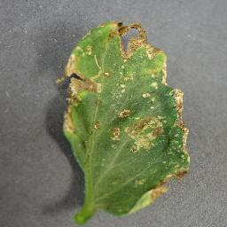
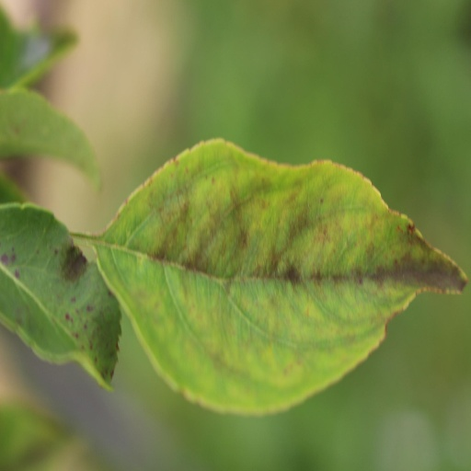
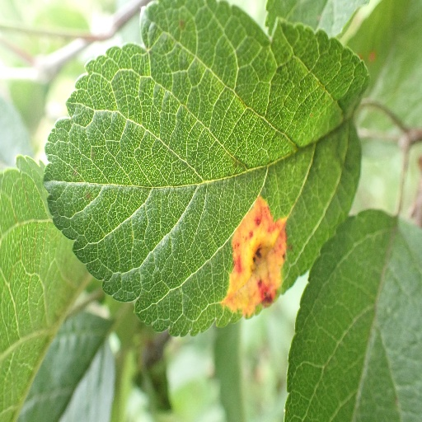
Data
Model will be deployed on 2 data sets, both sourced from Kaggle.
The first data set is titled “Plant Pathogen 2021 Resized 512 x 512”. It is provided by Kaggle user gpiosenka and can be located here. It consists of 18,632 images in 12 classes. A separate .csv file contains the image file path and the associated label for all images.
The second data set is titled “Tomato Disease Multiple Sources”. It is provided by Kaggle user cookiefinder and can be located here. It consists of 25,850 images in 11 classes. These data were prelabeled in their respective directories.
The images above are examples from the data sets.

Slide 5
Proposed Methodology
This will be an image classification problem.
The “Plant Pathogen” data set requires some manipulation to separate into classes. This will be accomplished in the ‘os’ package.
A Convolution Neural Network will be used to classify images.
Packages used for the CNN will be tensorflow and keras. Other packages will be utilized to support visualizations and data management.
A focus will be placed on model evaluation and optimization.

Slide 6
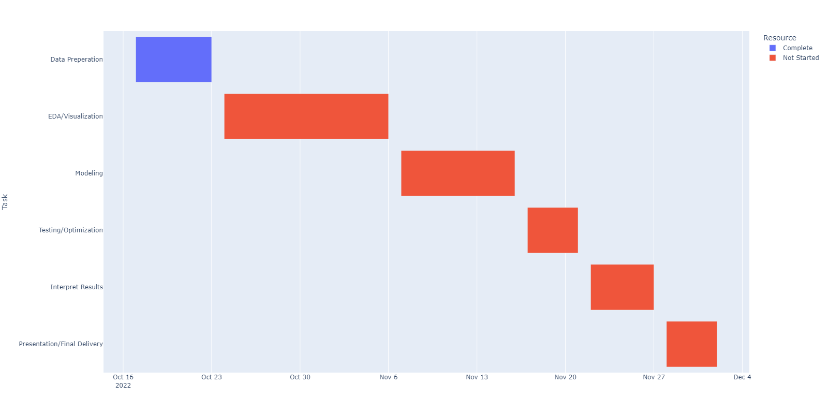
Project Timeline
*This timeline is preliminary and subject to change

Slide 7
References
USDA APHIS. (2022, April 5). Usda.gov. https://www.aphis.usda.gov/aphis/newsroom/news/sa_by_date/ sa-2022/protect-plants

Slide 8

Contact
tteasdale@regis.edu

