Slide 1
Face Mask Detection System
PythonPing
IDU1302
haQathon 2020
Global Product Engineering and Lifecycle Services Company
Notes:
Talking points:
We have built QuEST over the last 21 years as a aspiration driven organization. We continue to push the boundaries, create new frontiers across multiple safety critical and hi-tech industries we serve. We do this by offering our Customers a range of Services and Solutions and engagement models that spans – Engineering, Enterprise solutions, Operations, Supply Chain and Technology enabled solutions covering the complete product lifecycle.
As such, QuEST is a Leading Global Product Engineering and Lifecycle Services Company
In this presentation we will cover 3 aspects of QuEST.
WHO we are, WHAT we do and for WHOM, and why we are in business – our purpose
Then we move on to HOW we engage with Customers
Finally we will cover HOW we are different and can add unique value to you and help you “Create the Frontier”

Slide 2
Face Mask Detection system based on computer vision and deep learning using OpenCV and Tensorflow/Keras
PythonPing
Mentor | : | Ranjith Kumar K H
Ideator | : | Anju Susan Biju
Team Lead | : | Anoop Vijayakumar
Team Members | : | Anoop VijayaKumar, Anju Susan Biju, Sukritha N R, Sruthy S
Notes:
Idea/Solution/Prototype: Give a one-liner about the solution for the given problem statement
Team Name: Add team name to the entry field
Mentor Name: Add mentor’s name to the entry field
Ideator Name: Add ideator’s name to the entry field
Team Lead Name: Add team lead’s name to the entry field
Team Members Name: Add team member’s name to the entry fields one after another

Slide 3
Scope
Problem Statement
Approach
Outcome
In the present scenario due to Covid-19, there is no efficient face mask detection applications which are now in high demand for transportation means, densely populated areas, residential districts, large-scale manufacturers and other enterprises to ensure safety.
The model is accurate, and since we used the MobileNetV2 architecture, it’s also computationally efficient and thus making it easier to deploy the model to embedded systems (Raspberry Pi, Google Coral, etc.).This system can therefore be used in real-time applications which require face-mask detection for safety purposes due to the outbreak of Covid-19.
Face Mask Detection system built with OpenCV, Keras/TensorFlow using Deep Learning and Computer Vision concepts in order to detect face masks in static images as well as in real-time video streams.
Notes:
Problem Statement: Illustrate the basic problem along with technologies used
Approach: Methods planned to solve the target problem in order to attain a viable solution within the constrained time of 2 days of hackathon
Outcome: Results obtained as part of development towards the end of hackathon to be demonstrated with the help of table, diagram if any

Slide 4
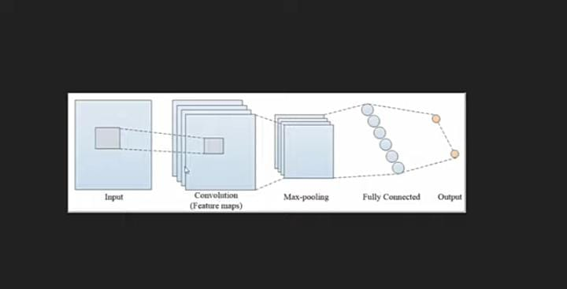
System Architecture
Notes:
System Architecture: Outline & detail the basic architecture of prototyped solution with the help of block diagrams, etc. if any

Slide 5
Technology Choices
Sl. No. | Technologies used | Rationale for selection
1 | Python | Readable and Maintainable Code
2 | OpenCV | One of the best library for computer vision
3 | Keras | High-level neural network library that runs on top of TensorFlow, it extremely simple and intuitive to use
4 | TensorFlow | Easiest framework for machine learning
5 | MobileNetV2 | neural network architecture
Notes:
Technology Choice: Add technologies used and rationale for selecting so

Slide 6
Learning Points
Scope for Improvement
This system can be used in real-time applications which require face-mask detection for safety purposes due to the outbreak of Covid-19. This project can be integrated with embedded systems for application in airports, railway stations, offices, schools, and public places to ensure that public safety guidelines are followed.
Notes:
Key Learning: Team Experience, Bottle necks, “Aha” Moments, etc.
Scope for Improvement: How the solution can be improved further?

Slide 7
Thank You
Engineering | Enterprise Solutions | Operations & Supply Chain | Technology & Digital Solutions

