Slide 1
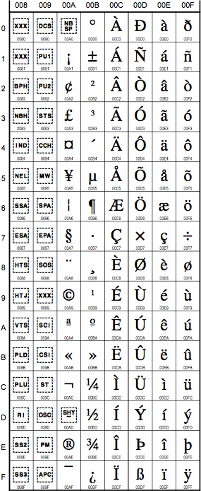
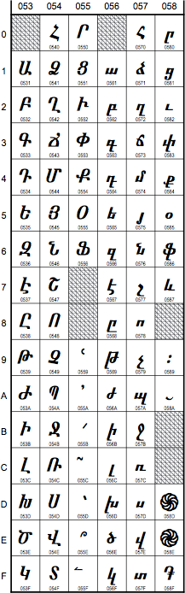
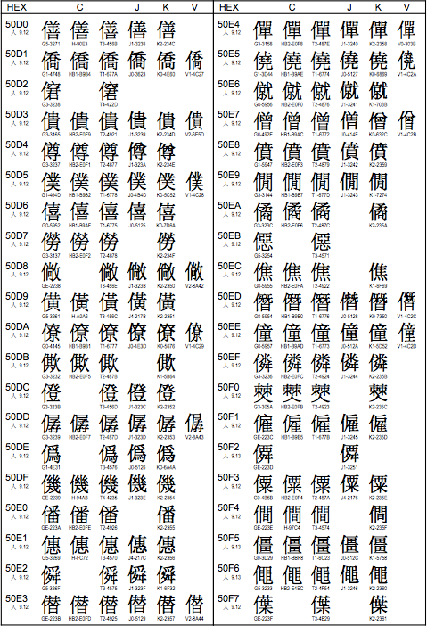
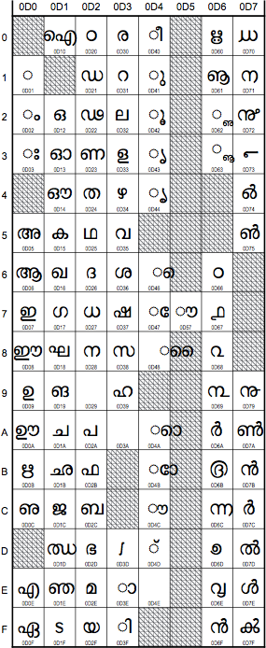
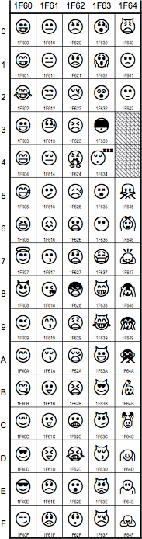
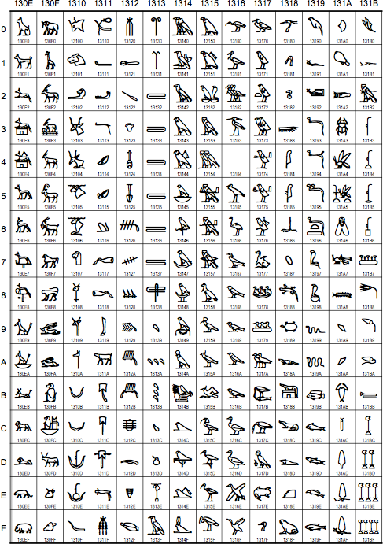
Unicode solutions in Python 2 and 3

Slide 2
Unicode solutions in Python 2 and 3
Latin-1
Armenian
Malayalam
CJK
Unified
Ideographs
Egyptian
Hieroglyphs
emoticons

Slide 3
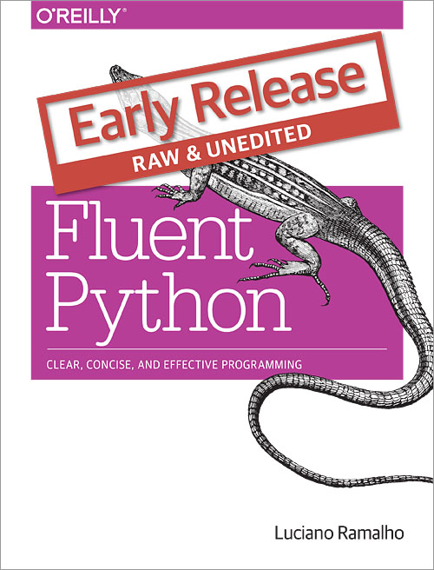
About me: Luciano Ramalho
Programming in Python since 1998
Focus on content management (i.e. text wrangling)
Teaching Python since 1999
Speaker at PyCon US,
OSCON, FISL, PythonBrasil,
RuPy, QCon...
Author of Fluent Python
Twitter: @ramalhoorg
Native language: Português
  “ação”
4 non-ASCII
characters here

Slide 4
Material de apoio
Repositório de exemplos:
  https://github.com/pythonprobr/unicode_pybr
Python Fluente
  http://www.novatec.com.br/livros/pythonfluente/
  Conteúdo relevante e examplos:
    Capítulo 4: Texto versus Bytes
      http://bit.ly/pyflu04
    Capítulo 18: Concorrência com asyncio
      os exemplos charfinder

Slide 5
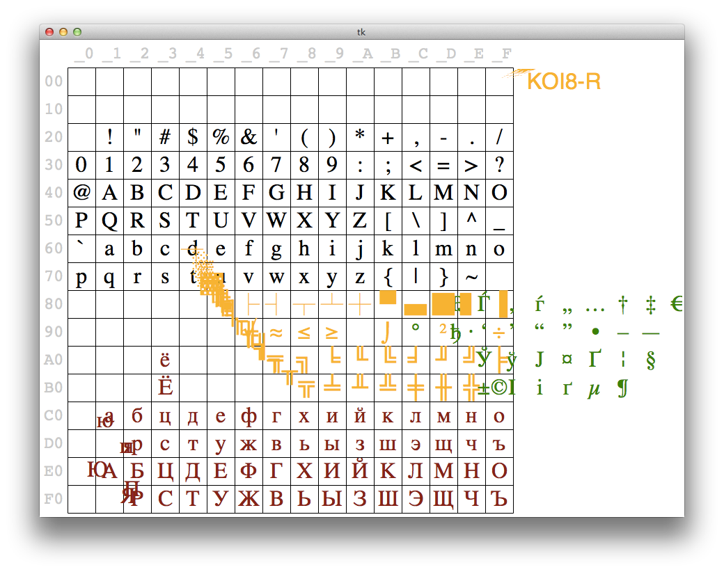
The single-byte codepage ballet
Video: https://www.youtube.com/watch?v=J4qioAacrYo
Source code: http://bit.ly/1Oqt0MZ

Slide 6

Why Unicode
Too many incompatible byte encodings
Separate concepts:
  character identity: one code point for each abstract character
    U+0041 → LATIN CAPITAL LETTER A
    U+096C → DEVANAGARI DIGIT SIX
  binary representation: multiple encodings
    U+0041 → 0x41 0x41 0x00
    U+096C → 0xE0 0xA5 0xAC 0x6C 0x09
UTF-8
UTF-16LE

Slide 7
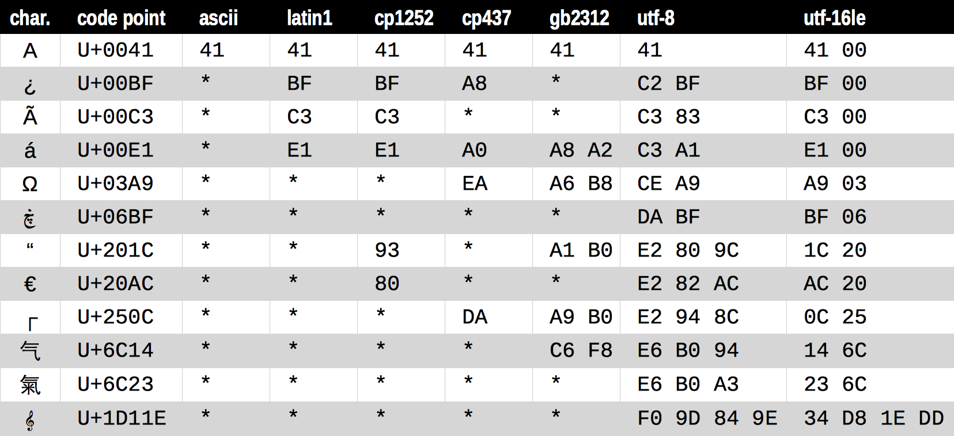
A sample of encodings
Figure 4-1 of Fluent Python

Slide 8
Data types for text or bytes
Py2
Py3
 | Python 2.7 | Python 3.4
Human text | unicode u'café', u'caf\xe9' | str 'café', u'café'
Bytes (immutable) | str 'café', 'caf\xe9', b'café'... | bytes b'caf\xc3\xa9'
Bytes (mutable) | bytearray bytearray(b'caf\xc3\xa9') | bytearray bytearray(b'caf\xc3\xa9')

Slide 9
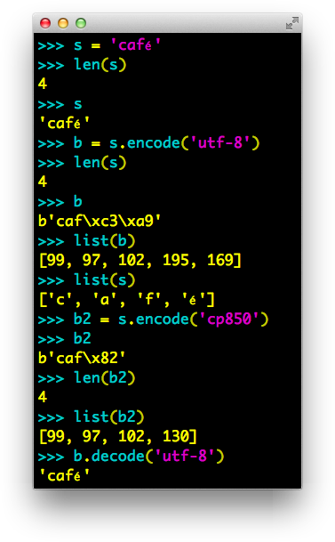
str v. bytes in Py3
Py3

Slide 10
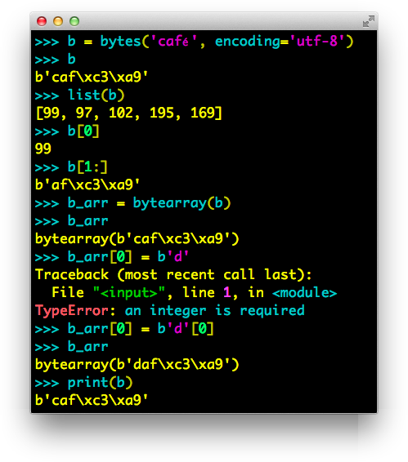
bytes in Py3
Py3

Slide 11
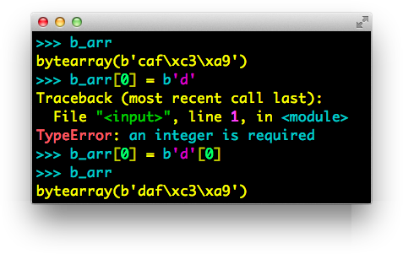
bytearray in Py2 & 3
Py2&3

Slide 12
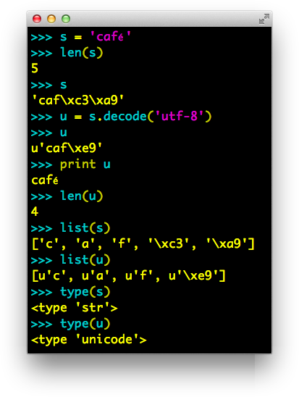
unicode v. str in Py2
Py2

Slide 13
.encode() vs .decode()
“Humans use text. Computers speak bytes.”
  Esther Nam and Travis Fischer in
  Character encoding and Unicode in Python
  (Pycon US 2014)
Use .encode() to convert human text to bytes
Use .decode() to convert bytes to human text
2.7 gotcha:
the methods
.encode() and .decode()
exist in str and unicode

Slide 14
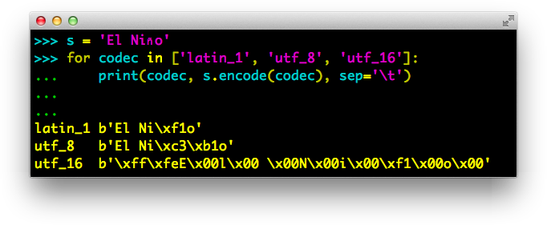
str.encode(…) in Py3
Py3

Slide 15
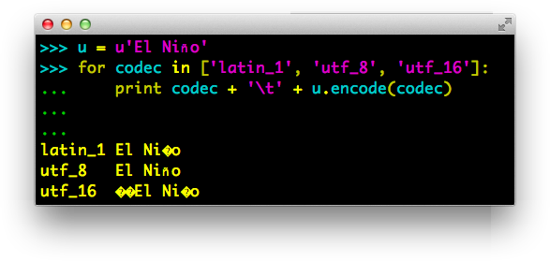
unicode.encode(…) in Py2
Py2

Slide 16
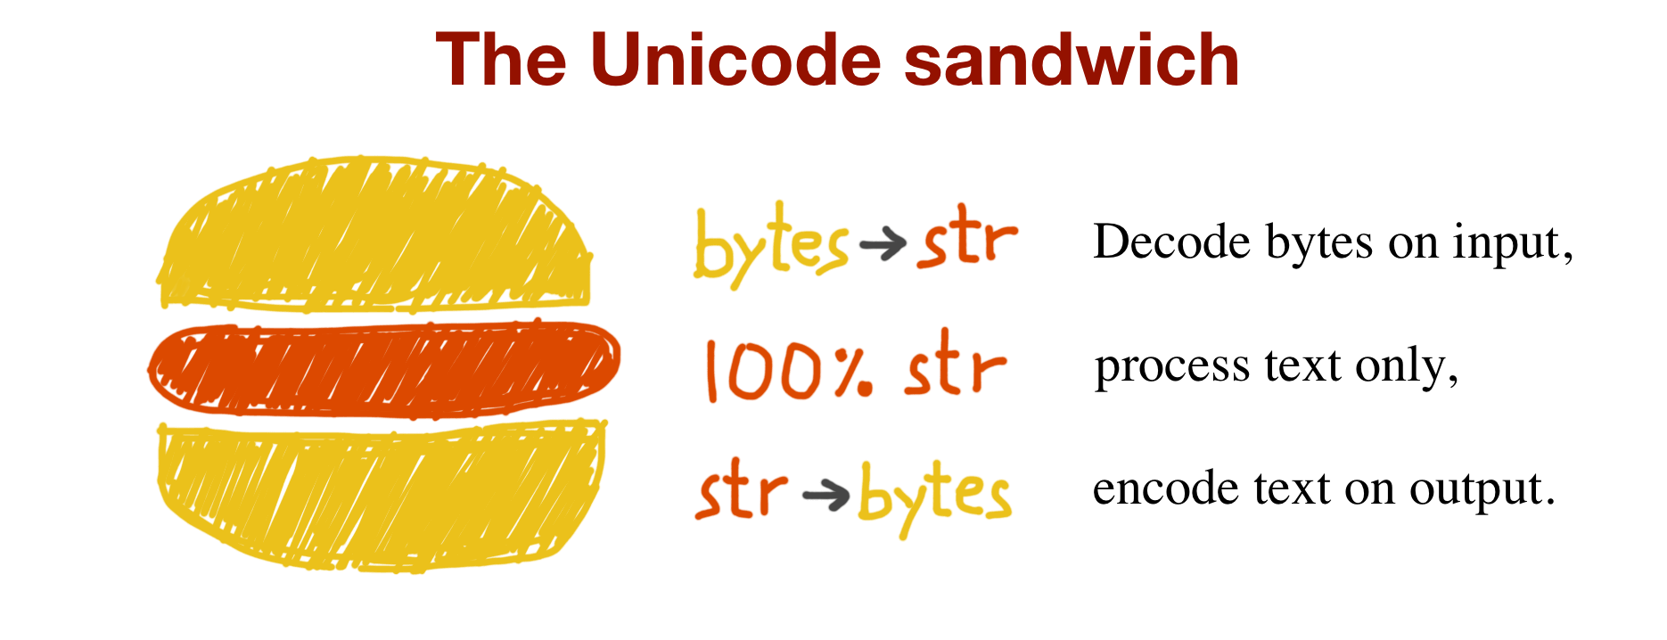
Best practice
Figure 4-2 of Fluent Python

Slide 17
How to implement the sandwich (1)
Always specify encoding when reading/writing text files
  that way you get text, and not bytes
  in Python 2.7, use io.open()
2.7 gotcha:
no way to specify
encoding in built-in open(…).
Must use io.open(…).

Slide 18
Coping with Unicode Errors
SyntaxError
  A .py file is loaded with contents in an unexpected encoding
UnicodeDecodeError
  A binary sequence is contains bytes that are not valid in the expected encoding
UnicodeEncodeError
  A Unicode string contains codepoints that have no representation in the desired encoding

Slide 19
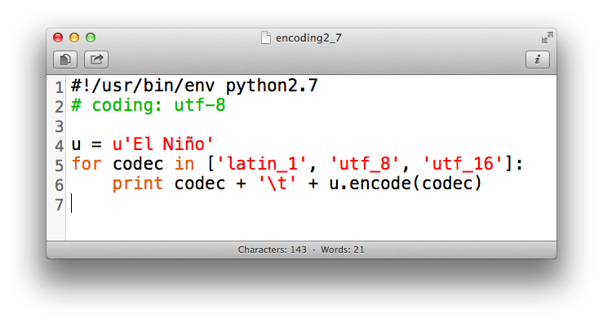
Coping with SyntaxError
Py2
A .py file is loaded with contents in an unexpected source code encoding
  The source file encoding is not the default, and no # coding comment was found.
  The source file encoding is not the one declared in the # coding comment
Default source encoding:
  Python 2.7 == ASCII
  Python 3.x == UTF-8
2.7 gotcha:
default source
encoding is ASCII

Slide 20
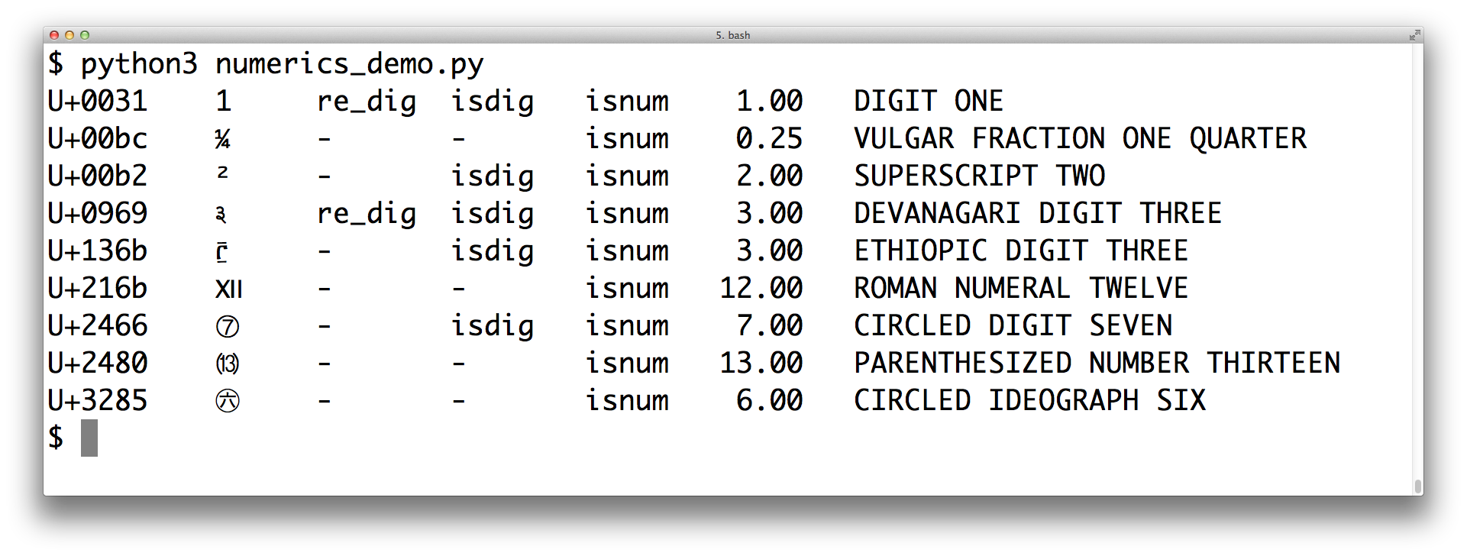
Unicode database

Slide 21
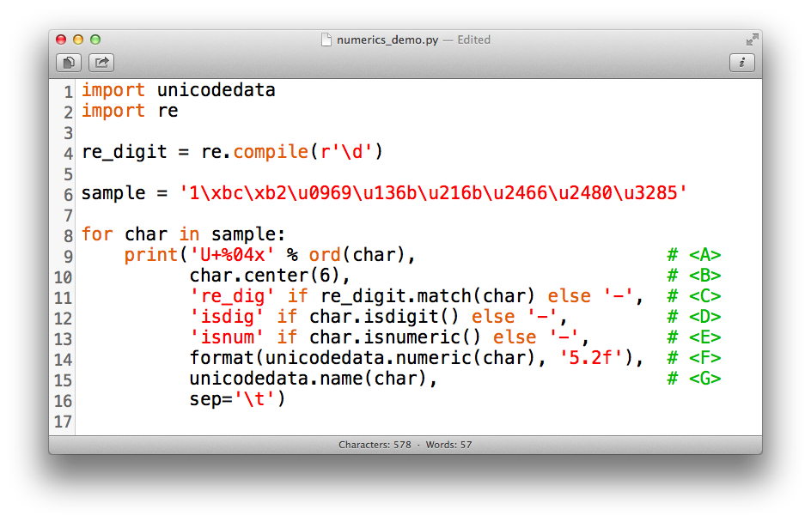
Unicode database
Py3

Slide 22
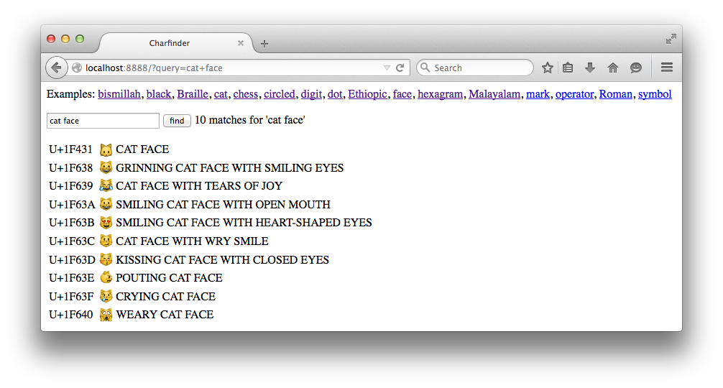
flupy-ch18/http_charfinder.py

Slide 23
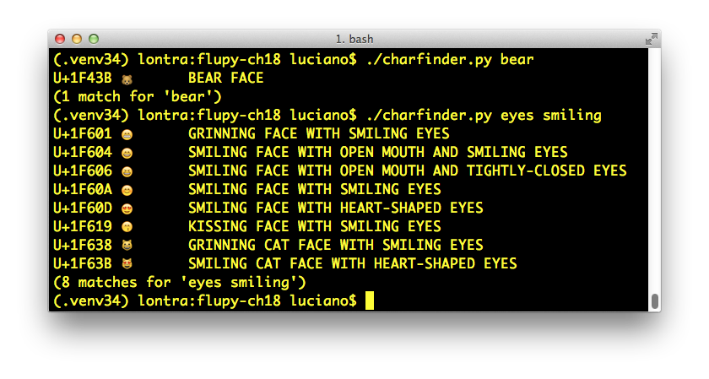
flupy-ch18/charfinder.py

Slide 24
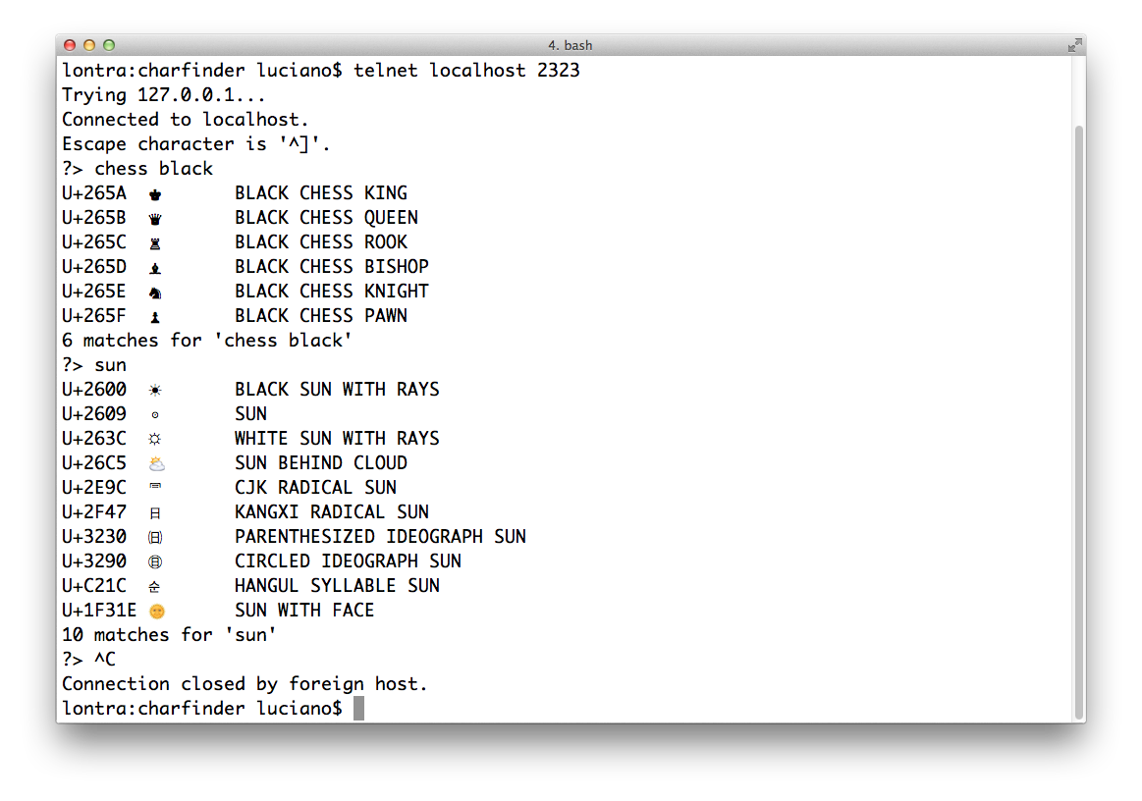
flupy-ch18/tcp_charfinder.py

