Slide 1
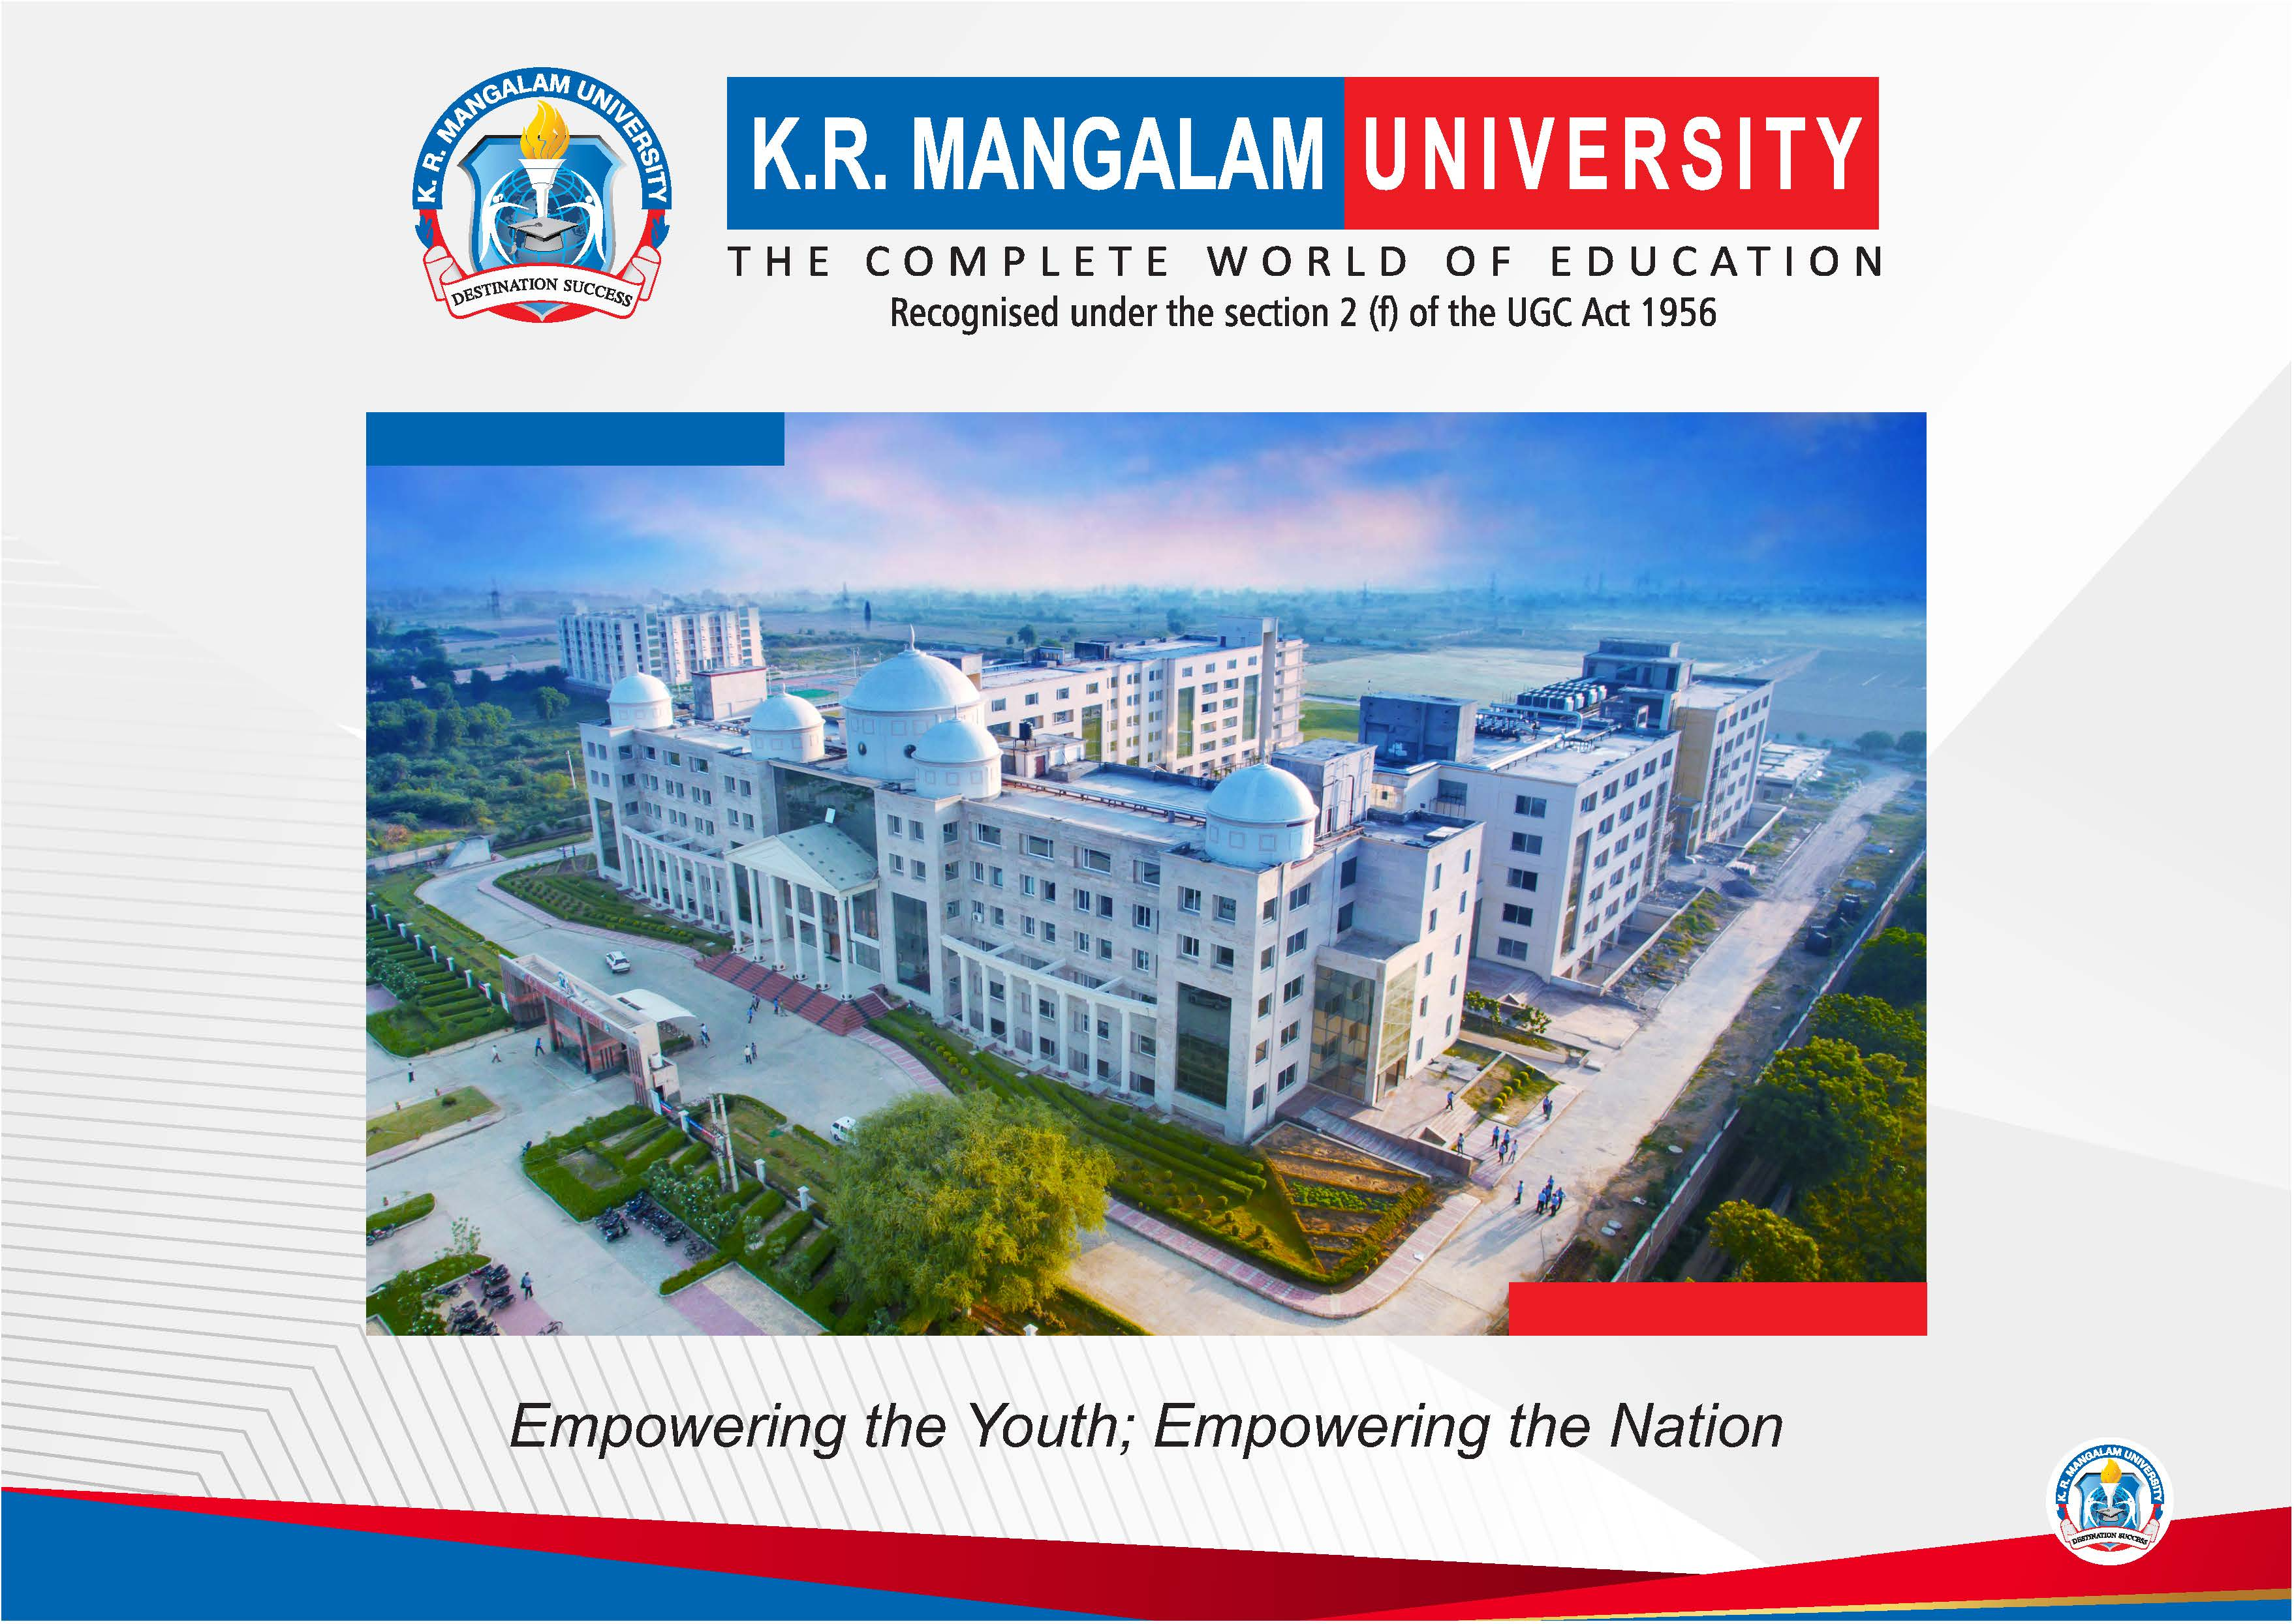

Slide 2


AI-Based Text-to-Image Generation
Final Year Project Synopsis
Submitted by
ROLL | NAME
Industry Mentor:
Faculty Mentor:
Notes:
New Courses replaced with New Programmes

Slide 3

This project focuses on developing an AI-based system that can generate images directly from natural language descriptions. By combining Natural Language Processing (NLP), Computer Vision (CV), and Generative Modeling techniques, the project aims to bridge the gap between text and visual content, enabling realistic and creative image synthesis.
Notes:
New Courses replaced with New Programmes

Slide 4
- To design and develop a prototype AI-based text-to-image generation system.
- To explore GANs, diffusion models, and transformer-based architectures.
- To enhance contextual accuracy between text and generated images.
- To evaluate model performance using realism and semantic alignment metrics.
- To investigate real-world applications in education, art, and design.
Notes:
New Courses replaced with New Programmes

Slide 5
- Text-to-image synthesis using advanced AI models.
- Support for both realistic and artistic image generation.
- Interactive prototype for real-time prompt-to-image conversion.
- Evaluation based on FID score, CLIP similarity, and user feedback.
- Applicability across multiple domains.
Notes:
New Courses replaced with New Programmes

Slide 6
Project Usecases & Scope
Notes:
New Courses replaced with New Programmes

Slide 7
System Flow:
1. Input Text Prompt
2. Text Preprocessing & Embedding (Transformer Models)
3. Model Inference (Diffusion/GAN-based)
4. Image Generation
5. Output Visualization via Prototype (Flask/Streamlit GUI).
Notes:
New Courses replaced with New Programmes

Slide 8
Datasets:
- COCO (Common Objects in Context)
- Conceptual Captions
- LAION-5B
Resources:
- Python, PyTorch, TensorFlow, Hugging Face Transformers
- Pre-trained models: Stable Diffusion, DALL·E-mini, AttnGAN
- CUDA-enabled GPUs for training and inference
Describe the data sources or materials you used.
Highlight any databases, software, or hardware.
Notes:
New Courses replaced with New Programmes

Slide 9
1. Data Collection: Large-scale text-image datasets (COCO, LAION-5B).
2. Preprocessing: Text tokenization & image normalization.
3. Model Selection: Diffusion models (Stable Diffusion), GANs (AttnGAN).
4. Training & Fine-Tuning: Improve semantic alignment and accuracy.
5. Evaluation: Metrics like FID and CLIP similarity.
6. Deployment: Interactive prototype using Streamlit/Flask.
Explain the approach or methods you used to tackle the problem.
Include any tools or technologies utilized.
Tools, technologies, frameworks you will use
Block diagram or flowchart (if applicable)
Notes:
New Courses replaced with New Programmes

Slide 10
Expected Results:
- High-resolution, realistic image generation from text prompts.
- Improved semantic alignment between input text and output image.
Impact:
- Democratization of AI-based creativity.
- Applications in education, art, design, healthcare, and gaming.
- Improved accessibility for non-artists and visually impaired individuals.
Notes:
New Courses replaced with New Programmes

Slide 11
Phase 1: Literature Review & Data Collection (Weeks 1-3)
Phase 2: Preprocessing & Model Selection (Weeks 4-6)
Phase 3: Model Training & Fine-tuning (Weeks 7-10)
Phase 4: Prototype Development (Weeks 11-12)
Phase 5: Evaluation & Testing (Weeks 13-14)
Phase 6: Documentation & Final Presentation (Weeks 15-16)
Phases of the project with estimated timeframes
Gantt chart or simple timeline format
Notes:
New Courses replaced with New Programmes

Slide 12
THANK YOU

