Slide 1
Agenda
Building a Knowledge Graph by Populating Data on Ontologies
Virtualization and Querying the Knowledge Graph

Slide 2
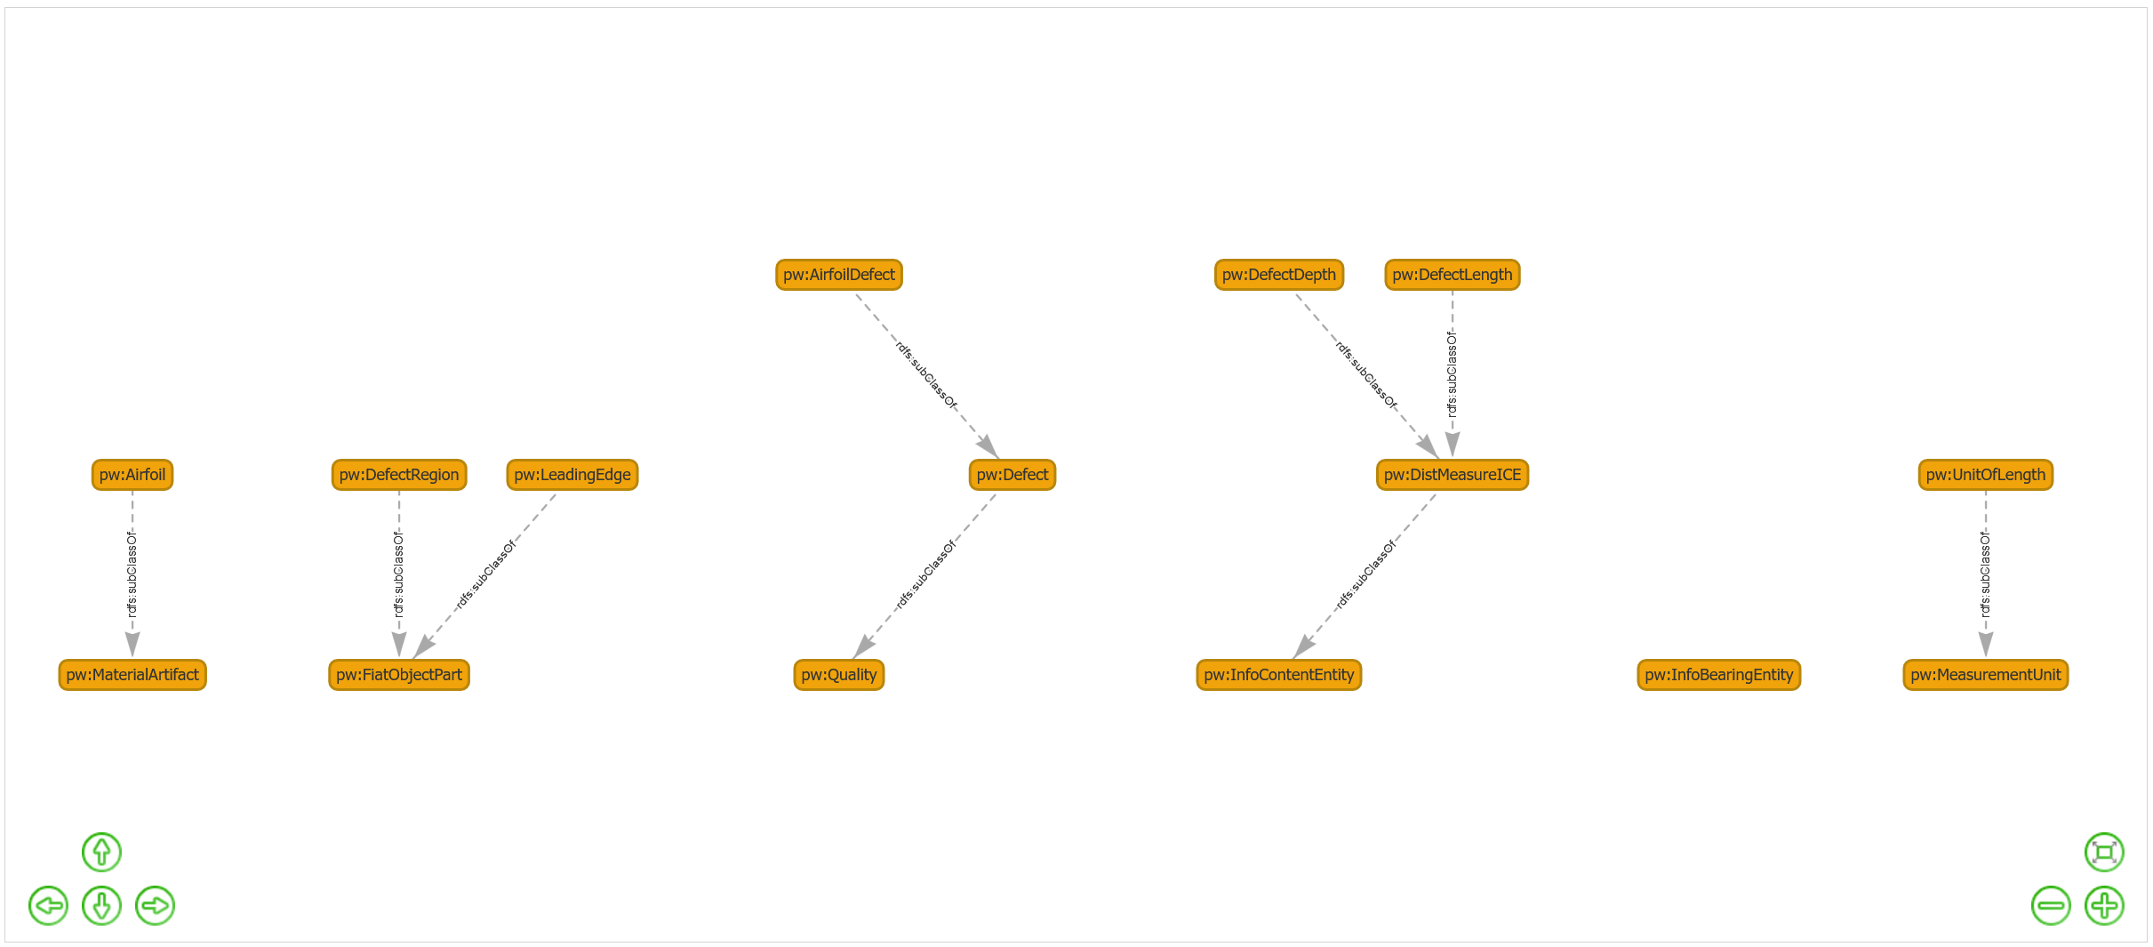

Slide 3
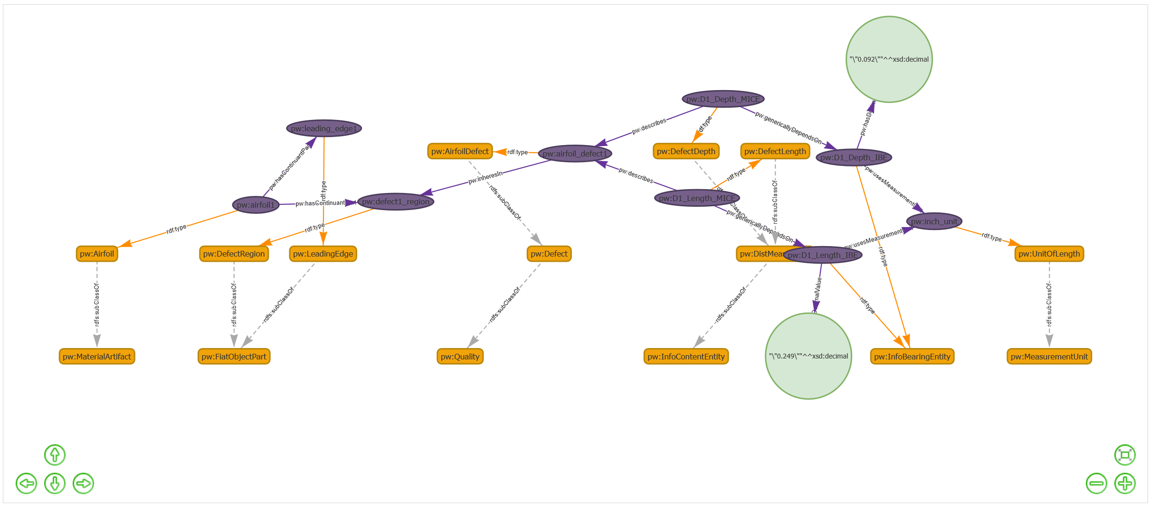

Slide 4
SPARQL
Pattern mathing example of query

Slide 5
Ontology & Individuals: Structuring and Populating Knowledge
The Ontology - The Blueprint / Schema
What is an Ontology?
A formal blueprint or schema for a domain of knowledge (like airfoil defects).
Defines the Types of Things (Classes) we care about (e.g., Airfoil, Defect, Edge).
Defines the Types of Relationships (Properties/Predicates) that can exist between these things (e.g., subClassOf, hasPart, measuredFrom).
Creates a shared vocabulary and structure for data.
# --- Ontology Snippet (Schema Definition) ---
# PREFIX rdfs: <http://www.w3.org/2000/01/rdf-schema#>
# PREFIX pw: <http://prattwhitney.com/ontology#> # Example prefix
# Class Definitions and Hierarchy (using rdfs:subClassOf)
pw:Airfoil rdfs:subClassOf pw:MaterialArtifact .
pw:Edge rdfs:subClassOf pw:FiatObjectPart .
pw:LeadingEdge rdfs:subClassOf pw:Edge .
pw:TrailingEdge rdfs:subClassOf pw:Edge .
pw:Tip rdfs:subClassOf pw:FiatObjectPart .
pw:Defect rdfs:subClassOf pw:Quality .
pw:AirfoilDefect rdfs:subClassOf pw:Defect .
pw:DefectRegion rdfs:subClassOf pw:FiatObjectPart .
pw:DefectDepth rdfs:subClassOf pw:DistanceMeasurementInfoContentEntity .
# ... and other measurement types ...
# (Implicitly defines properties used later like 'hasPart', 'inheresIn', 'measuredFrom' etc.)
Notes:
Here, we define what an 'Airfoil' is conceptually, that a 'LeadingEdge' is a type of 'Edge', and 'AirfoilDefect' is a type of 'Defect'. This creates the structured vocabulary.

Slide 6
Individuals - The Specific Instances / Data
What are Individuals (Instances)?
Specific, real-world things or data points that belong to the Classes defined in the ontology.
They are the actual data populating the knowledge graph.
Examples: A specific airfoil airfoil1, a particular defect airfoil_defect_id1, a concrete measurement Defect1_Depth_MICE.
Populating the Ontology:
Assigning individuals to their Class (rdf:type).
Connecting individuals using the Properties defined or implied by the ontology.
Linking individuals to literal data values (numbers, text, dates).
# --- Instance Data Snippet (Population) ---
# PREFIX rdf: <http://www.w3.org/1999/02/22-rdf-syntax-ns#>
# PREFIX pw: <http://prattwhitney.com/ontology#> # Example prefix
# (Assume prefixes map to your actual URIs/namespaces)
# == Describing Airfoil 'airfoil1' ==
pw:airfoil1 rdf:type pw:Airfoil . # 'airfoil1' is an instance of the Class 'Airfoil'
pw:airfoil1 pw:hasContinuantPart pw:leading_edge1 . # Connects 'airfoil1' to its specific leading edge
pw:airfoil1 pw:hasContinuantPart pw:defect1_region . # Connects 'airfoil1' to its specific defect region
pw:airfoil1 pw:hasContinuantPart pw:tip1 .
# == Describing specific parts of 'airfoil1' ==
pw:leading_edge1 rdf:type pw:LeadingEdge . # 'leading_edge1' is an instance of 'LeadingEdge'
pw:tip1 rdf:type pw:Tip .
pw:defect1_region rdf:type pw:DefectRegion .
# == Describing Defect 'airfoil_defect1' ==
pw:airfoil_defect1 rdf:type pw:AirfoilDefect . # 'airfoil_defect1' is an instance of 'AirfoilDefect'
pw:airfoil_defect1 pw:inheresIn pw:defect1_region .# Links the defect quality to its physical location
# (Note: 'inheresIn' is likely defined in your upper ontology)
# == Describing a specific measurement related to the defect ==
# Measurement Information Content Entity (MICE) for depth
pw:Defect1_Depth_MICE rdf:type pw:DefectDepth . # Instance of 'DefectDepth' class
pw:Defect1_Depth_MICE pw:describes pw:airfoil_defect1 . # Links measurement context to the defect
pw:Defect1_Depth_MICE pw:genericallyDependsOn pw:Defect1_Depth_IBE . # Links to the info bearer
# Information Bearing Entity (IBE) holding the value
pw:Defect1_Depth_IBE rdf:type pw:InformationBearingEntity . # General type
pw:Defect1_Depth_IBE pw:has_decimal_value "0.092"^^xsd:decimal . # The actual data value
pw:Defect1_Depth_IBE pw:uses_measurement_unit pw:inch_measurement_unit . # Link to the unit instance
pw:inch_measurement_unit rdf:type pw:MeasurementUnitOfLength . # The unit definition
Ontology = Structure & Rules | Individuals = Data & Facts
The Ontology provides the meaningful framework; Individuals populate that framework with specific knowledge, creating the Knowledge Graph.
Notes:
Now we introduce specific instances like airfoil1. We declare it's an Airfoil (using rdf:type). We link it to its specific leading_edge1 using the hasContinuantPart property. We describe a specific airfoil_defect1 located in defect1_region. Finally, we see how a specific measurement Defect1_Depth_MICE (which is of type DefectDepth) describes this defect and ultimately links (via the IBE) to the actual data value '0.092' inches.

Slide 7
virtualization

Slide 8
Relational and Graph Data
DefectID | AirfoilID | Location | Length_in | Depth_in
D101 | 1 | Leading Edge | 0.20 | 0.08
D102 | 2 | Leading Edge | 0.35 | 0.12
D103 | 1 | Leading Edge | 0.15 | 0.05
D104 | 3 | Leading Edge | 0.25 | 0.09
@prefix : <http://example.com/ontology#> .
:Airfoil_1 rdf:type :Airfoil ;
:hasSpecificPart :LE_partOf_1 .
:LE_partOf_1 rdf:type :LeadingEdge .
# Defect instance, linked from DefectID D101
:Defect_D101 rdf:type :AirfoilDefect ;
:locatedOnPart :LE_partOf_1 ;
:describedByMeasurement :Length_D101 ;
:describedByMeasurement :Depth_D101 ;
# *** Location info NOT in table, structured via ontology ***
:describedByMeasurement :X_Location_D101 ;
:describedByMeasurement :Y_Location_D101 .
# Length Measurement - Info FROM table
:Length_D101 rdf:type :DefectLength ;
:hasValue "0.20"^^xsd:decimal ;
:hasUnit :Unit_inch .
# Depth Measurement - Info FROM table
:Depth_D101 rdf:type :DefectDepth ;
:hasValue "0.08"^^xsd:decimal ;
:hasUnit :Unit_inch .
# X Location Measurement - Info NOT FROM table
:X_Location_D101 rdf:type :DefectIndex1DistanceToDatum ; # Ontology Class for X coord
:hasValue "5.75"^^xsd:decimal ; # Hypothetical X value
:hasUnit :Unit_inch ;
:measuredFrom :Datum_LE_Tip . # Reference Point
# Y Location Measurement - Info NOT FROM table
:Y_Location_D101 rdf:type :DefectIndex2DistanceToDatum ; # Ontology Class for Y coord
:hasValue "1.20"^^xsd:decimal ; # Hypothetical Y value
:hasUnit :Unit_inch ;
:measuredFrom :Datum_LE_Base . # Reference Point
:Unit_inch rdf:type :MeasurementUnitOfLength .
Notes:
Characteristics (Relational World):
Very specific focus: Only logs defect length.
Uses simple identifiers (AirfoilID).
Locations/types are descriptive text ('Leading Edge').
Missing Information: No defect depth, no timestamp, no inspection context beyond the log entry ID.
Queried with SQL: SELECT MeasuredLength_in FROM Defect_Length_Log WHERE AirfoilID = 1;
Efficient for its specific purpose but lacks broader context.
Characteristics:
Integrates table data: Uses Length_in and Depth_in for measurements.
Enriches data: Adds detailed XY location (:DefectIndex1Distance..., :DefectIndex2Distance...) based on ontology structure, information not present in the source table.
Explicit Semantics: Uses ontology classes and properties.
Structured Data: Represents measurements and location coordinates as distinct instances with values, units, and potentially reference points (:measuredFrom).
Queried with SPARQL: SELECT ?defect ?x ?y WHERE { ?defect a :AirfoilDefect ; :locatedOnPart/:type :LeadingEdge ; :describedByMeasurement [ a :DefectIndex1DistanceToDatum ; :hasValue ?x ] ; :describedByMeasurement [ a :DefectIndex2DistanceToDatum ; :hasValue ?y ] . } (Find XY coordinates of defects on leading edges).
The Question: How can we query the simple Defect_Measurements table but get results structured with rich spatial location details defined by the ontology, even when that detail isn't in the source table itself? Answer: R2RML maps the table data, and the query engine combines this with the ontology structure. (Again, virtualization typically maps existing data. Adding new data not in the source usually requires loading it into the graph or joining with another virtualized source that does contain it. This slide emphasizes the target structure's richness compared to the source).

Slide 9
What is R2RML?
R2RML = RDB to RDF Mapping Language
It's a W3C Standard: A formal recommendation for expressing mappings. (https://www.w3.org/TR/r2rml/)
Purpose: Defines a declarative language to describe how to transform data from relational tables (or SQL views/queries) into RDF triples.
It provides instructions for converting each row (or parts of rows) from your database into linked RDF statements.
written in Turtle syntax (.ttl), making it readable RDF itself.

Slide 10
Why Use R2RML? Key Benefits
Allows querying relational data directly using SPARQL without physically moving or duplicating the data into the graph database. (This is what we did with SQLite!).
Queries are translated on-the-fly (SPARQL -> SQL).
Standardization: Provides a common, vendor-neutral way to define mappings.
Reusability: Mappings can be shared and potentially reused across different tools that support R2RML.
Separation of Concerns: Keeps the mapping logic separate from application code and the databases themselves.
ETL (Extract, Transform, Load): Can also be used in ETL processes to physically convert and load relational data into RDF.

Slide 11
How Does it Work? Core Concepts
The Goal: Specify rules to generate RDF Triples (Subject - Predicate - Object) from table rows.
Key Building Blocks in an R2RML file:
rr:TriplesMap: The main container for mapping rules related to one logical source (e.g., one table or one query result).
rr:logicalTable: Defines where the source data comes from (e.g., rr:tableName "Persons" or rr:sqlQuery "SELECT ...").
rr:subjectMap: Defines how to create the Subject URI for each triple (often using a template with primary key values, like http://example.com/person/{id}).
rr:predicateObjectMap: Defines how to create the Predicate (the property URI, like foaf:name) and the Object (a literal value from a column like "Alice", or another URI).

Slide 12
Anatomy of a Mapping
Input (SQLite Row):
| id | name | city |
| :-: | :------ | :------- |
| 1 | "Alice" | "London" |
R2RML Snippets (Conceptual):
Subject Map Rule:
rr:subjectMap [ rr:template "http://example.com/person/{id}" ]
Generates -> <http://example.com/person/1>
Predicate-Object Map Rule 1:
rr:predicateObjectMap [ rr:predicate foaf:name; rr:objectMap [ rr:column "name" ] ]
Generates -> foaf:name "Alice"
Predicate-Object Map Rule 2:
rr:predicateObjectMap [ rr:predicate :livesInCity; rr:objectMap [ rr:column "city" ] ]
Generates -> :livesInCity "London"

Slide 13
SQL

Slide 14
VIRTUALIZATION & QUERYING (Approx. 10 minutes total)
Slide 7: What is Virtualization in Knowledge Graphs?
Definition: Enabling access to data sources without physically duplicating all data into the graph store.
Why It Matters
Real-time integration with legacy systems.
Reduced data redundancy and better synchronization.
Approaches
Virtual graphs: Query external data sources “as if” they’re part of the knowledge graph.
Federated queries: Combine data from multiple graph endpoints seamlessly.
Speaker Note (2 minutes)
Highlight how virtualization avoids heavy ETL for large-scale data.
Mention an example: “Query data from the PLM system while also pulling relevant records from the inspection database in real-time.”

Slide 15
Comprehensive Database Schema Design Techniques
1. Relational Database Normalization (1NF through 5NF and Beyond)
Relational schema design often uses normalization, a process of structuring tables to reduce redundancy and dependency issues​
. The classic normal forms include:
First Normal Form (1NF) – Each table column holds atomic (indivisible) values, with no repeating groups, and each row is uniquely identifiable​
. For example, a customer orders table violating 1NF might have a column listing multiple products per order; 1NF would split that into separate rows or a child table​
Second Normal Form (2NF) – Achieved after 1NF by ensuring full dependency on the primary key. No non-key attribute should depend on only part of a composite key​
. In practice, if a table’s primary key has multiple columns, every other column must depend on the entire key, not just one part. This usually means moving partially dependent data to another table​
Third Normal Form (3NF) – Achieved after 2NF by removing transitive dependencies. No non-key attribute should depend on another non-key attribute​
. In other words, if column A depends on column B which depends on the primary key, then A should be moved to a separate table linked to B. This prevents update/delete anomalies​
.
Boyce–Codd Normal Form (BCNF) – A stricter version of 3NF. It requires that every determinant (any attribute or set of attributes that functionally determines another) is a candidate key​
. BCNF addresses certain edge cases not covered by 3NF (usually when a table has multiple overlapping candidate keys). For example, if a table of students, courses, and instructors had a rule "Instructor teaches Course," then Instructor alone determining Course violates BCNF unless that pairing is made into a separate table​
Fourth Normal Form (4NF) – Eliminates multi-valued dependencies. If two independent one-to-many relationships exist in one table, 4NF splits them into separate tables to avoid redundant combinations. This normal form handles cases where a record contains two sets of repeating facts that don’t directly depend on each other (aside from the primary key)​
. 4NF is rarely needed outside of specialized designs (e.g. complex hierarchies or historical tracking)​
Fifth Normal Form (5NF) – Also called Projection-Join NF, it resolves join dependencies, ensuring that a complex relationship that can be reconstructed via joins is decomposed to avoid any anomalous data combinations​
. A table is in 5NF if it cannot be further non-losslessly decomposed into smaller tables​
. This is the highest normal form focused on eliminating redundancy; beyond this, Sixth Normal Form (6NF) and Domain-Key NF (DKNF) exist in theory, but these are used only in niche cases (such as temporal databases or certain data warehouse designs) and not common in industry practice​
Practical note: In industry, normalization is applied up through 3NF (or BCNF) for operational databases to ensure data integrity. Higher normal forms (4NF, 5NF) are less frequently encountered, as real-world requirements (performance, reporting needs) sometimes lead designers to balance strict normalization with other techniques like denormalization.

Slide 16
🔍 What are Anomalies in Database Schema Design?
Anomalies in a database schema occur when the schema is poorly designed—typically due to lack of proper normalization. These anomalies affect data integrity and can lead to inconsistent or redundant data.
💣 Common Types of Anomalies:
1. Insertion Anomaly
Occurs when you can't add data to the database without having to add unrelated data.
Example: You have a table like this:
| StudentName | Course |
|-------------|------------|
| Alice | Database |
If you want to add a new course that no student has enrolled in yet, you can't do it without inserting a dummy student.
2. Update Anomaly
Occurs when the same data is stored in multiple places, and you have to update it in all those places to keep it consistent.
Example: If a professor's name appears in 5 different rows and they change their name, you need to update all 5 rows. If one is missed, the data becomes inconsistent.
3. Deletion Anomaly
Occurs when deleting a record inadvertently removes useful information.
Example: You delete the only student enrolled in "AI Ethics" and accidentally lose all information about that course.
4. Redundancy
Storing the same piece of information in multiple places unnecessarily.
Problem:
Wastes space.
Leads to update anomalies.
Makes queries and maintenance harder.

Slide 17
Analogous "Anomalies" in Knowledge Graphs & Ontology-Based Schemas
These aren't called "anomalies" in formal semantic web literature as much as modeling pitfalls, semantic inconsistencies, or ontology anti-patterns. But they serve similar roles.
1. Semantic Redundancy
What it is: Multiple classes or properties expressing the same meaning.
Example:
Having both hasBirthDate and dateOfBirth properties with overlapping usage.
Why it’s bad:
Inference engines may duplicate inferred facts or produce contradictions.
Real-world effect:
In aerospace maintenance ontologies, this could mean systems showing multiple contradictory failure timelines.
2. Ontological Inconsistency
What it is: Logical contradictions due to class/property definitions, domain/range, or constraints.
Example:
A class is both defined as disjoint with another and subclass of it.
Why it’s bad:
Reasoners will mark the ontology as inconsistent, making it unusable for inference.
3. Over-Ontologizing (Over-Engineering)
What it is: Modeling overly detailed or abstract structures that don't map to real data.
Example:
Creating 6-level deep class hierarchies without any instance data.
Why it’s bad:
Harder to maintain, interpret, or use in real-world queries.
Seen in:
Some defense KGs, where ontologies are inherited from standards (e.g., MIL-STDs) but aren’t grounded in actual use.
4. Inference Explosion (Reasoning Overload)
What it is: Reasoners generate too many inferred triples, including irrelevant or misleading ones.
Causes:
Excessive use of owl:sameAs
Open-world assumption
Broad subclass hierarchies
Example:
A SHACL shape infers that "every component has a fault", flooding the graph.
5. Underspecification / Underdetermined Models
What it is: Not enough constraints to differentiate classes or properties.
Example:
A hasPart property used everywhere without any domain/range or inverse.
Why it’s bad:
Reasoners and SPARQL queries become ineffective or unpredictable.
6. Schema Drift in Graph DBs
What it is: In property graph DBs like Neo4j, schema is implicit, and nodes/relationships may change over time without central control.
Analogy: Like a schema-less RDBMS—leads to unexpected patterns or missing relationships.
Fix: Use SHACL/OWL constraints or enforce naming conventions and patterns.
7. Open World Assumption (OWA) Confusion
What it is: People assume data absence = false (closed-world), but RDF/OWL assumes data may just be missing.
Example:
Lack of hasMaintenanceDate doesn't mean no maintenance was done.
Why it’s bad:
Leads to flawed reasoning unless explicitly handled.
8. Disconnected Subgraphs
What it is: Portions of the graph are not reachable due to missing relationships.
Causes:
Forgetting to add rdfs:subClassOf, owl:equivalentClass, or rdf:type.
Effect:
SPARQL queries and inferences return incomplete results.
9. Misuse of owl:sameAs
What it is: Incorrectly declaring two entities as identical when they are only similar.
Effect:
Cascading identity errors in inference.
In defense/aerospace:
Confusing two different aircraft components across model versions could have serious implications.

Slide 18
🧠 Formal Theories & Tools to Detect These
✔️ Specification Languages:
SHACL – Shapes Constraint Language to validate RDF graphs
SPIN – SPARQL-based inference rules and constraints
SHOE, OWL 2 DL, and RDFS semantics – for formal reasoning
🧰 Tooling:
Protégé + HermiT or Pellet reasoners
TopBraid Composer, Stardog’s Integrity Constraints
Neo4j's Schema Constraints and APOC procedures
KG-Hub (by Monarch Initiative) for biomedical KGs
GraphLint, OntoClean, and other ontology anti-pattern checkers

