Slide 1
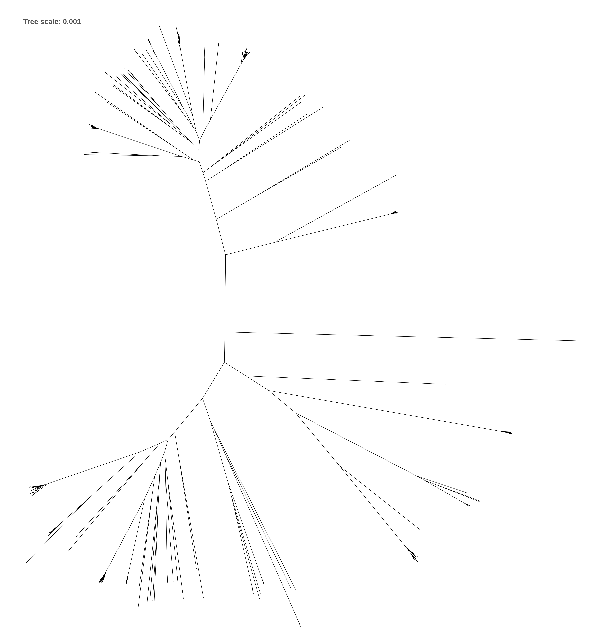
CC71
CC8
CC5
CC22
CC45
CC130
CC398
CC30
CC133

