Slide 1
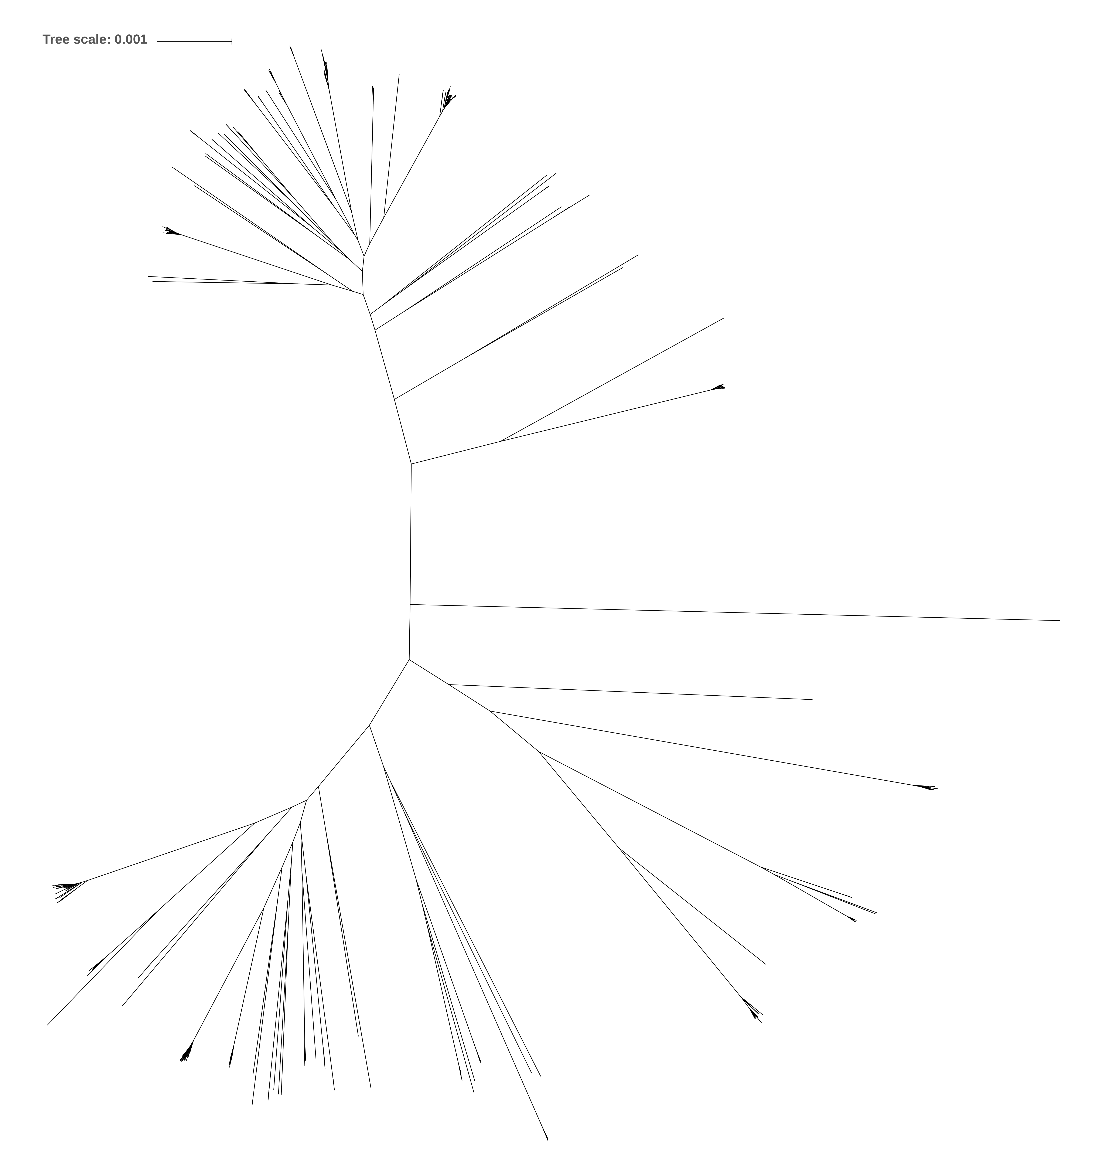
CC71
CC1
CC15
CC8
CC5
CC22
CC45
CC130
CC398
CC121
CC30
CC133

Slide 2
ST15
ST8, ST239
ST5, ST105
ST22
ST45
ST398
ST30, ST36

