Slide 1
Generative Adversarial Nets
PyTorch Taipei Aug. 16

Slide 2

Outline
Compare with VAE
Adversary
Procedure
Theory
DCGAN
CGAN
ACGAN
InfoGAN
Cycle GAN
Application

Slide 3
Comparing GANs with VAE
VAE: training from input image to image. MSE loss
GAN: training from input random noise to single scaler. KL divergence
GANs are based on a minimax game rather than an optimization problem, and have a value function that one agent seeks to maximize and the other seeks to minimize
Goodfellow, Ian, et al. "Generative adversarial nets." Advances in neural information processing systems. 2014.

Slide 4
Adversary
Compete a discriminative model
In GANs, one network produces vector that is used as the input to another network, and attempts to choose an input that the other network does not know how to process
Not Confusing with Adversarial example!
Random noise
Generate data
Single Scaler
Goodfellow, Ian, et al. "Generative adversarial nets." Advances in neural information processing systems. 2014.

Slide 5
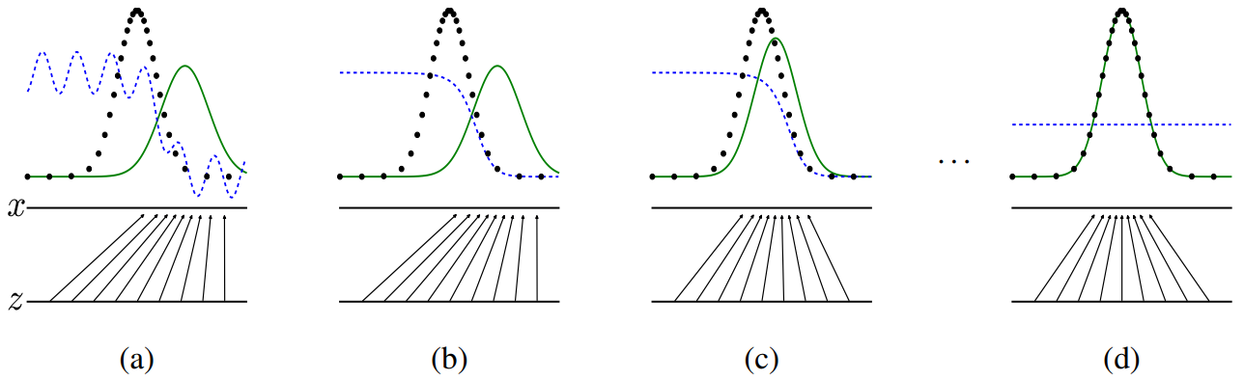
Procedure
Blue dash: discriminator
Black dot: real data
Green line: generator
Goodfellow, Ian, et al. "Generative adversarial nets." Advances in neural information processing systems. 2014.

Slide 6
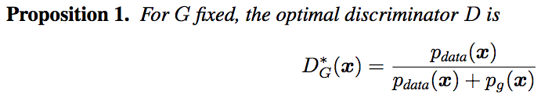
Theory
A minmax game

Slide 7
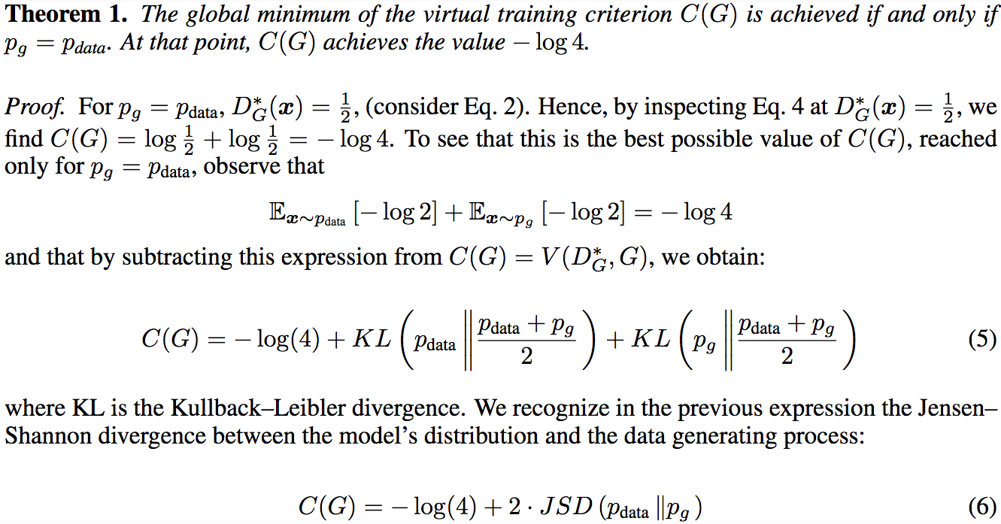
KL Divergence
a JS divergence!
Goodfellow, Ian, et al. "Generative adversarial nets." Advances in neural information processing systems. 2014.

Slide 8
Question about GANs
Guarantee converges in Optimality? No
Guarantee to improve? No
In practice, adversarial nets represent a limited family of distributions via the generator, and we optimize network parameters rather than distribution itself, so the proofs do not apply…
Goodfellow, Ian, et al. "Generative adversarial nets." Advances in neural information processing systems. 2014.

Slide 9
Training
Dataset: MNIST, Toronto Face Database, CIFAR-10
The generator used rectifier linear activations and sigmoid activations
The discriminator net used maxout activations, Dropout applied
Iterative training!

Slide 10
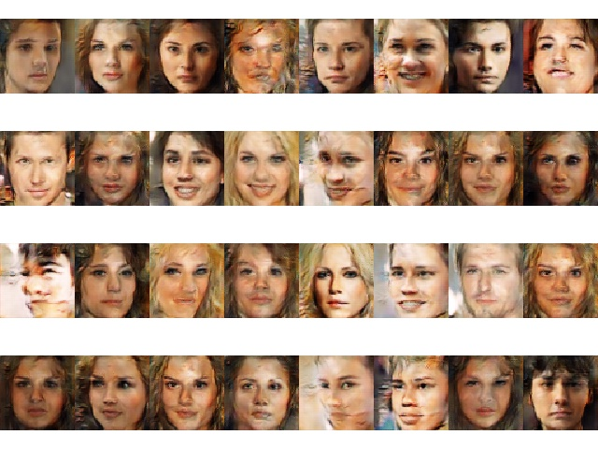
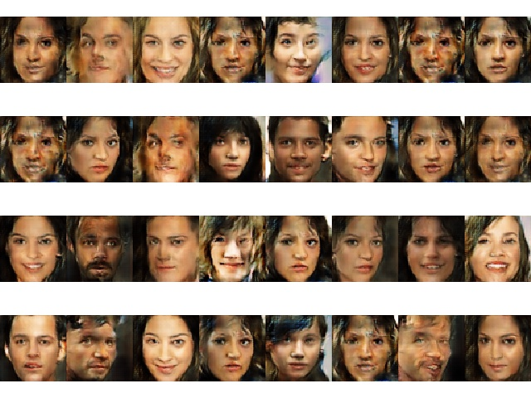
Problem: Mode Collapse
Generator collapses too many values of noise to the same value of output to have enough diversity to model data distribution
Training 90000 steps
Training 95000 steps

Slide 11
Training Tips
Different learning rate in Generator and Discriminator
Training Discriminator more
Rather than minimize log(1-D(G)), try maximize log(D(G))
How to train a GAN https://github.com/soumith/ganhacks

Slide 12
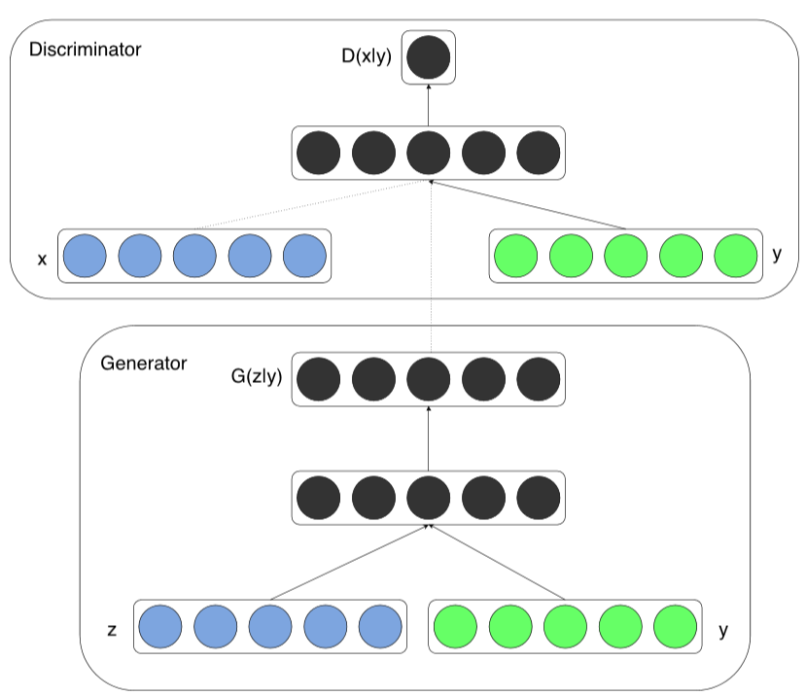
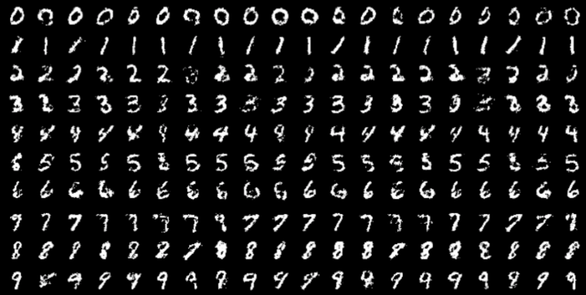
CGAN
A conditional generative model by adding c as input to both generator and discriminator

Slide 13
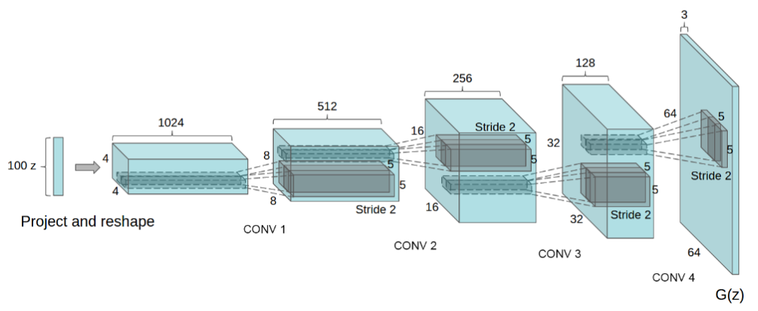
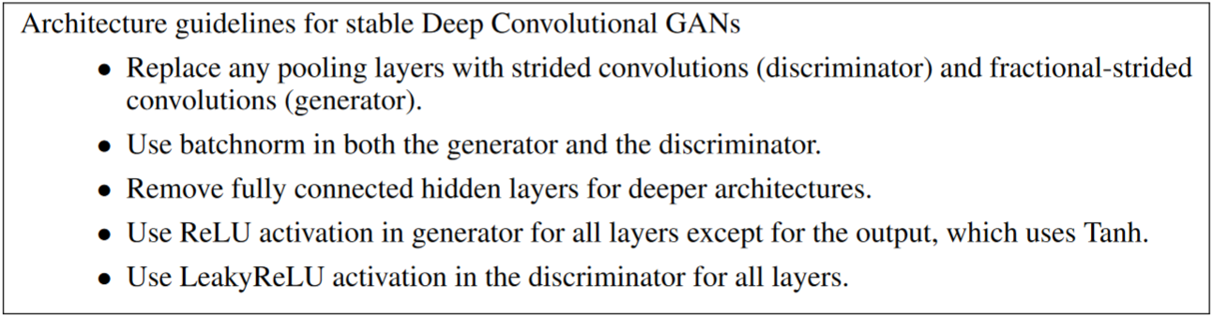
DCGAN
Use Convolutional layer!

Slide 14
ACGAN
Remove conditional input in Discriminator
Add additional Classifier on Discriminator
Classifier Networks
Y’

Slide 15
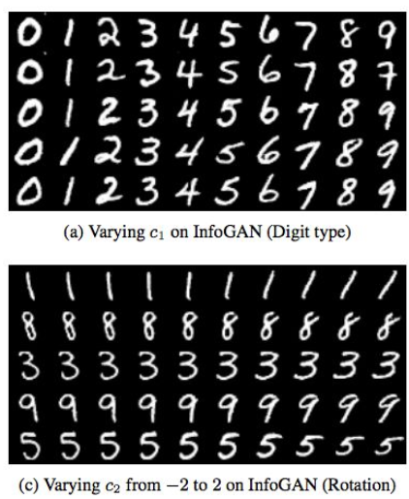
InfoGAN
In the paper, the author use information theory to prove why InfoGAN works
Preserve the input class to G, and let Discriminator classify (we don’t know what the class means…)

Slide 16
InfoGAN- training
Jointly train Classifier Networks and Generator when freeze Discriminator
Classifier Networks
Y’

Slide 17
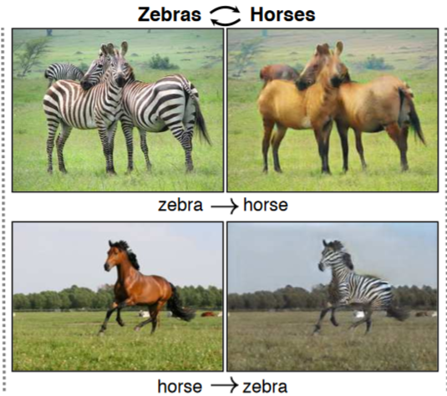
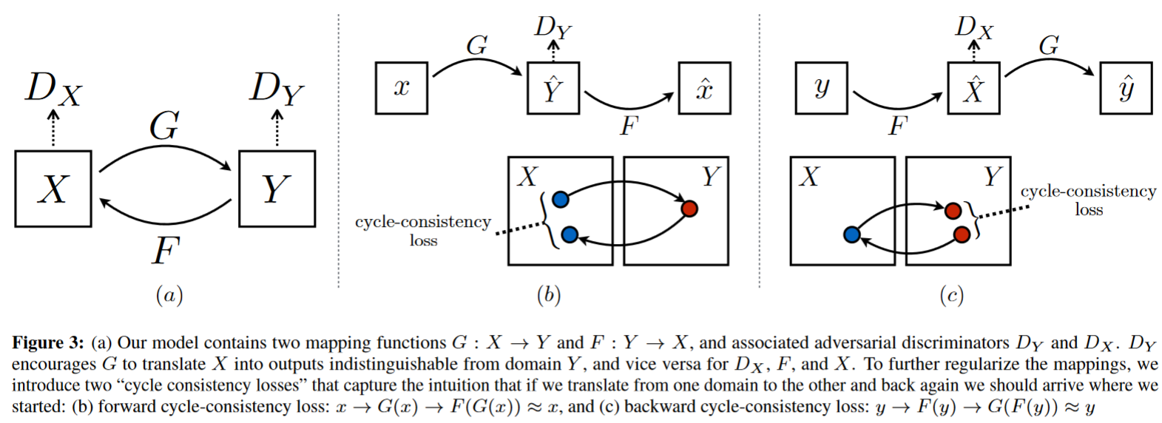
Cycle GAN

Slide 18
Application
Image Super resolution
Video Super resolution
Generate additional training data
Remove Mosaic(?)
deepFake (?)

Slide 19
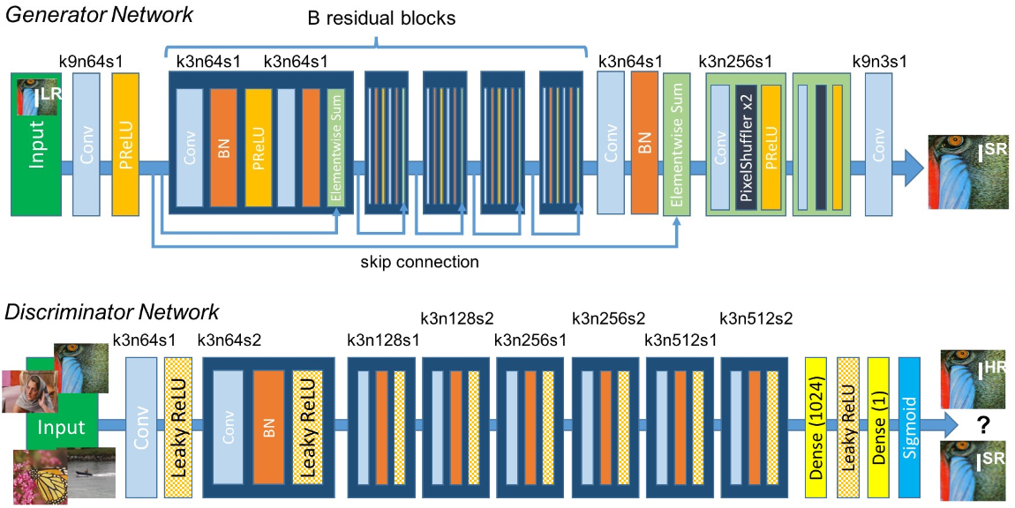
SRGAN

Slide 20
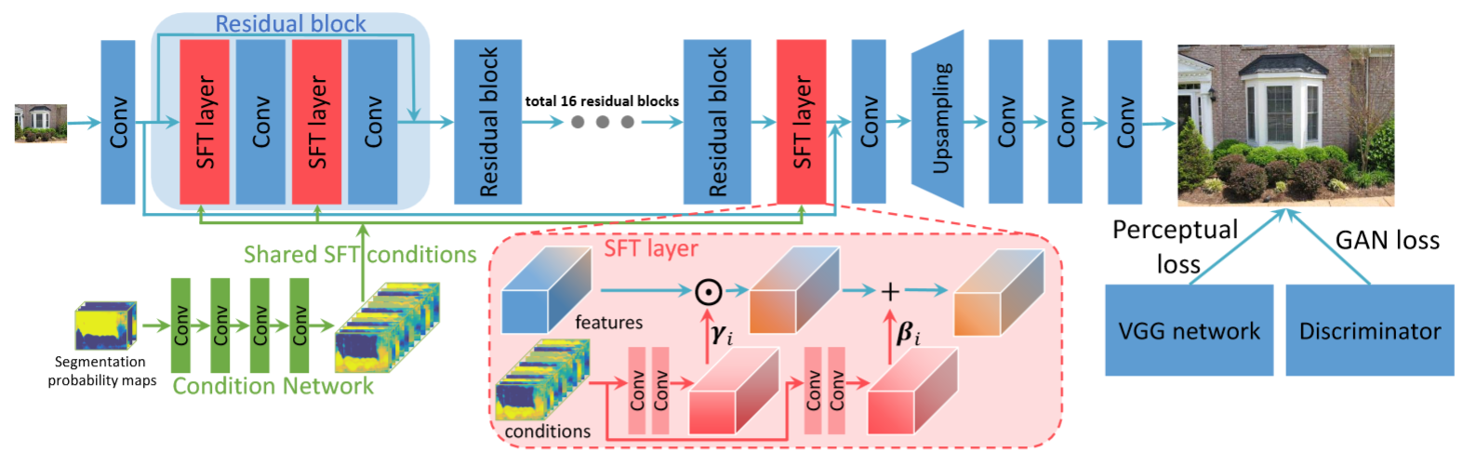
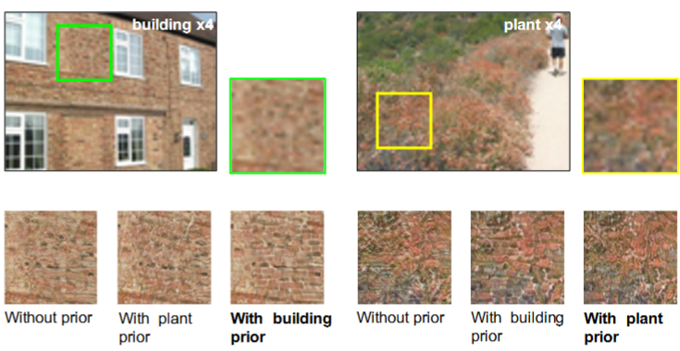
Spatial Feature Transform
CVPR 2018

Slide 21
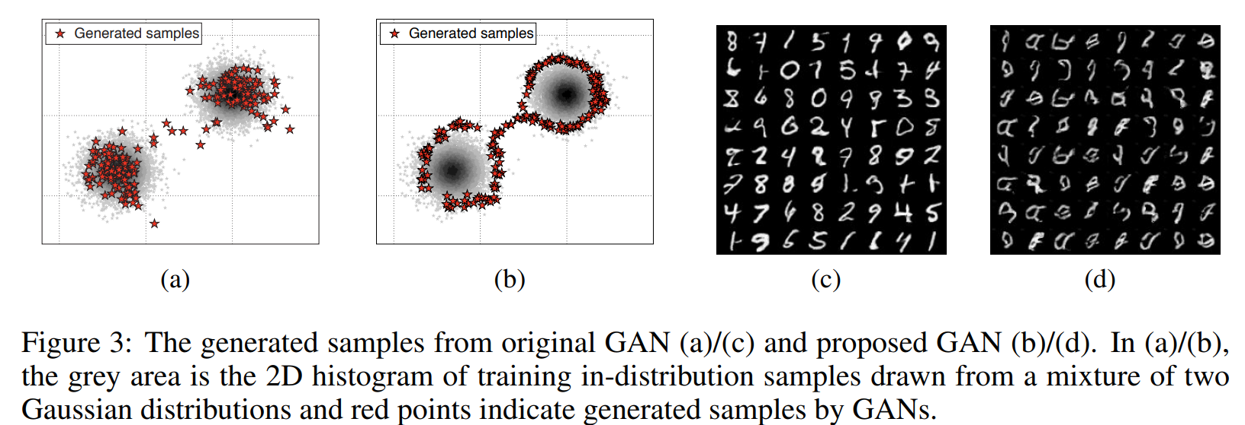
Generate Additional Training Data
Generate Data
Kimin Lee, Honglak Lee, Kibok Lee, Jinwoo Shin,”Training Confidence-calibrated Classifiers for Detecting Out-of-Distribution Samples” ICLR 2018

Slide 22
References
Goodfellow, Ian, et al. "Generative adversarial nets." Advances in neural information processing systems. 2014.
Goodfellow, Ian, et al. "Generative adversarial nets." Advances in neural information processing systems. 2014.
Radford, A., Metz, L., & Chintala, S. (2015). Unsupervised representation learning with deep convolutional generative adversarial networks. arXiv preprint arXiv:1511.06434.

Slide 23
References
Odena, A., Olah, C., & Shlens, J. (2016). Conditional image synthesis with auxiliary classifier gans. arXiv preprint arXiv:1610.09585.
Chen, Xi, et al. "Infogan: Interpretable representation learning by information maximizing generative adversarial nets." Advances in neural information processing systems. 2016.
Zhu, Jun-Yan, et al. "Unpaired image-to-image translation using cycle-consistent adversarial networks." arXiv preprint (2017).

Slide 24
References
Ledig, Christian, et al. "Photo-Realistic Single Image Super-Resolution Using a Generative Adversarial Network." CVPR. Vol. 2. No. 3. 2017.
Wang, Xintao, et al. "Recovering realistic texture in image super-resolution by deep spatial feature transform." arXiv preprint arXiv:1804.02815 (2018).
Kimin Lee, Honglak Lee, Kibok Lee, Jinwoo Shin,”Training Confidence-calibrated Classifiers for Detecting Out-of-Distribution Samples” ICLR 2018

Slide 25
Advanced Reading
Wasserstein GAN https://arxiv.org/abs/1701.07875
Improved Training of Wasserstein GANs https://arxiv.org/abs/1704.00028
Useful website: https://make.girls.moe/

Slide 26
Question and Question?
QAQ

