Slide 1
Probability and Information Theory
康仕承, 11 Oct 2018 at NTU

Slide 2
Outline
Introduction to Probability
Probability
Common Probability Distribution
Useful Properties of Common Functions
Bayes’ Rule
Technical Details of Continuous Variables
Information Theory
Structured Probabilistic Models

Slide 3
Introduction to Probability
Probability theory is a mathematical framework for representing uncertain statements.
In artificial intelligence applications:
the laws of probability tell us how AI systems should reason, so we design our algorithms to compute or approximate various expressions derived using probability theory.
we can use probability and statistics to theoretically analyze the behavior of proposed AI systems.

Slide 4
Introduction to Probability
Given that many computer scientists and software engineers work in a relatively clean and certain environment, it can be surprising that machine learning makes heavy use of probability theory.

Slide 5
Introduction to Probability
Probability theory allows us to make uncertain statements and to reason in the presence of uncertainty.
Inherent stochasticity
Incomplete observability
Incomplete modeling

Slide 6
Introduction to Probability
Simple, uncertain rule v.s complex, certain rule
Most birds fly
Birds ﬂy, except for very young birds that have not yet learned to ﬂy, sick or injured birds that have lost the ability to ﬂy, ﬂightless species of birds including the cassowary, ostrich and kiwi. .

Slide 7
Introduction to Probability
Probability meaning:
Repeatable events (frequentist probability):
Poker game, dice game, …
Degree of belief (Bayesian probability)
Doctor analyzes a patient

Slide 8
Introduction to Probability
If we list several properties that we expect common sense reasoning about uncertainty to have, the only way to satisfy those properties is to treat Bayesian probabilities as behaving exactly the same as frequentist probabilities.
if we compute the probability that a player will win a poker game given that he has a certain set of cards, we use exactly the same formulas as when we compute the probability that a patient has a disease given that he has certain symptoms.

Slide 9
Introduction to Probability
Probability can be seen as the extension of logic to deal with uncertainty.
Probability theory provides a set of formal rules for determining the likelihood of a proposition being true given the likelihood of other propositions

Slide 10
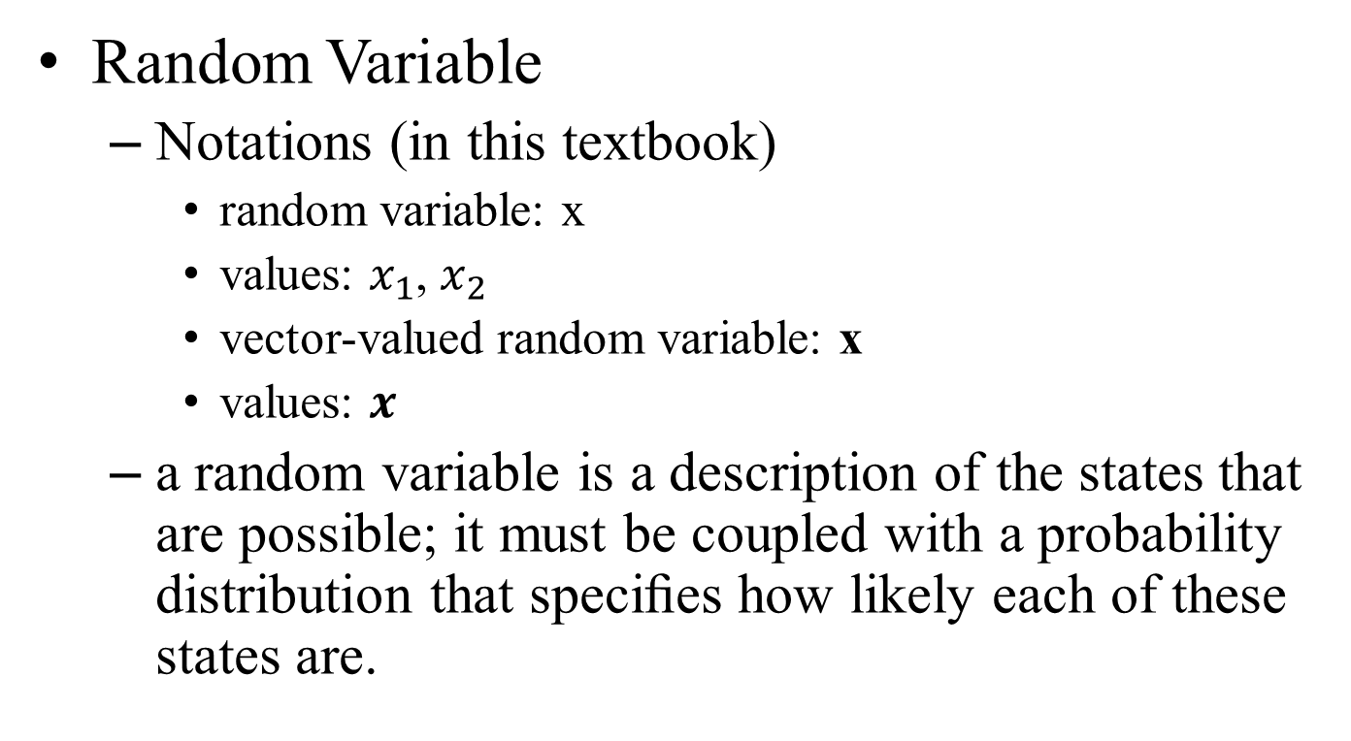
Probability
Random Variable
Notations (in this textbook)
random variable: x
values: $x_{1}$, $x_{2}$
vector-valued random variable: x
values: $x$
a random variable is a description of the states that are possible; it must be coupled with a probability distribution that speciﬁes how likely each of these states are.

Slide 11
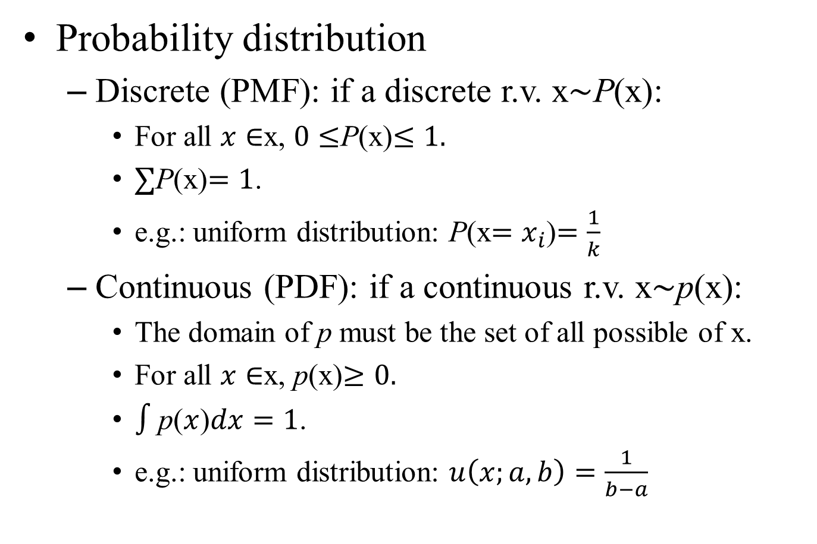
Probability
Probability distribution
Discrete (PMF): if a discrete r.v. x$\sim$P(x):
For all $x∈$x, $0≤$P(x)$≤1.$
$∑$P(x)$=1$.
e.g.: uniform distribution: P(x$=x_{i}$)$=\frac{1}{k}$
Continuous (PDF): if a continuous r.v. x$\sim$p(x):
The domain of p must be the set of all possible of x.
For all $x∈$x, p(x)$≥0.$
$∫$p($x$)$dx=1$.
e.g.: uniform distribution: $u\left(x;a,b\right)=\frac{1}{b−a}$

Slide 12
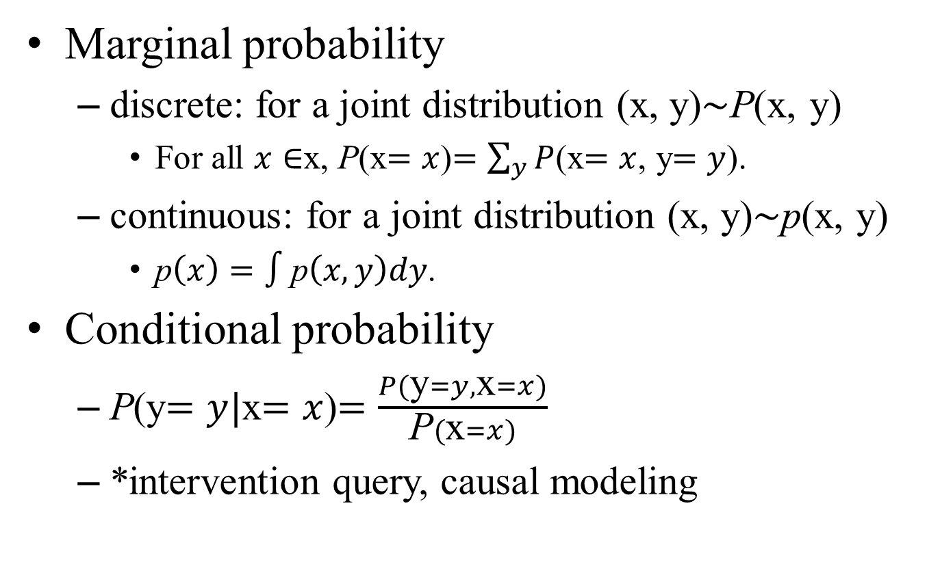
Probability
Marginal probability
discrete: for a joint distribution (x, y)$\sim$P(x, y)
For all $x∈$x, P(x$=x$)$=\sum_{y}{P}$(x$=x$, y$=y$).
continuous: for a joint distribution (x, y)$\sim$p(x, y)
p$\left(x\right)=∫$p$\left(x,y\right)dy$.
Conditional probability
P(y$=y|$x$=x$)$=\frac{P(\text{y}=y,\text{x}=x)}{\text{P}(\text{x}=x)}$
*intervention query, causal modeling

Slide 13
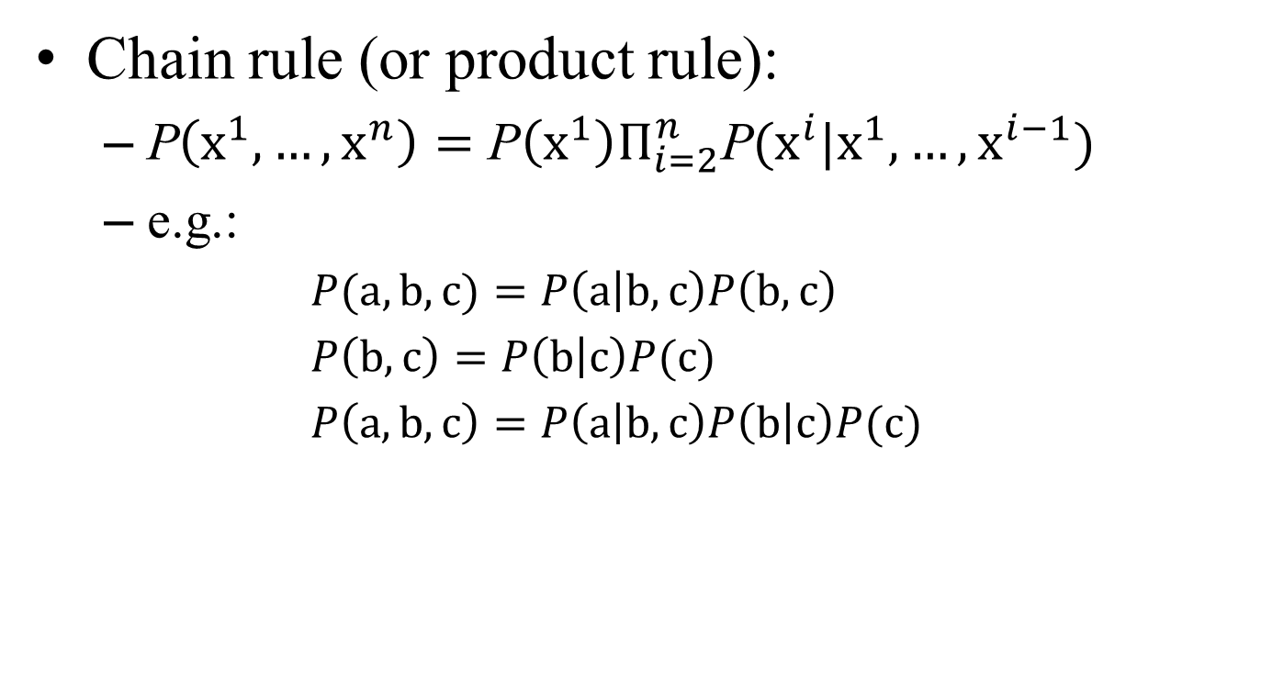
Probability
Chain rule (or product rule):
P$\left({\text{x}}^{1}, …, {\text{x}}^{n}\right)=$ $\text{P}\left({\text{x}}^{1}\right)Π_{i=2}^{n}$P$({\text{x}}^{i}|{\text{x}}^{1},…,{\text{x}}^{i−1})$
e.g.:
$P(\text{a},\text{b},\text{c})=P\left(\text{a} | \text{b},\text{c}\right)P\left(\text{b},\text{c}\right)$
$P\left(\text{b},\text{c}\right)=P\left(\text{b} | \text{c}\right)P(\text{c})$
$P\left(\text{a},\text{b},\text{c}\right)=P\left(\text{a} | \text{b},\text{c}\right)P\left(\text{b} | \text{c}\right)P(\text{c})$

Slide 14
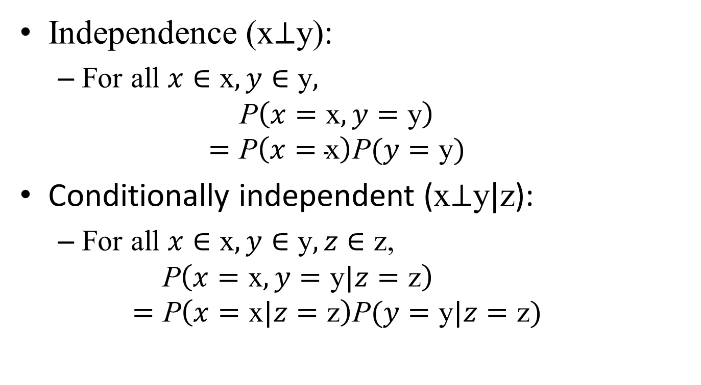
Probability
Independence (x$⊥$y):
For all $x∈\text{x}, y∈\text{y},$
$$\text{P}\left(x=\text{x},y=\text{y}\right)$$
$$=\text{P}\left(x=\text{x}\right)\text{P}(y=\text{y})$$
Conditionally independent (x$⊥$y$|$z):
For all $x∈\text{x}, y∈\text{y}, z∈\text{z}$,
$$\text{P}\left(x=\text{x},y=\text{y}|z=\text{z}\right) \\ =\text{P}\left(x=\text{x}|z=\text{z}\right)\text{P}(y=\text{y}|z=\text{z})$$

Slide 15
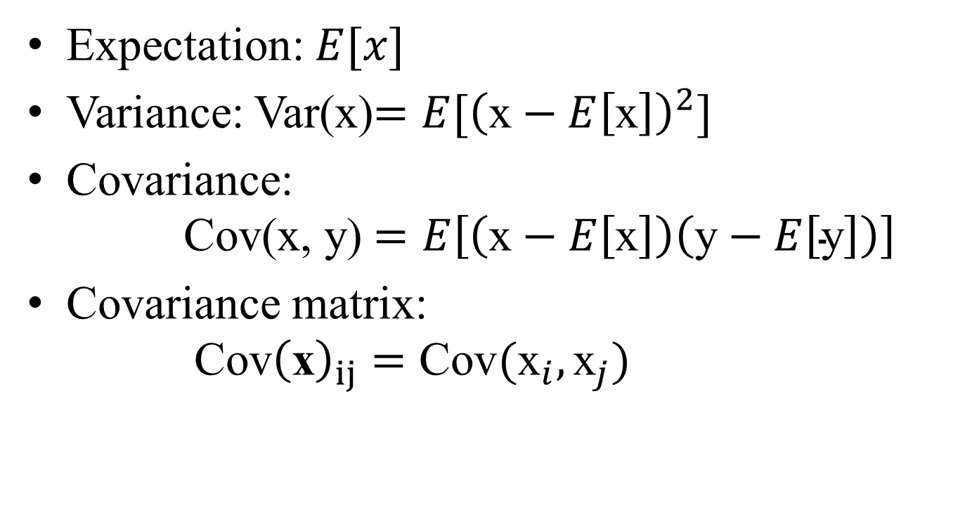
Probability
Expectation: $E[x]$
Variance: Var(x)$=E[{\left(\text{x}−E\left[\text{x}\right]\right)}^{2}]$
Covariance: Cov(x, y) $=E\left[\left(\text{x}−E\left[\text{x}\right]\right)\left(\text{y}−E\left[\text{y}\right]\right)\right]$
Covariance matrix: $\text{Cov}{\left(\text{x}\right)}_{ij}=\text{Cov}({\text{x}}_{i}, {\text{x}}_{j})$

Slide 16
Common Probability Distribution
Bernoulli Distribution
Multinoulli Distribution
Gaussian Distribution (Normal distribution)
Central Limit Theorem
Multivariate Normal Distribution
Exponential and Laplace Distribution
Dirac Distribution and Empirical Distribution
Mixtures of Distribution

Slide 17
Useful Properties of Common Functions
Logistic sigmoid
Softplus function

Slide 18
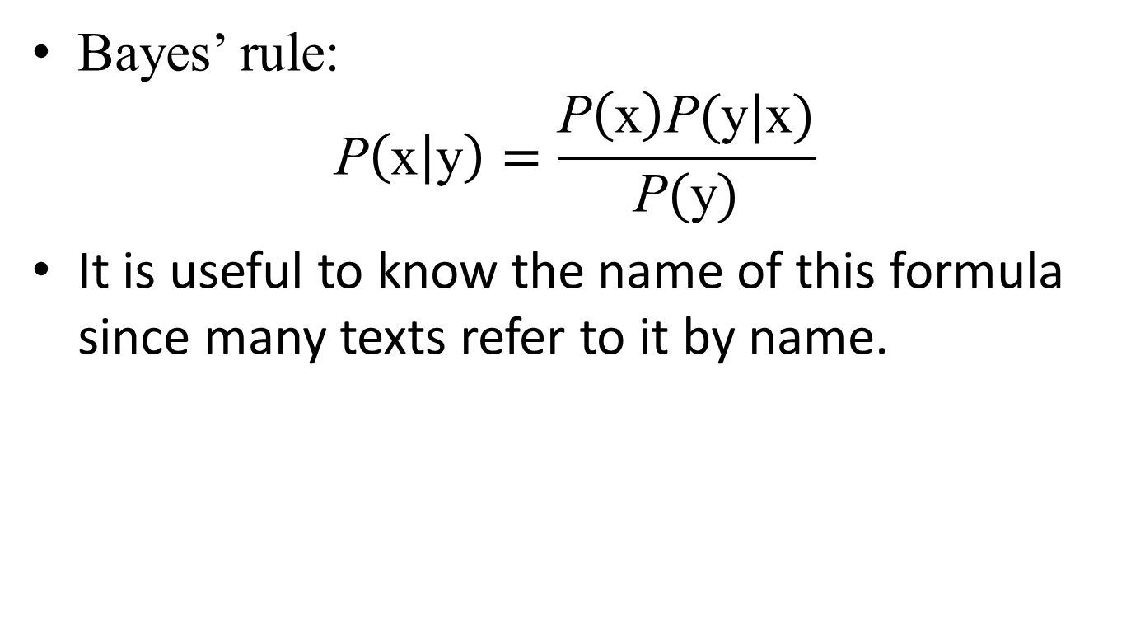
Bayes’ Rule
Bayes’ rule: $\text{P}\left(\text{x} | \text{y}\right)=\frac{\text{P}\left(\text{x}\right)\text{P}(\text{y}|\text{x})}{\text{P}(\text{y})}$
It is useful to know the name of this formula since many texts refer to it by name.

Slide 19
Technical Details of Continuous Variables
Measure Theory
provide a characterization of the set of sets we can compute the probability of without encountering paradoxes. (measurable set)
provides a rigorous way of describing that a set of points is negligibly small. (measure zero)
“almost everywhere”: some important results in probability theory hold for all discrete values but hold almost everywhere only for continuous values.

Slide 20
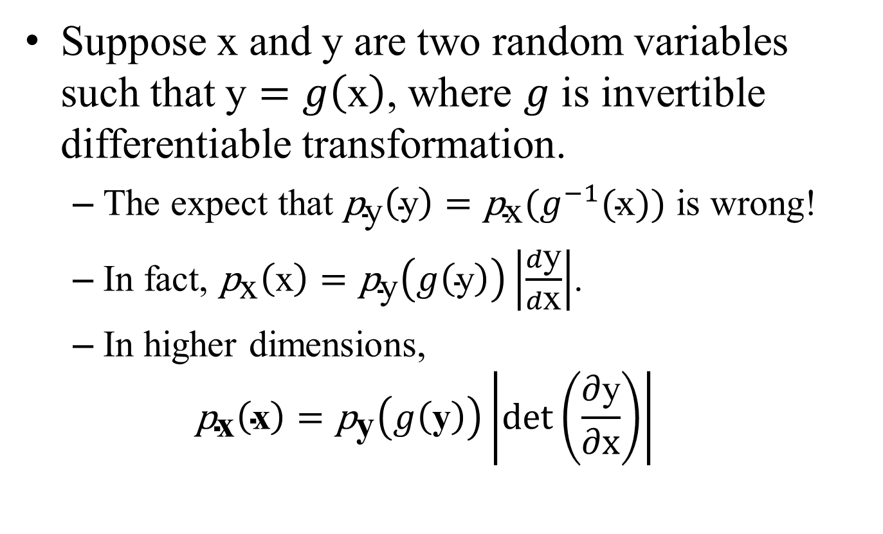
Technical Details of Continuous Variables
Suppose x and y are two random variables such that $\text{y}=g\left(\text{x}\right)$, where $g$ is invertible differentiable transformation.
The expect that ${\text{p}}_{\text{y}}\left(\text{y}\right)={\text{p}}_{\text{x}}(g^{−1}(\text{x}))$ is wrong!
In fact, ${\text{p}}_{\text{x}}\left(\text{x}\right)={\text{p}}_{\text{y}}\left(g\left(\text{y}\right)\right)\left|\frac{d\text{y}}{d\text{x}}\right|$.
In higher dimensions, ${\text{p}}_{\text{x}}\left(\text{x}\right)={\text{p}}_{\text{y}}\left(g\left(\text{y}\right)\right)\left|\text{det}\left(\frac{\text{∂}\text{y}}{\text{∂}\text{x}}\right)\right|$

Slide 21
Information Theory
Information theory revolves around quantifying how much information is present in a signal.
An unlikely event has occurred is more informative than learning that a likely event has occurred.
“the sun rose this morning” is uninformative
“there was a solar eclipse this morning” is very informative.

Slide 22
Information Theory
Axioms(discrete case):
Likely events have low information content.
Less likely events should have higher information content.
Independent events should have additive information.

Slide 23
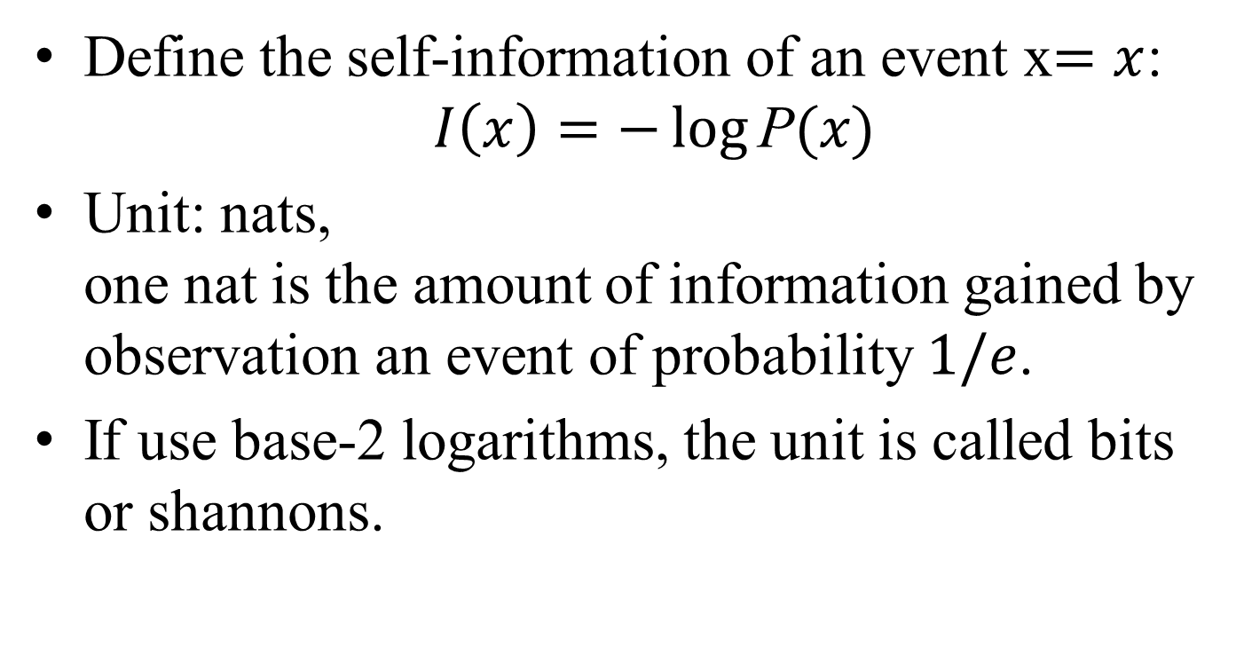
Information Theory
Define the self-information of an event x$=x$: $I\left(x\right)=−\log{\text{P}(x)}$
Unit: nats, one nat is the amount of information gained by observation an event of probability $1/e$.
If use base-2 logarithms, the unit is called bits or shannons.

Slide 24
Information Theory
When x is continuous, we use the same deﬁnition of information, but some of the properties from the discrete case are lost.
For example, an event with unit density still has zero information, despite not being an event that is guaranteed to occur.

Slide 25
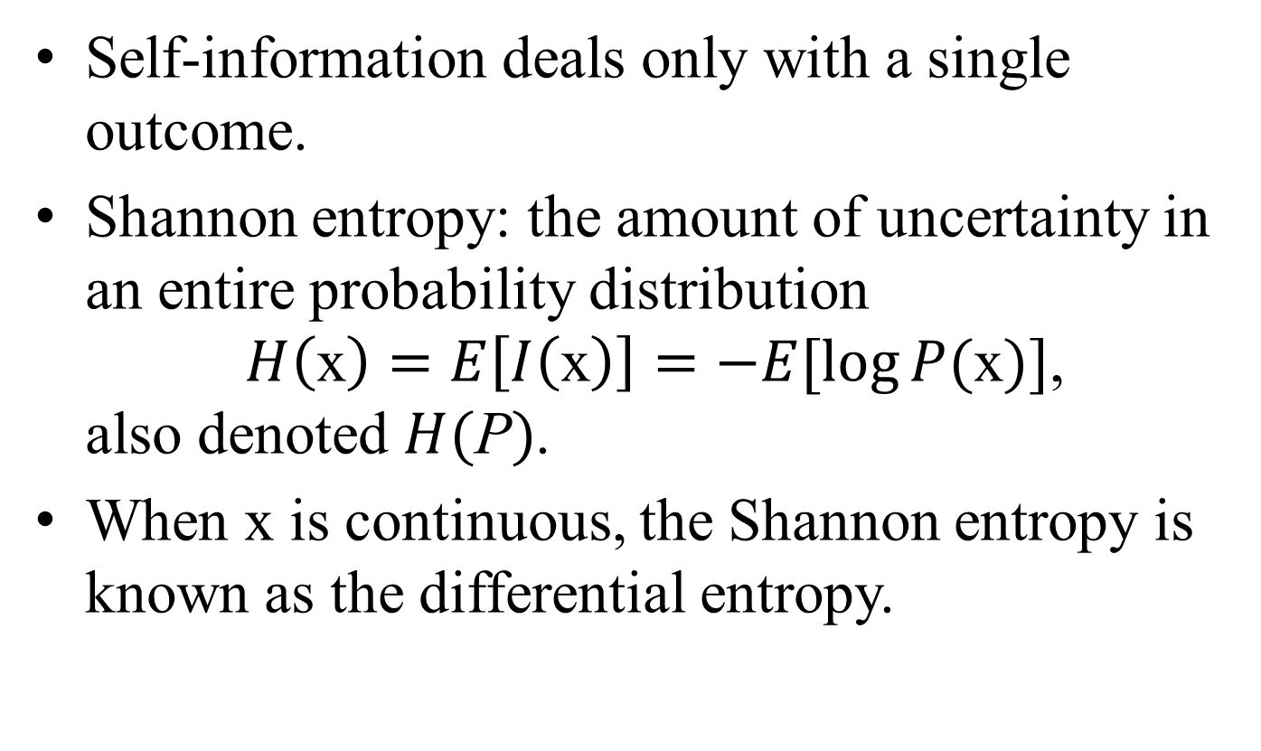
Information Theory
Self-information deals only with a single outcome.
Shannon entropy: the amount of uncertainty in an entire probability distribution $H\left(\text{x}\right)=E\left[I\left(\text{x}\right)\right]=−E[\log{P(\text{x})}]$, also denoted $H(\text{P})$.
When x is continuous, the Shannon entropy is known as the differential entropy.

Slide 26
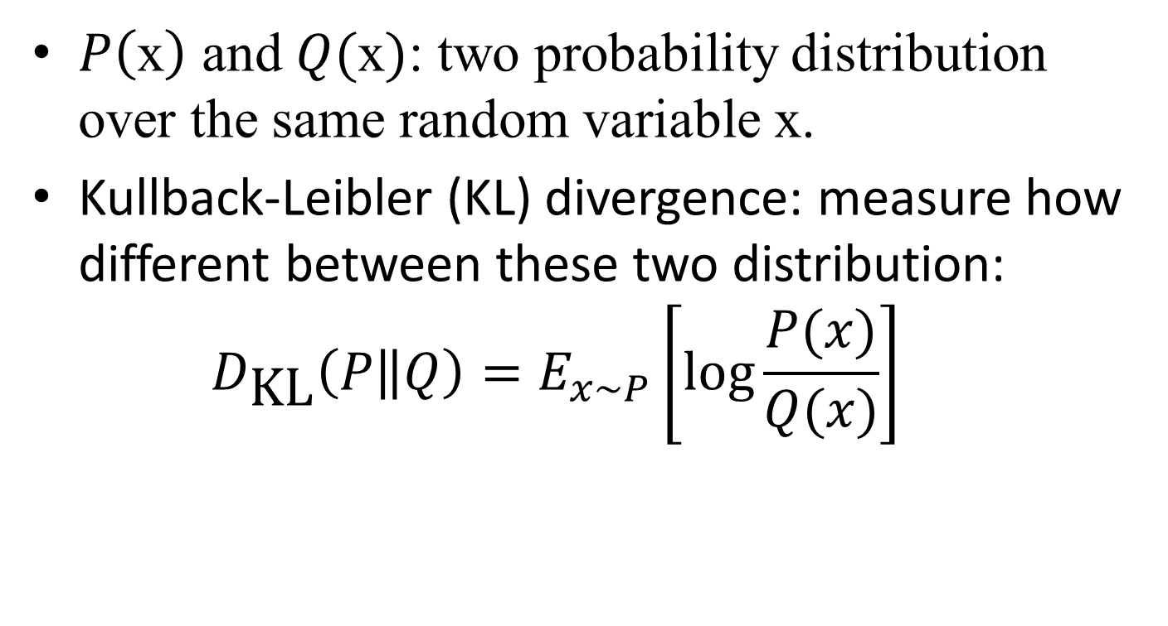
Information Theory
$P\left(\text{x}\right)$ and $Q(\text{x})$: two probability distribution over the same random variable x.
Kullback-Leibler (KL) divergence: measure how different between these two distribution: $D_{\text{KL}}\left(P\left\|Q\right.\right)=E_{x\sim P}\left[\log{\frac{P(x)}{Q(x)}}\right]$

Slide 27
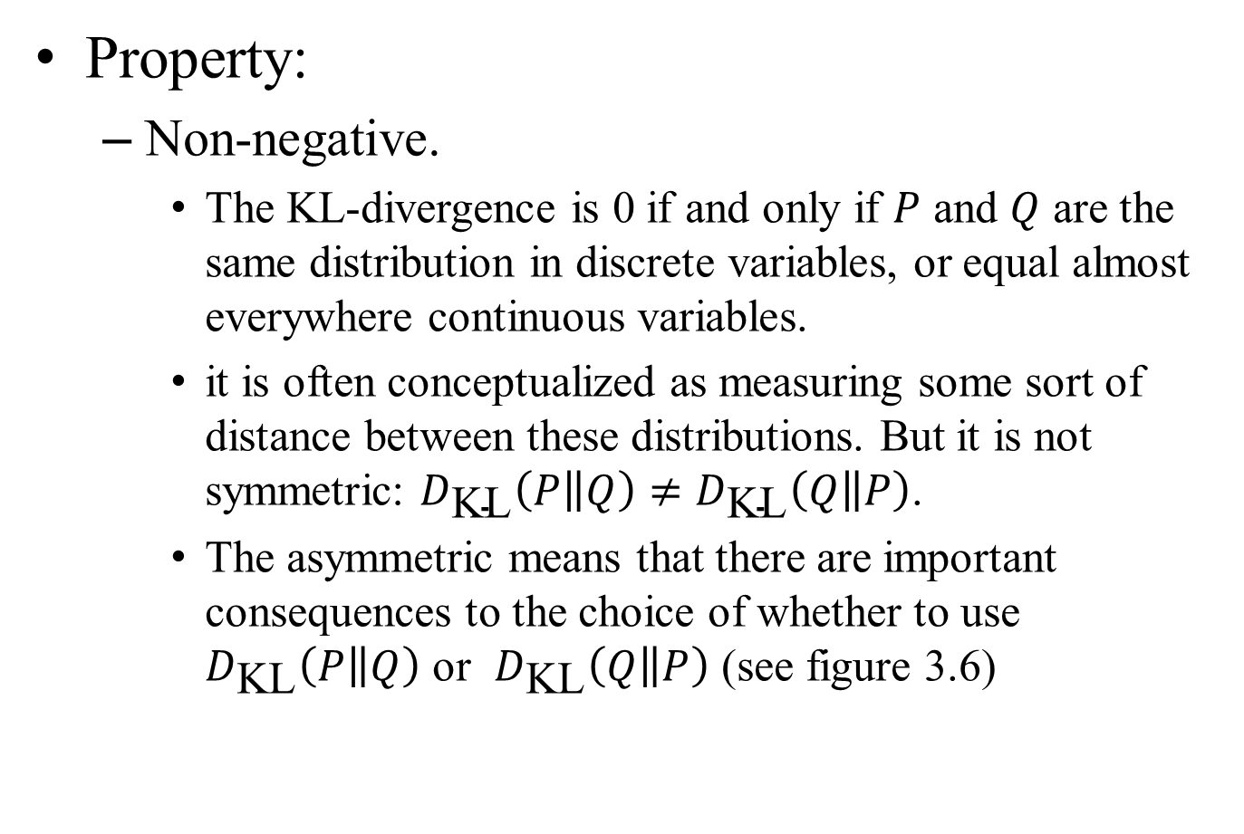
Information Theory
Property:
Non-negative.
The KL-divergence is 0 if and only if $P$ and $Q$ are the same distribution in discrete variables, or equal almost everywhere continuous variables.
it is often conceptualized as measuring some sort of distance between these distributions. But it is not symmetric: $D_{\text{KL}}\left(P\left\|Q\right.\right)≠D_{\text{KL}}\left(Q\left\|P\right.\right)$.
The asymmetric means that there are important consequences to the choice of whether to use $D_{\text{KL}}\left(P\left\|Q\right.\right)$ or $D_{\text{KL}}\left(Q\left\|P\right.\right)$ (see figure 3.6)

Slide 28
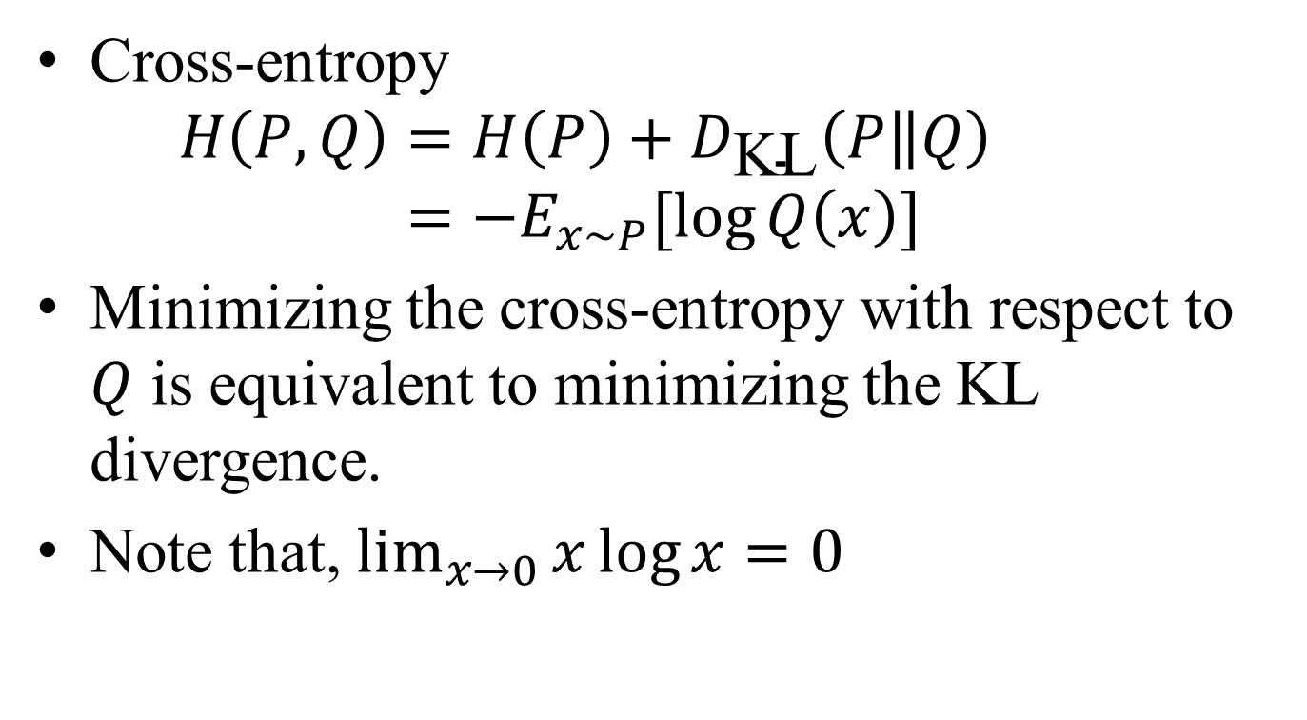
Information Theory
Cross-entropy $H\left(P,Q\right)=H\left(P\right)+D_{\text{KL}}\left(P\left\|Q\right.\right)$ $=−E_{x\sim P}[\log{Q\left(x\right)}]$
Minimizing the cross-entropy with respect to $Q$ is equivalent to minimizing the KL divergence.
Note that, $\lim_{x→0}{x\log{x}}=0$

Slide 29
Structured Probabilistic Models
Machine learning algorithms often involve probability distributions over a very large number of random variables.
Often, these probability distributions involve direct interactions between relatively few variables.
Using a single function to describe the entire joint probability distribution can be very ineﬃcient (both computationally and statistically)

Slide 30
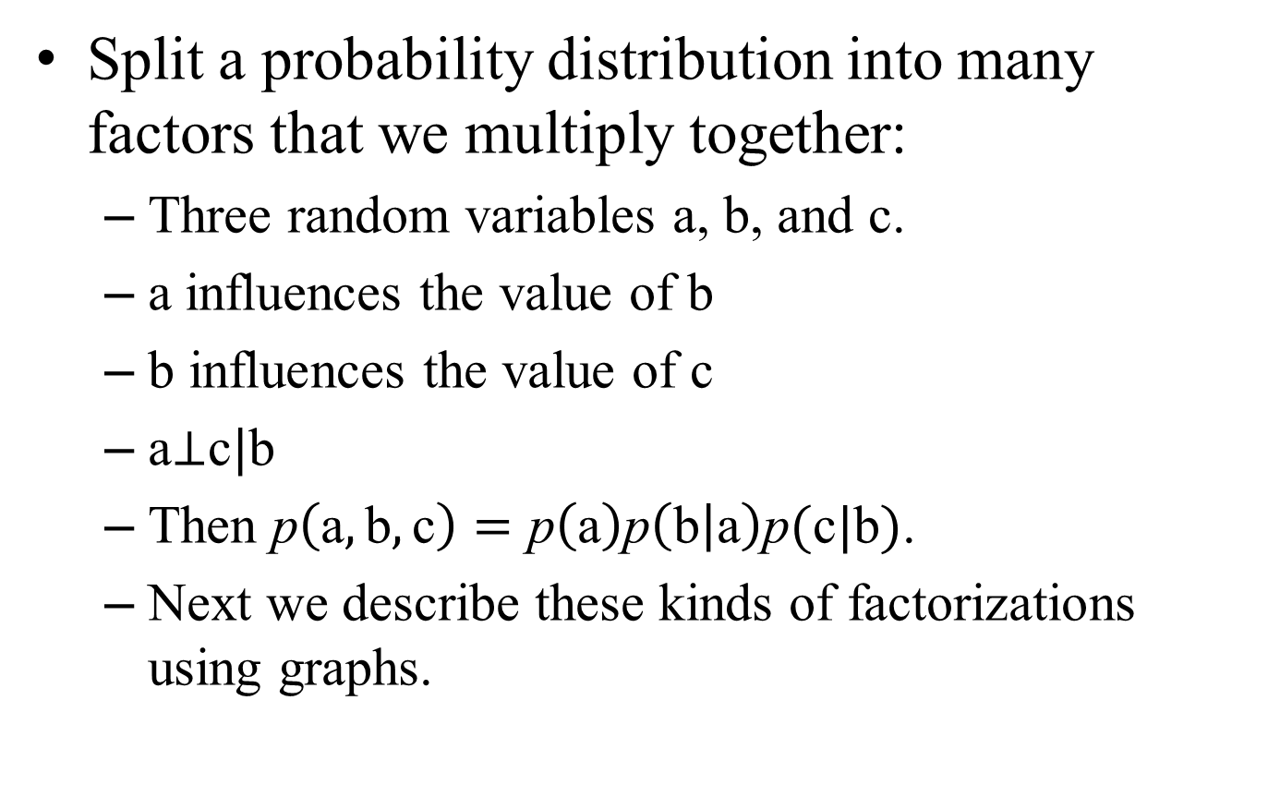
Structured Probabilistic Models
Split a probability distribution into many factors that we multiply together:
Three random variables a, b, and c.
a influences the value of b
b influences the value of c
a$⊥$c$|$b
Then $\text{p}\left(\text{a},\text{b},\text{c}\right)=\text{p}\left(\text{a}\right)\text{p}\left(\text{b} | \text{a}\right)\text{p}(\text{c}|\text{b})$.
Next we describe these kinds of factorizations using graphs.

Slide 31
Structured Probabilistic Models
A graph is a set of vertices that may be connected to each other with edges.
we represent the factorization of a probability distribution with a graph, we call it a structured probabilistic model, or graphical model.
Two main kinds: directed and undirected.

Slide 32

Structured Probabilistic Models
A graph $\text{G}$,
node (vertex): random variable
edge: the probability distribution is able to represent direct interactions.

Slide 33
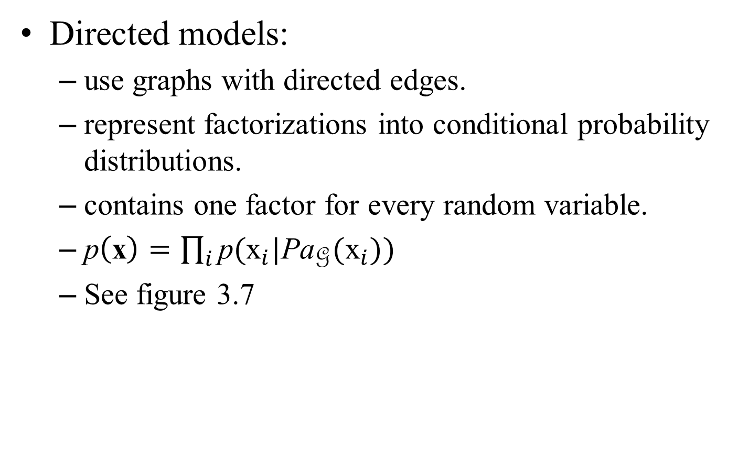
Structured Probabilistic Models
Directed models:
use graphs with directed edges.
represent factorizations into conditional probability distributions.
contains one factor for every random variable.
$\text{p}\left(\text{x}\right)=\prod_{i}{\text{p}({\text{x}}_{i}|\text{P}{\text{a}}_{\text{G}}({\text{x}}_{i}))}$
See figure 3.7

Slide 34
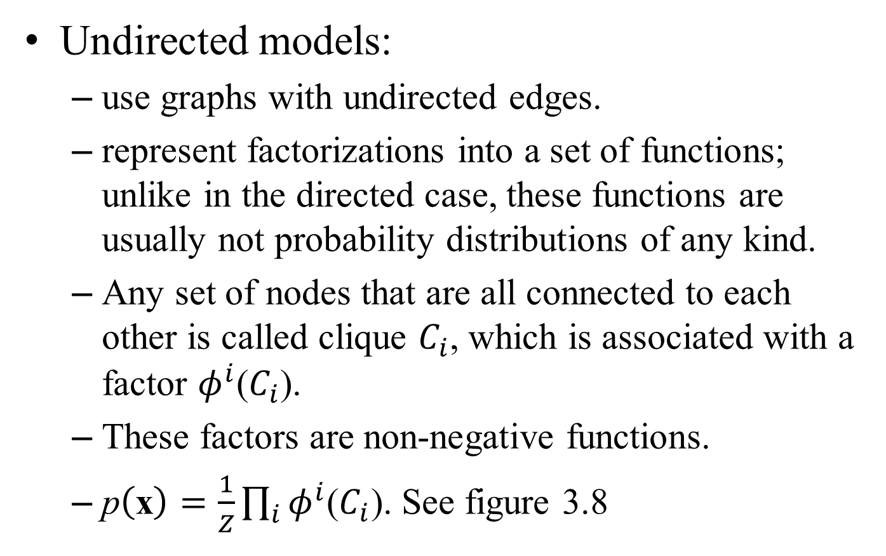
Structured Probabilistic Models
Undirected models:
use graphs with undirected edges.
represent factorizations into a set of functions; unlike in the directed case, these functions are usually not probability distributions of any kind.
Any set of nodes that are all connected to each other is called clique $C_{i}$, which is associated with a factor $φ^{i}$($C_{i}$).
These factors are non-negative functions.
$\text{p}\left(\text{x}\right)=\frac{1}{Z}\prod_{i}{φ^{i}\text{(}C_{i}\text{)}}$. See figure 3.8

Slide 35
Structured Probabilistic Models
Keep in mind:
these graphical representations of factorizations are a language for describing probability distributions. They are not mutually exclusive families of probability distributions.
Being directed or undirected is not a property of a probability distribution; it is a property of a particular description of a probability distribution, but any probability distribution may be described in both ways.

Slide 36
Thanks for your attention!

