Slide 1
FLASK PYTHON PROJECT
MOVIES WEBSITE

Slide 2
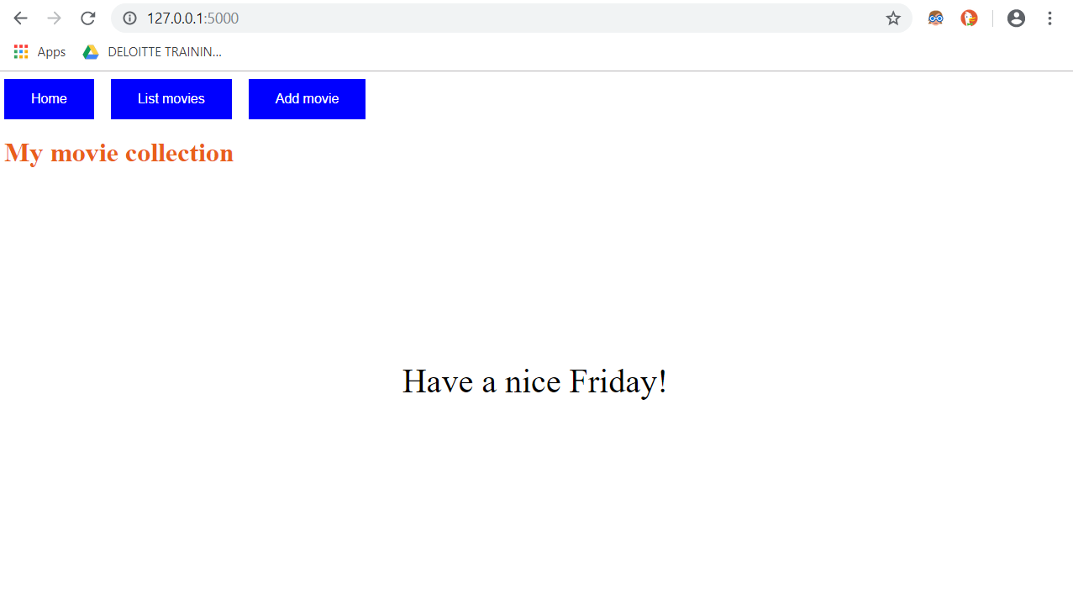
Home Page :

Slide 3
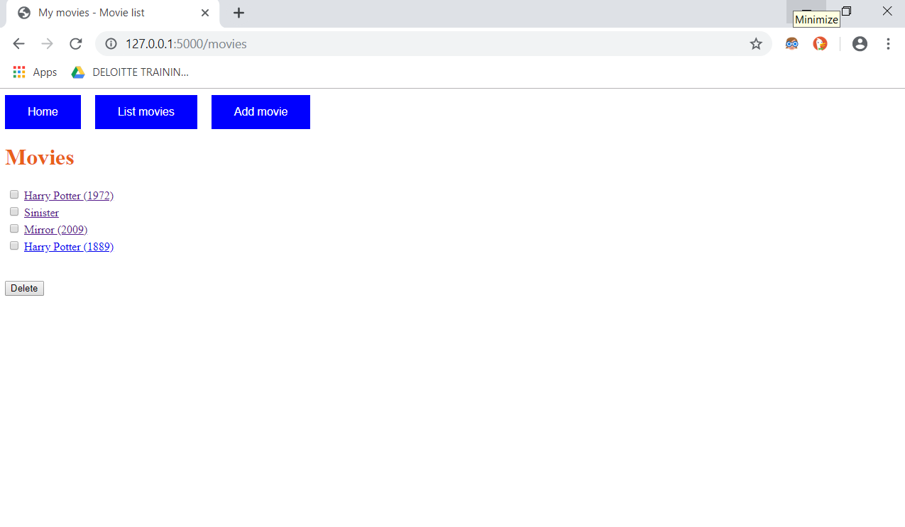
List Movies Page :

Slide 4
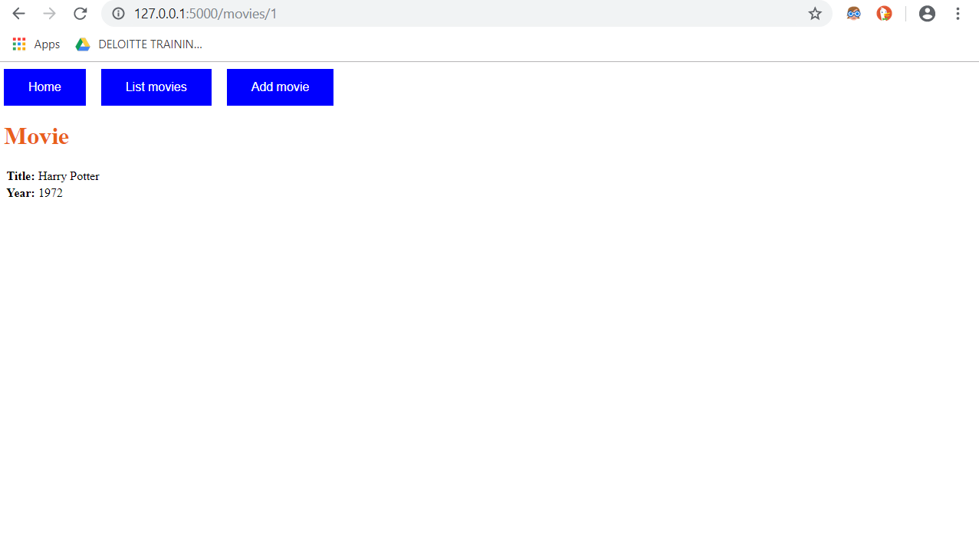
Details of Movie when clicked on the name with link description as the order number as 1,2…, :

Slide 5

Details of Movie when clicked on the name :

Slide 6
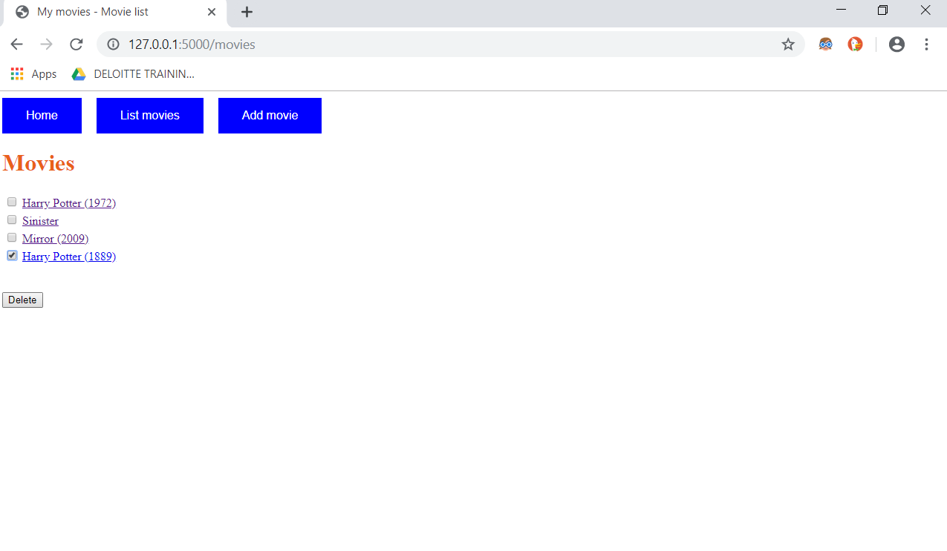
Delete Movie :

Slide 7
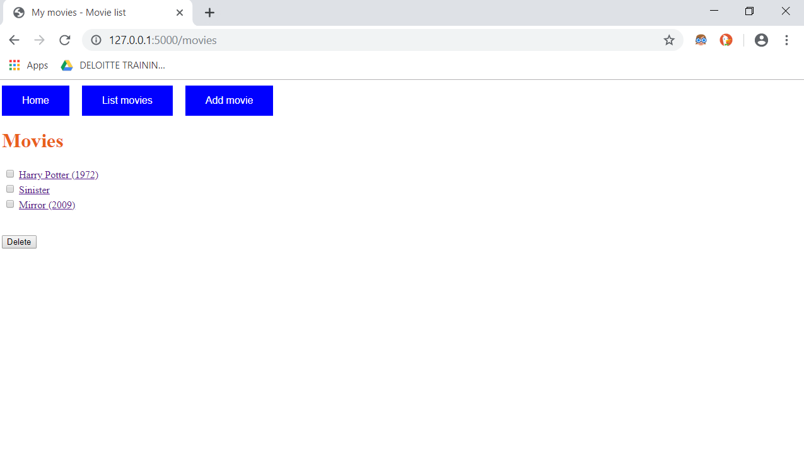
Movie Deleted :

Slide 8
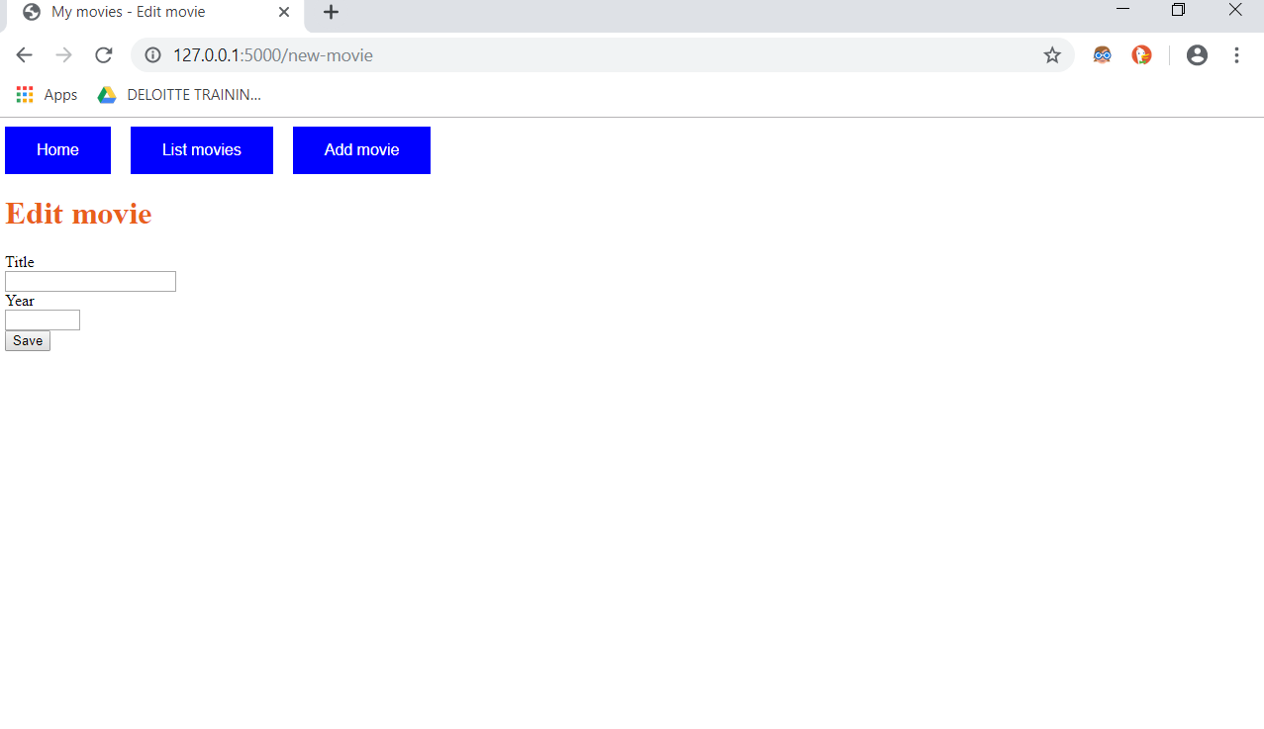
Add a new movie :

Slide 9
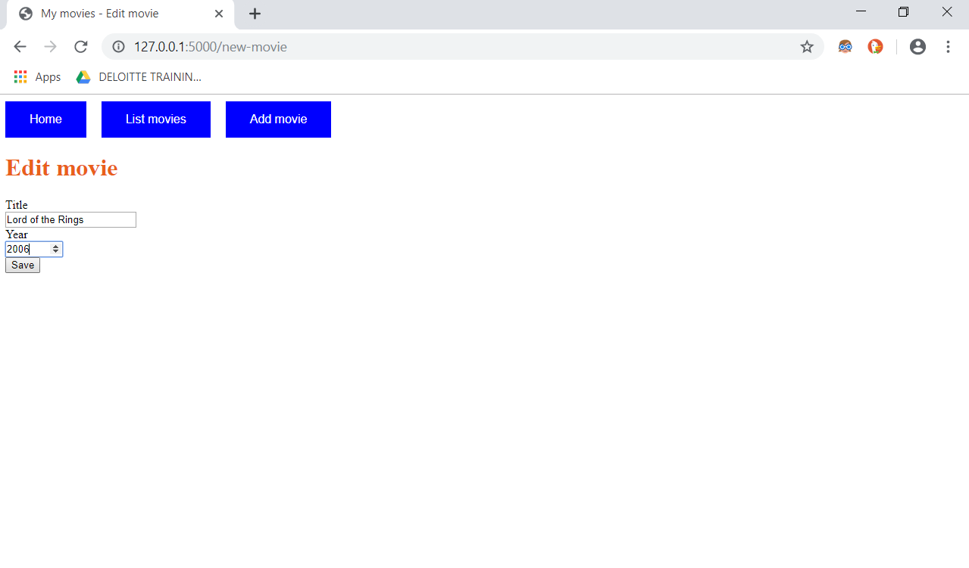
Adding movie with proper validation of Title and year > some specified year :

Slide 10
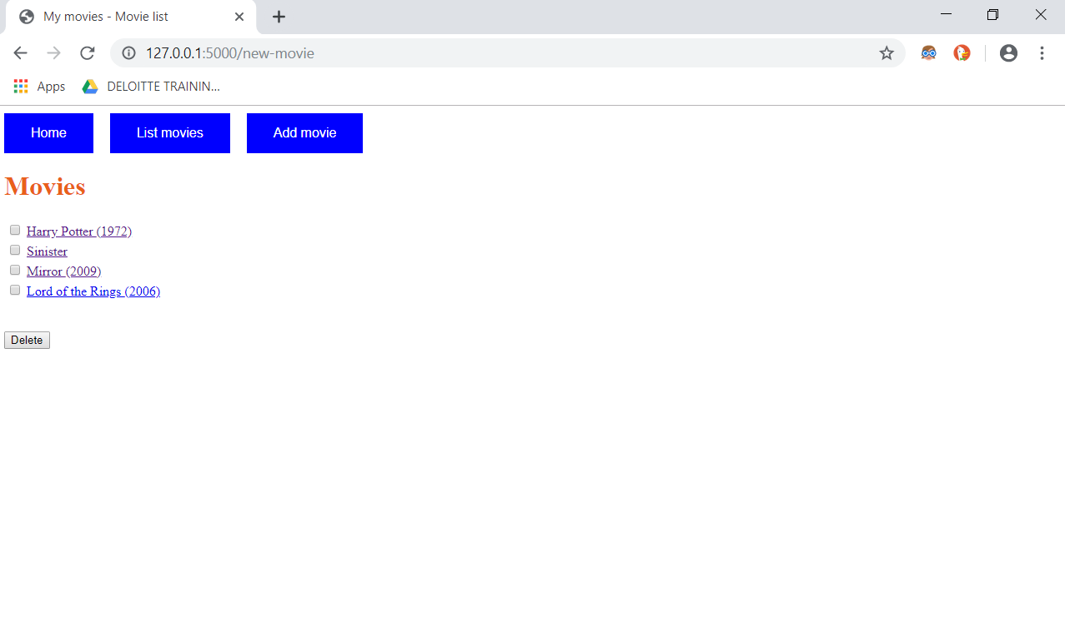
Movie Added to the list :

Slide 11
THANK YOU!

