Slide 1
ZS Data-a-thon 2018
MEDIPLEXIS Case Study

Slide 2
Agenda
A pharma company has provided the affinity data through historical channel interactions with doctors every, channel has given the affinity rating for different doctors, but few are Null values we have to find those values using Machine Learning Techniques.

Slide 3
Features In Data
HCP_ID – Unique Id of Doctor
Speciality ID – Doctor’s Speciality
Region – Doctor Office Location
Value – Value OF HCP
Rep_Live - RL
Peer2Peer – P2P
Online Video - OLV
Rep_Remote - RR
Direct Mail - DRT
Direct Message - DMS
Online Advertisement - OLA
Direct Email - DEM

Slide 4
Work Flow
Data Preprocessing
Insights From Data
Machine Learning Modeling
Cross Validation
Final Output

Slide 5
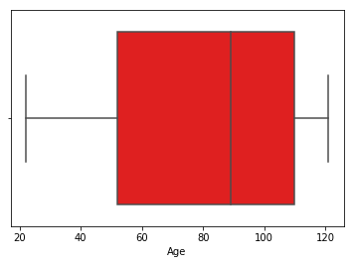
Quality Checks Performed /Errors Found
On analyzing the data, the only point where errors can be present are in the ‘Age’ variable.
There may be outlier present in this variable.

Slide 6
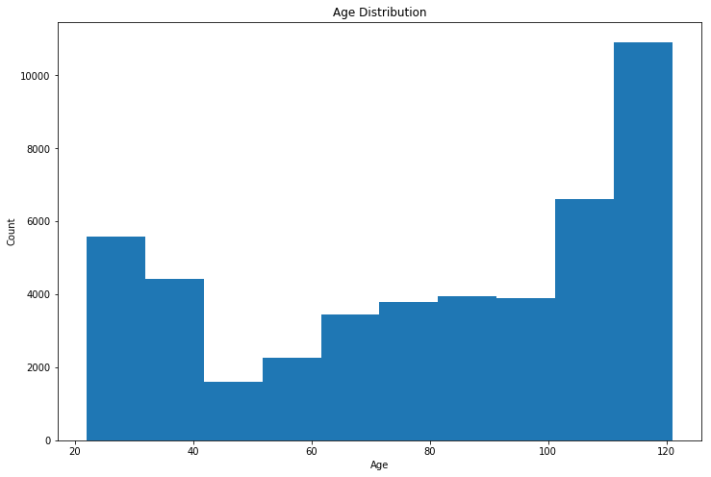
Age Minimum – 22
Age Maximum – 121

Slide 7
Data pre processing Steps
To pre process the data I merged the file demographics with train file. By doing this I got the new information ‘Age’ and ‘Gender’ for each ‘HCP_ID’.
Now few of the Null Values present in gender variable is filled by it’s mode that is ‘Male’.

Slide 8
Continuous features - HCP_Id, RL, P2P, OLV , RR , DRT , DMS, OLA ,DEM
Categorical features – Region , Value and Speciality_Id
Demographic Data have few HCP_Id’s which are of no use.
I used Label Encoding for Categorical Data.

Slide 9
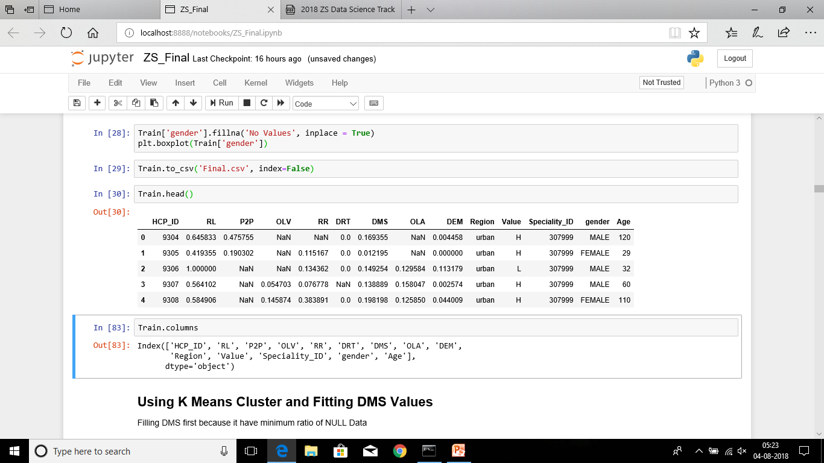
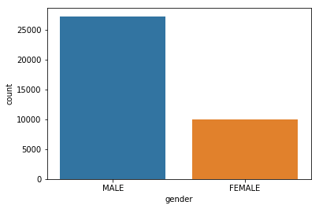
Final Data Set
Gender Distribution

Slide 10
Key Observation & Trends

Slide 11
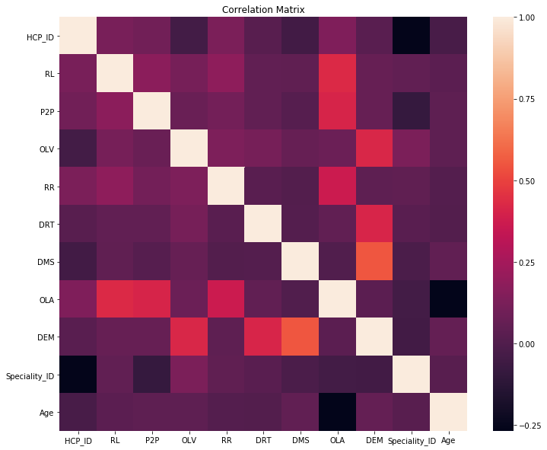
Correlation

Slide 12
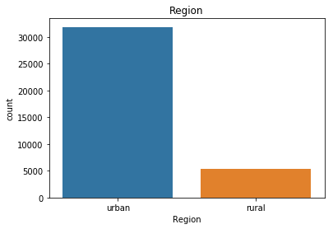
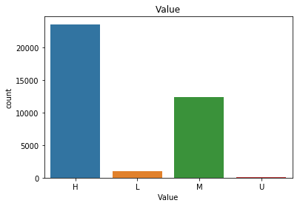
Distribution Of ‘Region’ Channel
Distribution Of ‘Value’

Slide 13
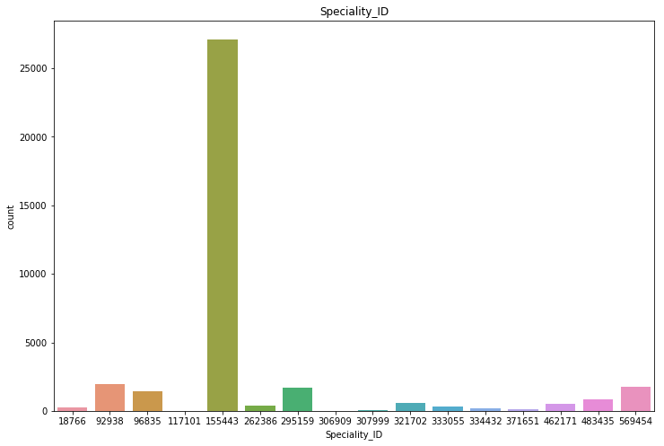
Distribution Of Speciality Id

Slide 14
Model Explanation
Used K- Means Clustering
Started with features having no Null Values and then clustered those features having lowest ratio of Null Values then merged these values in clustering to predict next Null value.

Slide 15
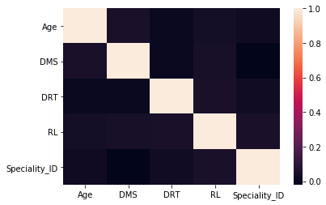
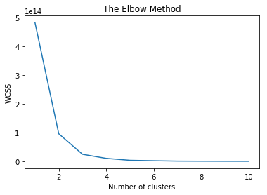
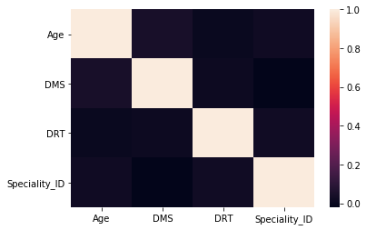
Correlation Matrix and Elbow Method

Slide 16
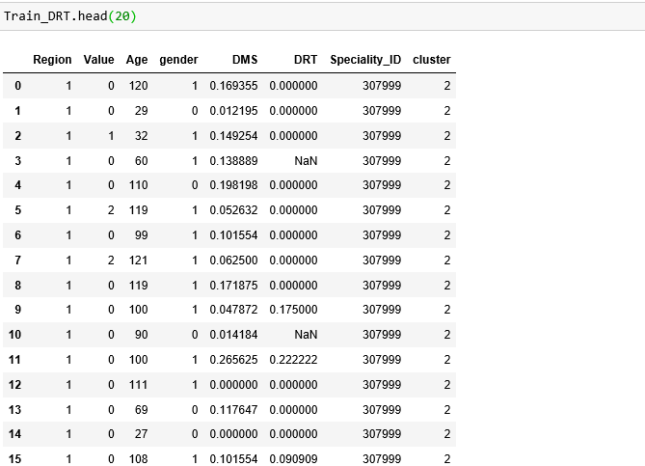
Clusters Assigned

Slide 17
Other Approaches
I started with KNN imputation but due to Memory error I was not able to continue with that. So I tried K-Means Clustering Approach.

Slide 18
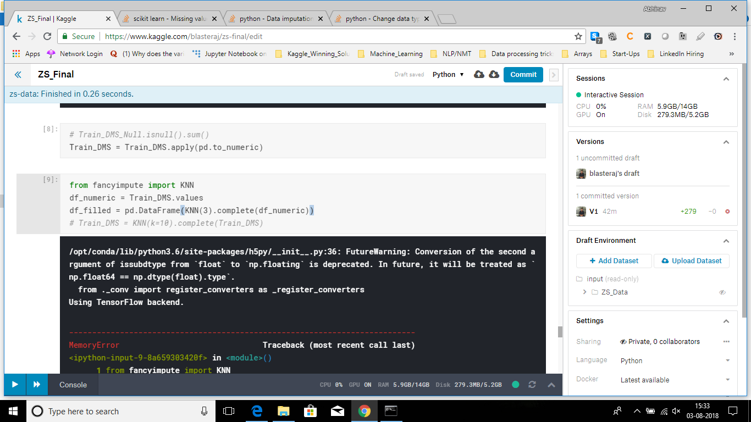

Slide 19
Errors
Use of results of K-Means clustering for filling the next Null value would result in increase in error as we are using wrong results for finding out next values. But since the dataset has lot of Null values we have to compromise.

Slide 20
THANKS to team ZS for providing me this opportunity !!

