Slide 1
APPROACH

Slide 2
Quality Checks Performed / Error Found:
No Error found.

Slide 3
Key Observations / Trends
There is a heavy correlation between expense price and sales price data.
Some of product sales prices are getting saturated and some are getting exponential increment.

Slide 4
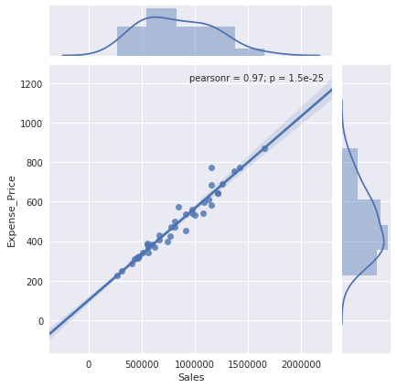
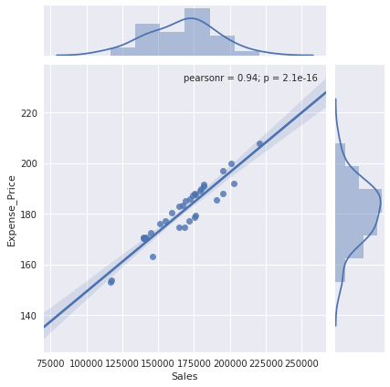

Slide 5
Model Choice Explanation
I used DECISION TREE WITH ARIMA MODEL for predictions because decision tree fits the data well and ARIMA is used to predict where we do not have expense price.

Slide 6
Top 5 Most Significant Variable in the Model:
In the model
Expense Data
Month
Year
Timestamp

Slide 7
Expected Error For Submission
I think that using Decision tree fits the data well so there will be a chance that overfitting may occur.
Overfitting will be the only cause of error.

