Slide 1

PyCon CZ
2015
Brno, Czech Republic November 14-15

Slide 2
Thank you!

Slide 3

Platinum Sponsor

Slide 4





Gold Sponsors
Silver Sponsors

Slide 5

Django Girls Workshop Sponsor

Slide 6
Party!
Coffee Savoy, Jakubské náměstí
20:00
Upstairs Gallery

Slide 7
Party!
Full bar, Coffe bar, Food till 22:00
Pay for your own drinks
Bring your badge to enter

Slide 8
Party!
CoC applies at all times

Slide 9
PyConTest
Extended until Sunday

Slide 10
Sprints & Workshops
Tomorrow
Remember: install requirements
See you there!

Slide 11
Let's do more of these!
See you in 2016

Slide 12
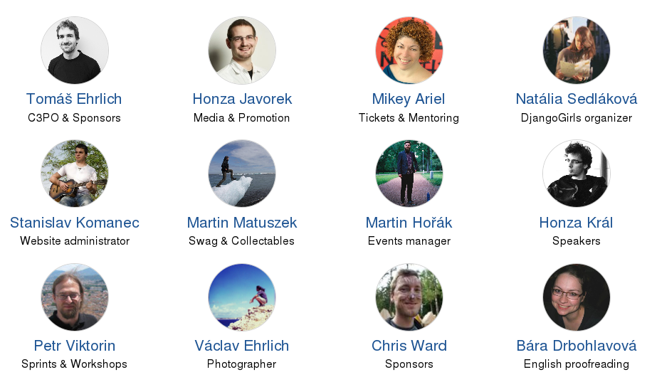
Your Organizers

