Slide 1
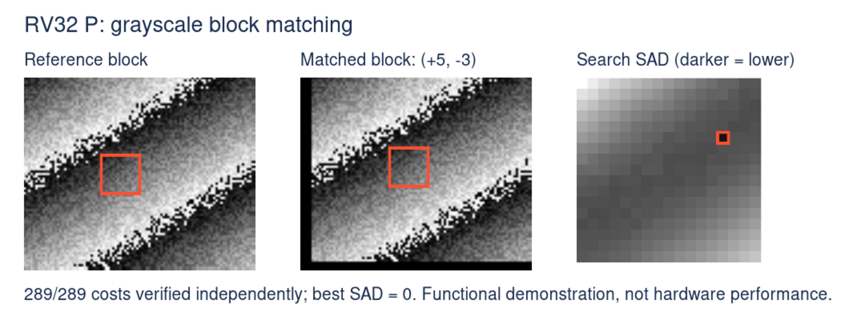
Image block matching, now on RV32 P
Add absolute pixel differences. The lowest SAD identifies the match.
RVP-Example | P 0.6 draft | QEMU instruction counts are not hardware timing
1

Slide 2
Four pixels per packed operation
The image kernel is C. No inline assembly is required.
LOAD
#include <riscv_packed_simd.h>
uint64_t sum = 0;
size_t x = 0;
for (; width - x >= 4; x += 4)
{
uint8x4_t av = __riscv_pld_u8x4 ((uint8_t *) (a + x));
uint8x4_t bv = __riscv_pld_u8x4 ((uint8_t *) (b + x));
sum += __riscv_pabdsumu_u8x4_u32 (av, bv);
}
Four pixels from each image
REDUCE
Four absolute byte
differences
ACCUMULATE
Add to a 64-bit total
Generated packed SAD: pabdsumu.b / pabdsumau.b
Full kernel: row strides, alignment handling and scalar tails. RV64 uses eight byte lanes.
RVP-Example | P 0.6 draft | QEMU instruction counts are not hardware timing
2

Slide 3
An integer-core demo, with clear assumptions
P uses the integer registers; this kernel needs neither floating point nor RVV.
RV32 KERNEL
HARDWARE MODE
Direct word loads.
Requires supported misaligned accesses.
RV32IMC + Zba/Zbb + P
P draft 0.6 · ILP32 soft-float ABI
STRICT MODE
The Linux demo runtime also needs A.
The SAD kernel does not.
Check alignment.
Use byte loads and packing when needed.
Misaligned-load support is a target assumption, not a P requirement.
RVP-Example | P 0.6 draft | QEMU instruction counts are not hardware timing
3

Slide 4
RV32: 76% fewer executed instructions
One 16 × 16 kernel call, including return · -O3 · lower is better
Scalar C · either layout
2,955
P · hardware / either layout
717
P · strict / aligned
850
P · strict / unaligned
1,954
0
600
1,200
1,800
2,400
3,000
Executed guest instructions
Identical logical pixels; SAD 22,364. Same -mtune=size; no LTO or auto-vectorization.
Equal aligned/unaligned counts do not imply equal hardware memory latency.
RVP-Example | P 0.6 draft | QEMU instruction counts are not hardware timing
4

Slide 5
Instruction savings have a footprint
RV32 hardware mode · kernel-only measurements · no application-size claim
Metric
Scalar · -O3
P · -O3
Scalar · -Os
P · -Os
Guest instructions
2,955
717
3,334
845
Kernel text, bytes
108
204
102
132
Static frame, bytes
0
32
16
16
P at -Os: text 204 → 132 bytes; instructions 717 → 845.
Strict P at -O3: 400 text bytes; 48-byte static frame.
GCC -fstack-usage reports static kernel frames, not maximum whole-program stack use.
RVP-Example | P 0.6 draft | QEMU instruction counts are not hardware timing
5

Slide 6
A demo you can reproduce
C kernels, included tools, independently checked image-search costs.
12
82,640
289/289
configurations pass
C checks per build
image costs verified
RV32 / RV64 × hardware / strict alignment × O2 / O3 / Os
XLEN=32 ALIGNMENT=hardware bash scripts/present.sh
Hardware speedup, memory latency and energy need a compatible board or cycle model.
github.com/pz9115/RVP-Example
RVP-Example | P 0.6 draft | QEMU instruction counts are not hardware timing
6

