Slide 1
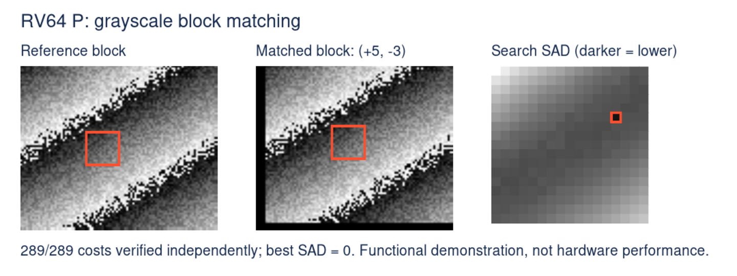
Image block matching with RV64 P
SAD = sum of absolute pixel differences. The lowest cost identifies the match.
RVP-Example | P 0.6 draft
Notes:
This example searches for a matching 16 x 16 grayscale block in two synthetic 96 x 80 images. SAD adds the absolute difference of corresponding unsigned 8-bit pixels. Lower is a better match. The search evaluates 289 candidate positions and recovers the known shift (+5, -3), with SAD 0. All candidate costs are checked independently. Block matching is a building block for motion estimation, not a complete video codec. Source: examples/rvp-image-sad/ and VALIDATION.md in https://github.com/pz9115/RVP-Example.

Slide 2
Eight grayscale pixels per packed operation
The image kernel is C. No inline assembly is required.
#include <riscv_packed_simd.h>
LOAD
Read eight pixels
from each image.
for (; width - x >= 8; x += 8)
{
uint8x8_t av =
REDUCE
__riscv_pld_u8x8 ((uint8_t *) (a + x));
Sum eight absolute
byte differences.
uint8x8_t bv =
__riscv_pld_u8x8 ((uint8_t *) (b + x));
ACCUMULATE
sum += __riscv_pabdsumu_u8x8_u64 (av, bv);
Add the result to
a 64-bit total.
}
Generated instruction: pabdsumu.b
The full C kernel handles alignment, row strides and scalar tails.
RVP-Example | P 0.6 draft
Notes:
This is an excerpt of sad_row_p in examples/rvp-image-sad/sad-p.c. The scalar reference computes the same unsigned absolute differences one pixel at a time. The P loop loads eight pixels from each row and uses a packed byte SAD reduction. The generated arithmetic instruction is pabdsumu.b; no inline assembly is used. The sum is uint64_t and x starts at zero in the full function. The draft load intrinsic takes a non-const pointer but only reads memory. Eight-byte alignment enables ordinary aligned loads; a strict-alignment-safe fallback handles unaligned inputs. A scalar tail handles widths not divisible by eight. P 0.6 remains a draft, so API and encoding details can change.

Slide 3
Fewer instructions for image SAD
Executed QEMU guest instructions per 16 × 16 kernel call · -O3 · lower is better
Scalar C
P intrinsics
77% fewer instructions
25% fewer instructions
3,000
2,527
2,524
1,899
2,000
1,000
571
0
8-byte aligned
Unaligned
Same compiler and common flags; no auto-vectorization or LTO.
Instruction counts are not cycles or hardware speedup.
RVP-Example | P 0.6 draft
Notes:
Measured 16 October 2026. Source: VALIDATION.md and build/acceptance/O3/result.json in RVP-Example. Counts are executed guest instructions within one 16 x 16 SAD kernel call, including return, not the whole image search. QEMU traces use -one-insn-per-tb -d exec,nochain and symbol-address filtering. Two traces per case agree. Aligned: scalar 2527, P 571, a 77.4% instruction reduction (shown rounded to 77%). Unaligned: scalar 2524, P 1899, a 24.8% reduction (rounded to 25%). Each P call executes 32 packed SAD instructions. Alignment strongly affects load generation; the fallback remains safe for strict-alignment implementations. Both paths use GCC 16.1.0 and common -O3 flags, without LTO or automatic vectorization. Scalar march: rv64gc_zba_zbb; P march: rv64gc_p0p6. Code size is a tradeoff: scalar 78 bytes versus P 450 bytes, including alignment paths and tails. QEMU is version 11.1.50 with local P support. These are workload-specific guest instruction counts, not cycles, hardware throughput or application speedup. Hardware performance has not been measured.

Slide 4
From C source to a reproducible demo
P-enabled GCC, Binutils and QEMU support this static RV64 C example.
C source
→
GCC + Binutils
→
RV64 binary
→
QEMU
Scalar + P intrinsics
Compile and link
Static Linux / lp64d
Execute and trace
82,576
289 / 289
O2 · O3 · Os
C checks per build
Image search costs matched
All three builds pass
github.com/pz9115/RVP-Example
RUN WITH THE INCLUDED TOOLS
C code, build instructions and notebook
bash scripts/present.sh
RVP-Example | P 0.6 draft
Notes:
The repository includes the scalar and intrinsic C kernels, build and run scripts, a notebook, and independent image validation. Python only drives the tools and provides an independent oracle; the image-processing kernel is C. Prebuilt P-enabled tools are included for x86_64 Linux. Run bash scripts/present.sh; rebuilding the tools is optional and documented in docs/BUILD.md. Run bash scripts/acceptance.sh for O2, O3 and Os checks and negative controls. Each optimization configuration passes 82,576 C checks and 289 independently recomputed image costs. Negative controls catch P-disabled execution and a modified input pixel. Tested versions: GCC 16.1.0, Binutils 2.47, glibc 2.43 and QEMU 11.1.50 with local P support, on x86_64 Ubuntu 24.04.2 / glibc 2.39 under WSL2. This is validation of the provided static RV64 C example, not certification of the full P ISA or other toolchain configurations. P 0.6 is a developed draft, not ratified. Code and tutorial license: MIT. See VERSION.json, VALIDATION.md and licenses/NOTICE for details.

