Slide 1
The learning app

Slide 2
General information:
This application with provide with students to read, learn, take preparations, give examinations & get certified within the application. This engine will also enable teachers to provide contents for learning, provide content for exam preparations, upload examination scripts, check scripts & provide certification with.

Slide 3
Project scope:
This project will initially deliver but not limited to:
Student perspective:
General reading
Taking exam preparation
Provide exam
Get certified
Teacher’s perspective:
Provide reading materials
Provide exam preparation materials
Provide exam scripts
Check and mark exam scripts
Provide certificates
Provide feedbacks

Slide 4
Project deliverables:
1. Student front end (application)
2. Student front end (web)
3. Teachers admin panel (application)
4. Teachers admin panel (web)
5. Admin panel & management panel
6. Service & purchase key
7. Middleware / API
8. Backend

Slide 5
Modules:
1. Profile
2. Reading module
3. Preparation module
4. Exam module
5. Certification module
6. Registration module
7. Tips/latest module
8. Notification module
9. Payment module
10. Merge module
11. State module

Slide 6
Task:
1. Work flow design
2. Modularize & module design
3. DFD
4. Backend design and implementation
5. Service design & implementation
6. Technology and cloud selection
7. UI design
8. Integrations
9. Output check
10. UAT
11. Bug fixing
12. UAT phase 2
12. Completion
13. Service roll out

Slide 7
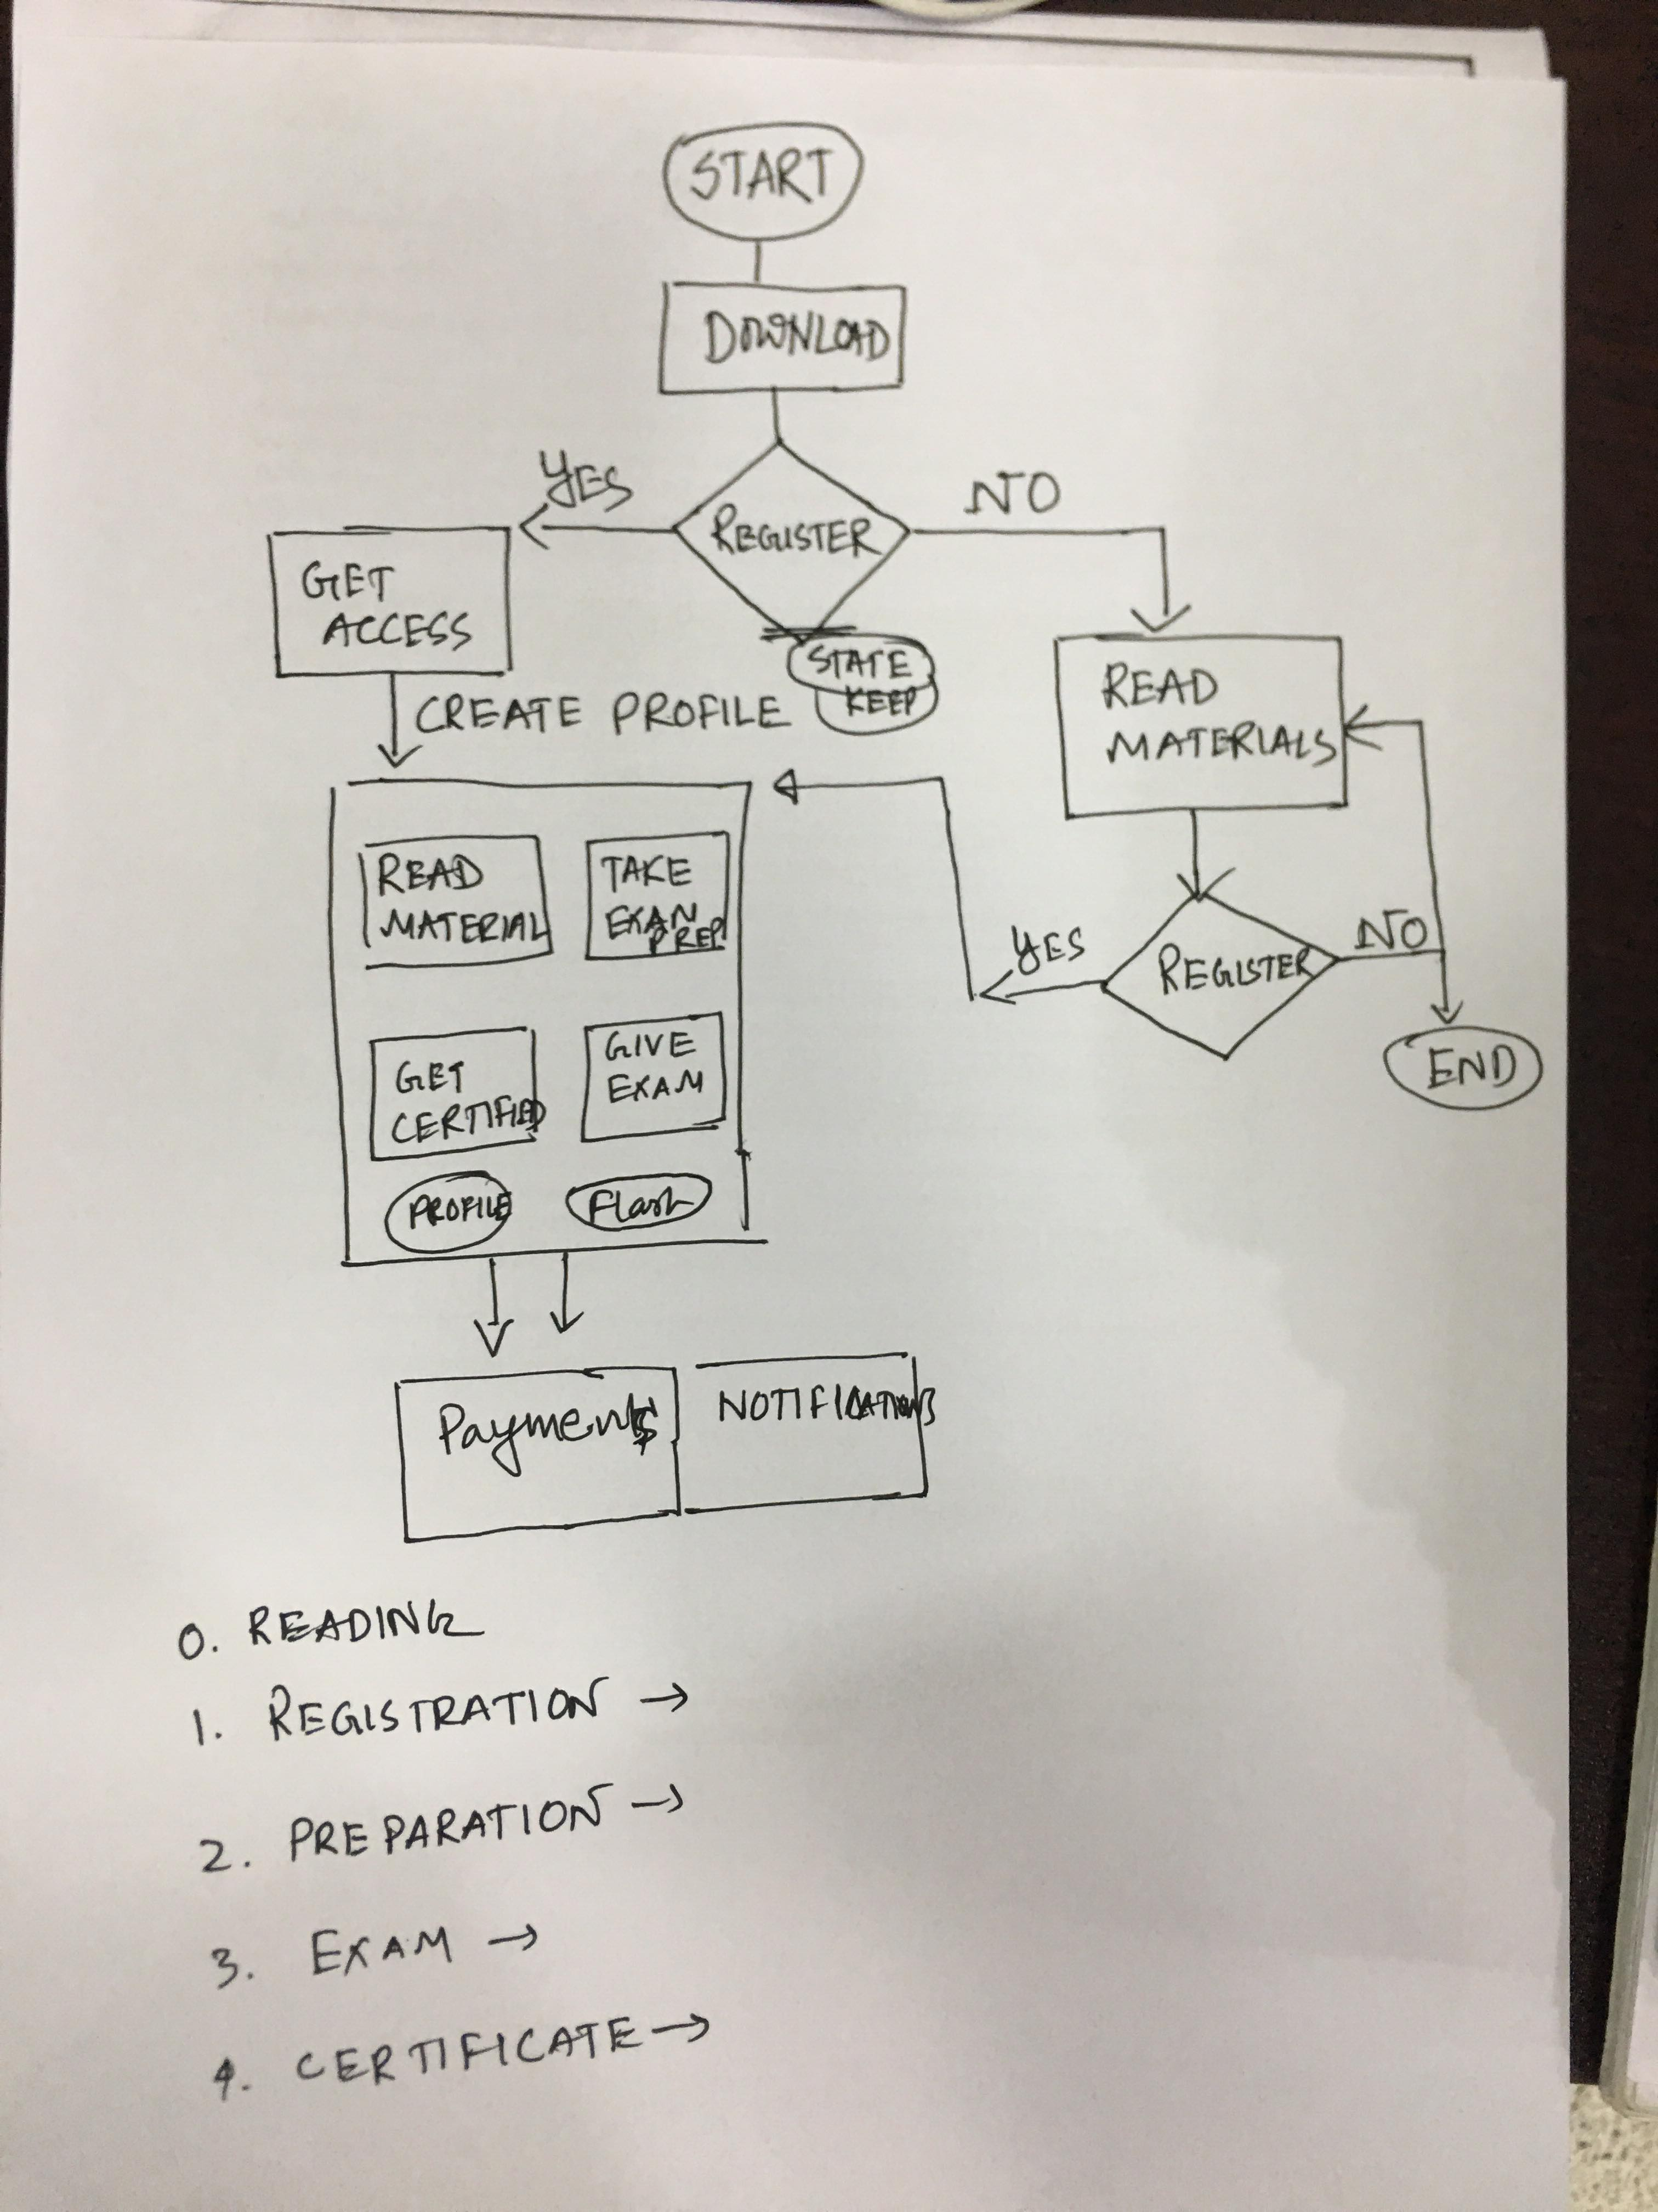
Work flow:

