Slide 1
Visualizing the Evolution of Debates
Yang Shan
Katharina Wallrabenstein
Pengfei Zhao

Slide 2
Contents
Introduction
General Architecture Overview
Key Features
Argument and Sentiment Visualisations
Topic Model Visualisation
Filtering
Overview of Tech Stack
Overview of our Work
Possible future extensions

Slide 3
Introduction
Social media has become an important platform for public debates e.g. #BlackLivesMatters, US elections, covid policies.
A lot of people from different spectrum of society take part in it.
As an individual you only experience a slice of it.
Machine Learning and NLP can offer a bird's-eye perspective on the state of the debate by aggregating and processing information.
However ML and NLP is not available for everyone.
For example : Social scientist wants to analyze the climate of the public debate on Black Lives Matters. They have data available, but no tools to process and visualize it.

Slide 4
Introduction
For this we provide a platform to analyze large amounts of data and visualize the evolution of a debate without requiring expert-knowledge for NLP
We utilize following NLP methods in the backend:
Sentiment Analysis
Argument Mining
Topic Modelling
We visualize with following methods in the frontend:
Scatter plot, Bar and Area Chart
Word Cloud
Activity Chart
LDAVis

Slide 5
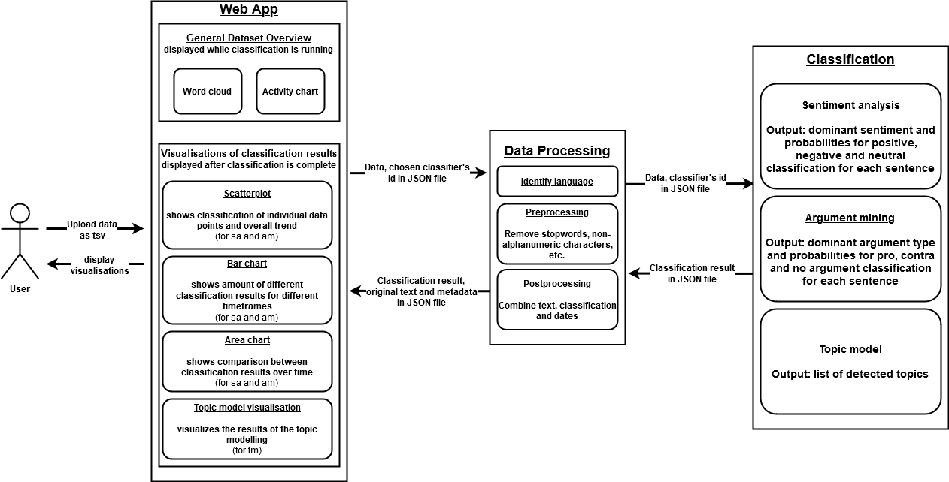
General Architecture Overview

Slide 6
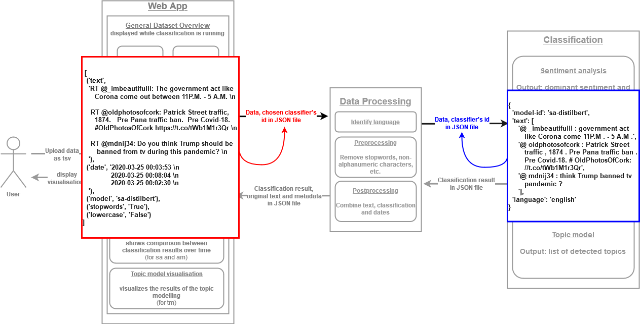
General Architecture Overview

Slide 7
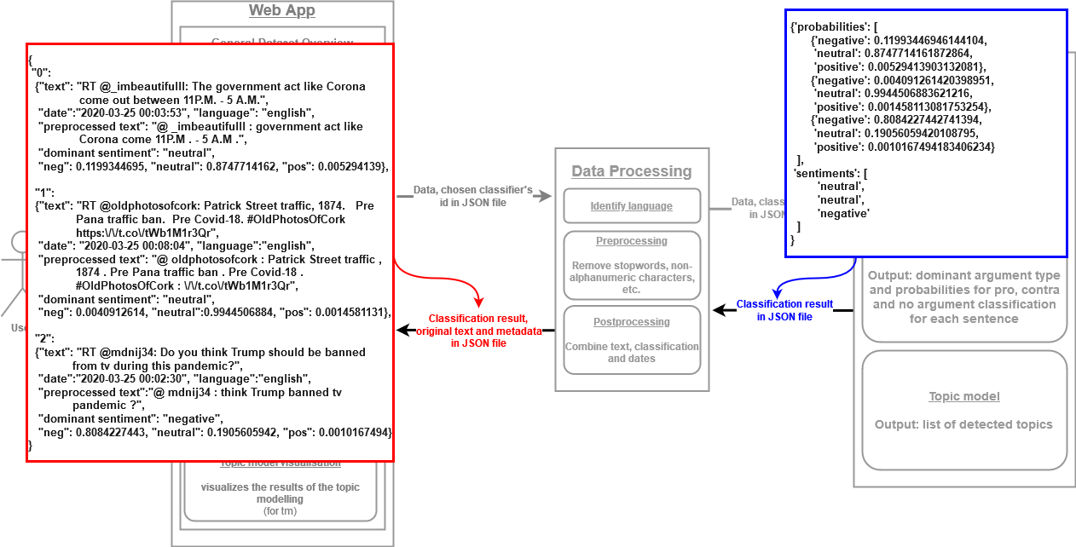
General Architecture Overview

Slide 8
Feature :
Argument and Sentiment Visualisations
Use Case :
User would like to know how the debate evolves with respect to sentiments and argument types.
For example the following questions could be addressed:
Is the debate overall dominated by positive sentiments or negative sentiments ?
What is the trend of sentiments ? Is the debate developing more towards positive sentiments ?
Are people arguing using arguments or claims throughout the debate ?

Slide 9
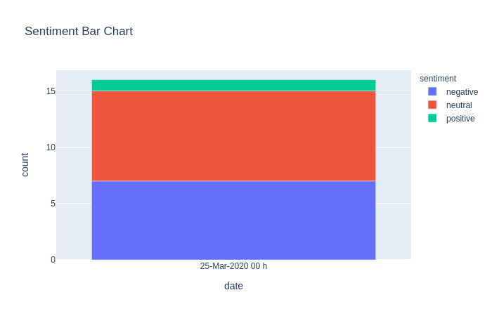
Feature :
Argument and Sentiment Visualisations
a) Overall Proportion with Bar Chart:

Slide 10
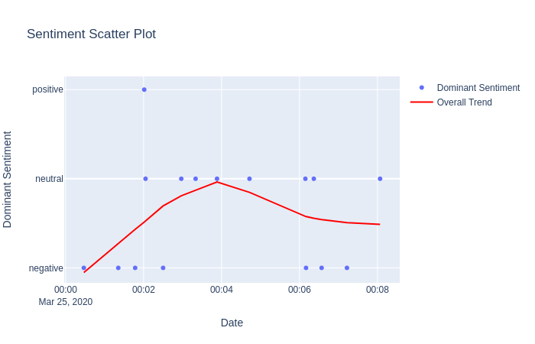
Feature :
Argument and Sentiment Visualisations
b) Trend with Scatter Plot :

Slide 11
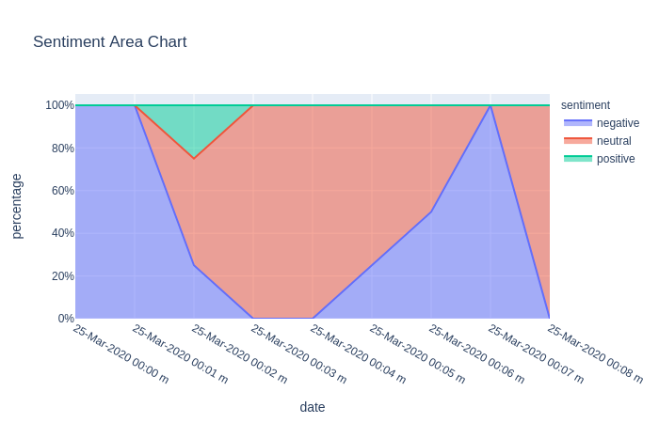
Feature :
Argument and Sentiment Visualisations
b) Trend with Area Chart :

Slide 12
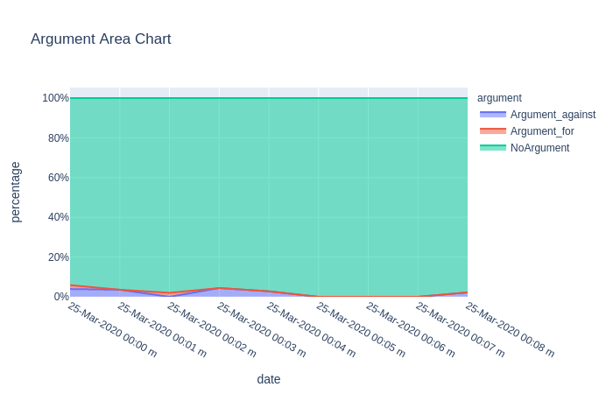
Feature :
Argument and Sentiment Visualisations
c) Argument Proportions with Area Graph :

Slide 13
Feature :
Argument and Sentiment Visualisations
Implementation :
DistilBert was used for sentiment and argument classification.
Pretrained models were loaded from huggingface-transformers¹ and finetuned.
The dataset used for finetuning sentiment-analysis model can be found here.
The visualisations were implemented using altair and plotly, two graphing libraries that are supported by streamlit
¹ Wolf, T., Debut, L., Sanh, V., Chaumond, J., Delangue, C., Moi, A., Cistac, P., Rault, T., Louf, R., Funtowicz, M., & Brew, J. (2019). HuggingFace's Transformers: State-of-the-art Natural Language Processing. ArXiv, abs/1910.03771.

Slide 14
Feature:
Topic Model Visualisation
Use Case :
User would like to know what kind of topics are relevant within the debate.
For example the following questions could be addressed:
Which topics are present in the debate?
Which words characterize these topics?
How do the topics relate to each other? Are they similar or very different?

Slide 15
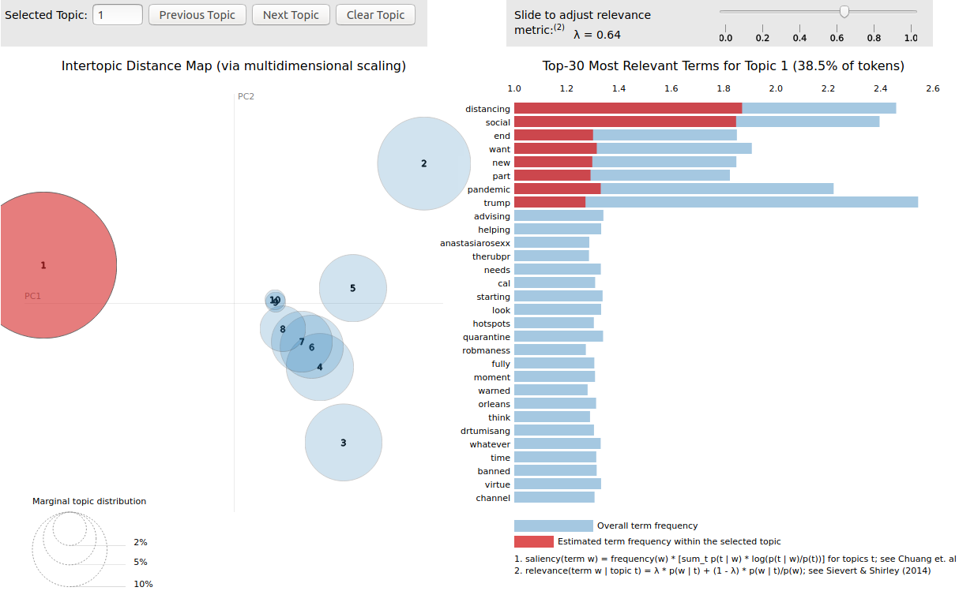
Feature:
Topic Model Visualisation

Slide 16
Feature:
Topic Model Visualisation
Description :
Circles represent the topics in the corpus. The distance between the circles describe their similarity. The size of the circle represent its relative importance.
Blue bars represent the frequency of words in the whole corpus
Red bars represent the frequency of words with respect to the selected topic

Slide 17
Feature:
Topic Model Visualisation
Implementation :
The topic model was implemented with Latent Dirichlet Allocation
The topic model visualisation was implemented with PyLDAvis. A Library specifically designed for visualizing LDA models, which is based on works from Sievert et al, 2014²
² Sievert, C., & Shirley, K. (2014). LDAvis: A method for visualizing and interpreting topics.

Slide 18
Feature:
Filtering
Use Case :
User would like to know how sentiment and argument types evolve with respect to a specific keyword in the debate.
User would like to know what topics are most popular within sentiment and argument types.
For example the following questions could be addressed:
How does sentiment with respect to keyword lockdown evolve in a debate about covid-19 measurements ?
What are the most popular topics among positive statements about covid-19 measurements ?

Slide 19
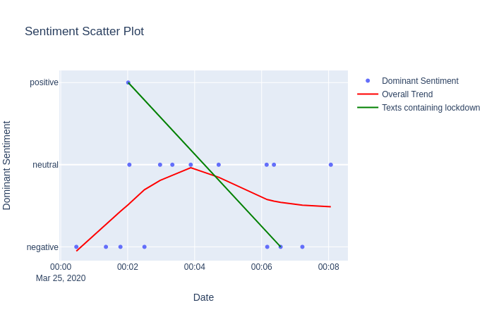
Feature:
Filtering
a) Filtering by keyword lockdown:

Slide 20
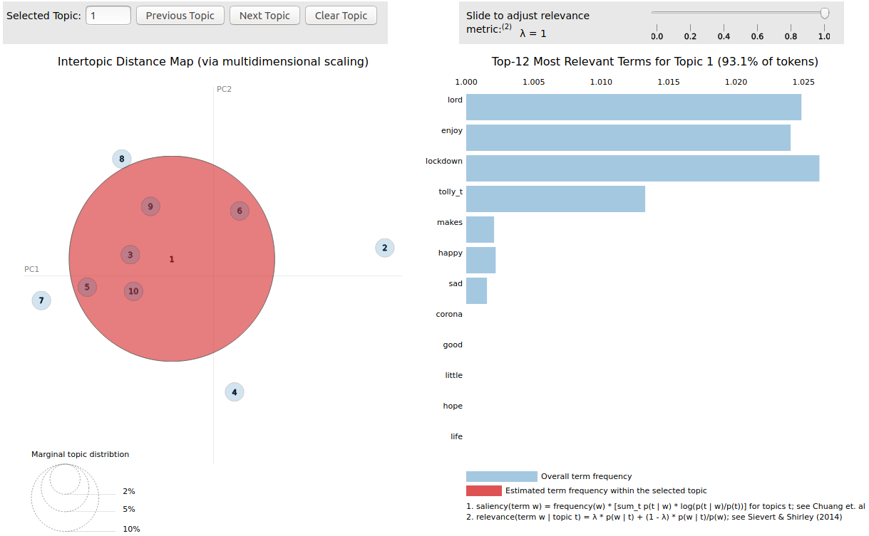
Feature:
Filtering
b) Filtering by positive sentiments:

Slide 21
Feature:
Filtering
Implementation :
Filtering by keyword
Dataframe used for visualisations is filtered for texts that contain the keyword by using Pandas str.contains()
Filtering by sentiment and argument types
Cache results from sentiment and argument classifications
Combine cached results in a Pandas Dataframe
Use sentiment or argument predictions to filter input data for LDA model.

Slide 22
Overview of tech stack
Streamlit for frontend
altair for Activity Chart
pyplot for Word Cloud
plotly for Scatter Plot, Bar Chart and Area Chart
Flask for backend
NLTK for pre-processing
langdetect for language guessing
Pytorch for training models
Huggingface-Transformers for pretrained models

Slide 23
Overview of our Work
Implemented a classification API for sentiment analysis, argument modeling and topic modeling
Implemented a server that handles pre-processing and the communication between the components
Implemented a website that visualizes the results of the classifiers using the following techniques:
scatter plot with a LOWESS trendline
bar chart
area chart
topic model visualisation

Slide 24
Possible future extensions/remaining work
Multilingual Support
More choice for different classifiers
Allow user to finetune models on his labeled data set
Provide support for fetching data from Twitter / Reddit given Keyword
Provide more visualisation as needed
Get actual feedback from social scientists and users

Slide 25
Thank you
Thank you for the great cooperation!
We hope you enjoyed it as much as we did.
All the best,
Yang, Katharina and Pengfei

