Slide 1


Teleconference with noise and eco cancellation
Group:
Animesh Das
Jonas Sedin
Mohammad Abdulla
Thomas Gaudy
Xavier Bush
Advisor:
Per Zetterberg
EQ2440 Project in Wireless Communication

Slide 2

Background
The first recognized work and patent on eliminating noise from speech signal was documented in 1934.
In 1950, a systems was designed where the noise in helicopter and airplane cockpits communication were canceled.
In 1985, a highly efficient Short-Time Spectral Amplitude (STSA) estimator for speech signals to minimize the mean square error of the log-spectra was developed.

Slide 3
Problem Formulation
The diversity of noise nature and its sources lead to a big challenge
Develop high performance solutions in these diverse environments.
Important to take into account the variability that the noise may experience.
Different classification of the noise
Duration of the noise sequences, color of the noise and stationarity
Therefore, a lot of systems are using combined techniques to reach the best possible performance

Slide 4
Approaches
Two approaches
Noise cancellation
Speech enhancement

Slide 5
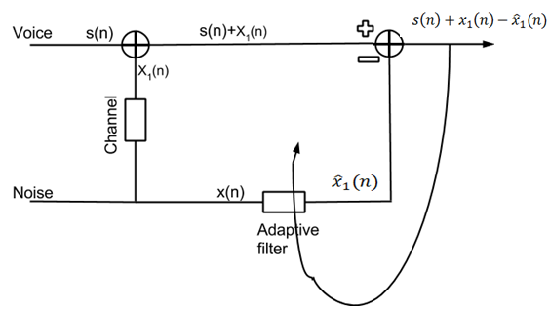
Noise cancellation

Slide 6
Noise cancellation
LMS
…
…
…
…

Slide 7
Speech enhancement
logMMSE
…
…
…
…

Slide 8
Unsuccessful approaches
RLS
- Computationally infeasible
Frequency LMS
- Not enough noise reduction
Kalman filter
- Difficult to postulate a state space model
- Also computationally infeasible
Lattice Recursive Least Squares
- Instable and difficult to implement
…

Slide 9
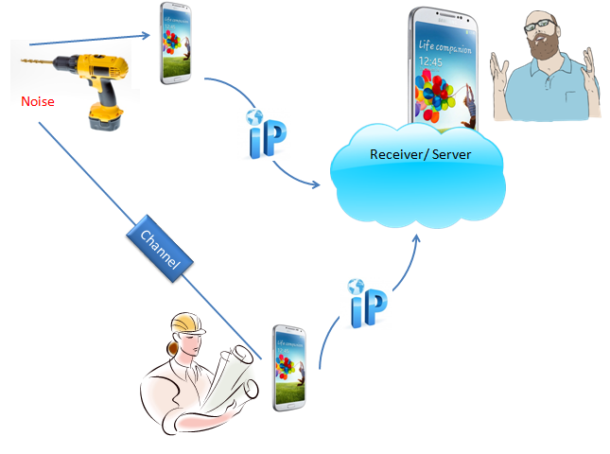
Android
Setup

Slide 10
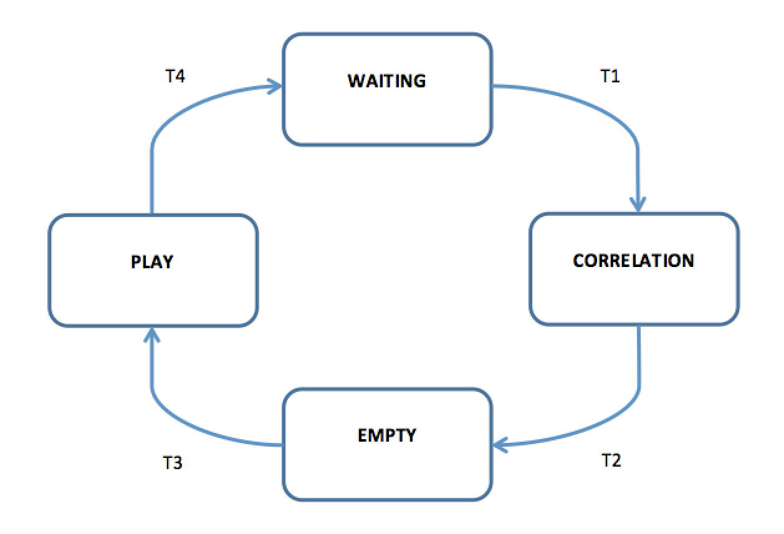
Android
State Machine

Slide 11
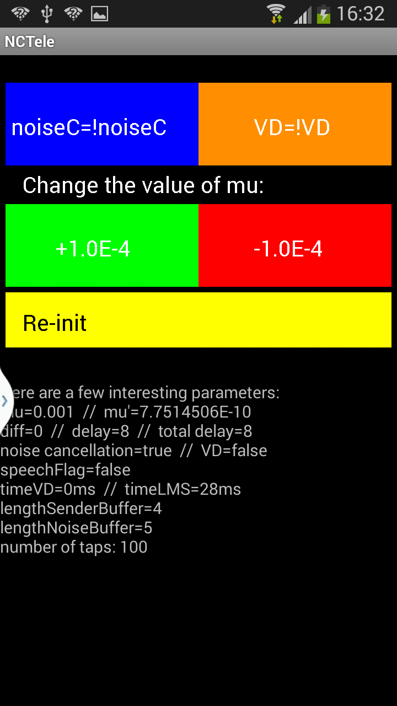
Android
App Interface

Slide 12
Conclusions
Theory results
LMS provides a big reduction of the noise
logMMSE after LMS removes almost the 100% of the noise
Android results
Distance between phones affects filter order (5m => order 163)
Big order => voice distortion
Trade-off between noise cancellation and voice distortion
Static phones limitation
Set-up for good results
Distance between Sender Phone and Noise Phone: 0.5 m
Order of NLMS: 10-50

Slide 13
Future Work
Proposal for future projects
Reach a non-static application
Reach phonic isolation between the Sender Phone and the Noise phone
Reach maximum correlation between the additive noise of the Sender Phone with the pure noise recording
Echo cancellation: enable hands free

Slide 14
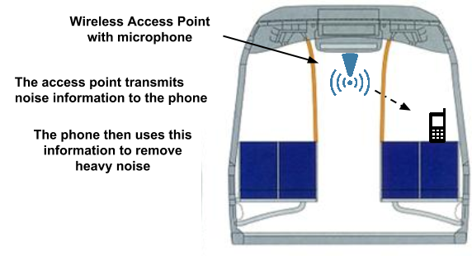
Potential Application

Slide 15
Thank you

