Slide 1


Teleconference with noise and eco cancellation
Group:
Animesh Das
Jonas Sedin
Mohammad Abdulla
Thomas Gaudy
Xavier Bush
Advisor:
Per Zetterberg
EQ2440 Project in Wireless Communication

Slide 2

Background
The first recognized work and patent on eliminating noise from speech signal was documented in 1934.
In 1950, a systems was designed where the noise in helicopter and airplane cockpits communication were canceled.
In 1985, a highly efficient Short-Time Spectral Amplitude (STSA) estimator for speech signals to minimize the mean square error of the log-spectra was developed.

Slide 3
Problem Formulation
The diversity of noise nature and its sources lead to a big challenge
Develop high performance solutions in these diverse environments.
Important to take into account the variability that the noise may experience.
Different classification of the noise
Duration of the noise sequences, color of the noise and stationarity
Therefore, a lot of systems are using combined techniques to reach the best possible performance

Slide 4
Approaches
Two approaches
Noise cancellation
Speech enhancement

Slide 5
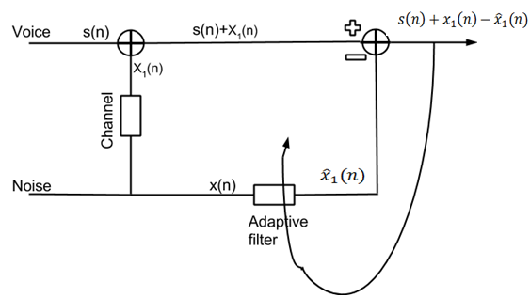
Noise cancellation

Slide 6
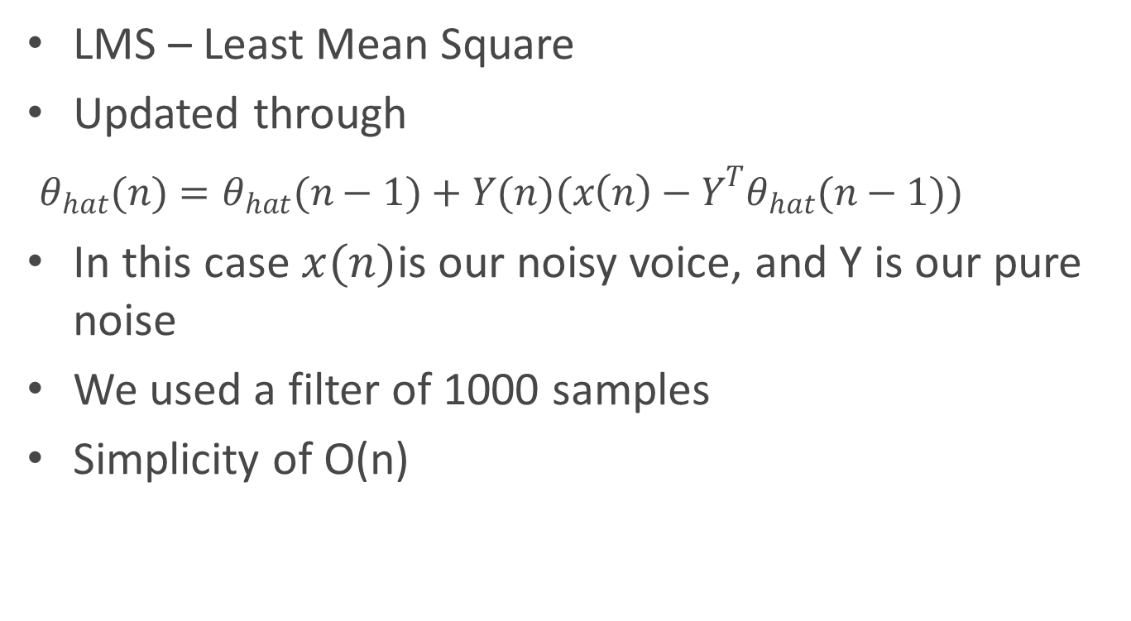
Noise cancellation - LMS
LMS – Least Mean Square
Updated through
$θ_{hat}(n)=θ_{hat}(n−1)+Y(n)(x\left(n\right)−Y^{T}θ_{hat}(n−1))$
In this case $x(n)$is our noisy voice, and Y is our pure noise
We used a filter of 1000 samples
Simplicity of O(n)

Slide 7
Speech enhancement
Single microphone approach
Transform and block-based
Instead of cancelling the noise, approximate the voice
Our method is based on the paper ”Speech Enhancement using a minimum mean square error log-spectral Amplitude Estimator”(Ephraim, 1985)

Slide 8
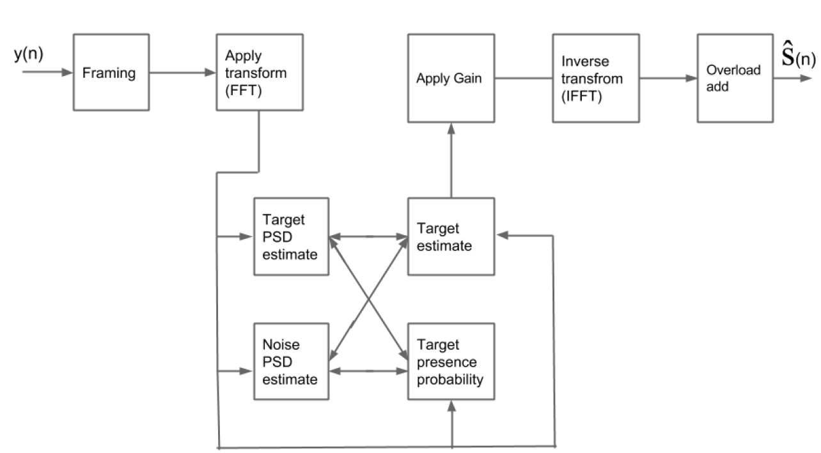
LogMMSE
Overlapping frames and windowing
FFT
Processing functions to estimate the speech
IFFT
Overlap and add

Slide 9
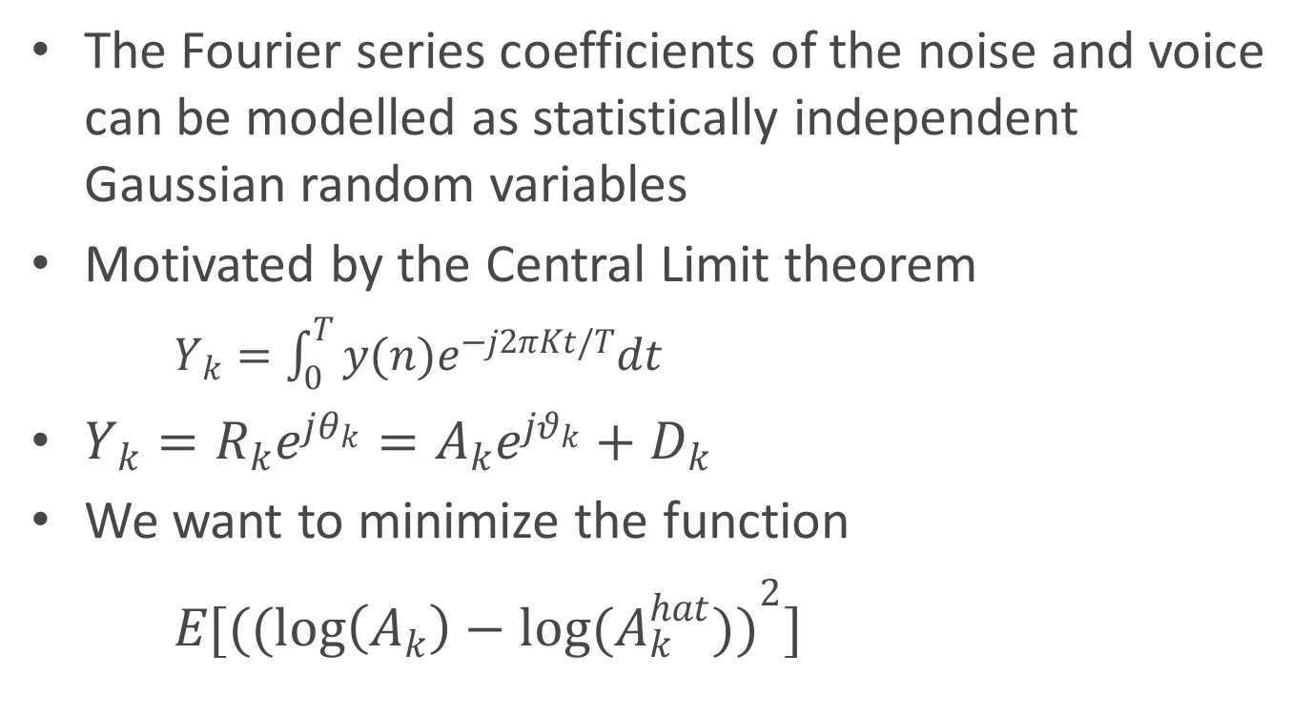
logMMSE
The Fourier series coefficients of the noise and voice can be modelled as statistically independent Gaussian random variables
Motivated by the Central Limit theorem
$Y_{k}=\int_{0}^{T}{y(n)e^{−j2πKt/T}dt}$
$Y_{k}=R_{k}e^{jθ_{k}}=A_{k}e^{jθ_{k}}+D_{k}$
We want to minimize the function
$E[({(\log\left(A_{k}\right)−log(A_{k}^{hat}))}^{2}]$

Slide 10
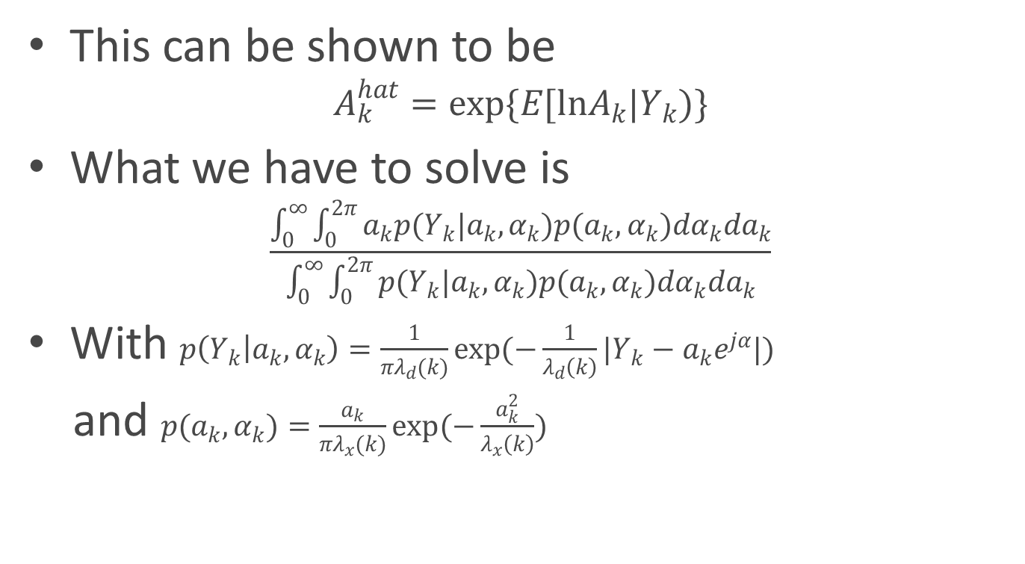
logMMSE
This can be shown to be
$$A_{k}^{hat}=exp\{E[lnA_{k}|Y_{k})\}$$
What we have to solve is
$$\frac{\int_{0}^{∞}{\int_{0}^{2π}{a_{k}p(Y_{k}|a_{k},α_{k})p(a_{k},α_{k})dα_{k}da_{k}}}}{\int_{0}^{∞}{\int_{0}^{2π}{p(Y_{k}|a_{k},α_{k})p(a_{k},α_{k})dα_{k}da_{k}}}}$$
With $p\left(Y_{k} | a_{k},α_{k}\right)=\frac{1}{πλ_{d}(k)}exp(−\frac{1}{λ_{d}\left(k\right)}|Y_{k}−a_{k}e^{jα}|)$
and $p(a_{k},α_{k})=\frac{a_{k}}{πλ_{x}(k)}exp(−\frac{a_{k}^{2}}{λ_{x}\left(k\right)})$

Slide 11
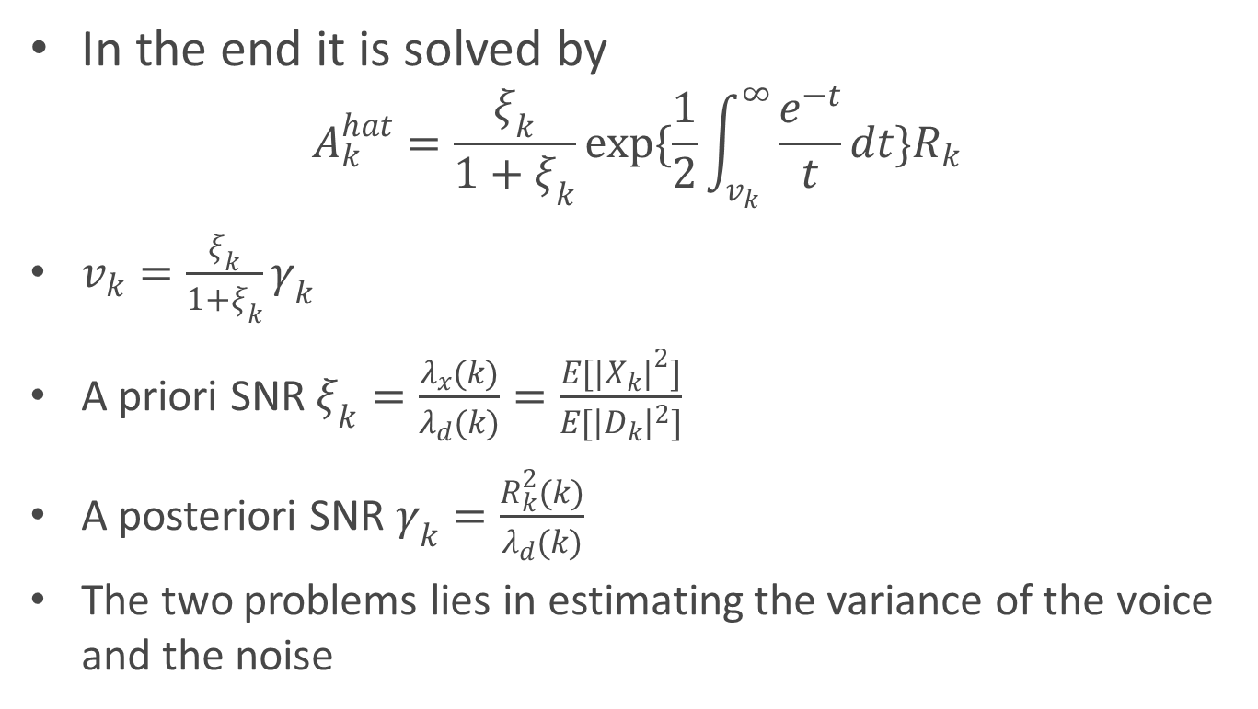
logMMSE
In the end it is solved by
$$A_{k}^{hat}=\frac{ξ_{k}}{1+ξ_{k}}exp\{\frac{1}{2}\int_{v_{k}}^{∞}{\frac{e^{−t}}{t}dt}\}R_{k}$$
$v_{k}=\frac{ξ_{k}}{1+ξ_{k}}γ_{k}$
A priori SNR $ξ_{k}=\frac{λ_{x}(k)}{λ_{d}(k)}=\frac{E[{|X_{k}|}^{2}]}{E[{\left|D_{k}\right|}^{2}]}$
A posteriori SNR $γ_{k}=\frac{R_{k}^{2}(k)}{λ_{d}(k)}$
The two problems lies in estimating the variance of the voice and the noise

Slide 12
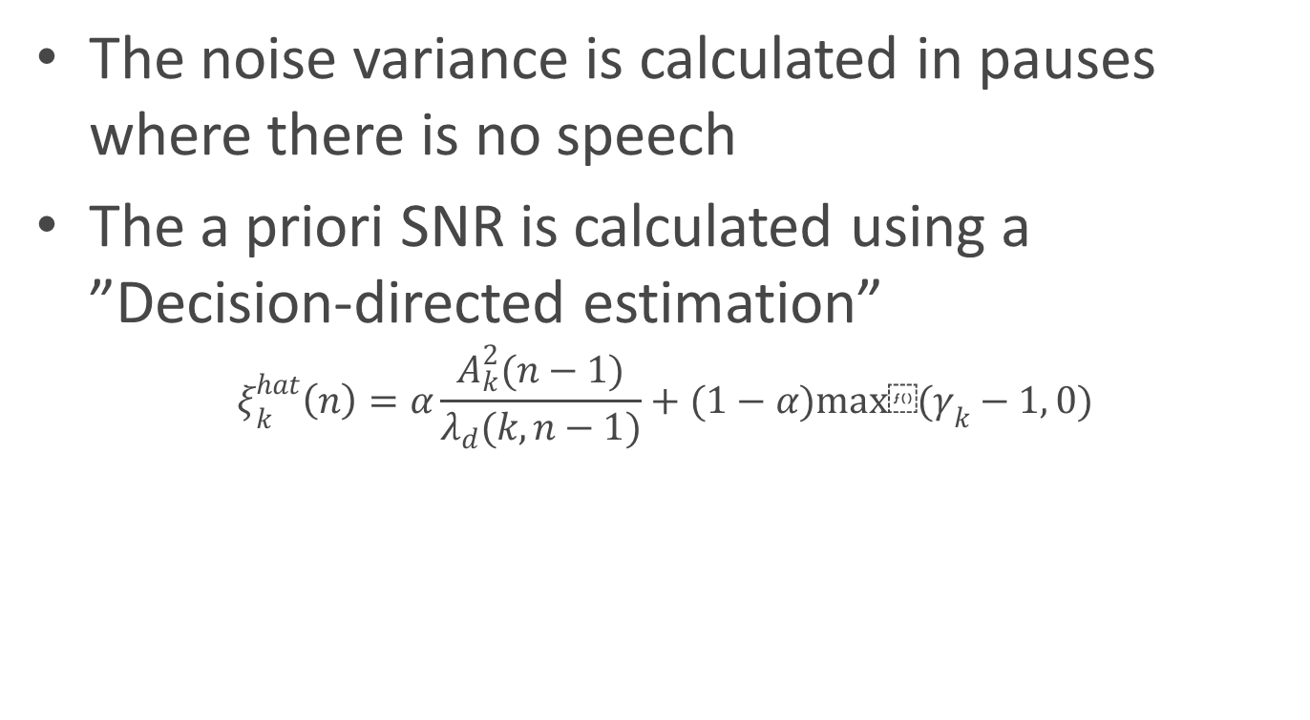
logMMSE
The noise variance is calculated in pauses where there is no speech
The a priori SNR is calculated using a ”Decision-directed estimation”
$$ξ_{k}^{hat}\left(n\right)=α\frac{A_{k}^{2}(n−1)}{λ_{d}(k,n−1)}+(1−α)max⁡(γ_{k}−1, 0)$$

Slide 13
Unsuccessful approaches
RLS
- Computationally infeasible
Frequency LMS
- Not enough noise reduction
Kalman filter
- Difficult to postulate a state space model
- Also computationally infeasible
Lattice Recursive Least Squares
- Instable and difficult to implement

Slide 14
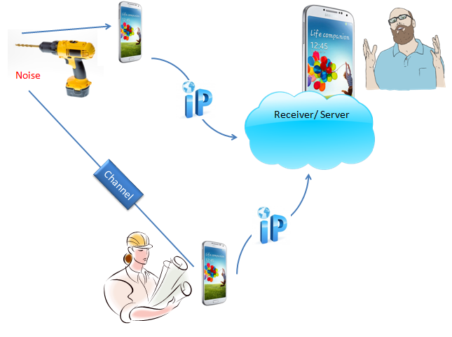
Android
Setup

Slide 15
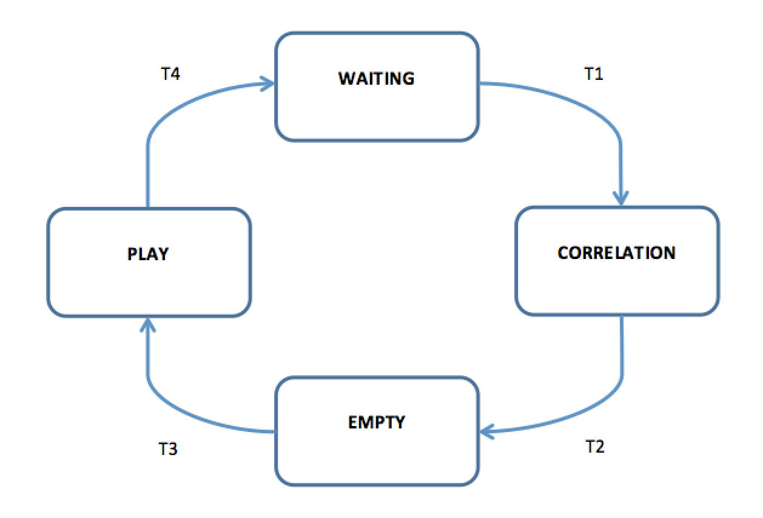
Android
State Machine

Slide 16
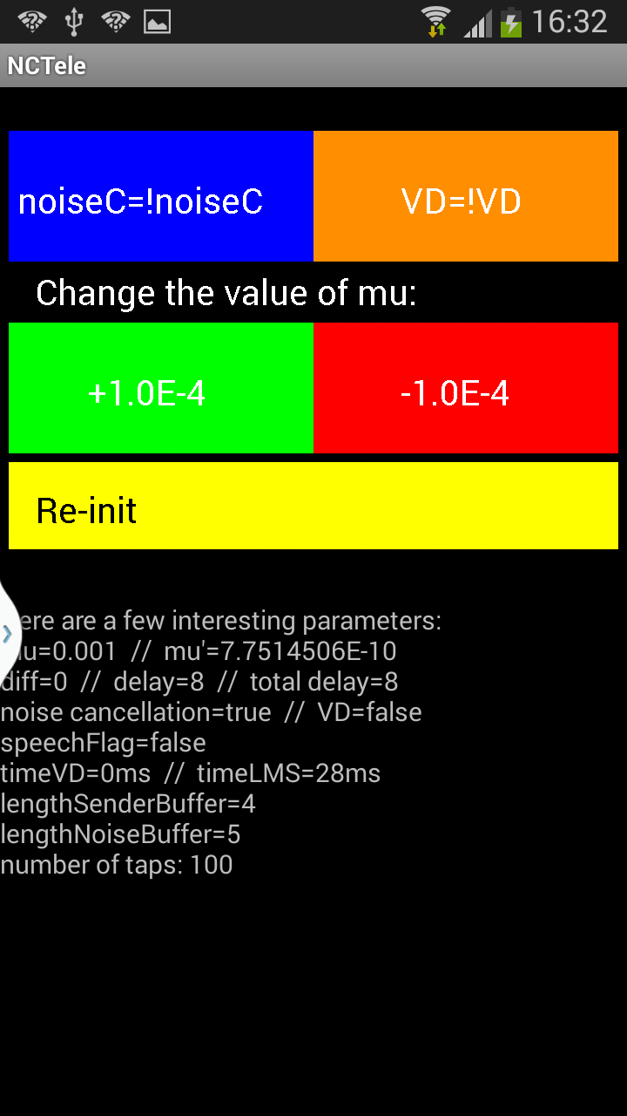
Android
App Interface

Slide 17
Conclusions
Theory results
LMS provides a big reduction of the noise
logMMSE after LMS removes almost the 100% of the noise
Android results
Distance between phones affects correlation
Correlation affects filter order (5m => order 163)
Big order => voice distortion
Trade-off between noise cancellation and voice distortion
Static phones limitation
Set-up for good results
Distance between Sender Phone and Noise Phone: 0.5 m
Order of NLMS: 10-50

Slide 18
Future Work
Proposal for future projects
Reach a non-static application
Reach phonic isolation between the Sender Phone and the Noise phone
Reach maximum correlation between the additive noise of the Sender Phone with the pure noise recording
Echo cancellation: enable hands free

Slide 19
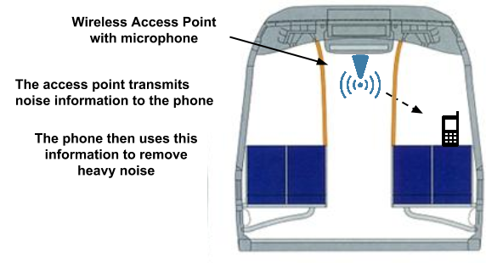
Potential Application

Slide 20
Thank you

