Slide 1
Cloud Computing and Big Data Apache Spark and More
Oxford University
Software Engineering Programme
July 2021

Slide 2
Contents
What is wrong with Hadoop?
Apache Spark
PySpark / Python
SparkSQL and Hive
SparkR
Spark and Yarn
Spark and Mesos

Slide 3
Issues with Hadoop
Hadoop is fundamentally all about Map Reduce
Though v2 did allow for other approaches
Based on cheap commodity hardware
But….
Not based on cheap commodity hardware with lots of memory!

Slide 4
Hadoop Model
Map
Reduce
Map
Reduce
Map
Reduce
HDFS

Slide 5
Hadoop and Disk
Hadoop does everything via replicated disk images
Intermediate results are stored on disk
Slow for many operations
Including Machine Learning
No support for interactive processing

Slide 6
Improved Approach
A new model based on memory
Based on Directed Acyclic Graphs
And partitions
What about reliability?

Slide 7
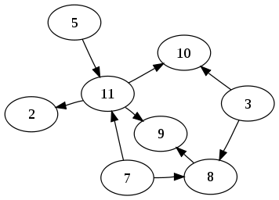
DAG Directed Acyclic Graph No Loops!

Slide 8
Apache Spark
Started in 2009 at UC Berkeley
Donated to Apache in 2013
Written on top of JVM mainly in Scala
10x-100x faster than Hadoop
Supports coding in:
Scala
Java
Python
R
Supports an interactive shell
More details in this paper:
http://www.cs.berkeley.edu/~matei/papers/2012/nsdi_spark.pdf

Slide 9
Resilient Distributed Datasets
A logical collection of data
Partitioned across multiple machines
Logs the lineage of the current data
If there is a failure, recreate the data
Solves the reliability problem
Developers can specify the persistence and partitioning of RDDs

Slide 10
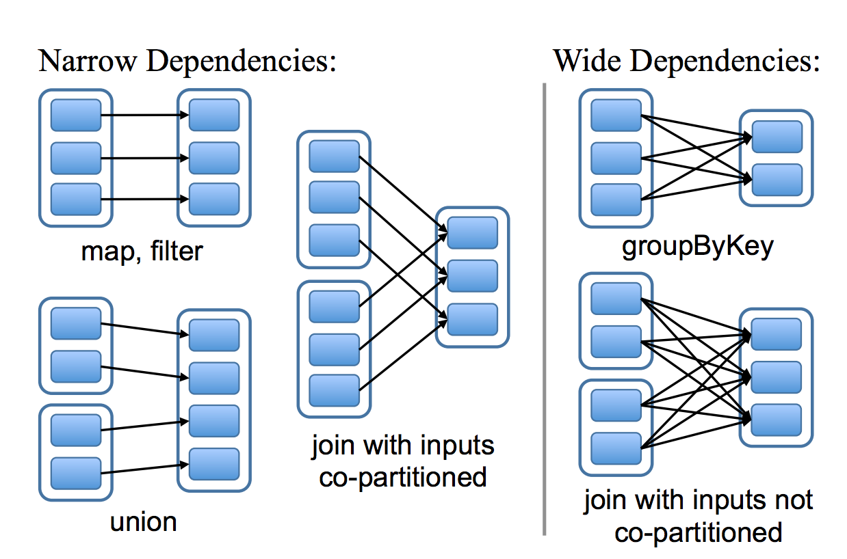
Narrow and Wide dependencies
Narrow dependencies: Each partition of the parent is used by one child partition
Wide Dependencies: multiple child dependencies depend upon it
Source: http://www.cs.berkeley.edu/~matei/papers/2012/nsdi_spark.pdf

Slide 11
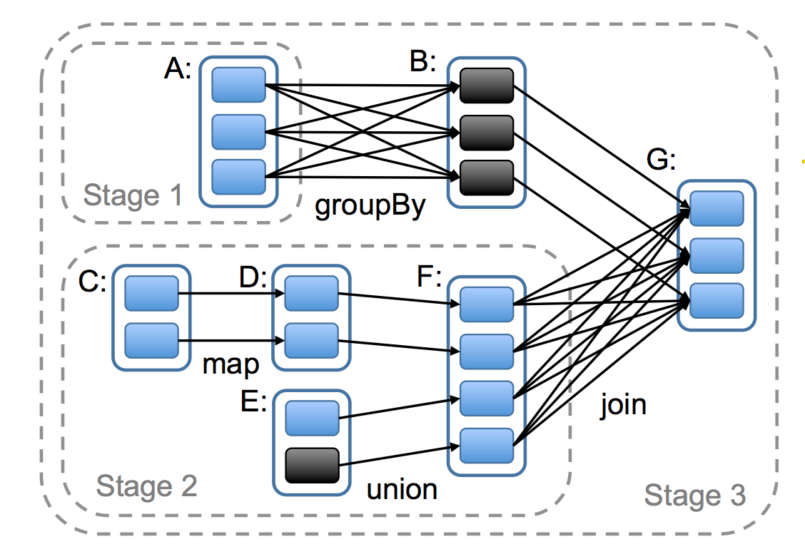
How Spark computes jobs
Boxes with solid outlines are RDDs. Partitions are shaded rectangles, in black if they are already in memory.
To run an action on RDD
G, build stages at wide dependencies and pipeline narrow transformations inside each stage. In this case, stage 1’s
output RDD is already in RAM, so we run stage 2 and then 3.
Source: http://www.cs.berkeley.edu/~matei/papers/2012/nsdi_spark.pdf

Slide 12
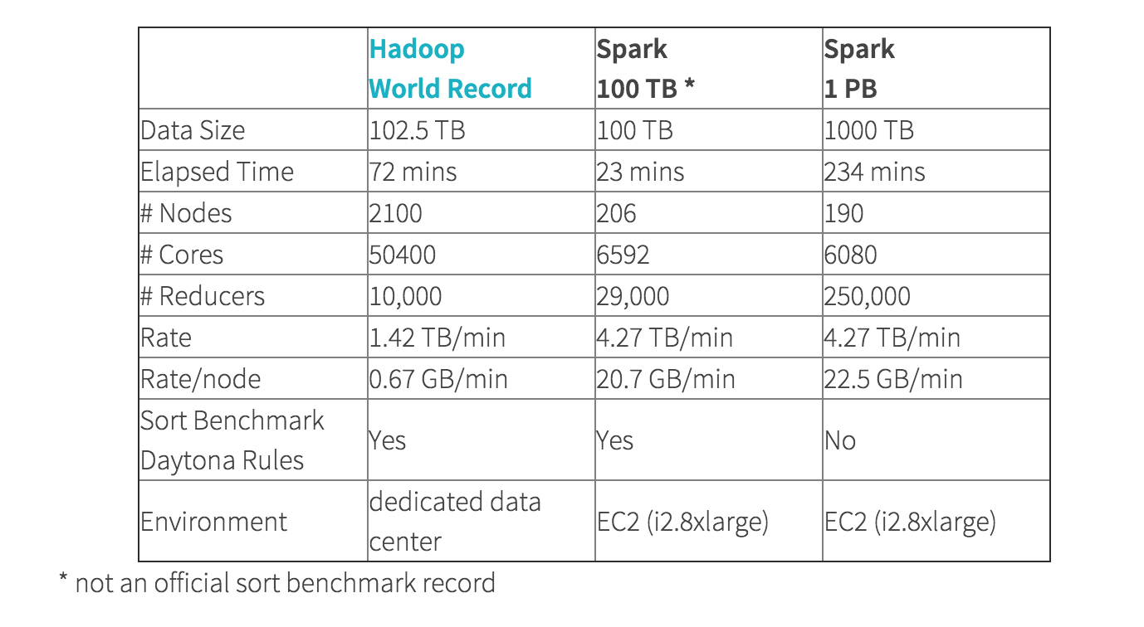
Hadoop vs Spark sorting

Slide 13

Apache Spark cluster model

Slide 14
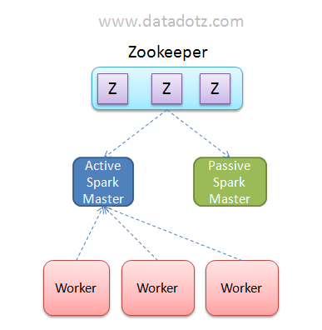
Apache Spark Master availability
http://chennaihug.org/knowledgebase/high-availability-of-apache-spark-using-apache-zookeeper-quorum/

Slide 15
Spark Coding
You can code in:
Scala
Java
Python
R
SQL
We will be using Python in the class
After you leave here you can use anything you like
Including “Not Spark”

Slide 16
Spark Key Objects
RDD
Think of it like an array
You can do map/reduce operations on it
And others
But you can’t assume everything is run on one machine
Unless you explicitly force that using forEach() or collect()
DataFrame
Think of it like a DB resultSet
You can convert from DF <-> RDD

Slide 17
Apache Spark RDD objects
Typical operations include
map: apply a function to each line/element
flatMap: can return a sequence not just an element
filter: return element if func(element) is true
reduceByKey: reduces a set of [K,V] key/value pairs
reduce: apply a reducer function
collect: get all the results back to the master (driver) server in the cluster
foreach: apply a function across each element
Operations on RDDs will happen across machines
Be careful!

Slide 18
Most common
RDD.map(lambda x: …)
Applies the lambda function to each element in the RDD
RDD.flatMap(lambda x: ...)
The lambda produces a sequence of items that are then flattened into a single RDD
RDD.reduce(lambda x,y: …)
Applies the function iteratively across all the elements in the RDD

Slide 19
reduceByKey
Function (V,V) → V
Takes pairs (K,V)
It will apply the function within the Key K
[(hello, 1), (hello, 1), (hello, 1), (world,1), (world, 1)] lambda x,y: x+y
What is the result?

Slide 20
Getting results
You often need to bring the results back to a single thread to display them:
collect()
Alternatively you can save the results (which can happen in parallel)
RDD.saveAsTextFile()
DataFrame.save()

Slide 21
Other useful things
first()
Returns the first member of an RDD
take(10)
Returns the first 10 elements
sample(..)/takeSample(..)
Samples the RDD
Very useful for reducing a massive dataset to something workable while you are testing
count()
Counts the RDD
countByKey()
Counts by key
Might have been useful in our word count example ☺
forEach()
Allows you to do operations with side-effects (accumulators)

Slide 22
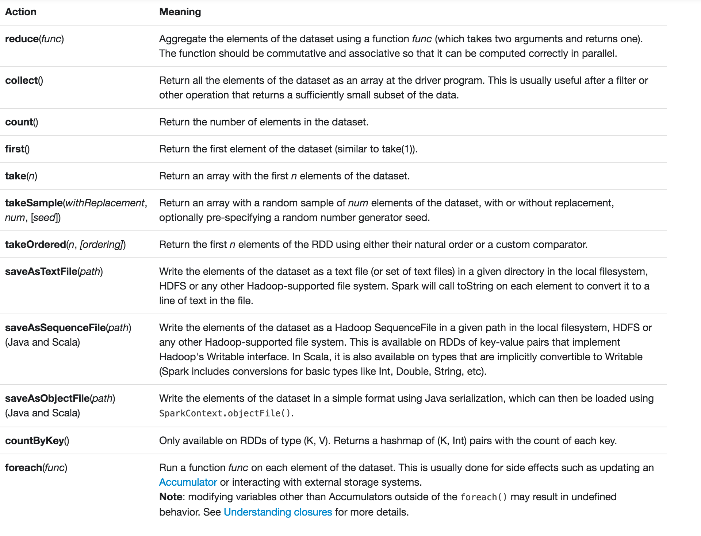

Slide 23
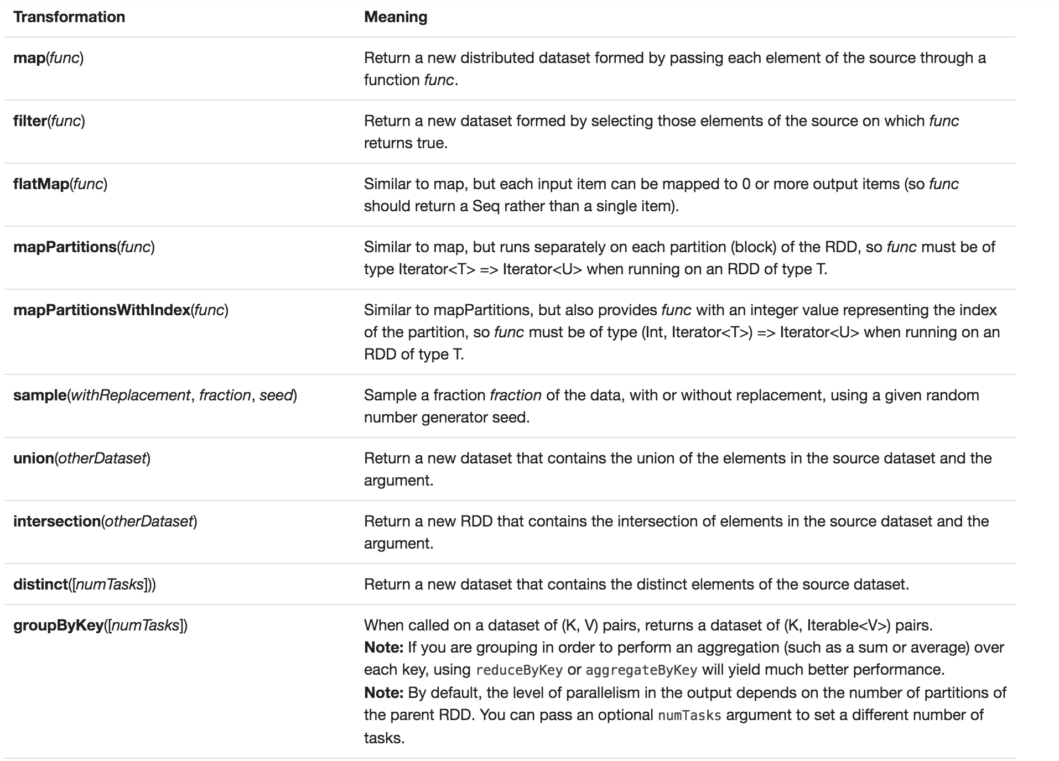

Slide 24
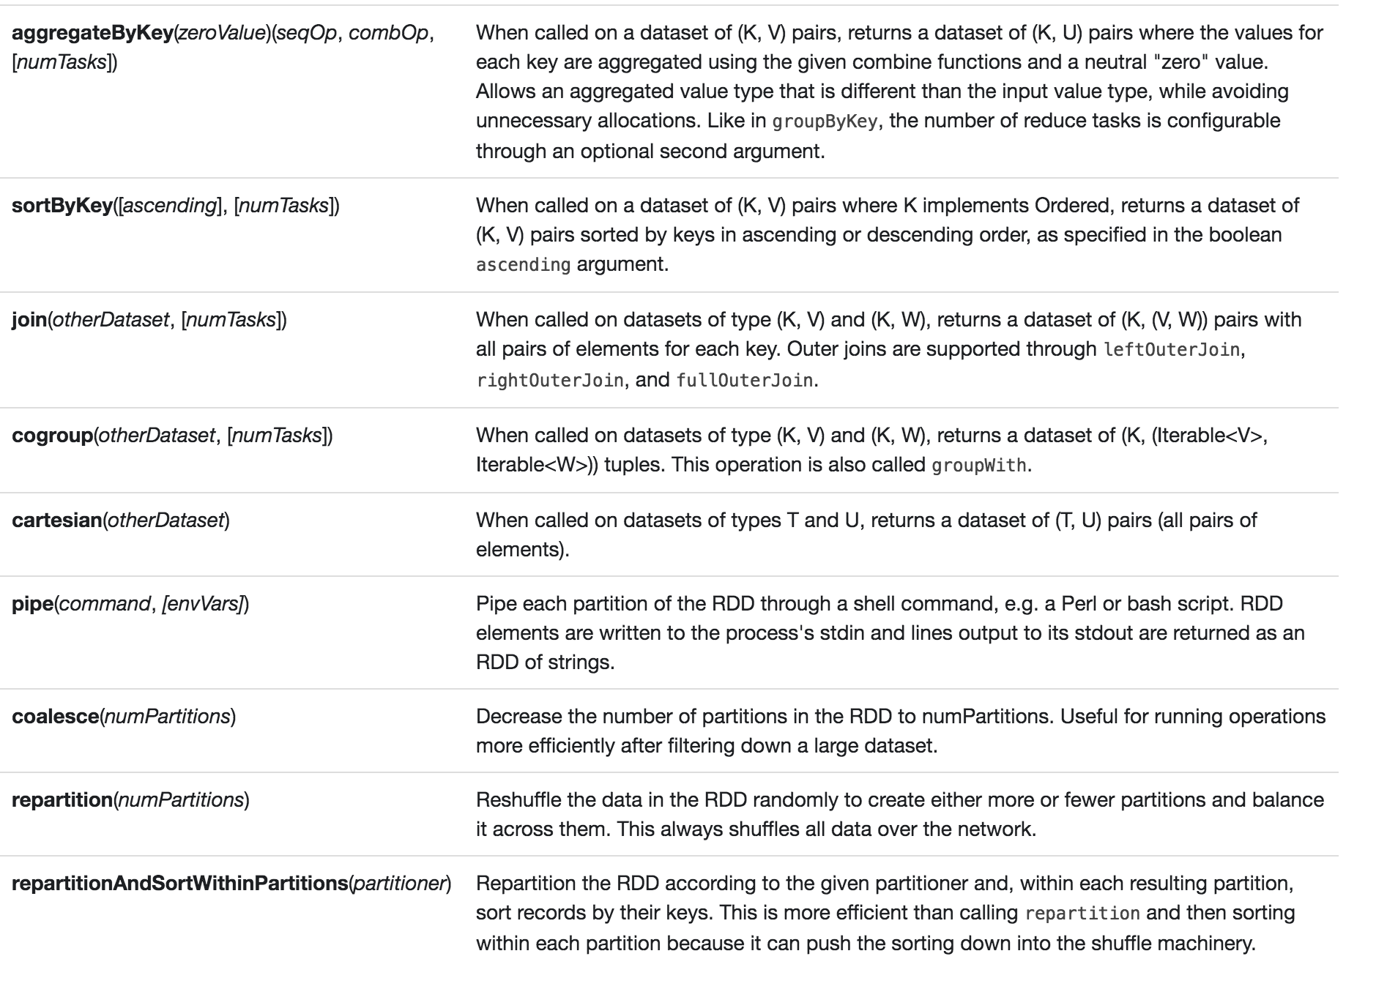

Slide 25
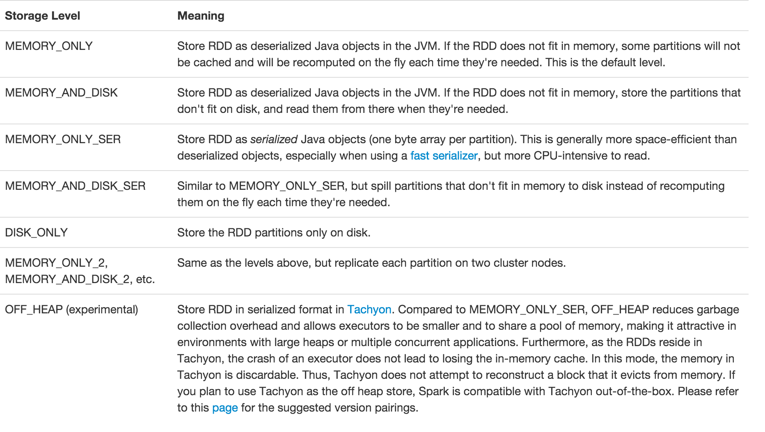
Serialization

Slide 26
Lambda syntax
Lambda’s are unnamed functions
From Alonzo Church’s 1930s work on the Lambda Calculus
Even Java has it now :-)

Slide 27
Lambda syntax in Python
Simply:
f = lambda x: x.split()
g = lambda x,y: x+y

Slide 28
Tuples Clever pattern matching
A tuple in Python is just (x,y) or (x,y,z)
You can have tuples in tuples:
(x, (y,w), z)
What parameters do the following functions take and return?
lambda x,y: x+y lambda (x,y): x+y lambda (w,v),(x,y): ((w+x), (v+y)) lambda (x,(y,z)): (x,y+z)

Slide 29
Example
sc = SparkContext()
books = sc.textFile(“books/*”)
split = books.flatMap(lambda line: line.split())
numbered = split.map(lambda word: (word, 1))
wordcount = numbered.reduceByKey(lambda a,b: a+b)
for k,v in wordcount.collect():
print (k,v)
sc.stop()

Slide 30
What doesn’t work in a cluster
counter = 0
rdd = sc.parallelize(data)
# Wrong: Don't do this!!
rdd.foreach(lambda x: counter += x)
print("Counter value: " + counter)

Slide 31
Apache Spark cluster model

Slide 32
How to count across a cluster?
Accumulators
acc = sc.accumulator()
rdd = sc.parallelize(data) rdd.foreach(lambda x: acc.add(x))

Slide 33
What also doesn’t work
rdd.forEach(println)
Of course this will work when you test in local mode

Slide 34
SparkSQL
Integrates into existing Spark programs
Mixes SQL with Python, Scala or Java
Integrates data from CSV, Avro, Parquet, JDBC, ODBC, JSON, etc
Including joins across them
Fully supports Apache Hive
If you build it with Hive support
Fits into the resilient scalable model of Spark

Slide 35
Spark SQL example
from pyspark.sql import SQLContext, Row
sqlContext = SQLContext(sc)
lines = sc.textFile("examples/src/main/resources/people.txt")
parts = lines.map(lambda l: l.split(","))
people = parts.map(lambda p: Row(name=p[0], age=int(p[1])))
schemaPeople = people.toDF()
schemaPeople.registerTempTable("people")
teenagers = sqlContext.sql("SELECT name FROM people WHERE age >= 13 AND age <= 19")
teenNames = teenagers.rdd.map(lambda p: "Name: " + p.name)
for teenName in teenNames.collect():
print(teenName)

Slide 36
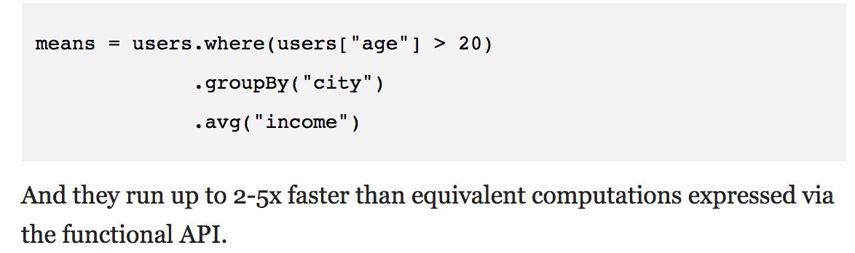
DataFrame Based on Python and R dataframes
Column based object used by SQL
Offers SQL like programming
Supports algebraic optimisation and code gen
E.g. in Scala:

Slide 37
More SQL
df. select('postcode’,’id'). withColumn('first_pc', split(df.postcode, '\s’[0]). where((col("first_pc") == 'SW11') or (col("first_pc") == 'OX1')). groupBy('first_pc'). agg({"id": "count"}).show()

Slide 38
Spark packages
A wide set of plugins
Currently 148 community donated plugins
Data connectors
Cassandra, Couchbase, Mongo, CSV, etc
Machine Learning, Neural networks
Streaming
etc

Slide 39
Using Spark Packages
Automatic download from the web:
bin/spark-shell
--packages com.databricks:spark-csv_2.11:1.2.0

Slide 40
Notebooks
A way of creating and sharing big data analysis
Combines code, comments, analysis and results
Jupyter
Previously IPython, now much extended for Big Data
Supports not just Python, but Spark Scala and others
Apache Zeppelin
A new project aimed at multiple big data analysis models

Slide 41
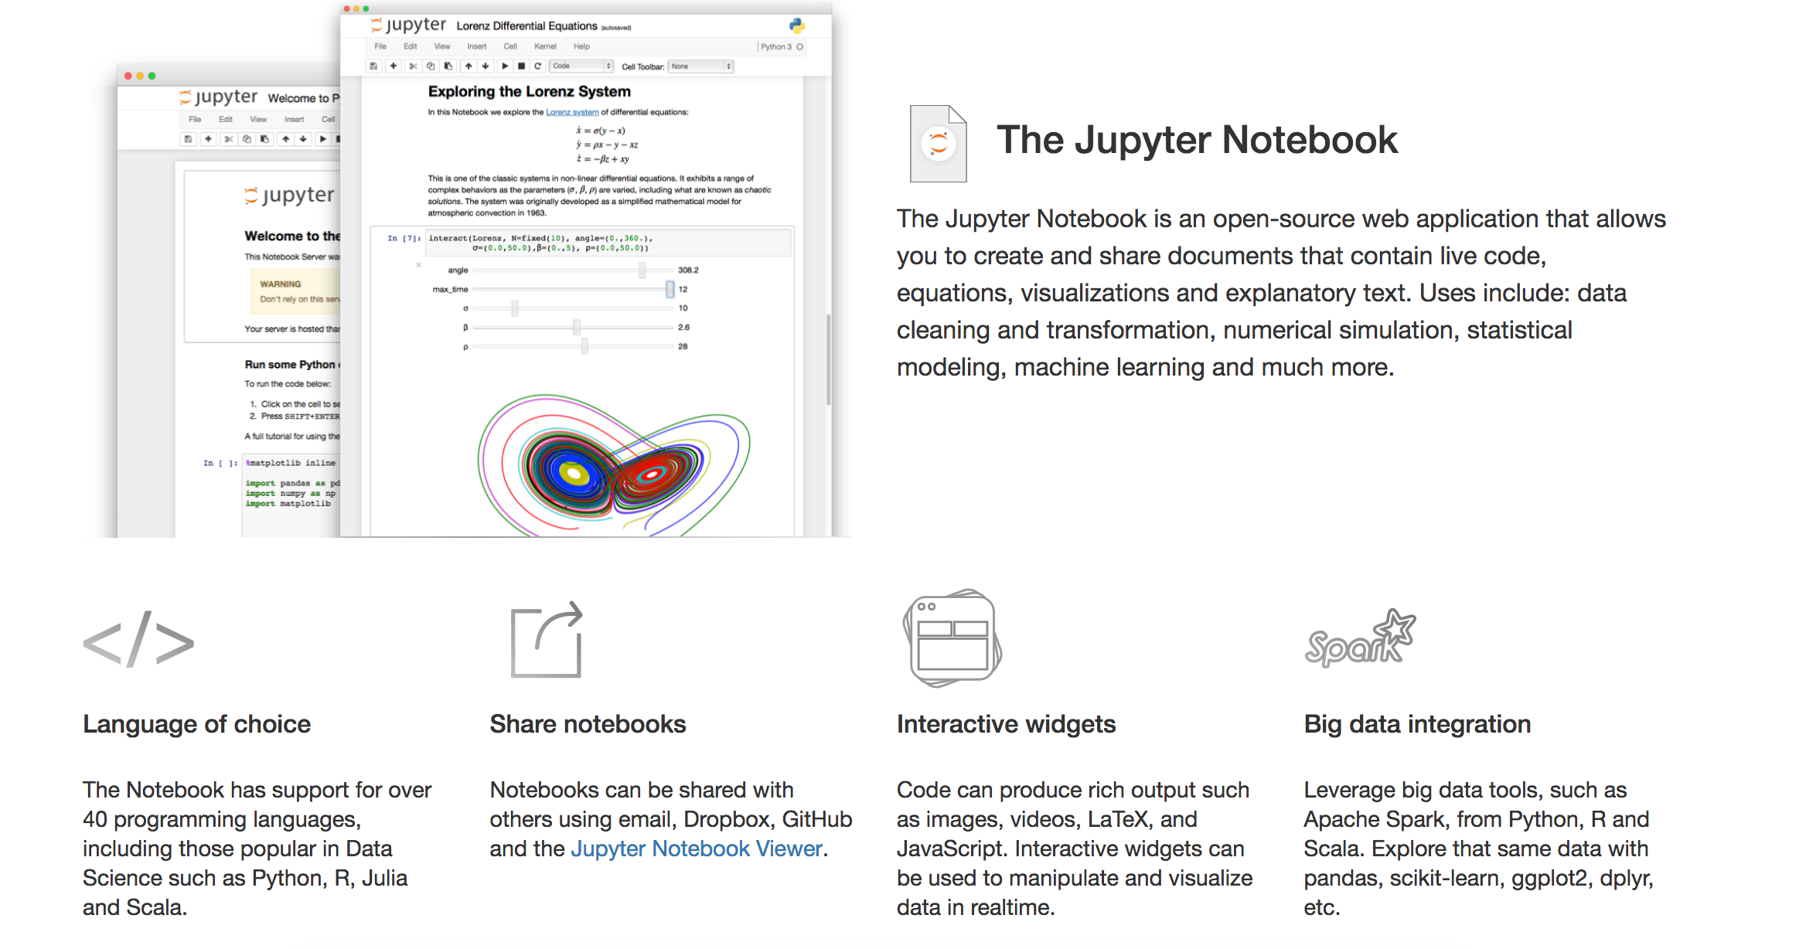
Jupyter

Slide 42
Time for a lab!

Slide 43
Locality
Spark understands the locality of data:
Already in memory
HDFS location
Cassandra location

Slide 44
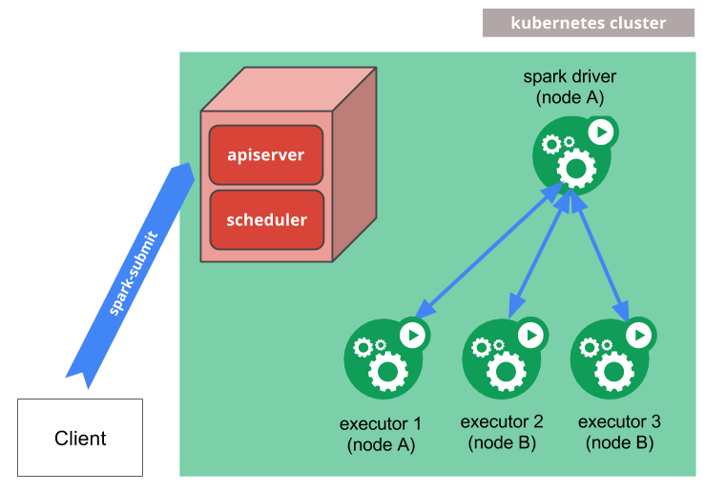
Spark on Kubernetes
https://spark.apache.org/docs/latest/running-on-kubernetes.html

Slide 45
Spark Extras
Spark
SQL
Spark Streaming
Spark
MLlib
SparkR
GraphX
Spark Core

Slide 46
Spark Extras
Spark Streaming
Realtime analysis in Spark
Spark MLLib
Like Mahout – Machine learning in Spark
GraphX
Graph processing in Spark
SparkR
R statistical analysis on Spark

Slide 47
Spark MLlib
Simple stats and correlation testing
Classification and regression
Collaborative Filtering
Alternating Least Squares
Clustering
k-means, etc
Frequent Pattern Mining
Plus more

Slide 48
MLlib example
from pyspark.mllib.fpm import FPGrowth
data = sc.textFile("data/mllib/sample_fpgrowth.txt")
transactions = data.map(lambda line: line.strip().split(' '))
model = FPGrowth.train(transactions, minSupport=0.2, numPartitions=10)
result = model.freqItemsets().collect()
for fi in result:
print(fi)

Slide 49
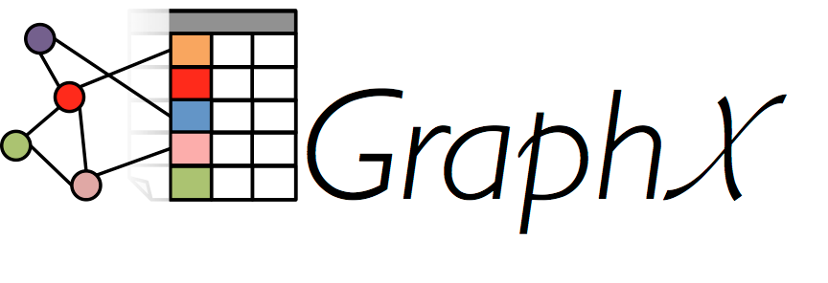
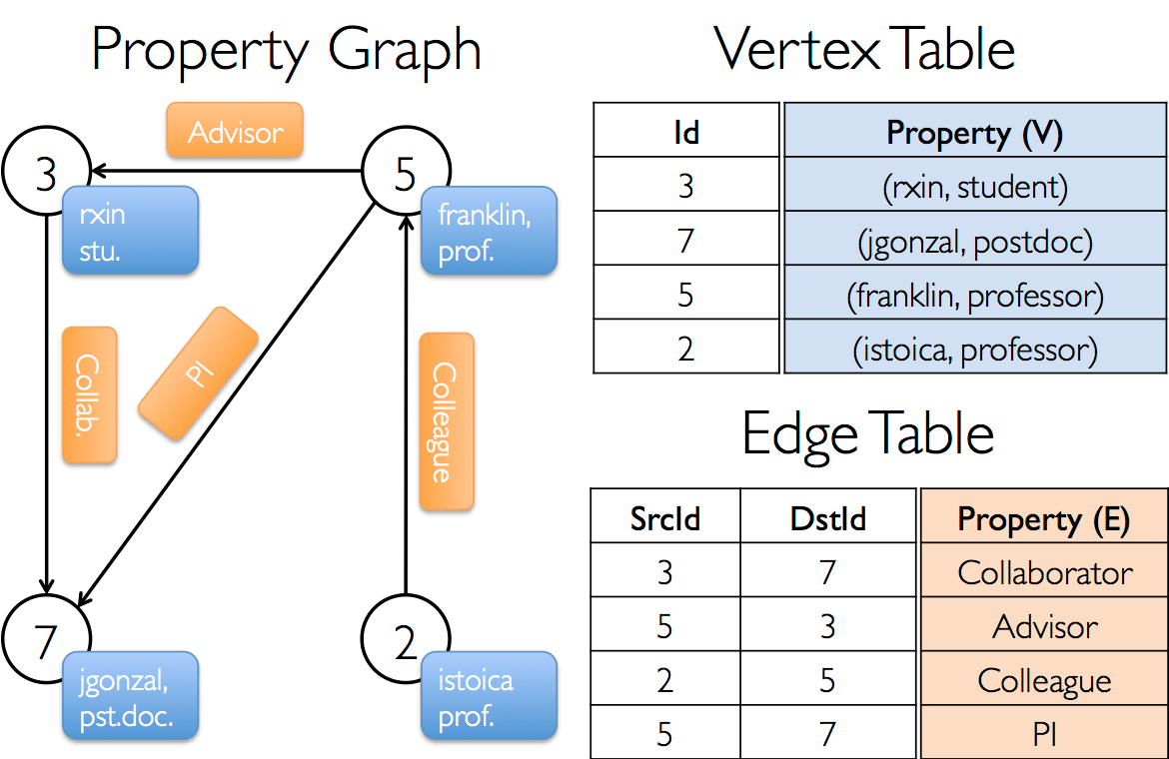
GraphX

Slide 50

R
R is an open source system for statistics and graphics
Based on the S language from AT&T Bell Labs
Supports a wide variety of statistical techniques and graphing tools
An extensible set of packages that provide extra functions via CRAN
The Comprehensive R Archive Network

Slide 51
SparkR
A lightweight approach to use Spark from within R
Also works with MLlib for machine learning
Allows complex statistical analysis to be done on a Spark cluster

Slide 52
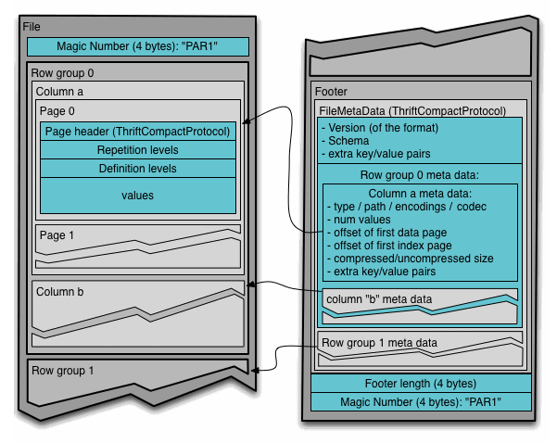
Apache Parquet
Apache Parquet is a columnar data storage model
Works with Hadoop, Spark and many others
Efficient storage of data
Based on another Google system called Dremel

Slide 53
Questions?

