Slide 1
Cloud Computing and Big Data Apache Cassandra
Oxford University
Software Engineering Programme
July 2021

Slide 2
Apache Cassandra
Masterless / Symmetric
Every node is equal and you can write to any node as well as read
Shared Nothing architecture
Each server has its own disk
Based on Dynamo
for automatic sharding and eventual consistency
And BigTable
For “Column Families”
Donated to Apache by Facebook
Now mostly developed by DataStax

Slide 3
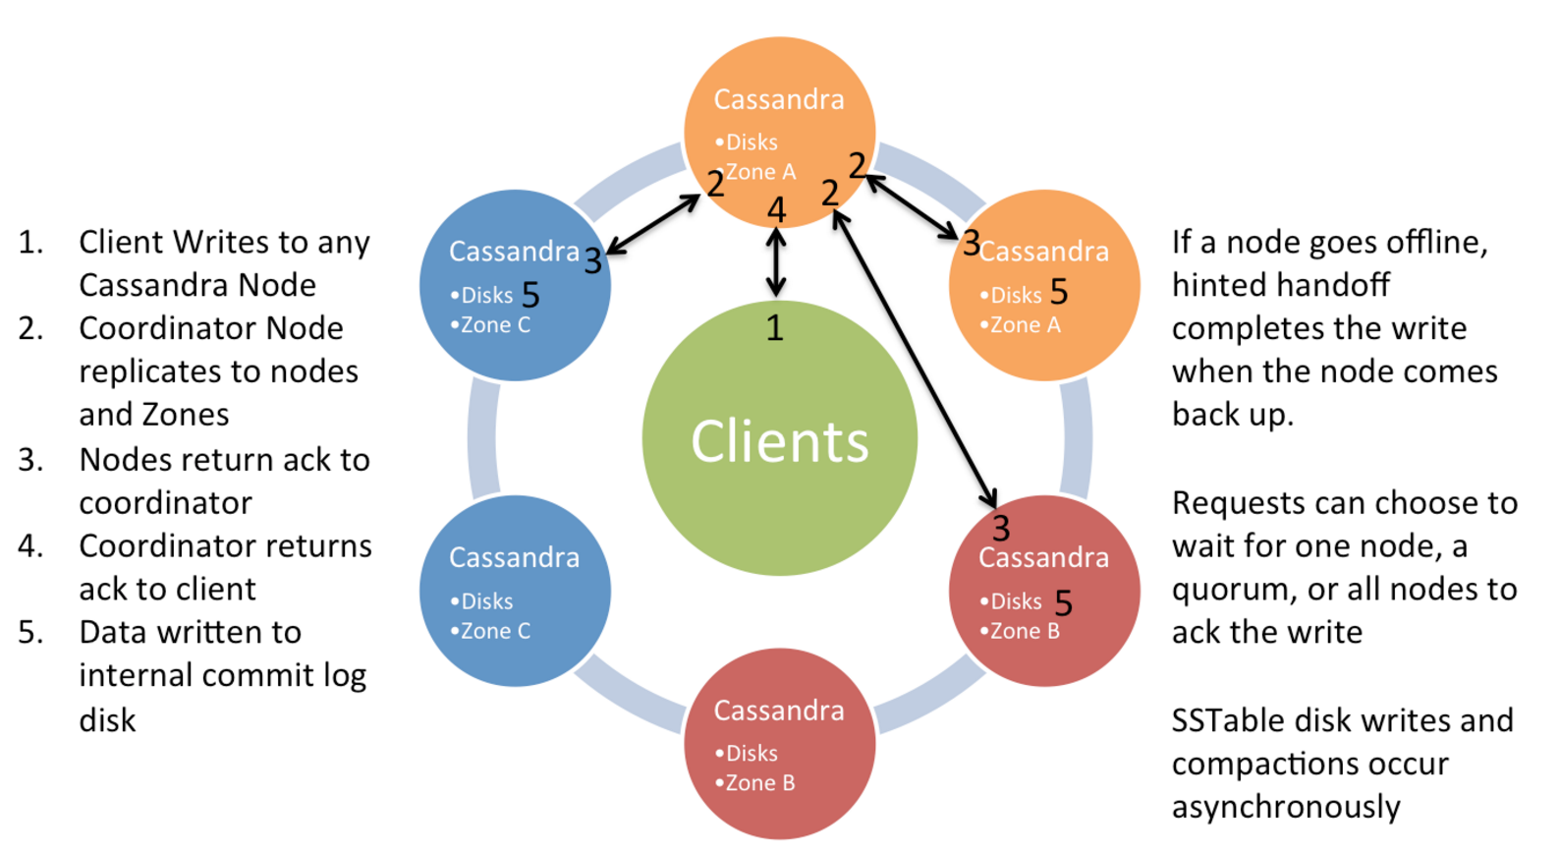
Cassandra Write Model Single Datacentre
Source: Netflix

Slide 4
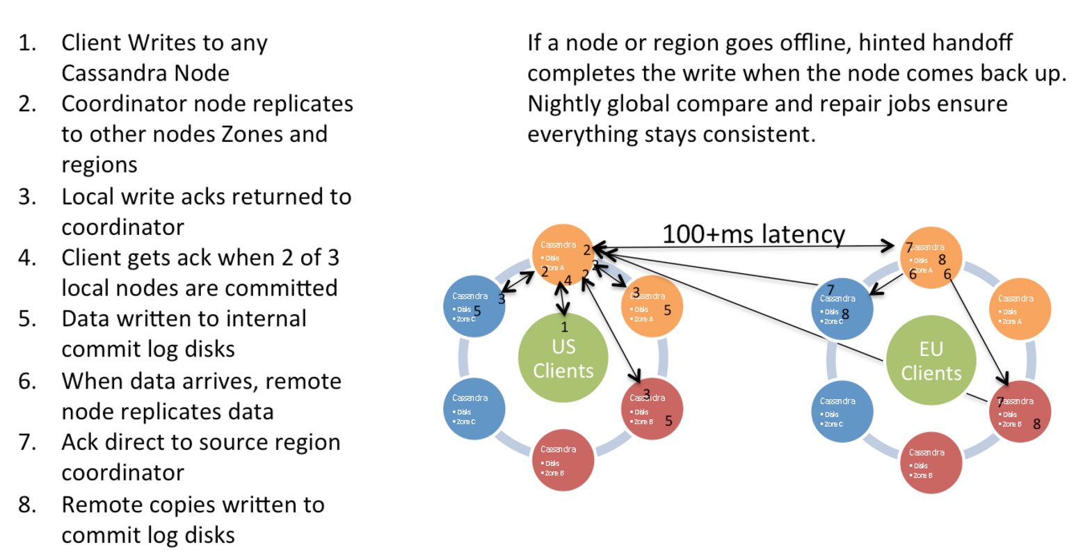
Multi Datacentre Writes
Source: Netflix

Slide 5
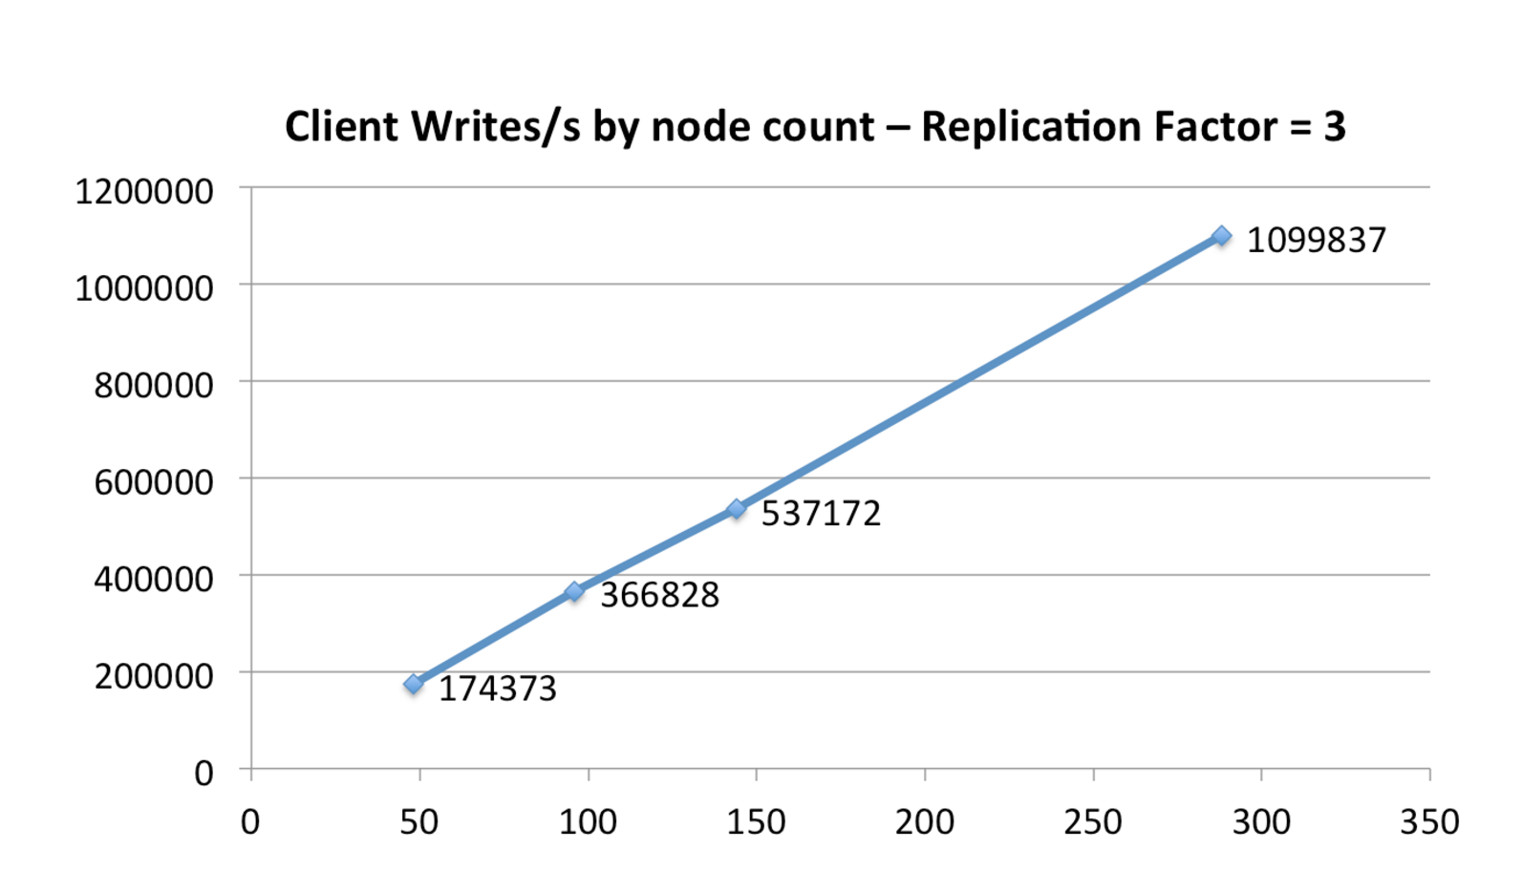
Cassandra Scale Up In Amazon EC2
From Netflix
Source: Netflix

Slide 6
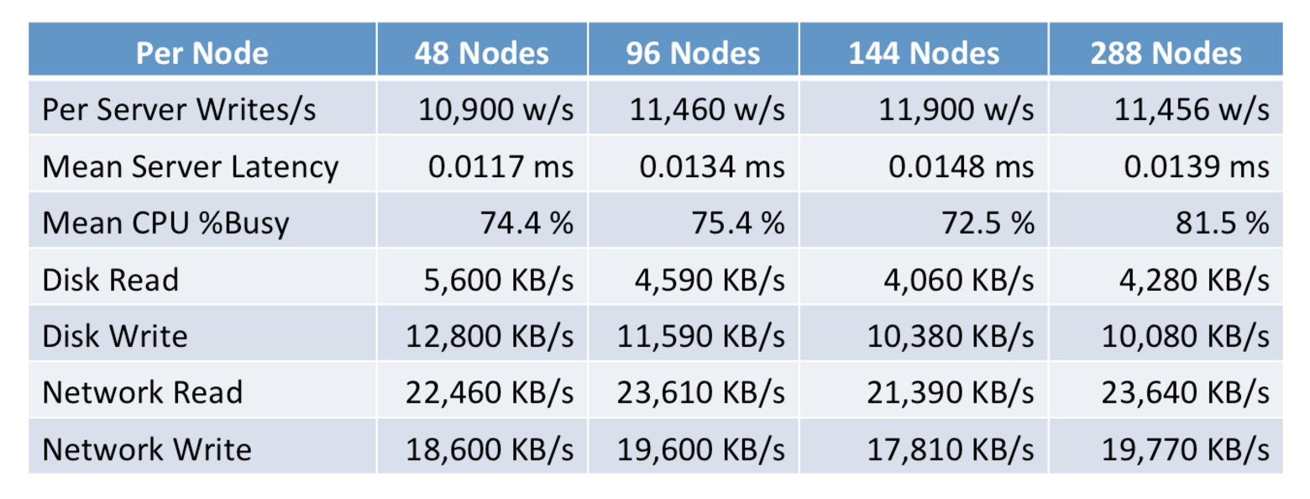
The numbers
Source: Netflix

Slide 7
Cassandra Model
Keyspaces are roughly equivalent to SQL Databases
Encapsulate replication strategies
Column Families roughly equivalent to SQL tables
Generally a different approach vs SQL
Writes are cheap
Indexes are expensive
Normalization is not the goal

Slide 8
Cassandra Model cont.
Inserts are the same as updates
No read first
Data can be marked with a Time to Live (TTL)
Automatically deleted
Deletes are not instant
Deleted rows are marked with a tombstone
Eventually cleaned up
Can re-appear if you do not run node repair after a node failure

Slide 9
Partitioning
Row Insert
Node1
Hash Function
Node5
Node2
Node4
Node3

Slide 10
Partitioning / Hashing
Cassandra partitions your data via a Hash function onto different nodes
Based on the row key
This can be random (MD5 hash), or specific to the data (ordered)
Random is recommended as it is guaranteed to be balanced
The latest random partitioner is the Murmur3Partitioner based on the Murmur3 hash function
https://en.wikipedia.org/wiki/MurmurHash
Specified in cassandra.yaml

Slide 11
Replication
Row Insert
Node1
Hash Function
Node5
Node2
Node4
Node3

Slide 12
Replication
Each row is replicated to other servers based on the replication factor
Replication factor 1 means no copies
Set per keyspace
SimpleStrategy
Copied onto the next n servers clockwise in the cluster
NetworkTopologyStrategy
Tries to get onto a different rack
Or a different datacentre if you specify a Replica Group

Slide 13
The snitch
Manages the Replication
Simple Snitch
Simple replication strategy
Rack Inferring Snitch
Assumes your IP address octets define the datacentres and racks
Property File Snitch
Let’s you specify your topology using a properties File
EC2 snitch
Makes calls to EC2 to understand the topology

Slide 14
CQL
A variant of SQL written specifically for Cassandra
The preferred model of access
Replaces the old “Thrift” API
Attempts to have some compatibility with normal SQL
e.g. you can use either KEYSPACE or TABLE interchangeably

Slide 15
CQL examples
SELECT name, occupation FROM users WHERE userid IN (199, 200, 207);
However, some queries are not permitted:
SELECT firstname, lastname FROM users WHERE birth_year = 1981 AND country = 'FR';
Requires a large scan of the database and cannot give a predictable time response:
ALLOW FILTERING will make this run anyway

Slide 16
INSERT / UPDATE
INSERT INTO NerdMovies (movie, director, main_actor, year)
VALUES ('Serenity', 'Joss Whedon', 'Nathan Fillion', 2005)
USING TTL 86400;
Every row can have a specified expiry time
Inserts work even if the data is already there, unless you specify:
INSERT INTO NerdMovies (movie, director, main_actor, year)
VALUES ('Serenity', 'Joss Whedon', 'Nathan Fillion', 2005) IF NOT EXISTS
USING TTL 86400;
This can have unpredictable timing because it requires read-before-write

Slide 17
Non-SQL data types
Sets
CREATE TABLE cycling.cyclist_career_teams ( id UUID PRIMARY KEY, lastname text, teams set<text> );
Lists
CREATE TABLE cycling.upcoming_calendar ( year int, month int, events list<text>, PRIMARY KEY ( year, month) );
Maps
CREATE TABLE cycling.cyclist_teams ( id UUID PRIMARY KEY, lastname text, firstname text, teams map<int,text> );
Tuples
CREATE TABLE cycling.popular (rank int PRIMARY KEY, cinfo tuple<text,text,int> );

Slide 18
Direct support for JSON
INSERT INTO cycling.cyclist_category JSON '{
"category" : "GC",
"points" : 780,
"id" : "829aa84a-4bba-411f-a4fb-38167a987cda",
"lastname" : "SUTHERLAND" }';

Slide 19
cassandra.yaml
Configuration of the major parts of the system
Datacentres, Racks, Cluster name
Authentication and Authorization
Partitioner
Data Storage location
Cacheing
Network topology and ports
Etc, etc

Slide 20
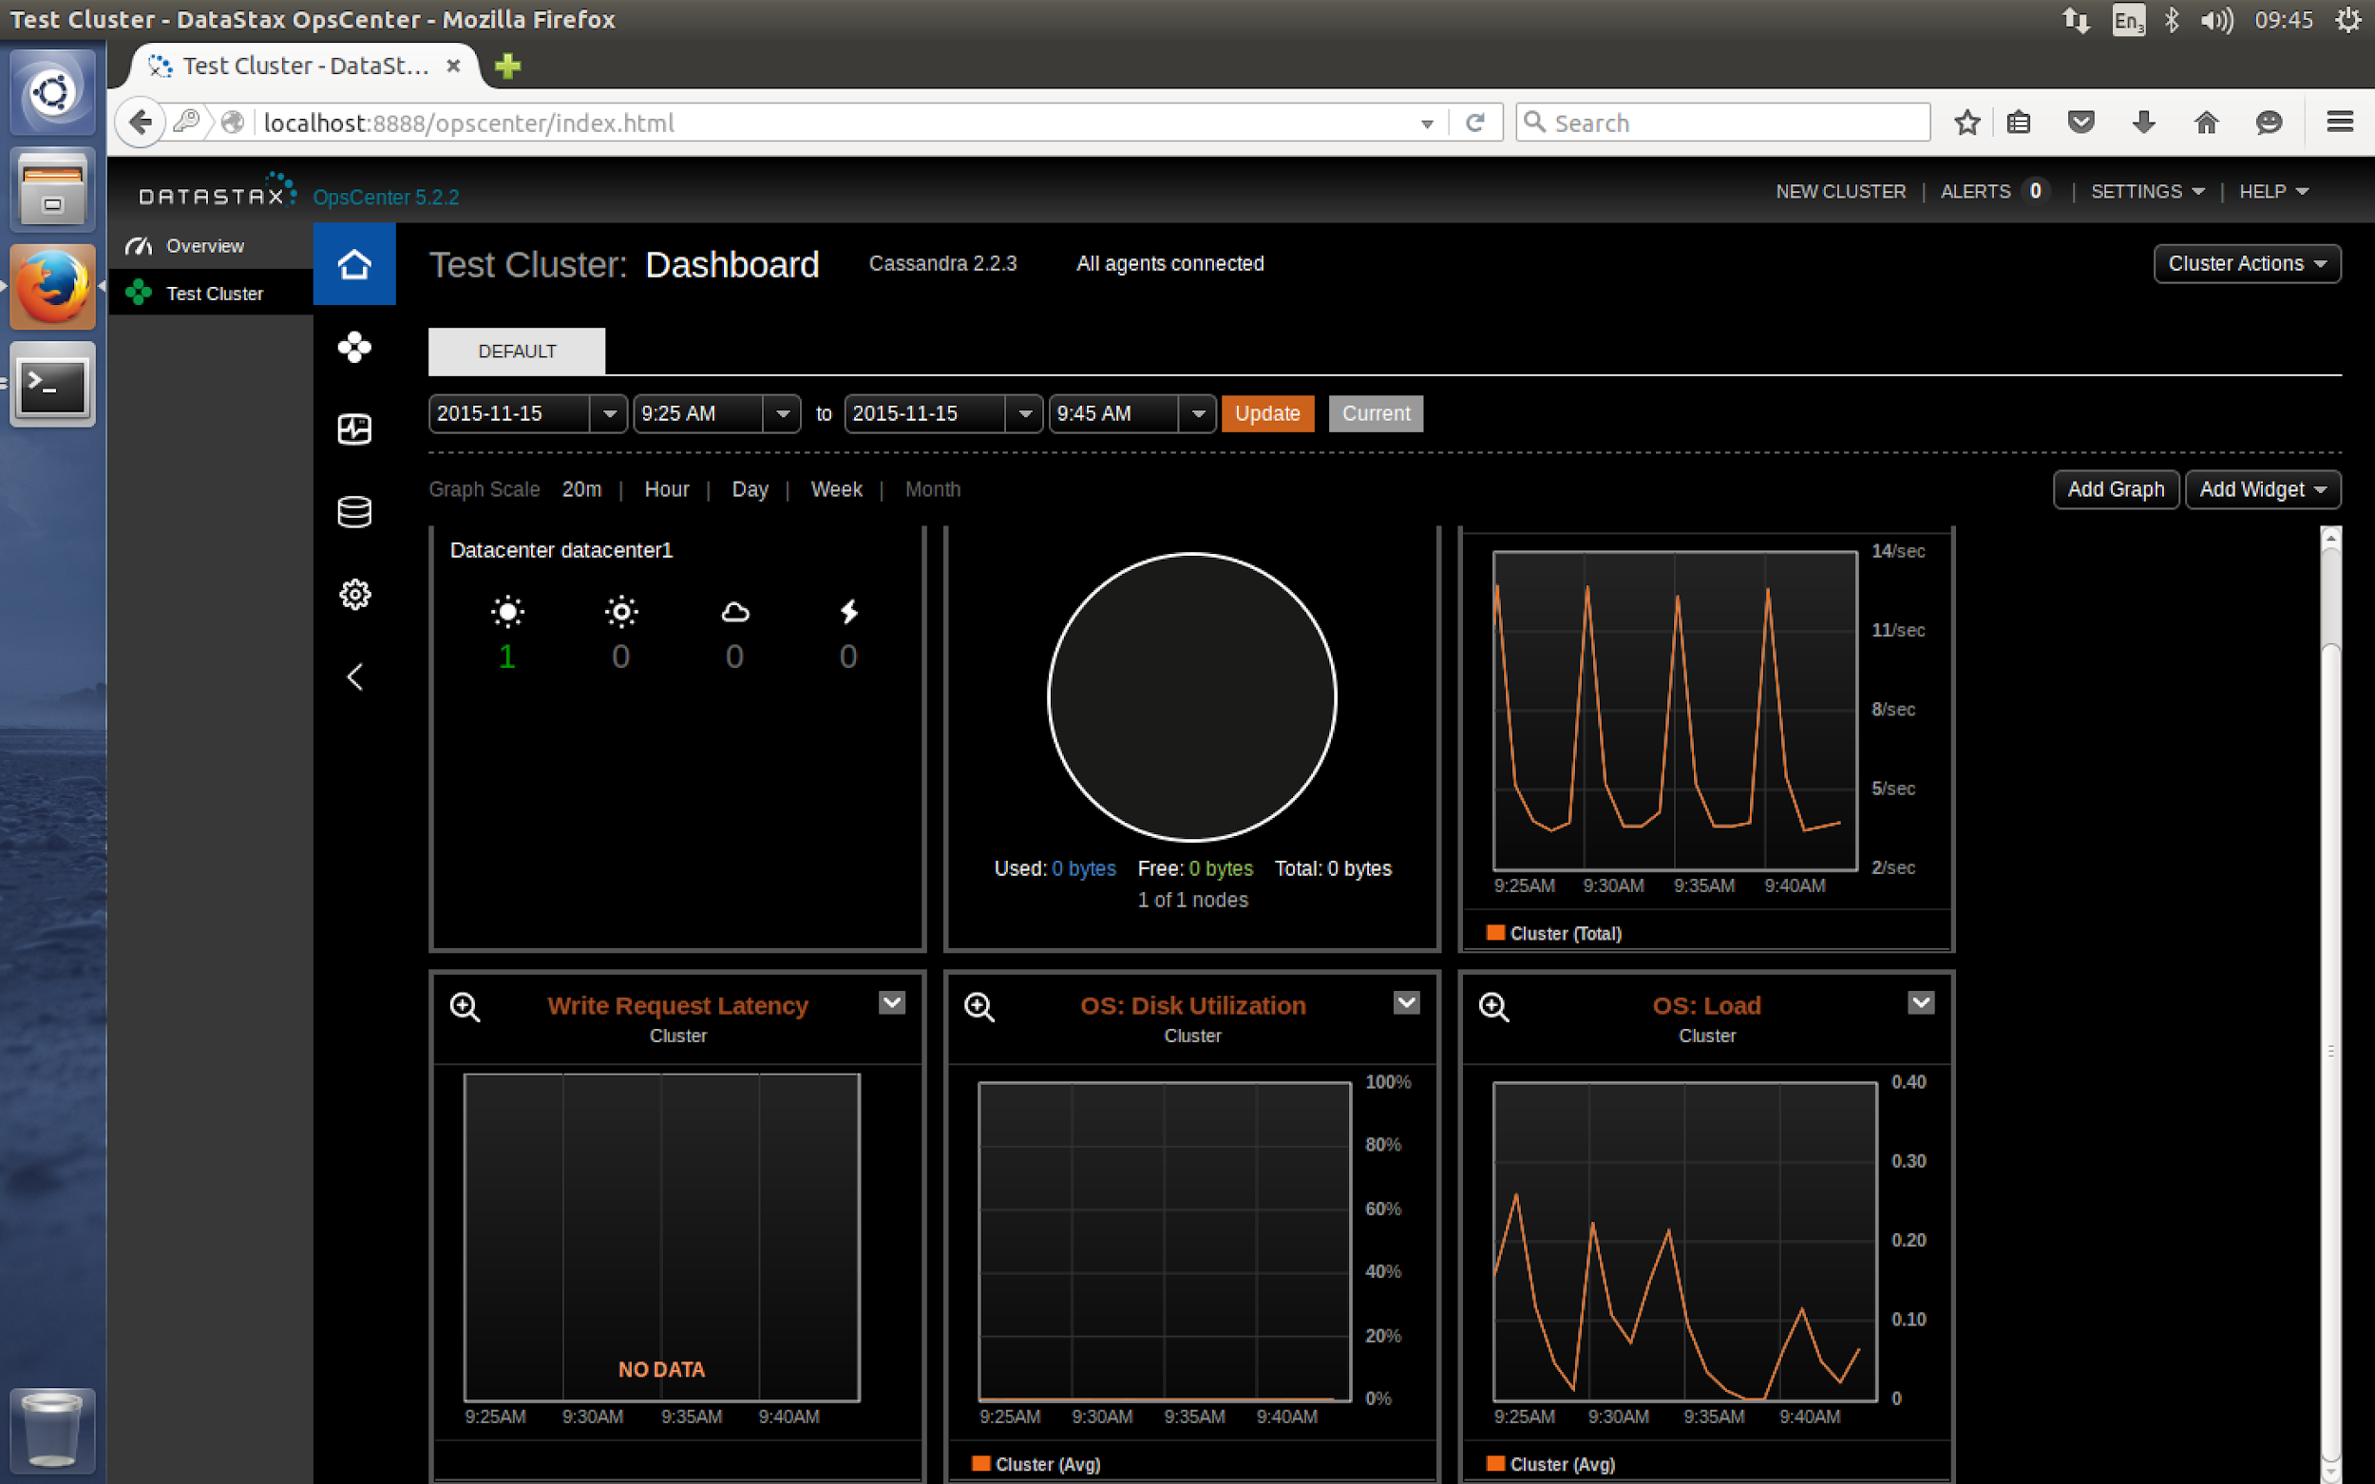
DataStax OpsCenter

Slide 21
OpsCenter
Part of DataStax Cassandra distribution
Community edition has limited features
Enterprise edition expands these
Not open source, but free to use in the community edition
Requires an agent on each Cassandra node
It will install this via SSH if possible

Slide 22
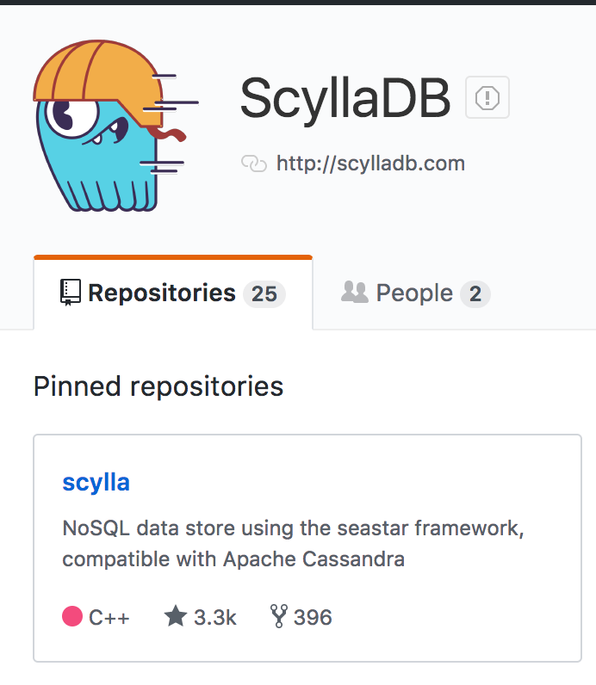
ScyllaDB
A C++ “clone” of Cassandra
Also Open Source
Claims to be significantly faster

Slide 23
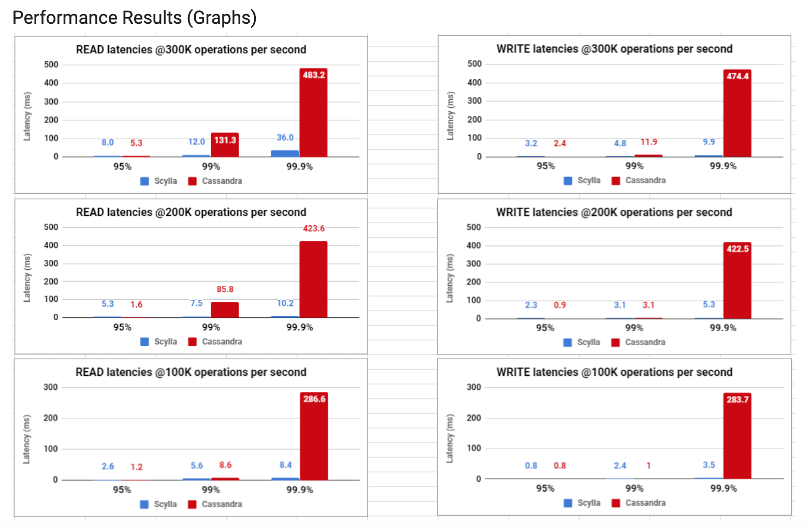
Scylla vs Cassandra

Slide 24
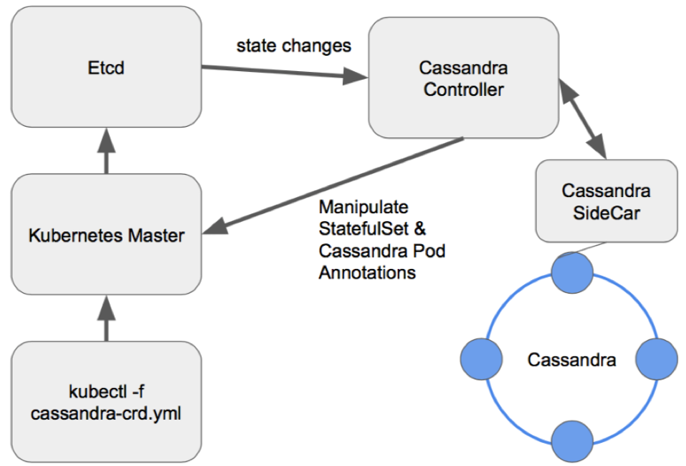
Cassandra on Kubernetes
https://kubernetes.io/docs/tutorials/stateful-application/cassandra/
https://medium.com/flant-com/running-cassandra-in-kubernetes-challenges-and-solutions-9082045a7d93

Slide 25
Questions?

