Slide 1
Cloud Computing and Big Data Cloud Computing Background and Theory
Oxford University
Software Engineering Programme
July 2020

Slide 2
Contents
Distributed Computing
Scalability
Virtualization
Multi-tenancy
Amdahl’s Law and Gustavson’s Law
Karp-Flatt Metric
Shared Nothing Architectures
CAP Theorem
Eventual Consistency

Slide 3
Distributed Computing
Cloud would not be possible without RPC/Services/APIs
e.g. Call a service to instantiate a machine image for us
Grid and Cloud both emerged from distributed computing concepts

Slide 4
Fundamental problems in Distributed Computing
Efficient distribution of work
combating serialization
Consensus
combating failure

Slide 5


Virtualization
Apps
Apps
Apps
Apps
OS
OS
OS
OS
Hypervisor
Physical Hardware

Slide 6
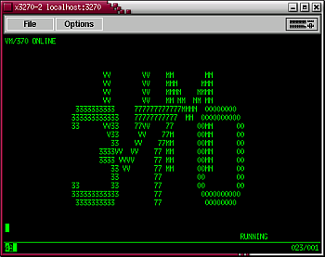
Virtualization
Dates back to 1972 with IBM VM/370
Each user had a “virtual mainframe”
Including a virtual punch card reader and writer!

Slide 7
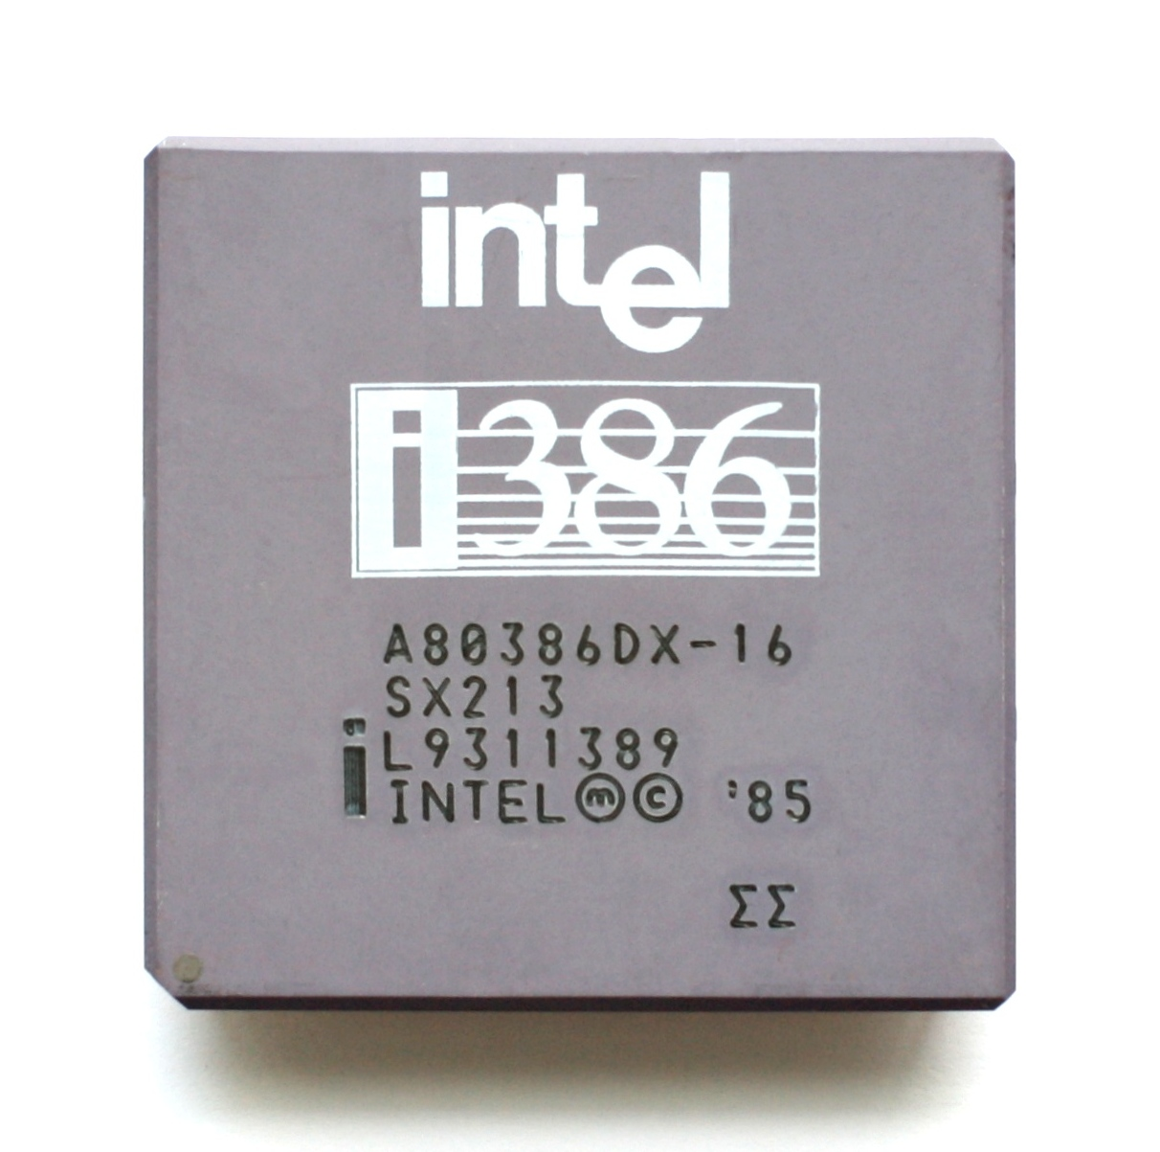
Commodity Hardware Virtualization
1985

Slide 8

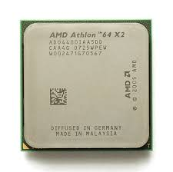
Late 2005 / Early 2006
VT-X
AMD-V

Slide 9
Benefits of Virtualization
Replicability
Machines become repeatable images
Can be migrated, snapshotted, version controlled
Better resource utilization
Most servers run at about 6-12% utilization
Flexibility
New instances don’t necessarily require new hardware

Slide 10
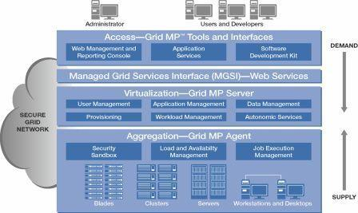
Grid Computing

Slide 11


What is Multi-tenancy ?
Many parties sharing the same set of resources, while giving each their own space

Slide 12
Multi-tenancy models
Pure hardware
Virtual Machine
Container
Isolation
Shared Process
Resource Optimization

Slide 13
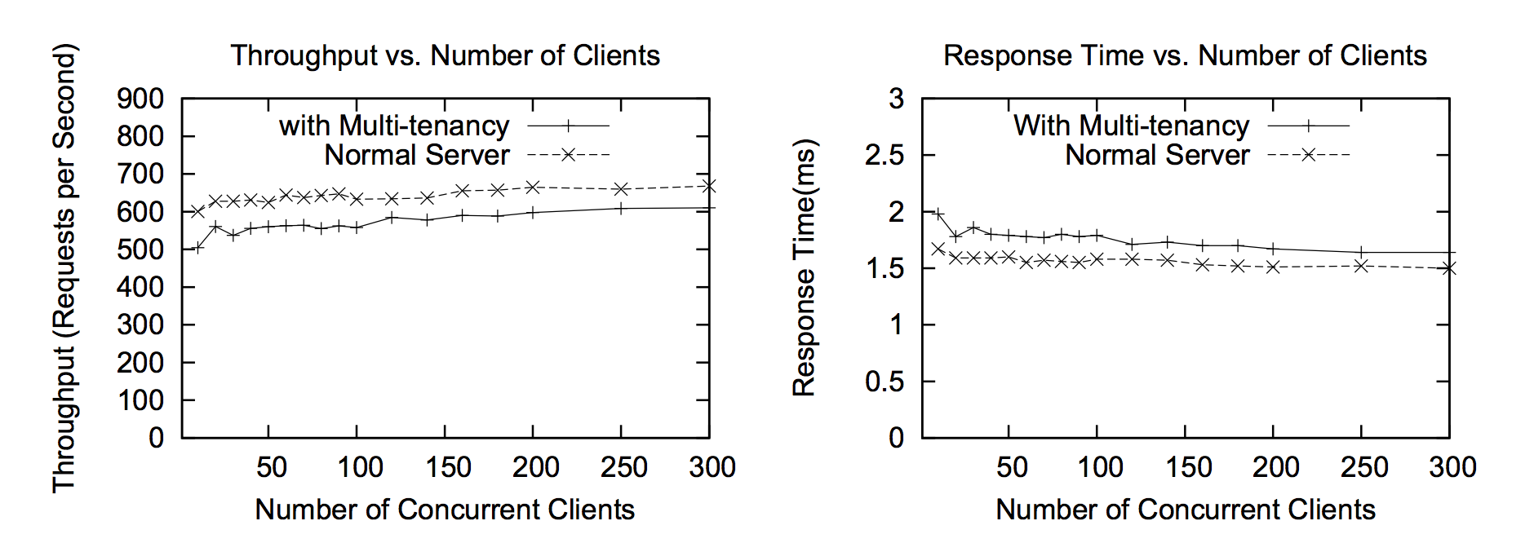
Performance Overhead of Multi-Tenancy in WSO2 Carbon platform
Azeez, Afkham, Srinath Perera, Dimuthu Gamage, Ruwan Linton, Prabath Siriwardana, Dimuthu Leelaratne, Sanjiva Weerawarana, and Paul Fremantle. "Multi-tenant SOA middleware for cloud computing." In Cloud computing (cloud), 2010 ieee 3rd international conference on, pp. 458-465. IEEE, 2010.

Slide 14
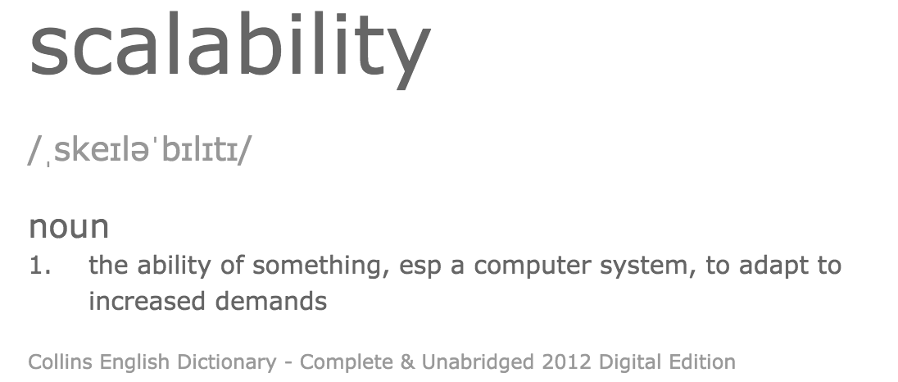

Slide 15
Speedup
The speedup is defined as the performance of new / performance of old
e.g. move from 1 -> 2 servers
New system is 1.8 x faster than the old
In terms of transactions/sec (throughput)
Speedup = 1.8

Slide 16
What inhibits speedup?
In general you can split work into
Parallelizable and
Serial
parts
The serial parts stop you from scaling

Slide 17
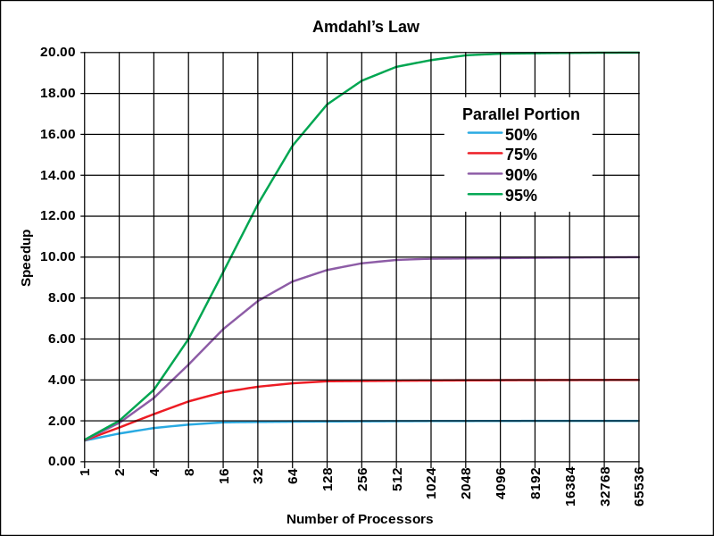
Amdahl’s Law Theoretical speedup given a fixed data size
The speedup of a program using multiple processors in parallel computing is limited by the time needed for the serial fraction of the program, given a fixed size of data

Slide 18
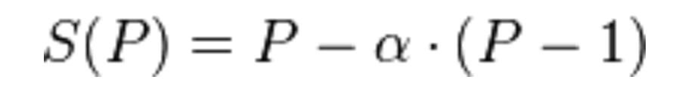
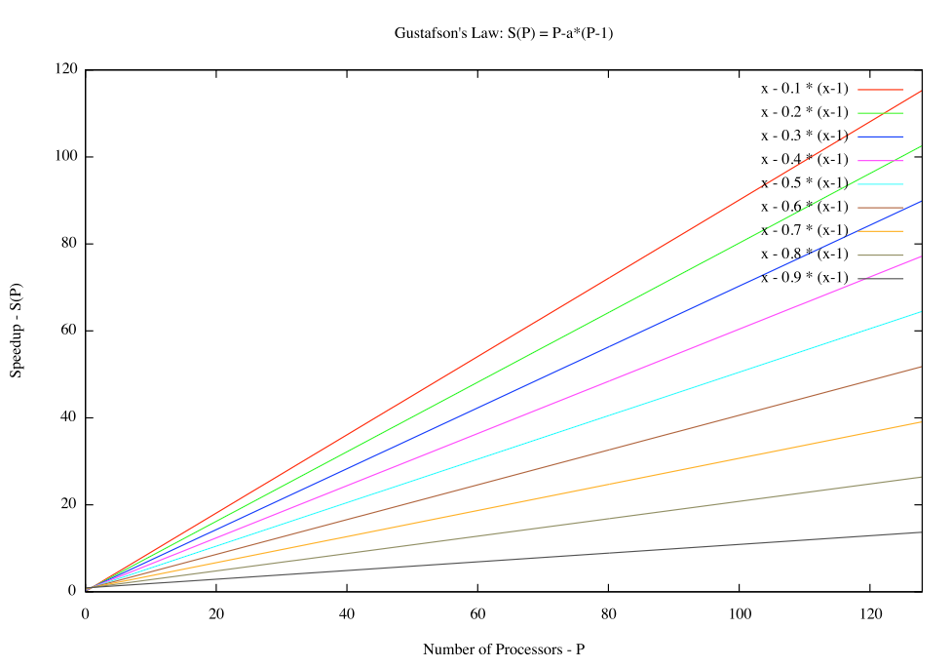
Gustafson’s Law What if the data increases too?
α is the largest
non-parallelizable fraction

Slide 19
A driving metaphor
Amdahl’s Law
You are travelling to London (60 miles)
30 miles in you have spent one hour
You can never average > 60 mph
Gustafson’s Law
You are travelling across the US
You’ve spent an hour at 30 mph
You can achieve any average speed given enough time and distance

Slide 20
Performance Single system under increasing load
Good
Performance
Bad
Resource contention
causes slowdown
Load

Slide 21
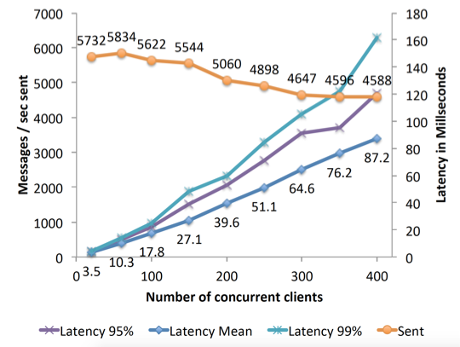
A real example (OAuthing)

Slide 22
Performance Scaling servers when fully loaded
Best
The performance of n servers is equal to
n x the single server performance
Not bad
Additional servers scale linearly,
but there is a cost to scaling
Performance
Bad
System performance
reaches a maximum no matter how many
servers are added
1 server
1 server
Number of servers

Slide 23
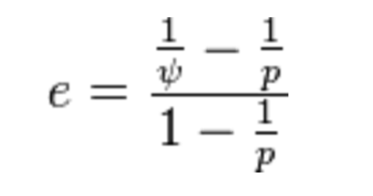
Karp-Flatt Metric
e is the Karp-Flatt Metric
ψ is the speedup
p is the number of processors
e = 0 is the best
e = 1 indicates no speedup
e > 1 indicates adding processors
slows down the system!!!

Slide 24
Karp-Flatt metric
e=0
e=0.3
Performance
e->1 as p increases
1 server
1 server
Number of servers

Slide 25


Shared Nothing Architecture
Server
Disk
Load Balancer
Server
Disk
Server
Disk

Slide 26
Shared Nothing Architecture
Implies there is no serial part to the computation
Karp-Flatt Metric of 0
Assuming 100% efficient load balancing
In practice, this is difficult!

Slide 27
Partitioning / Sharding
A-I
Server
Disk
J-R
Load Balancer
Server
Disk
S-Z
Server
Disk

Slide 28
Problems with Sharding
Imbalance
Fewer S-Z’s than A-I’s
Failover
Adding new servers requires a re-balance
Is this automatic or manual?!

Slide 29
Elastic Scaling
Dynamically adjusting the number of nodes in a cloud
Both up and down
Based on input load
Aiming to meet a specific SLA

Slide 30

Elastic Queue Consumers
Pull
Worker pool
Pull
Job
Queue depth
Elastic Scale
Cloud Controller

Slide 31
Load Balancer-based elastic scaling
Worker pool
Client
Load Balancer
Elastic scale
Cloud Controller
Monitoring
Topology update

Slide 32
Cache
Disk
Server
Disk
Load Balancer
Server
Disk
Server
Cache Server

Slide 33
Consensus
Leadership
How to elect a leader from a group of nodes
Failure detection
How to spot a failed leader

Slide 34
ACID
atomicity
all-or-nothing
consistency
integrity-preserving: invariants satisfied
isolation
hidden intermediate results: multi-user behaviour consistent with single-user mode
durability
permanent committed results

Slide 35
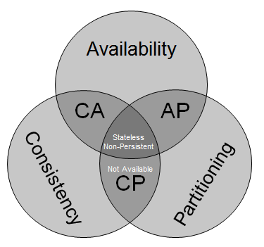
CAP Theorem
Originally proposed by Eric Brewer
Inktomi and Berkeley
Proved in 2002 by Gilbert and Lynch
You can have 2 out of three:
Consistent
ACID
Available
Partitioned
Survive network down between nodes
http://blog.mccrory.me/2010/11/03/cap-theorem-and-the-clouds/

Slide 36
Imagine two nodes
Update
Node 1
Node 2
Propagate
Potential Partition

Slide 37
Imagine two nodes
Update
Node 1
Node 2
Propagate
Potential Partition
If there is a partition, then you can either update one node (give up on C), or make one node unavailable (give up on A). If you want C and A you can’t allow a Partition.

Slide 38
CAP options
CA
Traditional databases
Cannot be scaled multi-datacentre or work in cases of high-latency
AP
Multi-master NoSQL databases
Dynamo, Cassandra, CouchDB
Not consistent but work across datacentres in a highly available model
CP
Not a good idea, as not available!

Slide 39
CAP Theorem
However, the details are important
The proof requires some complex definitions of C, A and P
I recommend reading Brewer’s update:
http://www.infoq.com/articles/cap-twelve-years-later-how-the-rules-have-changed
“The 2 of 3 formulation was always misleading”
“CAP prohibits only a tiny part of the design space”

Slide 40
In real life
Partitions are rare
So we can implement a strategy:
Detect a partition
Enter “partition mode”
Carry on with inconsistency
Recover when partition vanishes
Known as “eventually consistent”

Slide 41
What does recovery mean?
Depends on your database and requirements
E.g. Amazon’s shopping cart is made consistent by creating the union of the inconsistent carts
Deleted items may re-appear
Another option is to forbid certain operations during partition mode
To make it easier to recover consistency
A simplistic approach would be to go read-only

Slide 42
What does that mean in real-life?
Databases like Cassandra let you “tune” consistency and availability
Define the quorum you need for a response
Trades off latency vs consistency
Choose an “easy quorum” for guaranteed low latency
Choose a “hard quorum” for higher potential latency

Slide 43
PACELC (pr. pass-elk)
Partition: Availability vs Consistency, Else Latency vs Consistency
“For data replication over a WAN, there is no way around the consistency/latency tradeoff”
Usually a combination of sync/async
Synchronous writes to n systems followed by asynchronous writes to m systems
http://cs-www.cs.yale.edu/homes/dna/papers/abadi-pacelc.pdf

Slide 44
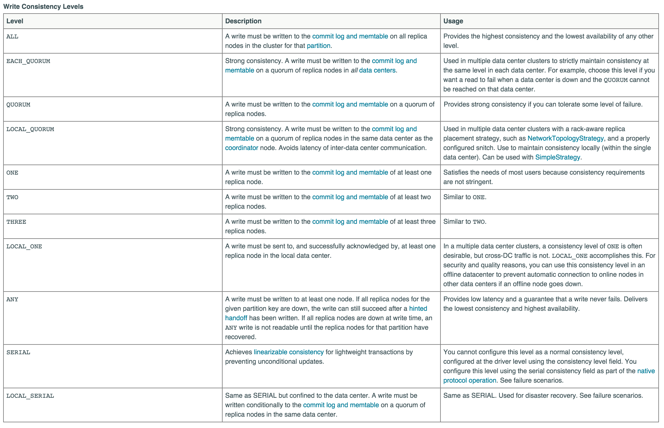
Cassandra Quorum Levels (Write)

Slide 45
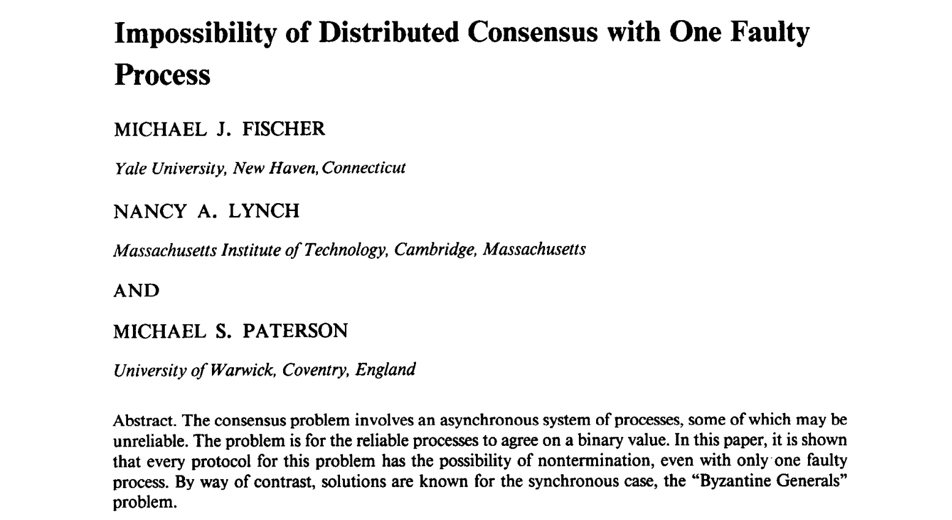
One more surprising thing (from 1985!)

Slide 46
FLP Result (Fischer, Lynch, Paterson)
In a truly async system, consensus cannot be achieved if even one part fails
We cannot distinguish between failure and delay
Distributed consensus systems use non-deterministic timeouts to prevent infinite leader election processes
E.g. Paxos, Raft

Slide 47
Summary
We have looked at the challenges to scaling on multiple servers
Serial vs Parallel
Fixed data vs growing
CAP
Eventually Consistent

Slide 48
Questions?

