Slide 1
Introduction
Service Oriented Architecture
Oxford University
Department of Computer Science
Dec 2012

Slide 2
Introduction
Aims
Pre-requisites
Contents
Connections
Resources
Rules of Engagement
Introductions

Slide 3
Aims
Understanding of Principles
Exploration of de facto and de jure standards
Practical experience of different technologies
Architecture and Design
Wider context

Slide 4
Pre-requisites
XML including XML namespaces and XML schema
JSON
JSON is dead simple but it would help if you have looked at it before
Java
Basic Java language skills

Slide 5
Contents
Evolution of distributed computing
REST Architecture: Resources, URIs, HATEOS
JAX-RS
Web Services: Evolution of MOM into SOAP, WS-*, etc
JAX-WS
REST and SOAP compared
SOA in Action – Amazon and Amazon EC2, Netflix, PEPPOL
Intermediation: ESBs and Enterprise Integration Patterns
Quality of Service: WS-Security, SAML2, XACML, OAuth, etc
Governance
API Management
Composition and Orchestration: BPEL and BPMN
Other Patterns: Thrift, Protocol Buffers, EDA, MQTT, AMQP, etc

Slide 6
Practicals
Creating a REST Service using JAX-RS
Creating a SOAP Service using JAX-WS
Security
Governance and Registry lookup at runtime
ESB intermediation and transformation
API Management and OAuth2
BPEL and process orchestration

Slide 7
Connections
Objects (OOR, OOD, OOP, DPA, SPL)
Formal techniques (SEM, SDE)
Concurrency (CDS, ACT, MOB)
Security (SPR, SRO, DES, NES)

Slide 8
Resources
Singh and Huhns, Service Oriented Computing (Wiley, 2005)
Josuttis, SOA in Practice (O’Reilly, 2007)
Erl, SOA (Prentice-Hall, 2005)
Szyperski, Component Software (Addison-Wesley, 2nd Ed, 2002)
Richardson and Ruby, RESTful Web Services (O’Reilly, 2007)
Weerawarana et al, Web Services Platform Architecture, (Pearson, 2005)
Fielding, Architectural Styles andthe Design of Network-based Software Architectures, (University of California, 2000)
Various W3C, OASIS, IETF, OMG standards

Slide 9
Rules of Engagement
Ask questions as we go along
  We will “park” any that are better answered later
  Don’t wait till the end to ask or raise concerns
Timings are flexible
Please keep mobile phones silent or better still turned off

Slide 10
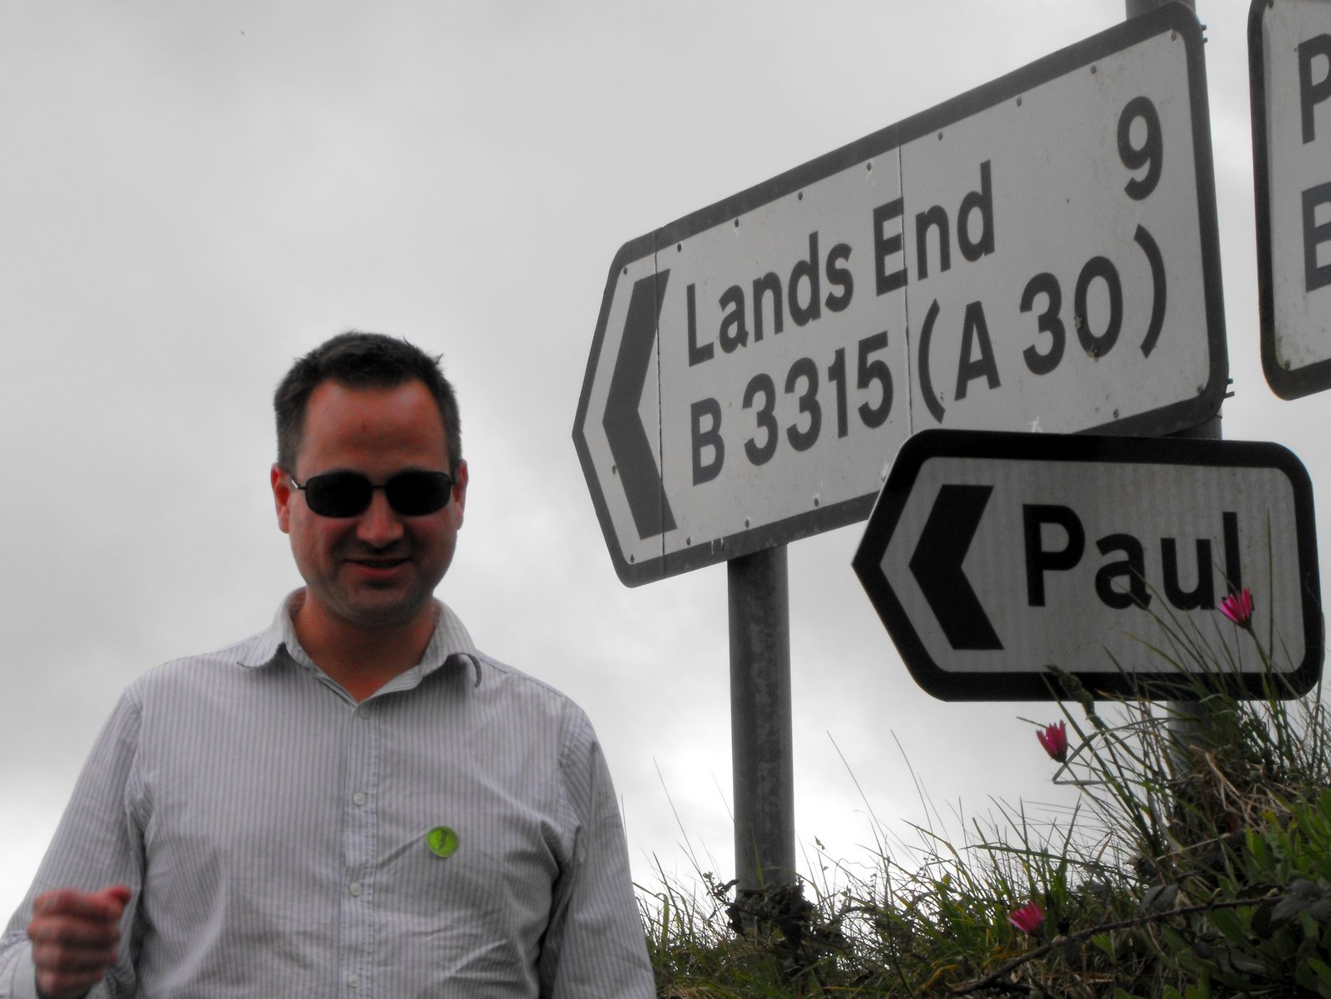
Paul Fremantle
CTO and Co-Founder of WSO2
Previously Senior Technical Staff Member, IBM WebSphere architecture
Co-Chair Web Services Reliable eXchange at OASIS (WSRM)
VP, Apache Synapse and Member of ASF
MA in Maths and Philosophy
MSc in Computation (1995)
Plays the tin whistle

Slide 11
Approximate Schedule
Monday | Tuesday | Wednesday | Thursday | Friday
Introduction | SOAP and WS-* SOA in Action | ESB, Intermediation Architecture | Orchestration, Choreography | Other Models: Thrift, ProtoBuf, Avro Event Driven Architecture
Evolution of Distributed Computing | JAX-WS Practical | ESB Practical | BPEL Practical | Engineering Conclusion
REST/JAX-RS | QoS and WS-Security Other Security: SAML2, XACML, OAuth2 | Governance, Dependency Management | API Management APIs vs Services
JAXRS Practical | WS-Security Practical | Registry Practical | API Management Practical

Slide 12
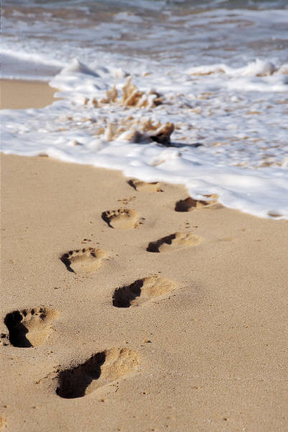
Let’s get started

