Slide 1
Choreography and Orchestration of Services
Oxford University
Software Engineering Programme
April 2021

Slide 2
Business Process Management
Hammer & Champy [1993] “A collection of activities that takes one or more kinds of input and creates an output that is of value to the customer.”
Davenport [1992] “A structured, measured set of activities designed to produce a specific output for a particular customer or market. It implies a strong emphasis on how work is done within an organization, in contrast to a product focus’s emphasis on what.”

Slide 3
Composition
Services provide platform- and language-independent access to software components
But these components are isolated: they need to be assembled into service-oriented architectures
Ideally, they should be recursively composable to form composite services in their own right
Workflow languages for scripting or ‘glue’ between individual services
BPMN, WSCI, WSFL, XLANG, BPEL. . .
beyond mere business protocol specifications like RosettaNet, which are essentially paper specifications so can’t be automated and won’t scale

Slide 4
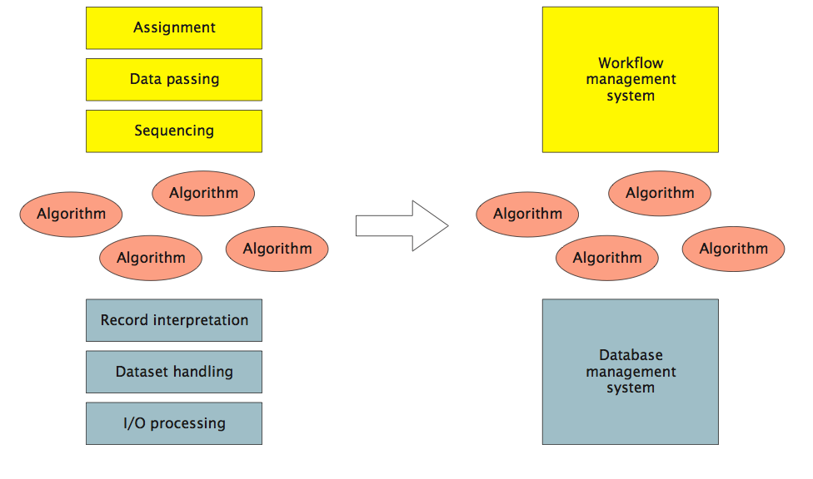
Removal of Dependencies (Leymann and Roller)
DBMS provides independence from data representation; workflow provides independence from control or data flow.

Slide 5
Motivations
Model Business Processes
Understand what happens?
Who is responsible?
What is involved?
Simulate
Improve and model
Execute
Automate processes
Improve them more quickly
Monitor
Get a real-time health status of processes

Slide 6
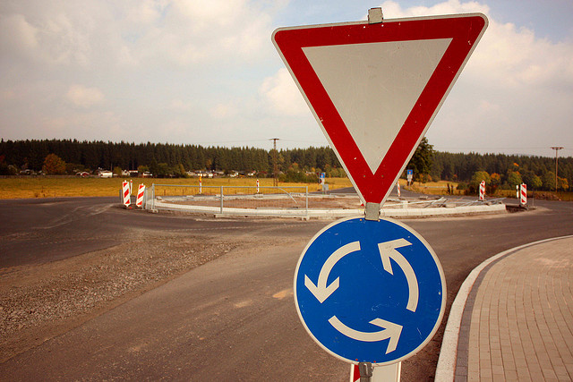

Orchestration vs Choreography
http://www.flickr.com/photos/herrolm/
http://www.flickr.com/photos/tasuki/

Slide 7
Orchestration vs Choreography
Orchestration
Describes procedure
instructs participants globally – imperative; centralized
typically deterministic: ‘must’
Choreography
Describes protocol
Constraints on interaction, but participants act locally – declarative; no ‘current state’
Usually non-deterministic: ‘may’
Orchestra has a conductor, Ballet does not

Slide 8
BPMN 1.1
Designed to allow process designers to communicate
Think UML
Activities, Gateways, Events
Control and Data Flow
Organization modelling (Pools, Swimlanes)

Slide 9
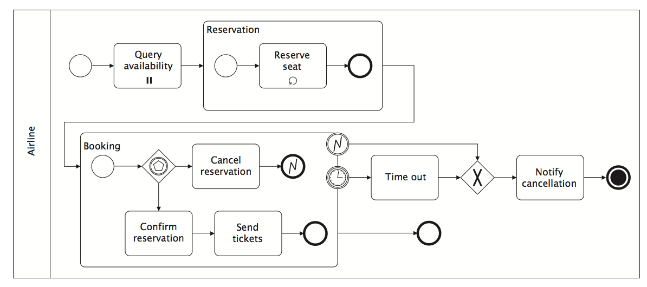
BPMN Example

Slide 10
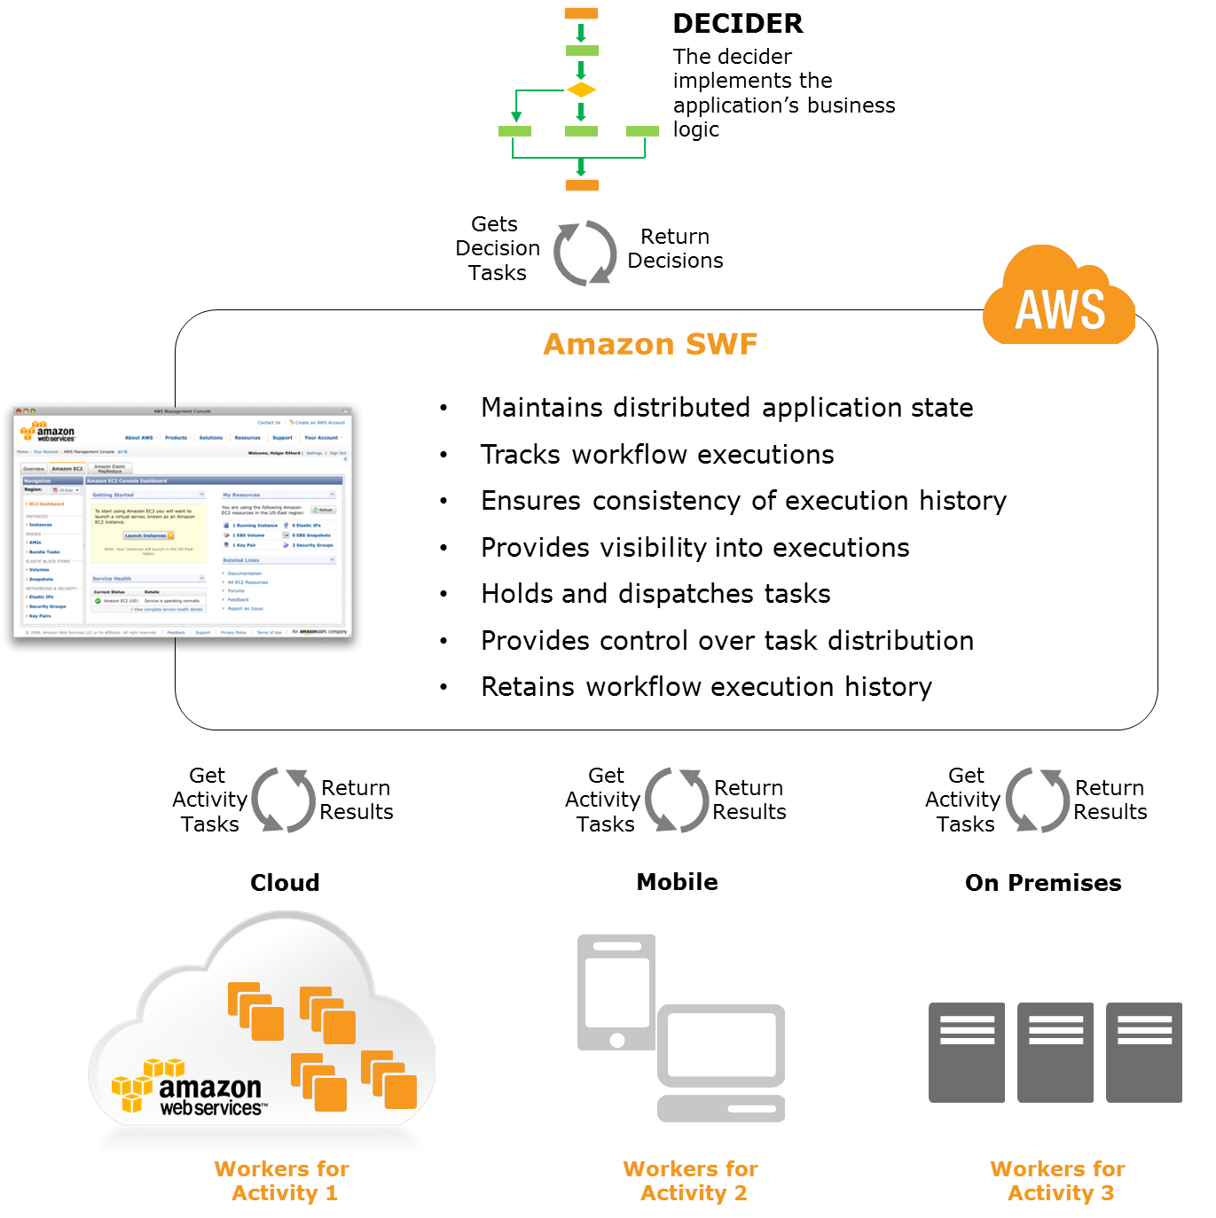
Amazon Simple Workflow Service
http://aws.amazon.com/swf/

Slide 11
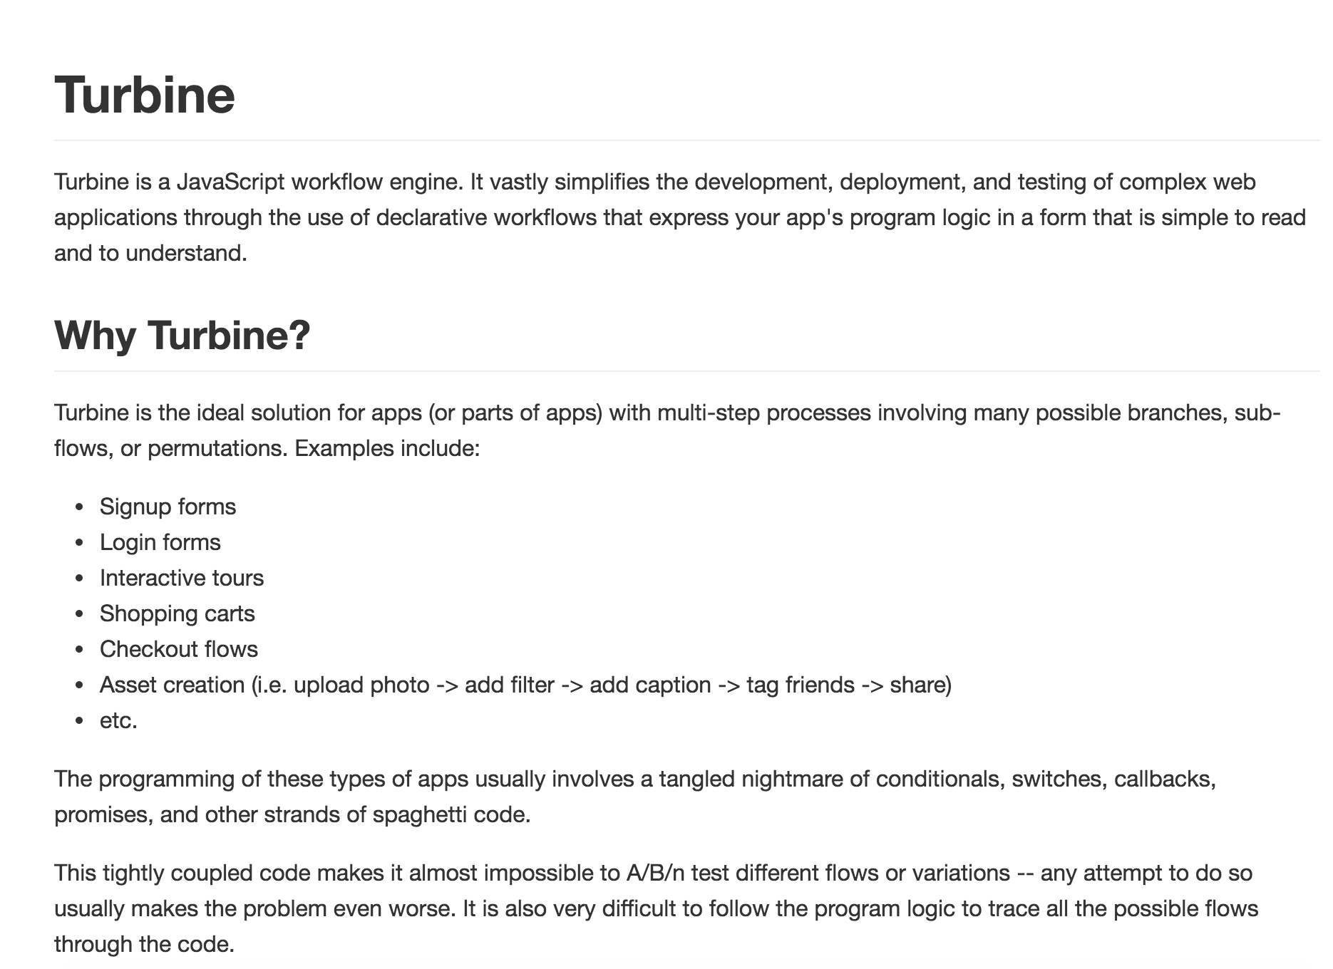

Slide 12
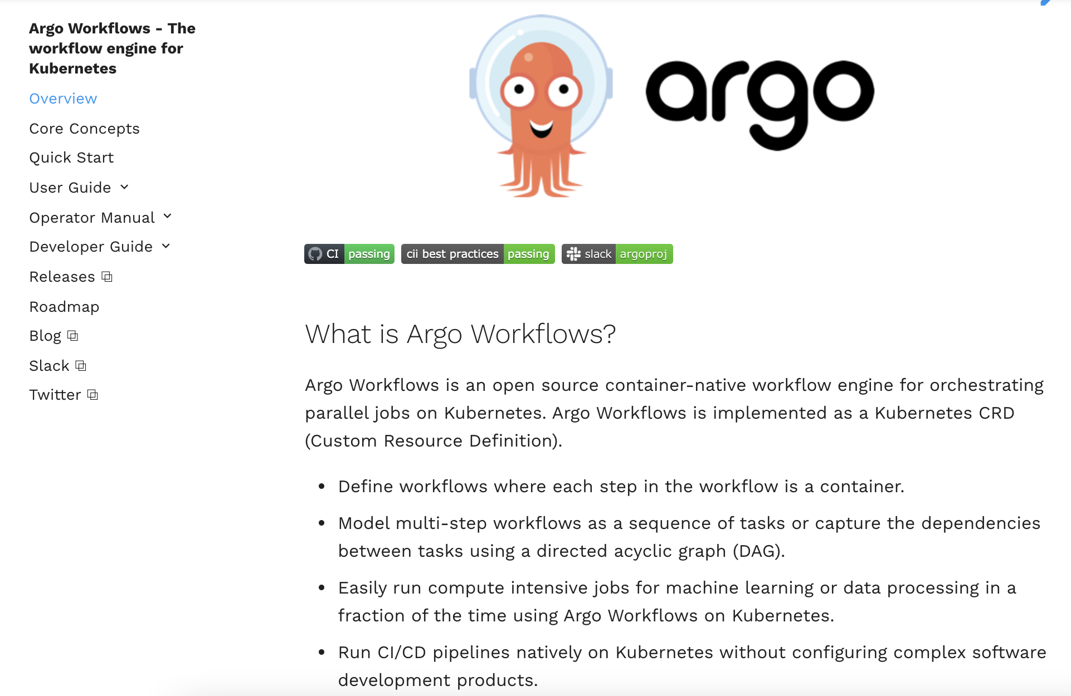

Slide 13
Business Process Execution Language (BPEL)
Standardised XML language for executable processes
Well defined execution
No deadlocks
Graphs must be acyclic
Tied to WSDL concepts
No built in support for human activities (though this has been added)
No graphical notation

Slide 14
The main strength of BPEL (IMO)
BPEL is a completely executable standalone language
PartnerLinks define places where you can call WSDL services
Or where other parties can call WSDL Services into the process
Deployment descriptor + BPEL can be executed without any Java or other language

Slide 15
The main weaknesses of BPEL (IMO)
Too much like a programming language
Need WS-HumanTask, BPEL4People and script or Java extensions to make it useful for real processes
No swimlanes (explained in a minute)
No common visual notation

Slide 16
BPMN + BPEL
In theory:
Process experts design and model in BPMN
Developers/Implementors implement in BPEL
No standard bridging/mapping
Double the effort

Slide 17
BPMN 2.0
A notation for a subset of BPEL
Execution semantics for BPMN
Notational support for choreography
The best of both worlds?
Cons:
Need to write external logic in another language to implement a process

Slide 18
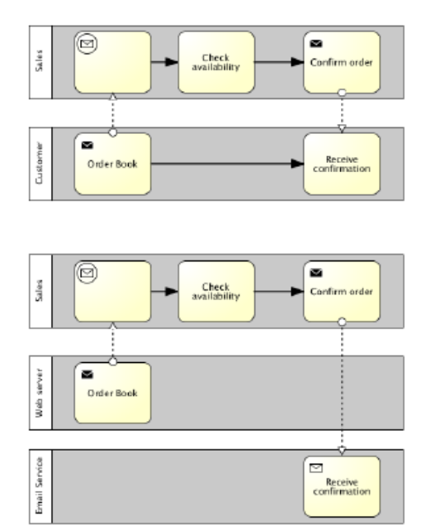
BPMN 2.0

Slide 19
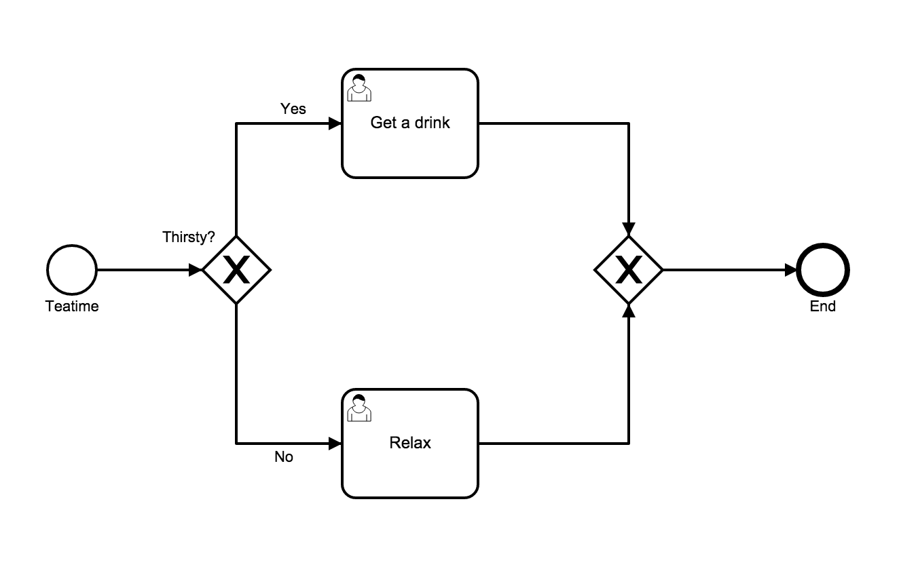
BPMN 2.0 Basics

Slide 20
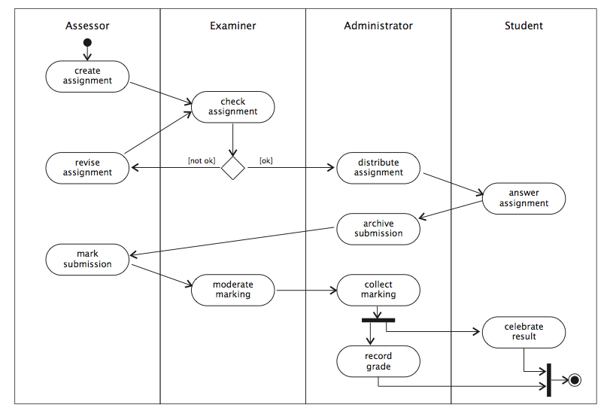
Swimlanes: partition an activity diagram into the responsibilities of different entities

Slide 21
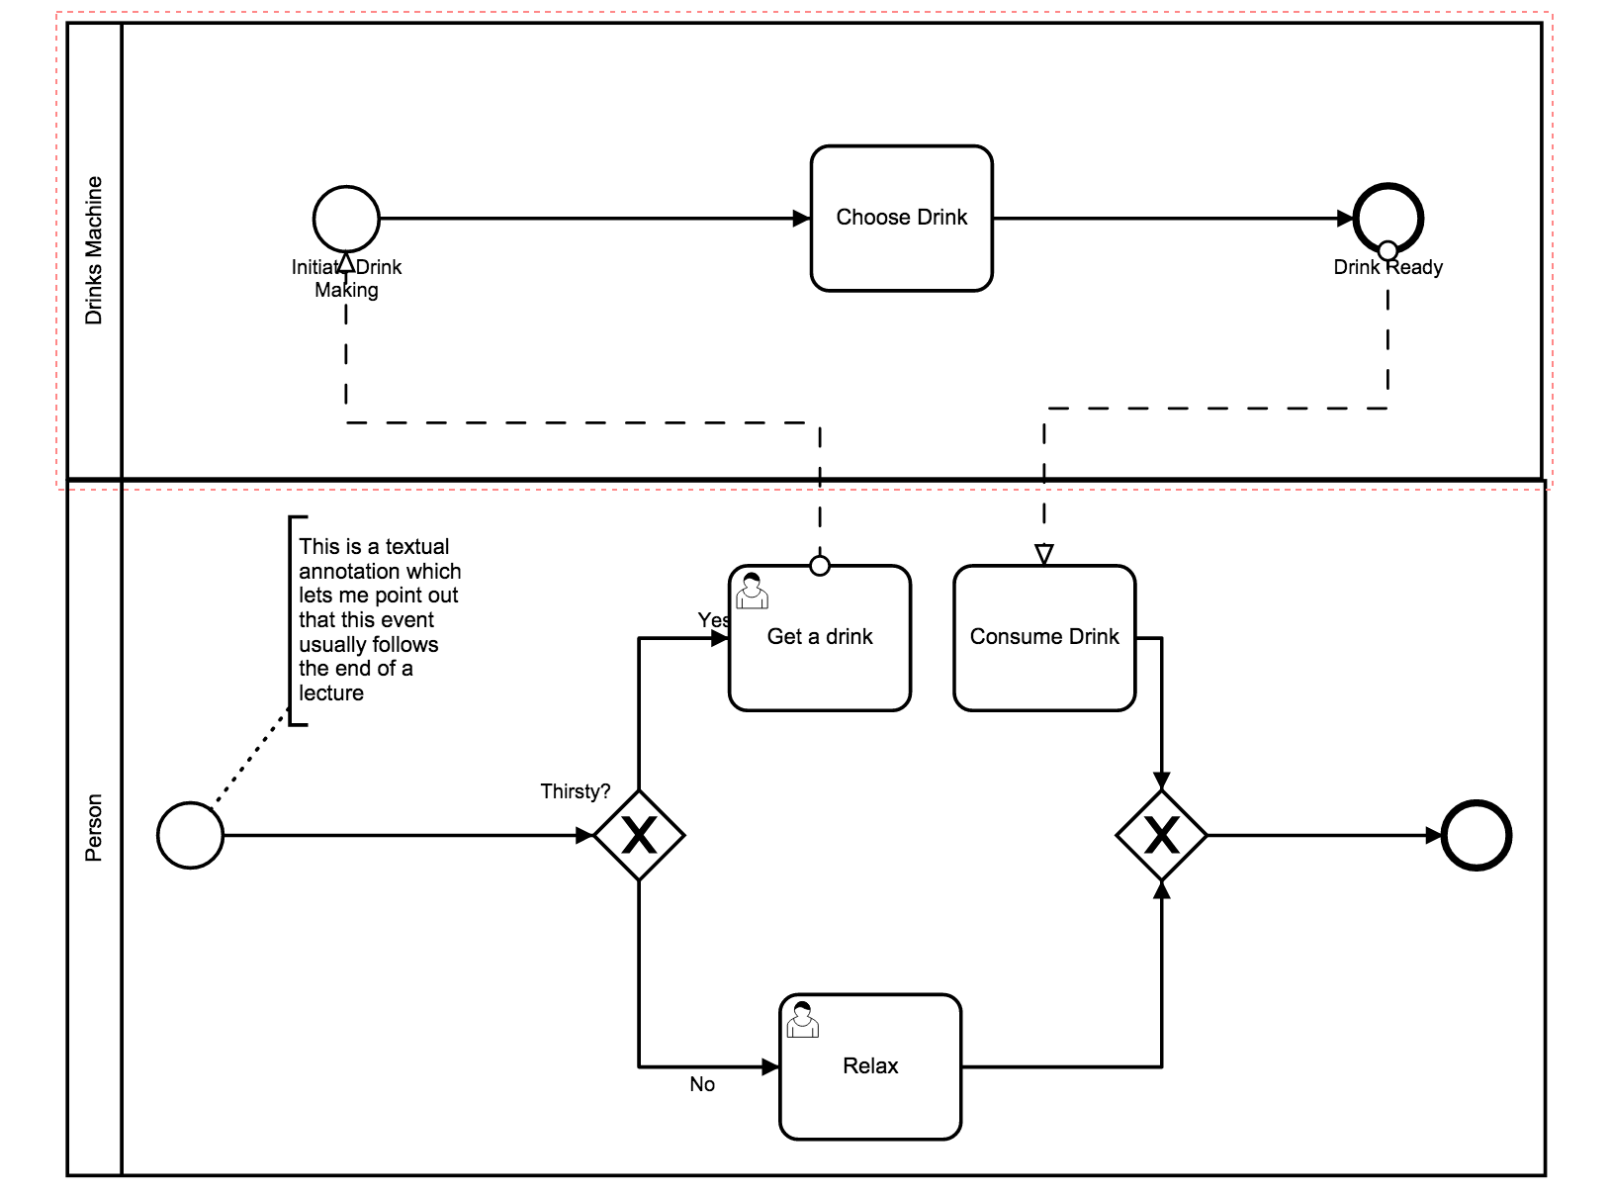
Swimlanes represent different participants

Slide 22




BPMN Basic Constructs
Events
Activities
Gateways
Sequence Flows

Slide 23
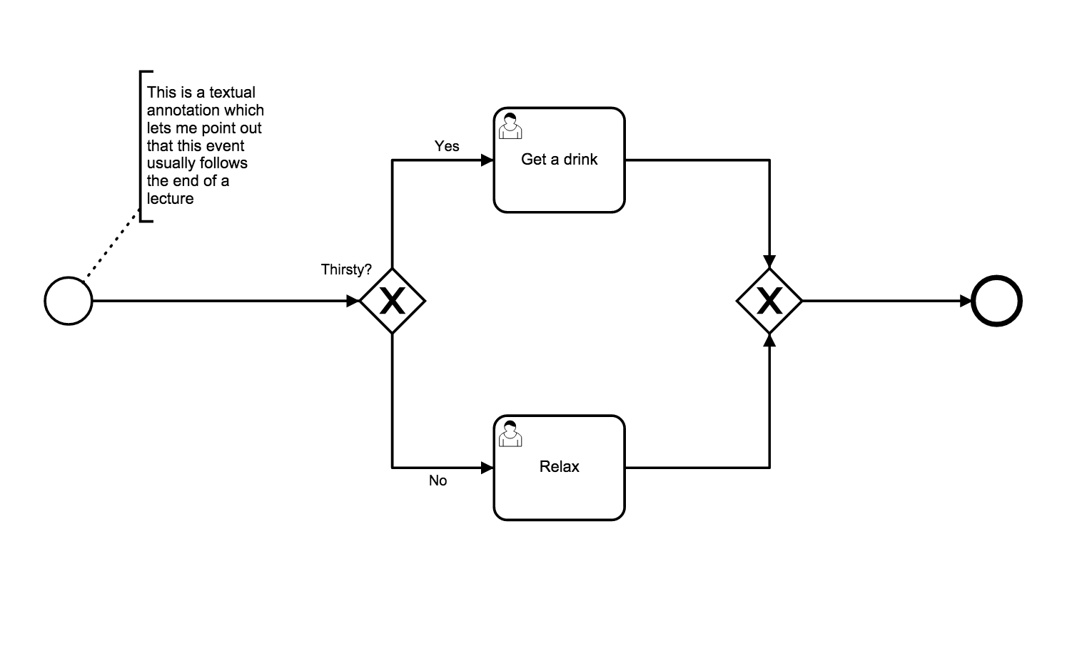
Text Annotations
How you document your processes

Slide 24





Start Events
Start Event
Message Start
Timer Start
Conditional Start
Signal Start

Slide 25

Some Intermediate Events
Basic Intermediate Event
Message Catch
Message Throw
Timer
Escalation

Slide 26
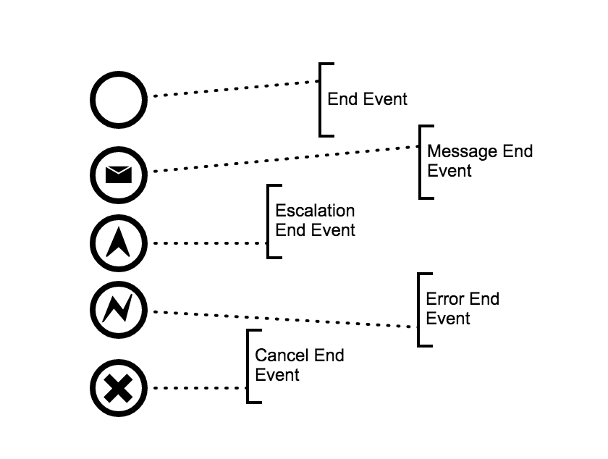
Some End Events

Slide 27
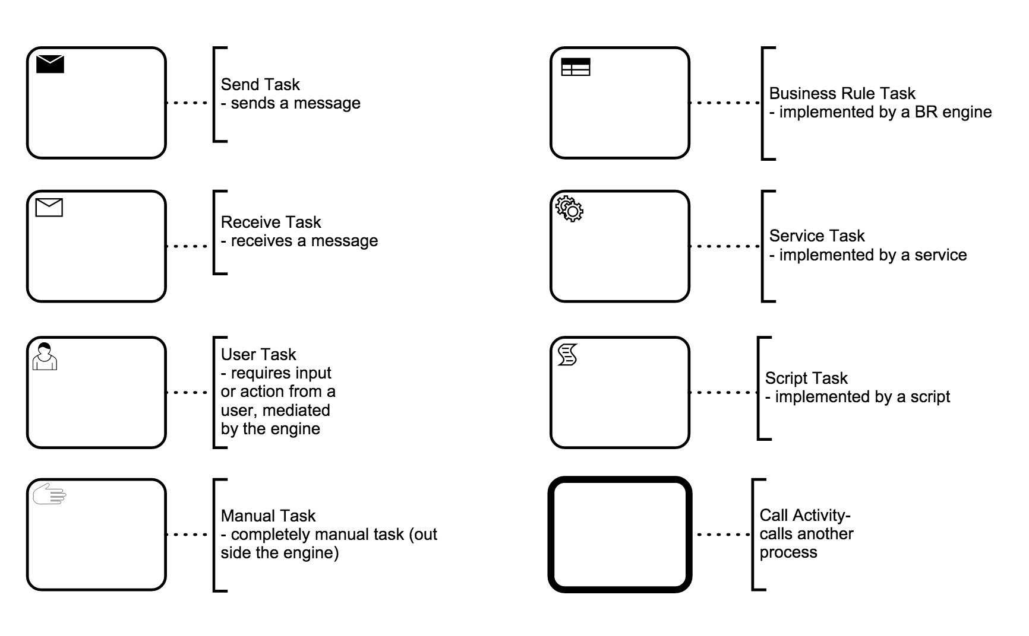
Activities

Slide 28
Service Task
Call a service
Unlike BPEL there is no direct way of capturing the actual service
Typically need to write some code (e.g. Java) to capture that

Slide 29
Data Flow
Transitions between activities represent control dependencies: one activity must complete before another can start
Workflows also have data dependencies: one activity produces a result that another requires
UML activity diagrams allow object flow as well as control flow
Dependent data is shown as an object icon (rectangle with underlined name and type)
dependencies shown as dashed arrows from generating activity to object, and from object to consuming activity(s)
same object may occur multiple times in an activity diagram, typically in different states (shown in square brackets after object name)

Slide 30
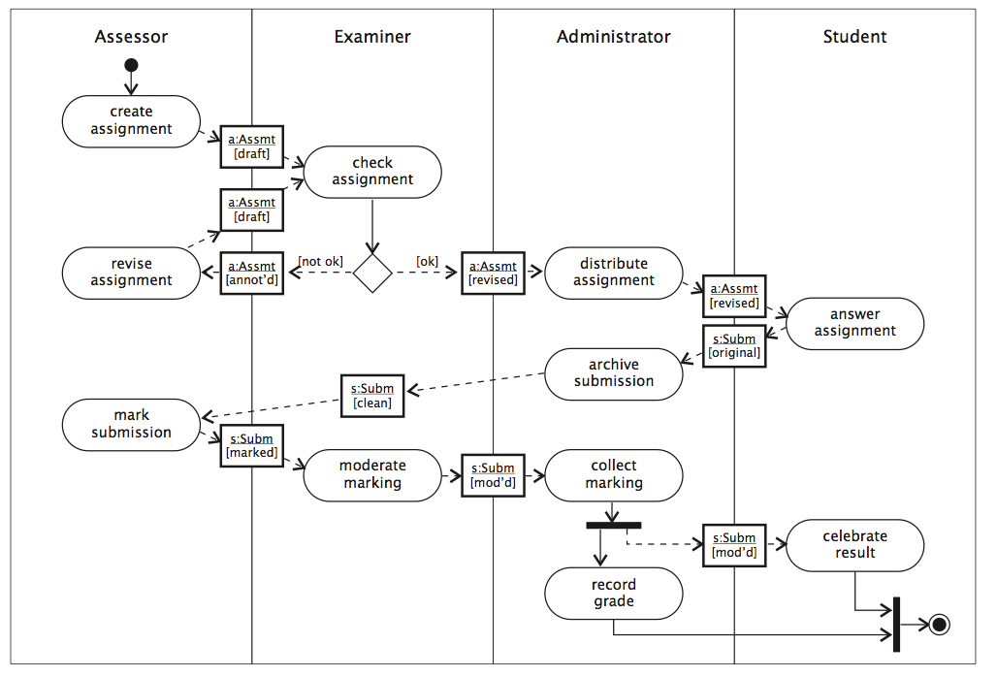
Example Object Flow

Slide 31
Flows
Sequence
Message
Sequence flows are within a
Swimlane
Message flows between
swimlanes

Slide 32


Gateways
Exclusive Gateway
Fork – choose one path (if/else)
Join – wait for a single event
Parallel Gateway
Fork – do both / all paths
Join – wait for all inputs

Slide 33
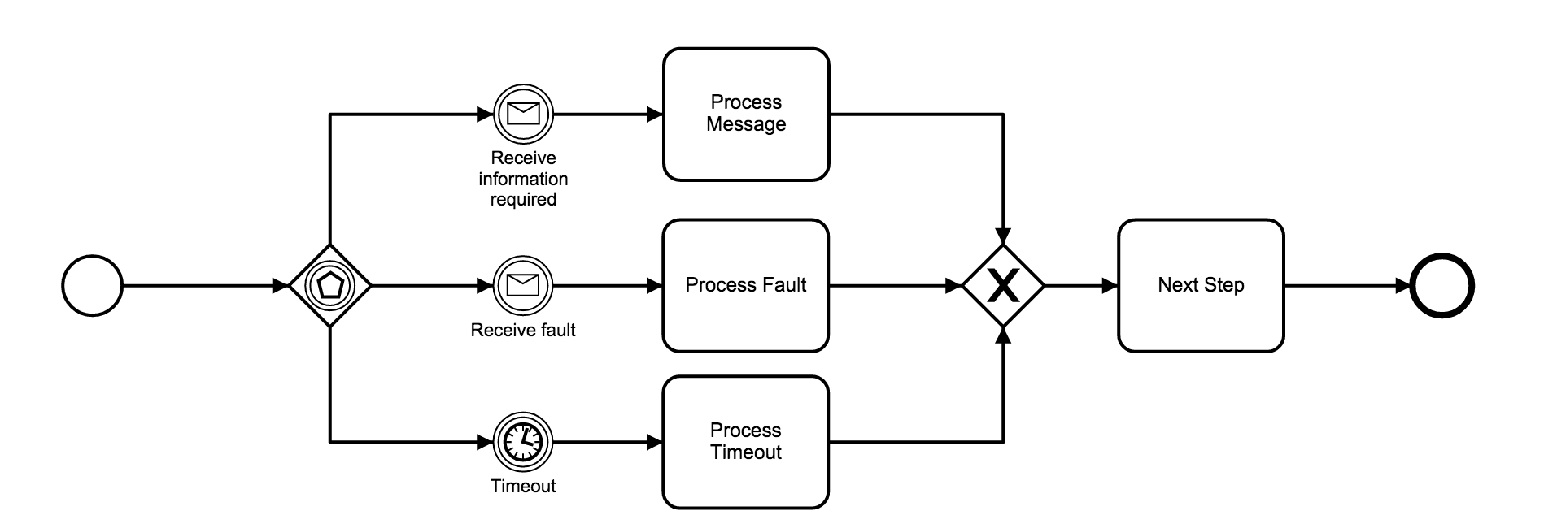
Event Gateway
An Event Gateway allows different events to trigger different actions

Slide 34
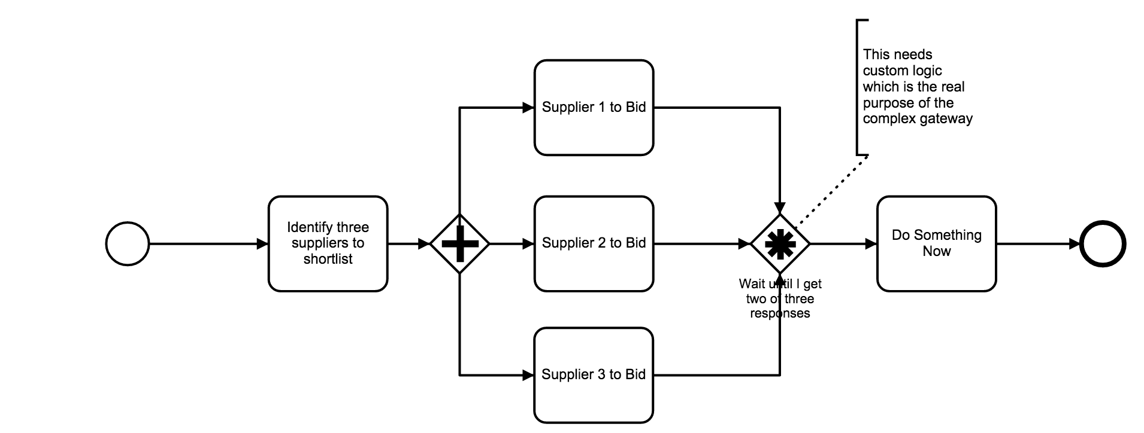
Complex Gateway

Slide 35
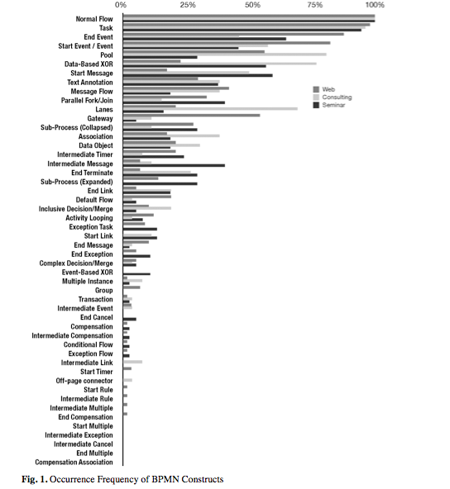
How much BPMN do you need?
How Much Language is Enough? Theoretical and Practical Use of the Business Process Management Notation
http://papers.ssrn.com/sol3/ papers.cfm?abstract_id=2038665

Slide 36
Summary
Process Management has a strong place in composing SOA systems
Externalising dependencies
Agility
Sharing with the business owners

