Slide 1
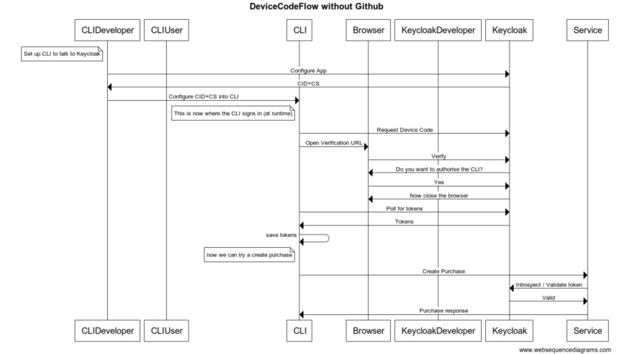
Notes:
title DeviceCodeFlow without Github
participant CLIDeveloper
participant CLIUser
participant CLI
participant Browser
participant KeycloakDeveloper
participant Keycloak
participant Service
note left of CLIDeveloper
Set up CLI to talk to Keycloak
end note
CLIDeveloper->Keycloak: Configure App
Keycloak->CLIDeveloper: CID+CS
CLIDeveloper->CLI: Configure CID+CS into CLI
note left of CLI
This is now where the CLI signs in (at runtime)
end note
CLI -> Keycloak: Request Device Code
CLI -> Browser: Open Verification URL
Browser -> Keycloak: Verify
Keycloak -> Browser: Do you want to authorise the CLI?
Browser -> Keycloak: Yes
Keycloak -> Browser: Now close the browser
CLI -> Keycloak: Poll for tokens
Keycloak -> CLI: Tokens
CLI -> CLI: save tokens
note left of CLI
now we can try a create purchase
end note
CLI -> Service: Create Purchase
Service -> Keycloak: Introspect / Validate token
Keycloak -> Service: Valid
Service -> CLI: Purchase response

Slide 2
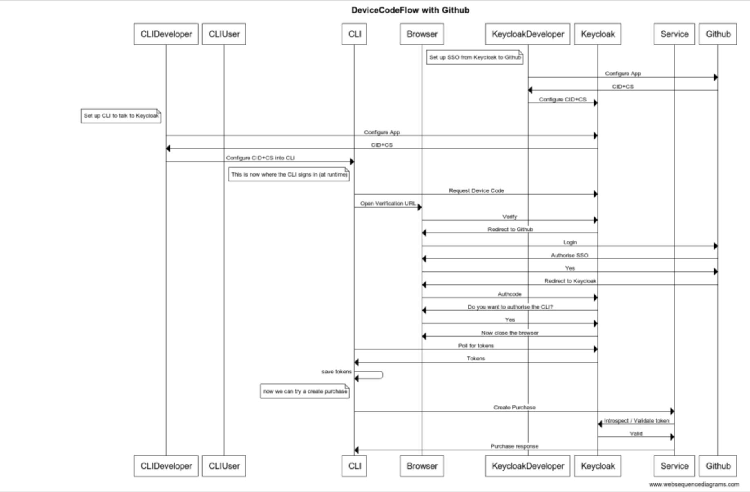
Notes:
title DeviceCodeFlow with Github
participant CLIDeveloper
participant CLIUser
participant CLI
participant Browser
participant KeycloakDeveloper
participant Keycloak
participant Service
participant Github
note left of KeycloakDeveloper
Set up SSO from Keycloak to Github
end note over
KeycloakDeveloper->Github: Configure App
Github->KeycloakDeveloper: CID+CS
KeycloakDeveloper->Keycloak: Configure CID+CS
note left of CLIDeveloper
Set up CLI to talk to Keycloak
end note
CLIDeveloper->Keycloak: Configure App
Keycloak->CLIDeveloper: CID+CS
CLIDeveloper->CLI: Configure CID+CS into CLI
note left of CLI
This is now where the CLI signs in (at runtime)
end note
CLI -> Keycloak: Request Device Code
CLI -> Browser: Open Verification URL
Browser -> Keycloak: Verify
Keycloak -> Browser: Redirect to Github
Browser -> Github: Login
Github -> Browser: Authorise SSO
Browser -> Github: Yes
Github -> Browser: Redirect to Keycloak
Browser -> Keycloak: Authcode
Keycloak -> Browser: Do you want to authorise the CLI?
Browser -> Keycloak: Yes
Keycloak -> Browser: Now close the browser
CLI -> Keycloak: Poll for tokens
Keycloak -> CLI: Tokens
CLI -> CLI: save tokens
note left of CLI
now we can try a create purchase
end note
CLI -> Service: Create Purchase
Service -> Keycloak: Introspect / Validate token
Keycloak -> Service: Valid
Service -> CLI: Purchase response

