Slide 1
Scalability
Oxford University
Software Engineering Programme
April 2021

Slide 2
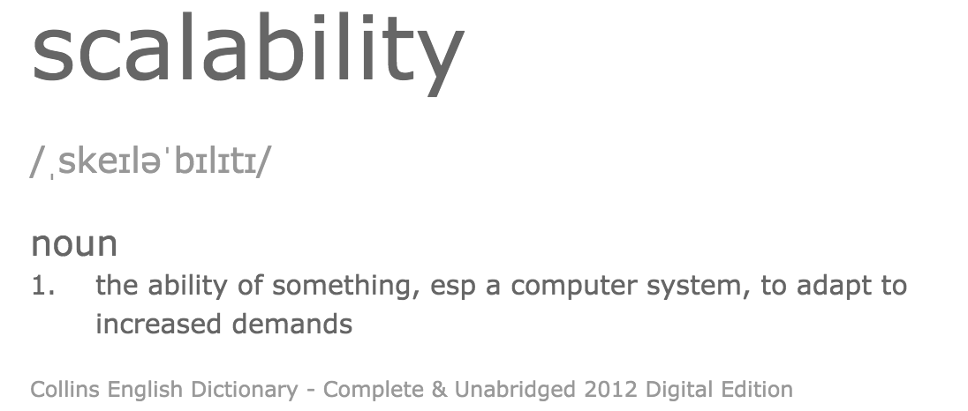

Slide 3
Speedup
The speedup is defined as the performance of new / performance of old
e.g. move from 1 -> 2 servers
New system is 1.8 x faster than the old
In terms of transactions/sec (throughput)
Speedup = 1.8

Slide 4
What inhibits speedup?
In general you can split work into
Parallelizable and
Serial parts
The serial parts stop you from scaling

Slide 5
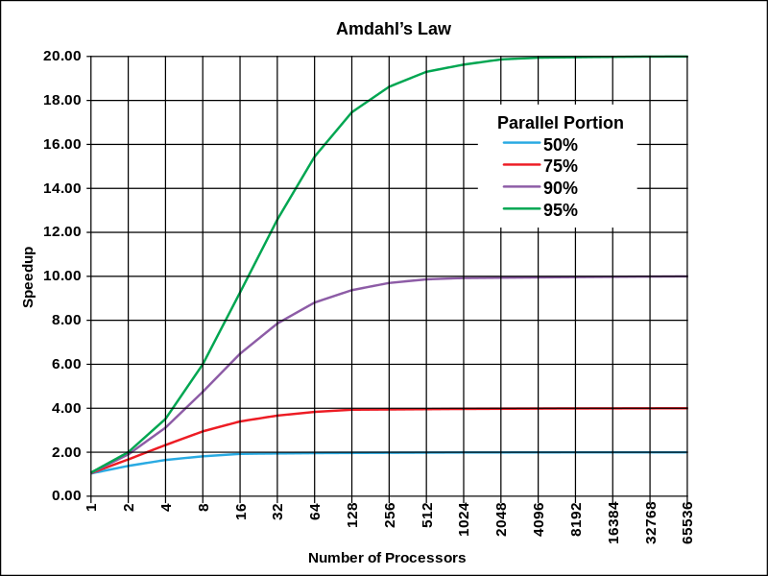
Amdahl’s Law Theoretical speedup given a fixed data size
The speedup of a program using multiple processors in parallel computing is limited by the time needed for the serial fraction of the program, given a fixed size of data

Slide 6
Performance Single system under increasing load
Good
Performance
Bad
Resource contention
causes slowdown
Load

Slide 7
Performance Scaling servers when fully loaded
Best
The performance of n servers is equal to
n x the single server performance
Performance
Not bad
Additional servers scale linearly,
but there is a cost to scaling
Bad
System performance
reaches a maximum no matter how many
servers are added
1 server
1 server
Number of servers

Slide 8
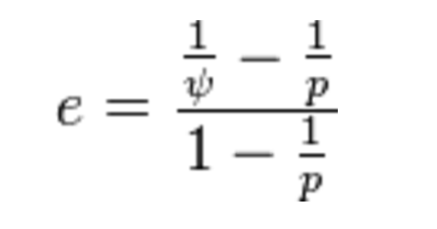
Karp-Flatt Metric
e is the Karp-Flatt Metric
ψ is the speedup
p is the number of processors
e = 0 is the best
e = 1 indicates no speedup
e > 1 indicates adding processors
slows down the system!!!

Slide 9
Karp-Flatt metric
e=0
e=0.3
Performance
e🡪1 as p increases
1 server
1 server
Number of servers

Slide 10


Shared Nothing Architecture
Server
Disk
Load Balancer
Server
Disk
Server
Disk

Slide 11
Shared Nothing Architecture
Implies there is no serial part to the computation
Karp-Flatt Metric of 0
Assuming 100% efficient load balancing
In practice, this is difficult!

Slide 12
Partitioning / Sharding
A-I
Server
Disk
J-R
Load Balancer
Server
Disk
S-Z
Server
Disk

Slide 13
Problems with Sharding
Imbalance
Fewer S-Z’s than A-I’s
Failover
Adding new servers requires a re-balance
Is this automatic or manual?!

Slide 14

Load Balancer-based elastic scaling
Worker pool
Client
Load Balancer
Elastic scale
Cloud Controller
Monitoring
Topology update

Slide 15
Statelessness is hard
There is a lot of intermediate calculation in most web systems that needs to be stored between transactions.
The exemplar is the shopping cart

Slide 16
Intermediate state storage
In-memory
Breaks statelessness, limits scalability
In the client
OK for some APIs but can be slow and hard to program
In the database
Slow and expensive
Cache servers:
The client keeps a cookie, which is the key to the datastore
The usual practise
Redis, memcached, Hazelcast, Infinispan

Slide 17
Cache
Disk
Server
Disk
Load Balancer
Server
Disk
Server
Cache Server

Slide 18
Questions?

