Slide 1
How to GET a cup of coffee
Based on Jim Webber’s Article:
http://www.infoq.com/articles/webber-rest-workflow/

Slide 2
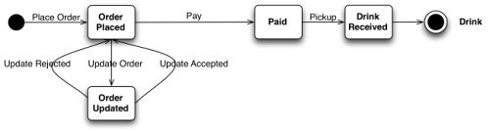
The customer state machine

Slide 3

The barista’s state machine

Slide 4
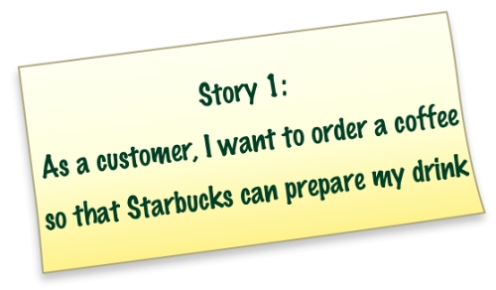

Slide 5
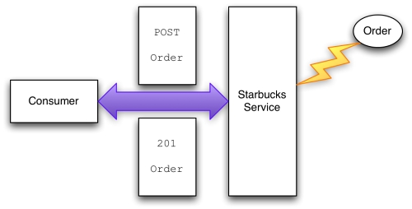
Story 1. POST

Slide 6
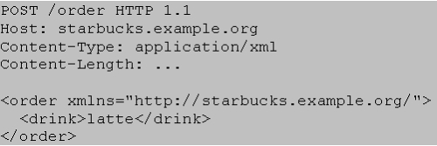
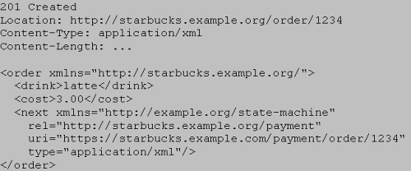
POST

Slide 7
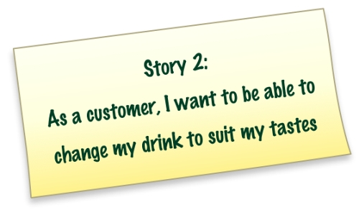

Slide 8
OPTIONS
OPTIONS /order/1234 HTTP 1.1 Host: starbucks.example.org
200 OK Allow: GET, PUT

Slide 9
Look before you leap
PUT /order/1234 HTTP 1.1 Host: starbucks.example.com Expect: 100-Continue
100 Continue
or
417 Expectation Failed

Slide 10
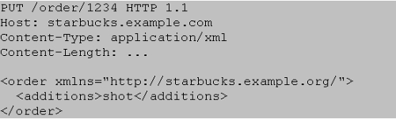
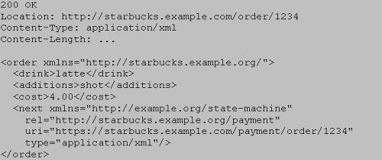
PUT

Slide 11
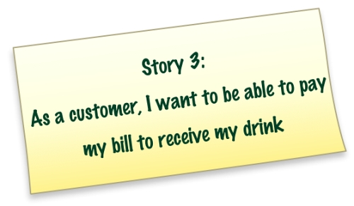

Slide 12

How to pay?
OPTIONS/payment/order/1234 HTTP 1.1 Host: starbucks.example.com
Allow: GET, PUT

Slide 13
Payment PUT Headers
PUT /payment/order/1234 HTTP 1.1
Host: starbucks.example.com
Content-Type: application/xml
Content-Length: ...
Authorization: Digest username="Jane Doe"
realm="starbucks.example.org“
nonce="..."
uri="payment/order/1234"
qop=auth
nc=00000001
cnonce="..."
reponse="..."
opaque="..."

Slide 14
PUT Entity
<payment xmlns="http://starbucks.example.org/">
<cardNo>123456789</cardNo>
<expires>07/07</expires>
<name>John Citizen</name>
<amount>4.00</amount>
</payment>

Slide 15
PUT Response
201 Created
Location: https://starbucks.example.com/payment/order/1234
Content-Type: application/xml
Content-Length: ...
<payment xmlns="http://starbucks.example.org/">
<cardNo>123456789</cardNo>
<expires>07/07</expires>
<name>John Citizen</name>
<amount>4.00</amount>
</payment>

Slide 16
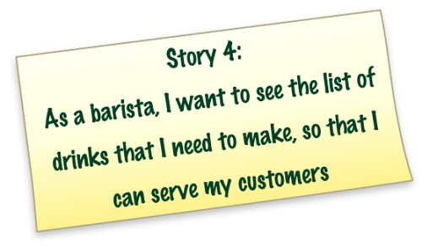

Slide 17
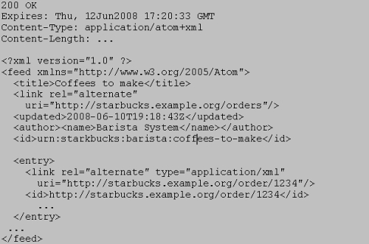
GET Drinks to be made

Slide 18
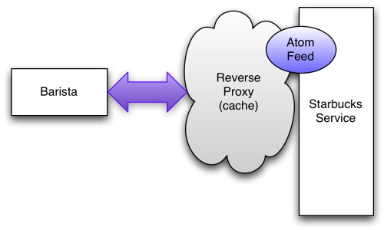
Cacheing

Slide 19
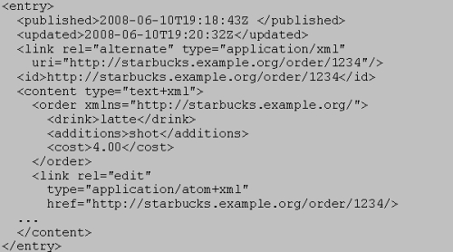
AtomPub lets us update state

Slide 20
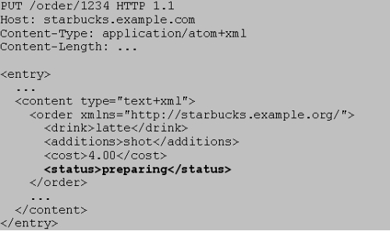
Update state

Slide 21
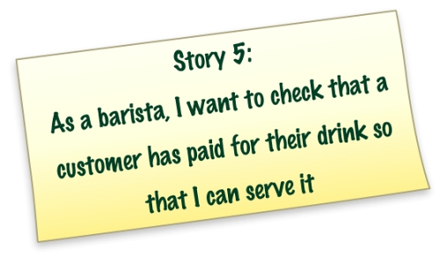

Slide 22
GET
GET /payment/order/1234 HTTP 1.1 Host: starbucks.example.org
401 Unauthorized WWW-Authenticate: Digest realm="starbucks.example.org", qop="auth", nonce="ab656...", opaque="b6a9..."

Slide 23
Retry with credentials
GET /payment/order/1234 HTTP 1.1
Host: starbucks.example.org
Authorization: Digest username="barista joe" realm="starbucks.example.org“ nonce="..." uri="payment/order/1234" qop=auth nc=00000001 cnonce="..." reponse="..." opaque="...”
200 OK
Content-Type: application/xml
Content-Length: ...
<payment xmlns="http://starbucks.example.org/">
<cardNo>123456789</cardNo>
<expires>07/07</expires>
<name>John Citizen</name>
<amount>4.00</amount>
</payment>

Slide 24
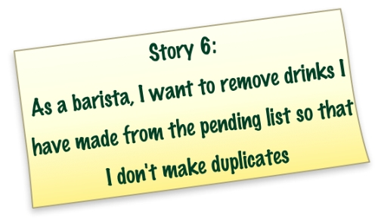

Slide 25
DELETE
DELETE /order/1234 HTTP 1.1
Host: starbucks.example.org
200 OK

Slide 26

Enjoy

