Slide 1
Applied Perception
Augmented Reality
By Piter Garcia

Slide 2
Augmented Reality
Architecture
Education
Activities
Applied Perception
Paper
World
Imitative Art
Tools
Tools
Better Output

Slide 3
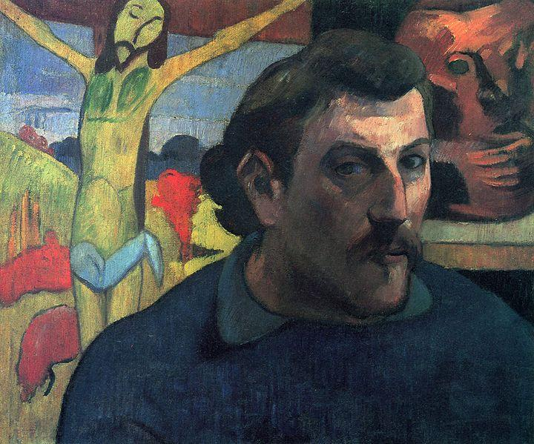
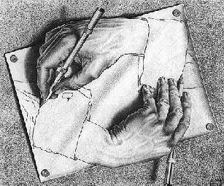

Why Augmented Reality?
Using my own perspective, I can explain it as follows:
Imitative Artist
Paper
Tools

Slide 4

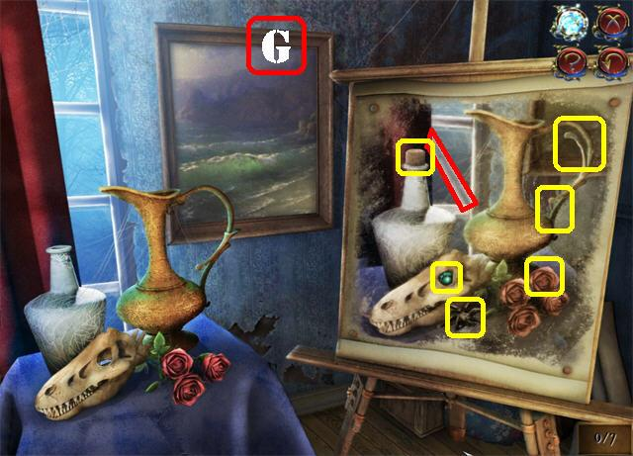
The Artist sees the world
Paints it
Fix it
It does not actually mean is true, but it makes the real world better.

Slide 5
Why?
In art, even though you know it is not true, once you see it, you have a better perception of what you really want, what it is, and how it should really be.
Does that apply for Augmented Reality?
Let’s see...
http://www.youtube.com/watch?v=e4OKbfB-ZAU
http://www.youtube.com/watch?v=s4ZkOmbavgs#t=11

Slide 6
How Could We Change what we see?
Marker vs Markerless Augmented Reality
Currently, many people associate augmented reality with black and white squares that trigger augmented reality elements. These black and white squares are called markers.
Markerless technology requires no marker to know the position of the object or person. Smartphone browsers that layer information over live locations are often considered in the markerless category, although they still use embedded "marked" information through geolocation and geotagging.
The goal is to have augmented reality work much like this HP commercial [http://www.youtube.com/watch?v=BraU_cpfBeI Jerry Seinfeld for HP]

Slide 7
How it works
Smart phones 'camera, compass and GPS information is needed to operate an AR Browser.
The browser first locates the user with GPS and compass of phone. Next, it retrieves information from online sources based on those geographical coordinates.
The information and graphics are then overlaid onto the camera view of the smart phone’ screen. In effect, the AR browser label the real world.
http://www.youtube.com/watch?v=BraU_cpfBeI

Slide 8




Why Is AR Important?
There are numerous areas in which Augmented Reality importance can be explained. However, I have purposely chosen Education, Medicine, Architecture and Activities to show how AR can highly improve the way of learning, diagnosing, building and doing.
Education
Activities
Medicine
Architecture

Slide 9
Education
It provides a rich contextual learning for individuals learning a skill.
It appeals to constructivist notions of education where students take control of their own learning.
It provides opportunities for more authentic learning and appeals to multiple learning styles.
It has the power to engage a learner in ways that have never been possible.
It can provide each student with his/her own unique discovery path.
No real consequences if mistakes are made during skills training

Slide 10
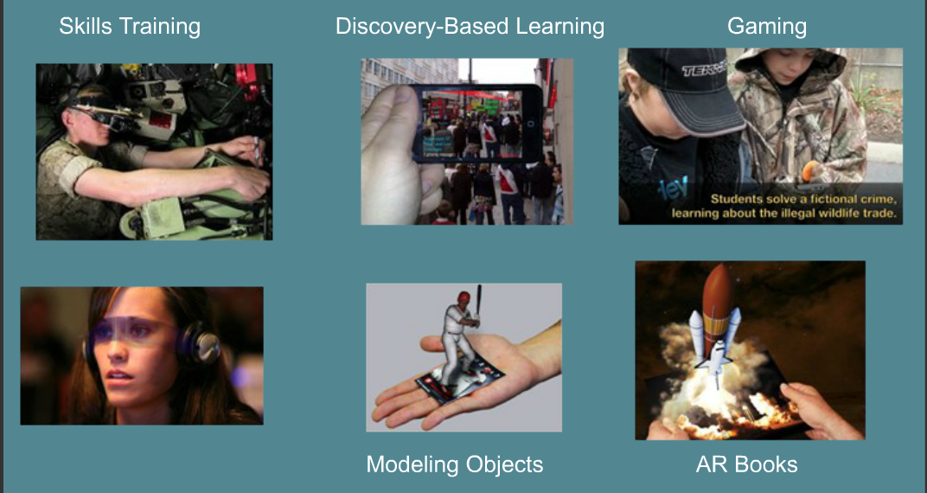
Where Does It Take Place?
According to my research, educational improvement have been more noticeable in the following areas:

Slide 11
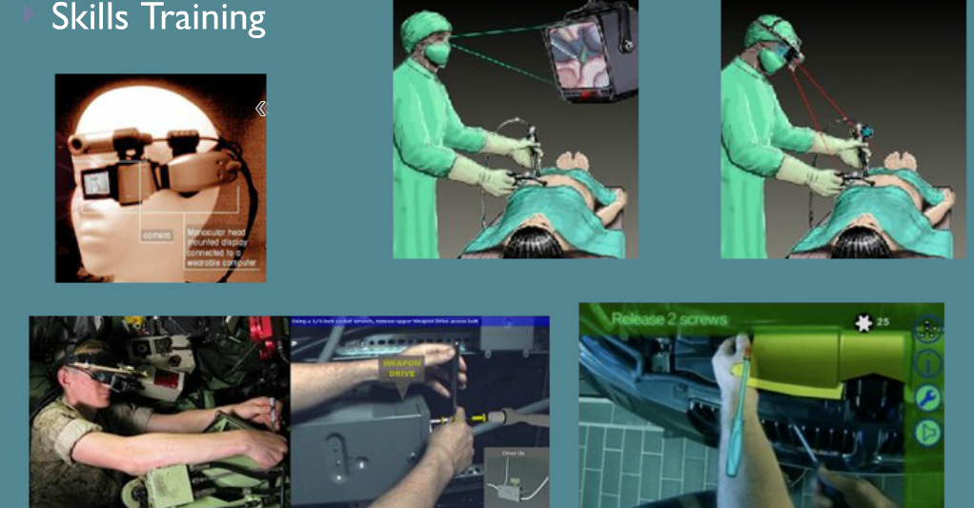
Several uses of the AR skills training:
The military is using AR to train mechanics and to train their troops with AR games.
The firefighters are using AR to fight fires.
Surgeon are learning procedure by using AR applications.

Slide 12
Training
The Military has long been a leader in the use of augmented reality especially in the area of training. Virtual displays layered over the field of vision of the user to enhance scenes using wearable head gear have become common.
In 2009 Sarnoff Corporation demonstrated the first augmented reality training system for US Warfighters in what the military calls its Future Immersive Training Environment (FITE) Joint Capability Technology Demonstration (JCTD).The 36 Million dollar experiment allows soldiers to train at home to prepare for small, urban and borderless conflicts around the world. Sarnoff's head-mounted visualization training system combines real world views, computer generated images and avatars. Soldiers interact in a realistic training environment with their own weapon, while interacting with computer-generated avatars. The avatar responds realistically to the soldier’s actions by talking, avoiding contact or returning fire. The soldier is able to record and replay training sessions.

Slide 13
The Military has also used AR to train users in maintenance and repair.
http://www.youtube.com/watch?v=mn-zvymlSvk
In March 2010, the US Army put out a request for information on "Augmented Reality (AR) Systems Technology Roadmap Survey Dismounted Soldier Applications." Their objective is to explore, "methods of presenting 2D/3D virtual objects (representing various types of targets, fire and effects, friendly forces and opposition forces, civilians on the battlefield (COB), vehicles, etc.) to the dismounted soldier while operating both indoors and outdoors, on various types of live training environments. Additionally, the trainee would be capable of interacting with virtual targets, personnel, vehicles, etc. as though real. The objective is to create an interactive, multi-sensory, non-linear environment that provides the Warfighter with training that is unparalleled in flexibility and realism.

Slide 14
AR Books
An AR book looks like any other book, but when you place in front of a webcam 3d elements, sounds and movies appear.
Example:
http://www.youtube.com/watch?v=ukrDPyPPYnE
http://alpha.zooburst.com/index.php?viewbook=210

Slide 15
Medicine
In the field of medicine, augmented reality is being used to enhance visualization, plan operations and train medical staff in various procedures. In the past, surgeons constantly had to look away from an operating site to compare what they saw with static graphic scans. Augmented reality during an operation allows a surgeon to maintain a fixed view of a surgical site and have augmented graphic scans over their field of vision.
In training situations, surgeons receive training on simulators that allow them to train and gain experience in a realistic AR operating room without risk to actual patients. AR allows learners to practice a process and get feedback during training. Sanne Botden, a doctor and researcher from Eindhoven, Netherlands compared the performance of augmented reality and virtual reality surgical simulators to train doctors in laparoscopic surgery. She and her researchers made adjustments to their Augmented Reality simulator to provide on screen instructions and an opportunity to practice the process using real tissue, stitching material and instruments. The users were provided feedback on their skills. The virtual reality simulator did not mimic the surgery like the AR simulator and the instruments did not behave the same way as they would in real life. Using the AR simulator, participants learned the procedure in only eight sessions.

Slide 16
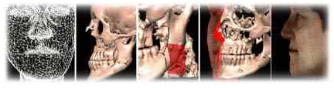
Modeling
Modeling objects is the first thing required to create simulations of the human anatomy. Initially, the main problem is of identifying the various objects in a given set of data. Once these are identified, simulating behaviors is possible, along with other tasks are possible such as rendering an object transparent or rotating an object. Further still, it is possible to simulate behavior when pressure is applied in certain ways.
A major advantage of behavior simulation is that it allows the user to predict the outcome of a certain procedure. An example of this application is plastic surgery.
http://www.youtube.com/watch?v=uVDxMr-47kU

Slide 17
Architecture
Augmented Reality (AR) is a system for blending virtual models with real life settings, thus making it possible to experience proposed architectural solutions in full scale at the intended site.
The author argues that this technology will have a significant impact on, and applicability for, the architectural design process and the mediating of architectural projects.
The use of Virtual Reality has added a new dimension to presentations of planned structures and in many instances proven valuable for the understanding of projects. In a complete VR system all parts of a scene have to be digitally constructed, which requires extensive work for the making of the model and highly specified and expensive hardware for the regeneration of them. Screen based VR presentations can easily be distributed but as with an immersive system, orientation is not intuitive, the feeling of presence is hard to achieve and the problem of understanding scale is still not solved. That is, even though one moves through digital models that closely resemble a reality, they are experienced as scale models.

Slide 18
Augmented Reality, AR, is a further development of the technology and is understood as a combination of digital models and the physical world.
An AR system generates a composite view with a combination of a virtual model or scene and the physical, real life setting in which the viewer is located. The technology has until recently been expensive, resource demanding and requiring advanced knowledge in the field. Due to these factors the use has been limited mainly to military, medical research and other highly specialized applications .
An Augmented Reality system consists in principle of these main components:
1. Software System and Databases
2. Position-registration System
3. Orientation-registration System
4. Display Device

Slide 19
Software System and Databases
The core of the augmented reality system is the software and database running on a portable computer. The database contains the 3D models to be viewed and their geo-location. The software position these according to the data retrieved from the registration systems.
Position-registration System
The position-registration system is crucial to the accuracy and field of use of the AR system. Its purpose is to provide the system with the exact geo-location of the user so the virtual models can be positioned correctly according to this. Several different solutions exist, each with specific possibilities and limitations.

Slide 20
Orientation-registration System
Precise and accurate combination of the virtual model and the real environment requires the system to provide data for the exact location and viewing direction and angle of the user.
Display Device
The display device is for viewing the Augmented Reality. According to the definition of AR by Ronald Azuma2 there are several ways of viewing AR models.

Slide 21
Activities
Augmented reality provides a rich environment for discovery base learning.
Today visiting store sites can access an AR app and find out information about the location, for example how it looked at certain point in history.
http://www.youtube.com/watch?v=XtJ1ZrPu-00

Slide 22
How Am I Using this information?
To better explain this, I want you to see the following video.
Then, I will explain exactly how is it that I am planning to implement what I have learnt into the group project.
http://www.youtube.com/watch?v=iaaHcH9nQmI

Slide 23
Reference
Ernest Redondo1, Isidro Navarro1, Albert Sanchez2, David Fonseca3. " Special Issue on Visual Interfaces and User Experience: new approaches." Augmented Reality On Architectural and Building Engineering Learning Processes. (2013): 11.
Sorensen, Soren S. "Architects in the 21st Century - Agents of Change?" The development of Augmented Reality as a tool in Architectural and Urban Design 19 (2006): 8.

