Slide 1
BCS 370 Data Structures
Arthur Hoskey, Ph.D.
Farmingdale State College
Computer Systems Department

Slide 2
Chapter 5 ADTs Stacks and Queues
Today’s Lecture
Created By Arthur Hoskey, PhD

Slide 3
Describe a stack and its operations at a logical level
Demonstrate the effect of stack operations using a particular implementation of a stack
Implement the Stack ADT, in both an array-based implementation and a linked implementation
Describe the structure of a queue and its operations at a logical level
Goals

Slide 4
Demonstrate the effect of queue operations using a particular implementation of a queue
Implement the Queue ADT, using both a an array-based implementation and a linked implementation
Use inheritance to create a Counted Queue ADT
Goals

Slide 5

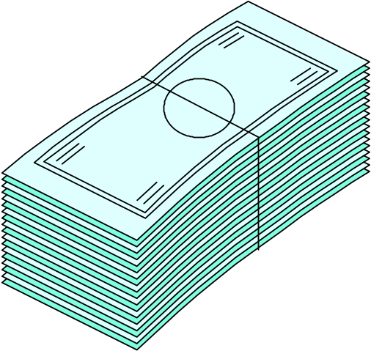

Stacks of Coins and Bills

Slide 6
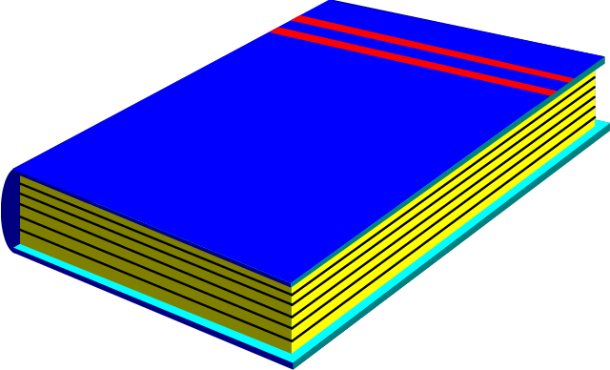

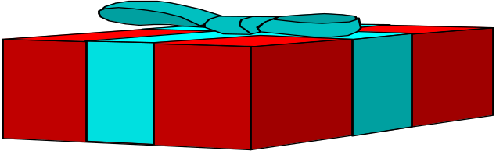
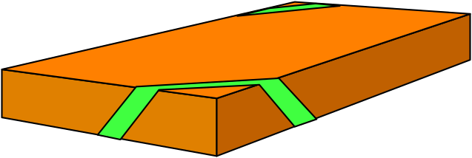
TOP OF THE STACK
TOP OF THE STACK
Stacks of Boxes and Books

Slide 7
What do these composite objects all have in common?
Stack

Slide 8
Stack
An abstract data type in which elements are added and removed from only one end (LIFO)
Stack

Slide 9
Stack
What operations would be appropriate for a stack?

Slide 10
Stacks
Transformers
  Push
  Pop
Observers
  IsEmpty
  IsFull
  Top
change state
observe state
What about an iterator?

Slide 11
class StackType {
public:
StackType();
bool IsEmpty() const;
bool IsFull() const;
void Push(int item);
void Pop();
int Top() const;
private:
// Private members go here…
};
Logical Level
Why is Top() defined as const?
Stack

Slide 12
class StackType {
public:
// Public members go here…
private:
int top;
int items[MAX_ITEMS];
};
Physical Level
[0] [1] [2] …. [M..]
stack
.items
.top
Stack (Array)

Slide 13
What does a stack look like if we insert the following elements (in the given order):
11, 14, 32
Stack (Array)
Created By Arthur Hoskey, PhD

Slide 14
Insert: 11, 14, 32
Which stack was created from the above insertions?
Stack A Stack B
Top
32
Top
11
14
14
11
32
Stack
Created By Arthur Hoskey, PhD

Slide 15
Insert: 11, 14, 32
Answer: Stack A occurs with the above insertions.
Stack A Stack B
Top
32
Top
11
14
14
11
32
Stack
Created By Arthur Hoskey, PhD

Slide 16
What does a stack look like before any elements are added.
Stack
Created By Arthur Hoskey, PhD

Slide 17
Here is a stack with 0 elements.
Note: Why does top contain the value -1?
Stack
0 1 2 3 4 5 6 7 8 9
top
0
0
0
0
0
0
0
0
0
0
-1
Stack (Array)
Created By Arthur Hoskey, PhD

Slide 18
Now run the following:
StackType s;
s.Push(11);
What happnens???
Stack
0 1 2 3 4 5 6 7 8 9
top
0
0
0
0
0
0
0
0
0
0
-1
Stack (Array) - Push
Created By Arthur Hoskey, PhD

Slide 19
s.Push(11);
Top has the value 0
The value 11 is in element 0 of the array.
Stack
0 1 2 3 4 5 6 7 8 9
top
11
0
0
0
0
0
0
0
0
0
0
Stack (Array) - Push
Created By Arthur Hoskey, PhD

Slide 20
What if we ran the following code:
s.Push(14);
s.Push(32);
What happens???
Stack
0 1 2 3 4 5 6 7 8 9
top
11
0
0
0
0
0
0
0
0
0
0
Stack (Array) - Push
Created By Arthur Hoskey, PhD

Slide 21
What is we ran the following code:
s.Push(14);
s.Push(32);
Stack grows in this direction
Stack
0 1 2 3 4 5 6 7 8 9
top
11
14
32
0
0
0
0
0
0
0
2
Stack (Array) - Push
Created By Arthur Hoskey, PhD

Slide 22
What code would we run to remove the top element of the stack?
Stack
0 1 2 3 4 5 6 7 8 9
top
11
14
32
0
0
0
0
0
0
0
2
Stack (Array)
Created By Arthur Hoskey, PhD

Slide 23
s.Pop();
What does the stack look like after we pop off one element?
Stack shrinks in this direction
Stack
0 1 2 3 4 5 6 7 8 9
top
11
14
32
0
0
0
0
0
0
0
2
Stack (Array) - Pop
Created By Arthur Hoskey, PhD

Slide 24
s.Pop();
Does the size of the C++ array actually change when we pop a value off of the stack?
Stack shrinks in this direction
Stack
0 1 2 3 4 5 6 7 8 9
top
11
14
32
0
0
0
0
0
0
0
1
Stack (Array) - Pop
Created By Arthur Hoskey, PhD

Slide 25
What happens if we run the following code on the stack below:
s.Push(33);
Stack grows in this direction
Stack
0 1 2 3 4 5 6 7 8 9
top
11
14
32
50
83
77
91
55
22
66
9
Stack (Array) - Pop
Created By Arthur Hoskey, PhD

Slide 26
s.Push(33);
THIS CAUSES A “Stack Overflow”.
Stack grows in this direction
Stack
0 1 2 3 4 5 6 7 8 9
top
11
14
32
50
83
77
91
55
22
66
9
Stack (Array) - Pop
Created By Arthur Hoskey, PhD

Slide 27
Stack overflow
The condition that results from trying to push an element on to a full stack
Stack (Array) - Overflow

Slide 28
What happens if we run the following code on the stack below:
s.Pop();
Stack shrinks in this direction
Stack
0 1 2 3 4 5 6 7 8 9
top
0
0
0
0
0
0
0
0
0
0
-1
Stack - Pop
Created By Arthur Hoskey, PhD

Slide 29
s.Pop();
THIS CAUSES A “Stack Underflow”.
Stack shrinks in this direction
Stack
0 1 2 3 4 5 6 7 8 9
top
0
0
0
0
0
0
0
0
0
0
-1
Stack (Array) - Underflow
Created By Arthur Hoskey, PhD

Slide 30
Stack underflow
The condition that results from trying to pop an empty stack
Stack (Array) - Underflow

Slide 31
StackType::StackType()
{
top = -1;
}
bool StackType::IsEmpty() const
{
return ( top == -1);
}
bool StackType::IsFull() const
{
return ( top == MAX_ITEMS);
}
Constructor
IsEmpty
IsFull
Stack (Array)

Slide 32
void StackType::Push(int newItem)
{
if (IsFull())
throw FullStack();
top++;
items[top] = newItem;
}
FullStack is an exception.
Stack (Array) - Push

Slide 33
void StackType::Pop()
{
if (IsEmpty())
throw EmptyStack();
top- -;
}
EmptyStack is an exception.
Stack (Array) - Pop

Slide 34
To get data from the stack you need to call the Top() method (for this particular ADT).
Note: There are other Stack ADTs where the Pop() method actually returns the value of the top item.
Stack
Created By Arthur Hoskey, PhD

Slide 35
int StackType::Top() const
{
if (IsEmpty())
throw EmptyStack();
return (items[top]);
}
EmptyStack is an exception.
Array-Based Implementation

Slide 36
Push, Pop and Top ALL throw exceptions.
Since they throw exceptions you MUST call them inside of a try/catch block.
For example…
Stack
Created By Arthur Hoskey, PhD

Slide 37
StackType s;
try
{
s.Push(11);
s.Pop();
}
catch (FullStack exp)
{ cerr << “FullStack exception thrown” << endl; }
catch (EmptyStack exp)
{ cerr << “EmptyStack exception thrown” << endl; }
Call Push and Pop from inside a try/catch block
Catch exceptions
Stack (Array)

Slide 38
The textbook also describes an alternative version of the array-based implementation.
The alternate version dynamically allocates the array.
This is similar to MyArray v 2.0 where we dynamically allocated the array.
Stack (Array)

Slide 39
Now we will move on to the linked-list implementation of the stack.
Stack (Linked)

Slide 40
Which functions have to be changed if we dynamically allocate the array items ?
Do we need to add any new functions?
Stack (Linked)

Slide 41
class StackType {
public:
StackType();
bool IsEmpty() const;
bool IsFull() const;
void Push(int item);
void Pop();
int Top() const;
private:
// Private members go here…
};
Logical Level
Same methods for the linked-list implementation
Stack (Linked)

Slide 42
class StackType {
public:
// Public members go here…
private:
NodeType *top;
};
Physical Level
All we need is a pointer to the top of the stack
Note:
The logical level (public part of the class declaration) stays the same;
the implementation level (private part of the class declaration) changes
Stack (Linked)

Slide 43
Assume the stack has 3 elements pushed on to it
s.Push(83);
s.Push(50);
s.Push(11);
top
Stack
data: 11
data: 50
data: 83
next:
next:
next:
Stack (Linked)
Created By Arthur Hoskey, PhD

Slide 44
Where would a new item go? How is it inserted?
s.Push(77);
top
Stack
data: 11
data: 50
data: 83
next:
next:
next:
Stack (Linked) - Push
Created By Arthur Hoskey, PhD

Slide 45
    You MUST push the item on to the top of the stack.
    Push Pseudocode
    Create a new NodeType item (dynamically allocate).
    Set the fields on the new NodeType item. This means setting the data item and the next pointer. The next pointer should be set to the current top.
    Set the top pointer to the new NodeType Item.
Stack (Linked) - Push
Created By Arthur Hoskey, PhD

Slide 46
    s.Push(77);
    Create a new NodeType item (dynamically allocate).
top
Stack
temp
data: 11
data: 50
data: 83
Data:
next:
next:
next:
next:
Stack (Linked) - Push
Created By Arthur Hoskey, PhD

Slide 47
    s.Push(77);
    Set the fields on the new NodeType item. Set data item and next pointer. Next points to current top.
top
Stack
temp
data: 11
data: 50
data: 83
data: 77
next:
next:
next:
next:
Stack (Linked) - Push
Created By Arthur Hoskey, PhD

Slide 48
    s.Push(77);
    Set the top pointer to the new NodeType Item.
Stack
top
temp
data: 11
data: 50
data: 83
data: 77
next:
next:
next:
next:
Stack (Linked) - Push
Created By Arthur Hoskey, PhD

Slide 49
    s.Push(77);
    When the Push method ends the temp pointer will go out of scope and disappear.
Stack
top
temp
data: 11
data: 50
data: 83
data: 77
next:
next:
next:
next:
Stack (Linked) - Push
Created By Arthur Hoskey, PhD

Slide 50
    This picture is LOGICALLY EQUIVALENT to the previous slide!!!
Stack
top
data: 77
data: 11
data: 50
data: 83
next:
next:
next:
next:
Stack (Linked) - Push
Created By Arthur Hoskey, PhD

Slide 51
void StackType::Push(ItemType newItem)
{
if (IsFull()) {
throw FullStack();
} else {
NodeType* location;
location = new NodeType;
location->info = newItem;
location>next = topPtr;
topPtr = location;
}
}
Allocate a new node
Set values on the new node
Place the new node at the top of the stack
Stack (Linked) - Push

Slide 52
    Pop Pseudocode
    Create a temporary pointer to the top node.
    Update the top pointer so that it points to the second item in the stack.
    Deallocate the memory pointed to by the temporary pointer (the old top node).
Stack (Linked) - Pop
Created By Arthur Hoskey, PhD

Slide 53
    s.Pop();
top
Stack
data: 77
data: 11
data: 50
data: 83
next:
next:
next:
next:
Stack (Linked) - Pop
Created By Arthur Hoskey, PhD

Slide 54
    Create a temporary pointer to the top node.
top
Stack
temp
data: 77
data: 11
data: 50
data: 83
next:
next:
next:
next:
Stack (Linked) - Pop
Created By Arthur Hoskey, PhD

Slide 55
    Update the top pointer so that it points to the second item in the stack.
top
Stack
temp
data: 77
data: 11
data: 50
data: 83
next:
next:
next:
next:
Stack (Linked) - Pop
Created By Arthur Hoskey, PhD

Slide 56
    Deallocate the memory pointed to by the temporary pointer (the old top node).
top
Stack
temp
data: 77
data: 11
data: 50
data: 83
next:
next:
next:
next:
Stack (Linked) - Pop
Created By Arthur Hoskey, PhD

Slide 57
    The temp pointer will disappear when the Pop method ends.
top
Stack
temp
data: 77
data: 11
data: 50
data: 83
next:
next:
next:
next:
Stack (Linked) - Pop
Created By Arthur Hoskey, PhD

Slide 58
    This picture is LOGICALLY EQUIVALENT to the previous slide!!!
top
Stack
data: 11
data: 50
data: 83
next:
next:
next:
Stack (Linked) - Pop
Created By Arthur Hoskey, PhD

Slide 59
void StackType::Pop()
{
if (IsEmpty()) {
throw EmptyStack();
} else {
NodeType* temp;
temp = topPtr;
top = top->next;
delete temp;
}
}
Create a temporary pointer to the top node
Now set top to the second item
Release memory for the old top node
Stack (Linked) - Pop

Slide 60
StackType::StackType()
{
top = NULL;
}
bool StackType::IsEmpty() const
{
return ( top == NULL);
}
Constructor
IsEmpty
Stack (Linked) – Constructor and IsEmpty

Slide 61
bool StackType::IsFull()
{
NodeType * location;
try
{
location = new NodeType;
delete location;
return false;
}
catch (bad_alloc exception)
{
return true;
}
}
Check to see if you can allocate memory.
If you can then stack is not full so return false.
If you cannot allocate memory then the stack is full.
Stack (Linked) – IsFull
Created By Arthur Hoskey, PhD

Slide 62
To get data from the stack you need to call the Top() method (for this particular ADT).
Note: There are other Stack ADTs where the Pop() method actually returns the value of the top item.
Stack
Created By Arthur Hoskey, PhD

Slide 63
int StackType::Top() const
{
if (IsEmpty())
throw EmptyStack();
return top->info;
}
EmptyStack is an exception.
Return the data in the top node.
Stack (Linked) - Top

Slide 64
bool StackType::~StackType()
{
NodeType * temp;
while (top != NULL)
{
temp = top;
top = top->next;
delete temp;
}
}
Deletes ALL of the elements in the stack.
Note: The array-based implementation does not need a destructor because it does NOT dynamically allocate memory.
Stack (Linked) – Destructor
Created By Arthur Hoskey, PhD

Slide 65
What are the Big-O runtimes for the array-based and linked-list implementations of a stack?
Big-O Comparison – Stack
Created By Arthur Hoskey, PhD

Slide 66
Operation | Cost
IsFull | O(1)
IsEmpty | O(1)
Push | O(1)
Pop | O(1)
Constructor | O(1)
Destructor | n/a
Big-O Comparison – Stack (Array)
Created By Arthur Hoskey, PhD

Slide 67
Operation | Cost
IsFull | O(1)
IsEmpty | O(1)
Push | O(1)
Pop | O(1)
Constructor | O(1)
Destructor | O(n)
Big-O Comparison – Stack (Linked)
Created By Arthur Hoskey, PhD

Slide 68
Take attendance now!!!
Attendance
Created By Arthur Hoskey, PhD

Slide 69
End of Slides
End of Slides
Created By Arthur Hoskey, PhD

