Slide 1
BCS 370 Data Structures
Arthur Hoskey, Ph.D.
Farmingdale State College
Computer Systems Department

Slide 2
Today’s Lecture
Chapter 7 Recursion
Created By Arthur Hoskey, PhD

Slide 3
Goals
Discuss recursion as another form of repetition
Do the following tasks, given a recursive routine
  Determine whether the routine halts
  Determine the base case(s)
  Determine the general case(s)
  Determine what the routine does
  Determine whether the routine is correct and, if it is not, correct it

Slide 4
Goals
Do the following tasks, given a simple recursive problem
  Determine the base case(s)
  Determine the general case(s)
  Design and code the solution as a recursive void or value-returning function
Verify a recursive routine, according to the Three-Question Method
Decide whether a recursive solution is appropriate for a problem

Slide 5
Goals
Compare and contrast dynamic storage allocation and static storage allocation in relation to using recursion
Explain how recursion works internally by showing the contents of the run-time stack
Replace a recursive solution with iteration and/or the use of a stack
Explain why recursion may or may not be a good choice to implement the solution to a problem

Slide 6
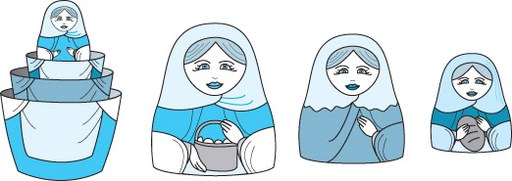
What Is Recursion?
How is recursion like a set of Russian dolls?

Slide 7
What Is Recursion?
Recursive call
A method call in which the method being called is the same as the one making the call
Direct recursion
Recursion in which a method directly calls itself
Indirect recursion
Recursion in which a chain of two or more method calls returns to the method that originated the chain

Slide 8
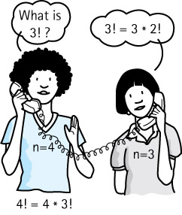
Example of Recursion
Recursive definition
A definition in which something is defined in terms of a smaller version of itself
What is 3 factorial?

Slide 9
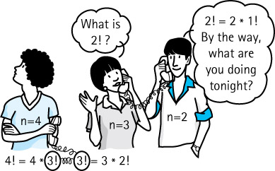
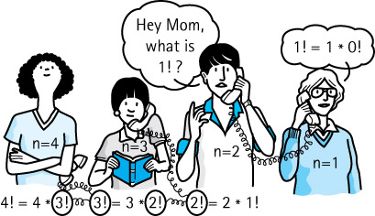
Example of Recursion

Slide 10
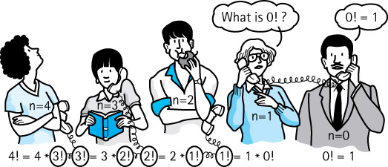
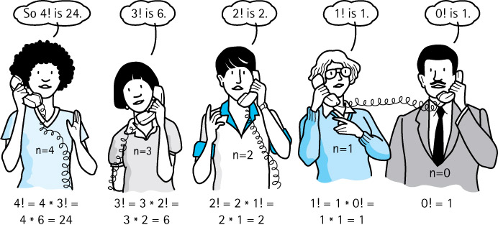
Examples of Recursion

Slide 11
Writing Recursive Solutions - Factorial
Mathematical Description of Factorial
n! = 1, if n = 0
n* (n-1)!, if n > 0

Slide 12
Example of Recursion
Base case
The case for which the solution can be stated nonrecursively
General (recursive) case
The case for which the solution is expressed in terms of a smaller version of itself
Recursive algorithm
A solution that is expressed in terms of (a) a smaller instance(s) of itself and (b) a base case(s)

Slide 13
Writing Recursive Solutions
Algorithm for writing recursive solutions
Determine the size of the problem
  Size is the factor that is getting smaller
  Size is usually a parameter to the problem
Identify the base case(s)
  The case(s) for which you know the answer
Identify the general case(s)
  The case(s) that can be expressed as a smaller version of the size

Slide 14
Writing Recursive Solutions - Power
Let’s try it
Problem: Calculate X^{n} (X to the nth power)
Recursive formulation: X*(X^{n-1})*(X^{n-2})*...*X⁰
  What is the size of the problem?
  Which case do you know the answer to?
  Which case can you express as a smaller version of the size?

Slide 15
Writing Recursive Solutions - Power
Mathematical Description of Power
X^{n} = 1, if n = 0
X^{n *} X^{n-1}, if n > 0

Slide 16
Writing Recursive Solutions - Power
int Power(int number, int exponent)
{
// Is it the base case?
if (exponent == 0)
{
// Base case
return 1;
}
else
{
// Recursive case – Call on smaller case
return number * Power(number, exponent - 1);
}
}

Slide 17
Writing Recursive Solutions
Pattern of solution
if (some condition for which answer is know)
solution statement
else
function call
Recursive case
Base case

Slide 18
Writing Recursive Solutions - Fibonacci
Shall we try it again?
Problem: Calculate Nth item in Fibonacci sequence
0, 1, 1, 2, 3, 5, 8, 13, 21, 34, 55
  What is the next number?
  What is the size of the problem?
  Which case do you know the answer to?
  Which case can you express as a smaller version of the size?

Slide 19
Writing Recursive Solutions - Fibonacci
Mathematical Description of Fibonacci Sequence
Fn = 0, if n = 0
1, if n = 1
Fn-1 + Fn-2, if n >= 2

Slide 20
Writing Recursive Solutions - Fibonacci
int Fibonacci(int n)
{
if (n == 0 || n == 1)
return n;
else
return Fibonacci(n-2) + Fibonacci(n-1);
}
That was easy, but it is not very efficient.
Why?

Slide 21
Writing Recursive Solutions
Shall we try it again?
Problem: Search a list of integers for a value and return true if it is in the list and false otherwise
  What is the size of the problem?

Slide 22
Unsorted List - DeleteItem
Recursively search a list for an item.
Unsorted List
0 1 2 3 4 5 6 7 8 9
length
11
50
83
77
91
32
14
22
44
0
9
Created By Arthur Hoskey, PhD

Slide 23
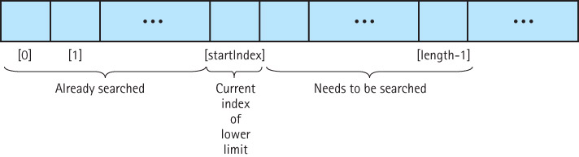
Writing Recursive Solutions
bool ValueInList(ListType data, int value, int startIndex);
  Which case do you know the answer to?
  Which case can you express as a smaller version of the size?

Slide 24
Writing Recursive Solutions
bool ValueInList(ListType list, int value, int startIndex
{
if (list.info[startIndex] == value)
return true;
else if (startIndex == list.length -1)
return false;
else return ValueInList(list, value, startIndex + 1);
}
Base Case 1
Base Case 2
Recursive Case
Note
This version passes a list in

Slide 25
Writing Recursive Solutions
bool UnsortedType::ValueInList(int value, int startIndex)
{
if (info[startIndex] == value)
return true;
else if (startIndex == length -1)
return false;
else return ValueInList(value, startIndex + 1);
}
Base Case 1
Base Case 2
Recursive Case
Note
This version is a member of list

Slide 26
Writing Recursive Solutions
Why use recursion?
True, these examples could more easily be solved using iteration
However, a recursive solution is a natural solution in certain cases, especially when pointers are involved

Slide 27
Writing Recursive Solutions
Printing a list in order
Size?
Base case?
Recursive (general) case?

Slide 28
Writing Reverse Solutions
void UnsortedType::Print(NodeType* listPtr)
{
if (listPtr != NULL)
{
std::cout << listPtr->info << std::endl;
Print(listPtr->next);
}
}
Where is the base case?

Slide 29
Writing Reverse Solutions
void UnsortedType::Print(NodeType* listPtr)
{
if (listPtr != NULL)
{
std::cout << listPtr->info << std::endl;
Print(listPrt->next);
}
}
Where is the base case?
ANSWER: When listPtr is NULL

Slide 30
Writing Reverse Solutions
// This version will call the recursive version UnsortedType::Print()
{
Print(listData);
}
// Recursive version will call itself
void UnsortedType::Print(NodeType* listPtr)
{
if (listPtr != NULL)
{ // Prints BEFORE recursive call
cout << listPtr->info << endl;
Print(listPtr->next);
}
}

Slide 31
Unsorted List
UnsortedType ul;
ul.print(); // Call the helper to start
Unsorted List
length
listData
data: 11
data: 50
data: 83
next:
next:
next:
3
Created By Arthur Hoskey, PhD

Slide 32
Unsorted List
ul.print(); // Calls recursive version with start of list
ul.print(listData); // First call to recursive version
Unsorted List
length
listData
listPtr
After ul.print(listData) is called
data: 11
data: 50
data: 83
next:
next:
next:
3
11 is printed before recursive call
Created By Arthur Hoskey, PhD

Slide 33
Unsorted List
ul.print(listData);// Calls recursive version again
ul.print(listPtr->next);
length
listData
listPtr
After ul.print(listPtr->next) is called
data: 11
data: 50
data: 83
next:
next:
next:
3
50 is printed before recursive call
Created By Arthur Hoskey, PhD

Slide 34
Unsorted List
ul.print(listPtr->next);
length
listData
listPtr
After ul.print(listPtr->next) is called
data: 11
data: 50
data: 83
next:
next:
next:
3
83 is printed before recursive call
Created By Arthur Hoskey, PhD

Slide 35
Unsorted List
ul.print(listPtr->next);
All the recursive calls are done. Now “unwind” since base case has been reached (listPtr == NULL).
length
listData
listPtr
After ul.print(listPtr->next) is called
data: 11
data: 50
data: 83
next:
next:
next:
3
Nothing is printed. Base case has been reached.
Created By Arthur Hoskey, PhD

Slide 36
Unsorted List
Call stack when base case is reached
Call Stack
top
Print(listData->next->next->next) –
Print(listData->next->next) – 83
Print(listData->next) – 50, 83
Print(listData) – 11, 50, 83
Print() – 11, 50, 83
Created By Arthur Hoskey, PhD

Slide 37
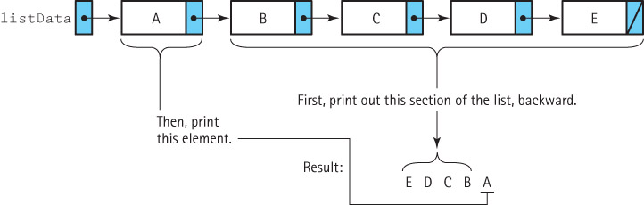
Writing Recursive Solutions
Printing a list in reverse order
What must be changed from the in-order print to make the code print in reverse order?

Slide 38
Writing Reverse Solutions
// This version will call the recursive version UnsortedType::RevPrint()
{
Print(listData);
}
// Recursive version will call itself
void UnsortedType::RevPrint(NodeType* listPtr)
{
if (listPtr != NULL)
{ // Prints AFTER recursive call
Print(listPtr->next);
cout << listPtr->info << endl;
}
}
Prints during the “unwind”.

Slide 39
bool Mystery( ItemType info[ ], ItemType item,
int fromLoc, int toLoc )
{
int mid;
if ( fromLoc > toLoc )
return false;
else
{
mid = ( fromLoc + toLoc ) / 2 ;
if (info[mid] == item)
return true ;
else
if (item < info[mid])
return Mystery (info, item, fromLoc, mid-1 );
else
return Mystery(info, item, mid + 1, toLoc) ;
}
}
What does this function return?

Slide 40
bool BinarySearch( ItemType info[ ], ItemType item,
int fromLoc, int toLoc )
{
int mid;
if ( fromLoc > toLoc )
return false;
else
{
mid = ( fromLoc + toLoc ) / 2 ;
if (info[mid] == item)
return true ;
else
if (item < info[mid])
return BinarySearch(info,item,fromLoc,mid-1 );
else
return BinarySearch(info, item, mid + 1, toLoc) ;
}
}
What does this function return?
ANSWER: true if found false otherwise

Slide 41
Writing Recursive Solutions
Problem: Insert item into list
  What is the size of the problem?
  Which case(s) do you know the answer to?
  Which case can you express as a smaller version of the size?

Slide 42
Writing Recursive Solutions
void Insert(NodeType*& listPtr, ItemType item)
{
if (listPtr == NULL || item < listPtr->info)
{
NodeType* tempPtr = listPtr;
listPtr = new NodeType;
listPtr->info = item;
listPtr->next = tempPtr;
}
else Insert(listPtr->next, item)
}
NodeType*&: Is the *& important?

Slide 43
How Recursion Works
Binding Time
The time at which a variable is assigned to a memory address
Static Storage Allocation
Binding occurs during compilation
Dynamic Storage Allocation
Binding occurs during run time
Global variables are bound at compile time.
When are parameters bound to an address?

Slide 44
How Recursion Works
Transfer of Control
When a function is called, control is passed to the first executable statement in the function
  How does control get passed back to the calling code?
Return Address
The address of the instruction in the calling code that immediately follows the function call
How does the function access the return address?

Slide 45
How Recursion Works
Activation Record (Stack Frame)
A record used at run time to store information about a function call, including the parameters, local variables, return address, and function return value (if a value-returning function)
Run-time Stack
A data structure that keeps track of activation records during the execution of a program

Slide 46
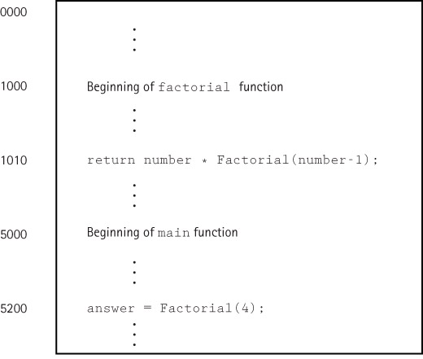
How Recursion Works
Function
Factorial
loaded
in
memory

Slide 47

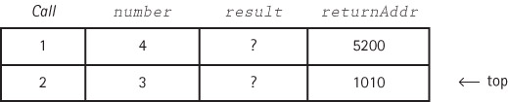
How Recursion Works
answer = Factorial(4);
return number * Factorial(number-1);

Slide 48
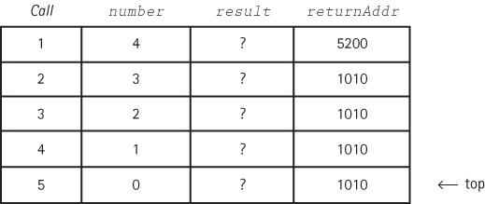
How Recursion Works
return number * Factorial(number-1); (2)
return number * Factorial(number-1); (1)
return number * Factorial(number-1); (0)
So now what?

Slide 49
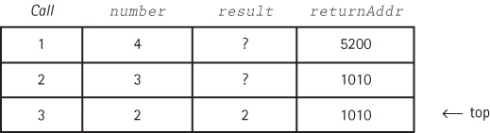
How Recursion Works
return number * Factorial(number-1); (2)
return number * Factorial(number-1); (1) popped
return number * Factorial(number-1); (0) popped

Slide 50
How Recursion Works
return number * Factorial(number-1); (4)
return number * Factorial(number-1); (3) popped
return number * Factorial(number-1); (2) popped
result from previous call (6) is multiplied by
current number giving 24. Now what happens?

Slide 51

How Recursion Works
void Insert(NodeType*& listPtr, ItemType item)
Did you figure out why it must be NodeType*&?
Let’s trace Insert(listData, 11)

Slide 52

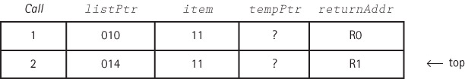
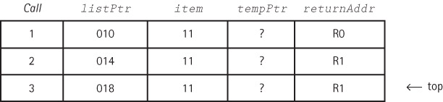
How Recursion Works
R0 is non-
recursive call

Slide 53
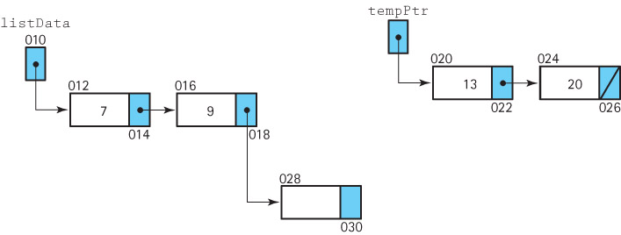
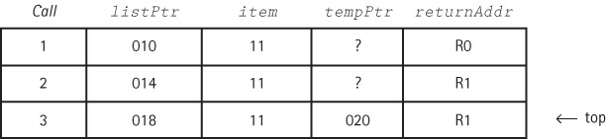
How Recursion Works
List before
insert
See
why
it
works
?
listPtr->next = tempPtr;

Slide 54
Writing Recursive Solutions
void Insert(NodeType*& listPtr, ItemType item) {
if (listPtr == NULL || item < listPtr->info)
{
NodeType* tempPtr = listPtr;
listPtr = new NodeType;
listPtr->info = item;
// Note: Prev slide shows list before next line runs
listPtr->next = tempPtr; // This value is seen by the
// listPtr is updated and seen by the calling function
}
else Insert(listPtr->next, item)
}

Slide 55
Removing Recursion
Tail Recursion
The case in which a function contains only a single recursive invocation and it is the last statement to be executed in the function
A tail recursive function can be replaced with iteration
Stacking
Using a stack to keep track of each local environment, i.e., simulate the run-time stack

Slide 56
When To Use Recursion
Depth of recursive calls is relatively “shallow” compared to the size of the problem
Recursive version does about the same amount of work as the nonrecursive version (same Big-O)
The recursive version is shorter and simpler than the nonrecursive solution
SHALLOW DEPTH EFFICIENCY CLARITY

Slide 57
Attendance
Take attendance now!!!
Created By Arthur Hoskey, PhD

Slide 58
End of Slides
End of Slides
Created By Arthur Hoskey, PhD

