Slide 1
Implementing an Unsorted List as a Linked Structure
CS 308 – Data Structures

Slide 2
Implementing an Unsorted List as a Linked Structure
Allocate memory for each new element dynamically
Link the list elements together
Use two pointers, currentPos and listData, to mark the current position in the list and the beginning of the list
Use an integer variable, length, to store the current length of the list.

Slide 3
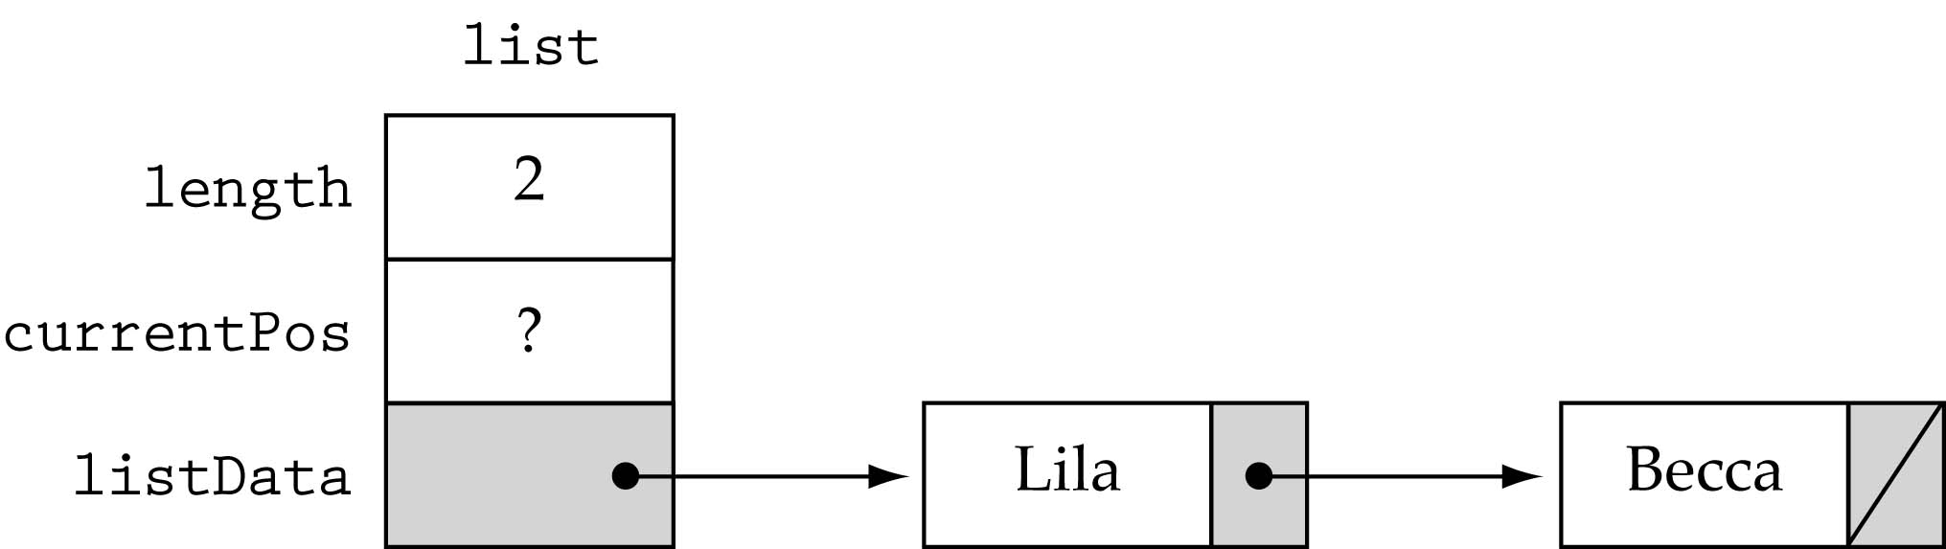
Implementing an Unsorted List as a Linked Structure (cont.)

Slide 4
Unsorted List Class Specification
template <class ItemType>
struct NodeType;
template<class ItemType>
class UnsortedType {
public:
UnsortedType();
~UnsortedType();
void MakeEmpty();
bool IsFull() const;
int LengthIs() const;
void RetrieveItem(ItemType&, bool&);
void InsertItem(ItemType);
void DeleteItem(ItemType);
void ResetList();
bool IsLastItem() const;
void GetNextItem(ItemType&);
private:
int length;
NodeType<ItemType>* listData;
NodeType<ItemType>* currentPos;
};

Slide 5
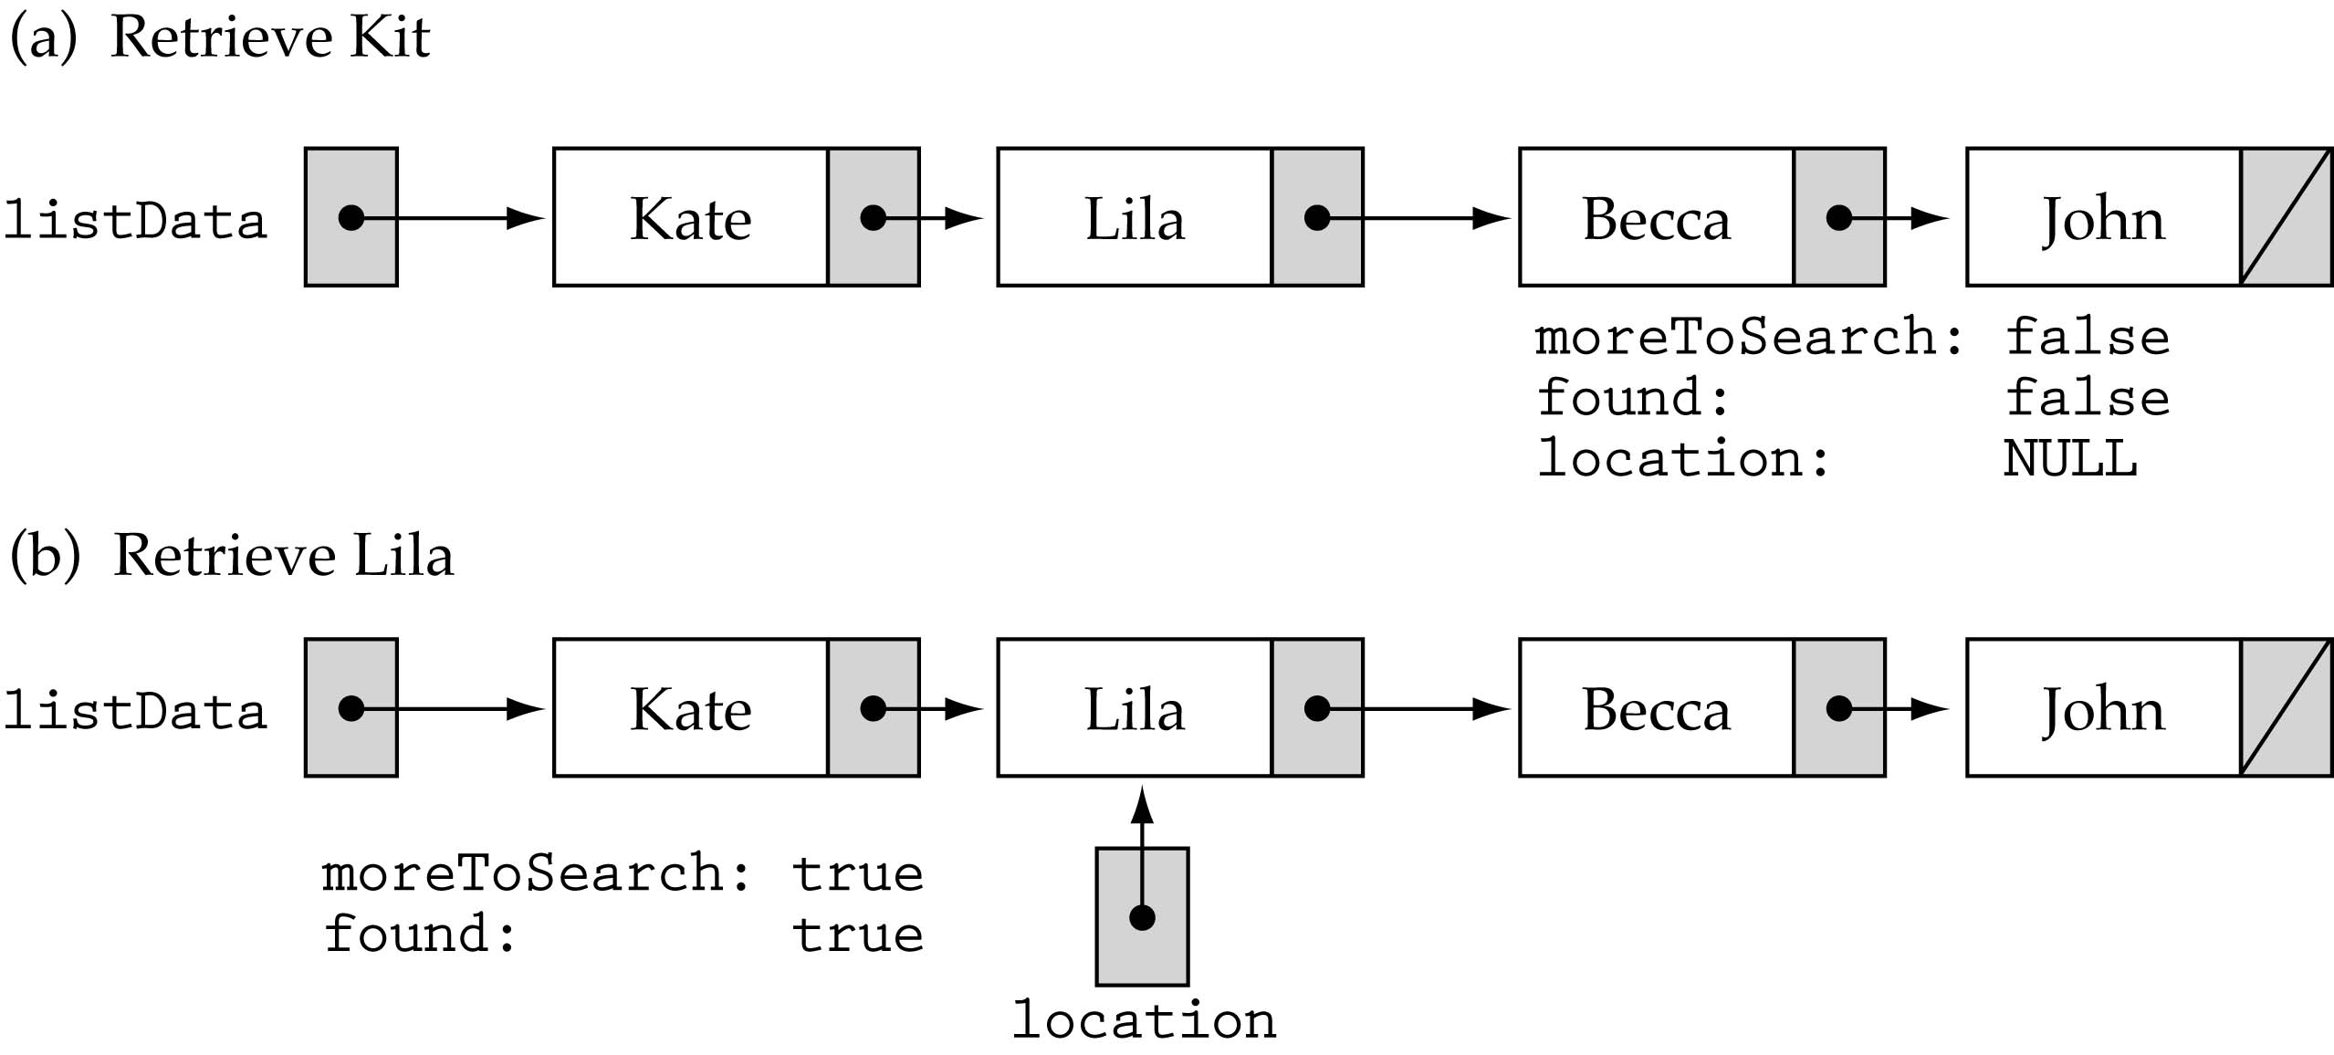
Function RetrieveItem

Slide 6
Function RetrieveItem (cont.)
template<class ItemType>
void UnsortedType<ItemType>::RetrieveItem
(ItemType& item, bool& found)
{
NodeType<ItemType>* location;
location = listData;
found = false;
while( (location != NULL) && !found) {
if(item == location->info) {
found = true;
item = location->info;
}
else
location = location->next;
}
}

Slide 7
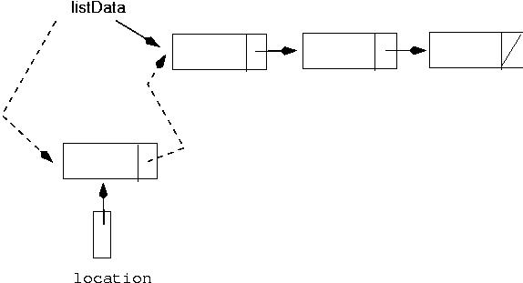
Function InsertItem
Just insert the item at the beginning of the list

Slide 8
Function InsertItem (cont.)
template <class ItemType>
void UnsortedType<ItemType>::InsertItem (ItemType newItem)
{
NodeType<ItemType>* location;
location = new NodeType<ItemType>;
location->info = newItem;
location->next = listData;
listData = location;
length++;
}

Slide 9
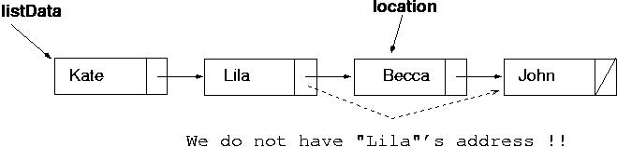
Function DeleteItem
Find the item first
In order to delete it, we must change the pointer in the previous node!!

Slide 10
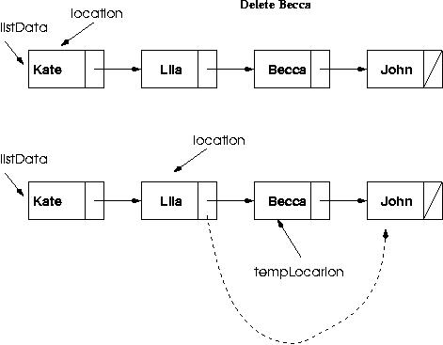
Function DeleteItem (cont.)
Solution: compare one item ahead ((location->next)->info)) !!
Deleting the first node is a special case ...

Slide 11
Important:this implementation will work without problems ONLY if the item to be deleted IS in the list ! (precondition)

Slide 12
Function DeleteItem (cont.)
template <class ItemType>
void UnsortedType<ItemType>::DeleteItem(ItemType item)
{
NodeType<ItemType>* location = listData;
NodeType<ItemType>* tempLocation;
if(item == listData->info) {
tempLocation = location;
listData = listData->next; // delete first node
}
else {
while(!(item == (location->next)->info))
location = location->next;
// delete node at location->next
tempLocation=location->next;
location->next = (location->next)->next;
}
delete tempLocation;
length--;
}

Slide 13
Other UnsortedList functions
template<class ItemType>
UnsortedType<ItemType>::UnsortedType()
{
length = 0;
listData = NULL;
}
template<class ItemType>
void UnsortedType<ItemType>::MakeEmpty()
{
NodeType<ItemType>* tempPtr;
while(listData != NULL) {
tempPtr = listData;
listData = listData->next;
delete tempPtr;
}
length=0;
}

Slide 14
Other UnsortedList functions (cont.)
template<class ItemType>
UnsortedType<ItemType>::~UnsortedType()
{
MakeEmpty();
}
template<class ItemType>
bool UnsortedType<ItemType>::IsFull() const
{
NodeType<ItemType>* ptr;
ptr = new NodeType<ItemType>;
if(ptr == NULL)
return true;
else {
delete ptr;
return false;
}
}

Slide 15
Other UnsortedList functions (cont.)
template<class ItemType>
int UnsortedType<ItemType>::LengthIs() const
{
return length;
}
template<class ItemType>
int UnsortedType<ItemType>::ResetList()
{
currentPos = listData;
}
template<class ItemType>
void UnsortedType<ItemType>::GetNextItem(ItemType& item)
{
item = currentPos->info;
currentPos = currentPos->next;
}
template<class ItemType>
bool UnsortedType<ItemType>::IsLastItem() const
{
return(currentPos == NULL);
}

Slide 16
Write a client function that merges two instances of the Unsorted List ADT using the following specification.
MergeLists(UnsortedType list1, UnsortedType list2, UnsortedType& result)
Function: Merges two unsorted lists into a third unsorted list (no duplicates).
Preconditions: list1 and list2 have been initialized.
Postconditions: result is an unsorted list that contains all of the items from list1 and list2.

Slide 17
{
ItemType item;
bool found;
list1.Reset();
list2.Reset();
result.MakeEmpty();
while ( !list1.IsLastItem() ); {
list1.GetNextItem(item);
if ( !result.IsFull() )
result.InsertItem(item);
}
while ( !list2.IsLastItem() ); {
list2.GetNextItem(item);
list1.RetrieveItem(item, found);
if ( !found )
if ( !result.IsFull() )
result.InsertItem(item);
}
}

Slide 18
Comparing unsorted list implementations
Big-O Comparison of Unsorted List Operations
Operation | Array Implementation | Linked Implementation
Class constructor | O(1) | O(1)
Destructor | O(1) | O(N)
MakeEmpty | O(1) | O(N)
IsFull | O(1) | O(1)
LengthIs | O(1) | O(1)
ResetList | O(1) | O(1)
GetNextItem | O(1) | O(1)
RetrieveNextItem | O(N) | O(N)
InsertItem | O(1) | O(1)
DeleteItem | O(N) | O(N)

Slide 19
Exercises
9, 10, 11, 15 - 18

