Slide 1
CSE 634 Data Mining Techniques
Professor Anita Wasilewska
SUNY Stony Brook
CLUSTER ANALYSIS
By: Arthy Krishnamurthy & Jing Tun
Spring 2005

Slide 2
References
Jiawei Han and Michelle Kamber. Data Mining Concept and Techniques (Chapter8). Morgan Kaufman, 2002.
M. Ester, H.P. Kriegel, J. Sander, and X. Xu. A density-based algorithm for discovering clusters in large spatial databases. KDD'96. http://ifsc.ualr.edu/xwxu/publications/kdd-96.pdf
K-means and Hierachical Clustering. Statistical data mining tutorial slides by Andrew Moore: http://www-2.cs.cmu.edu/~awm/tutorials/kmeans.html
How to explain hierarchical clustering. http://www.analytictech.com/networks/hiclus.htm
Teknomo, Kardi. K-means Clustering Numerical Example. http://people.revoledu.com/kardi/tutorial/kMean/NumericalExample.htm

Slide 3
Outline
What is Cluster Analysis?
Applications
Data Types and Distance Metrics
Clustering in Real Databases
Major Clustering Methods
Outlier Analysis
Summary

Slide 4
What is Cluster Analysis?
Cluster: a collection of data objects
  Similar to the objects in the same cluster (Intraclass similarity)
  Dissimilar to the objects in other clusters (Interclass dissimilarity)
Cluster analysis
  Statistical method for grouping a set of data objects into clusters
  A good clustering method produces high quality clusters with high intraclass similarity and low interclass similarity
Clustering is unsupervised classification
Can be a stand-alone tool or as a preprocessing step for other algorithms

Slide 5
Outline
What is Cluster Analysis?
Applications
Data Types and Distance Metrics
Clustering in Real Databases
Major Clustering Methods
Outlier Analysis
Summary

Slide 6
Examples of Clustering Applications
Marketing: Help marketers discover distinct groups in their customer bases, and then use this knowledge to develop targeted marketing programs
Insurance: Identifying groups of motor insurance policy holders with a high average claim cost
City-planning: Identifying groups of houses according to their house type, value, and geographical location
Earth-quake studies: Observed earth quake epicenters should be clustered along continent faults

Slide 7
Outline
What is Cluster Analysis?
Applications
Data Types and Distance Metrics
Clustering in Real Databases
Major Clustering Methods
Outlier Analysis
Summary

Slide 8


Data Structures
Data matrix o1
  p=attributes …
  n=# of objects oi
        …
Dissimilarity matrix
  d(i,j)=difference/
  dissimilarity
  between i and j

Slide 9
Types of data in clustering analysis
Interval-scaled attributes:
Binary attributes:
Nominal, ordinal, and ratio attributes:
Attributes of mixed types:

Slide 10
Interval-scaled attributes
Continuous measurements of a roughly linear scale
  E.g. weight, height, temperature, etc.
Standardize data in preprocessing so that all attributes have equal weight
  Exceptions: height may be a more important attribute associated with basketball players

Slide 11


Similarity and Dissimilarity Between Objects
Distances are normally used to measure the similarity or dissimilarity between two data objects (objects=records)
Minkowski distance:
  where i = (x_{i1}, x_{i2}, …, x_{ip}) and j = (x_{j1}, x_{j2}, …, x_{jp}) are two p-dimensional data objects, and q is a positive integer
If q = 1, d is Manhattan distance

Slide 12

Similarity and Dissimilarity Between Objects (Cont.)
If q = 2, d is Euclidean distance:
  Properties
    d(i,j) ≥ 0
    d(i,i) = 0
    d(i,j) = d(j,i)
    d(i,j) ≤ d(i,k) + d(k,j)
Can also use weighted distance, or other dissimilarity measures.

Slide 13



Binary Attributes
A contingency table for binary data
Simple matching coefficient (if the binary attribute is symmetric):
Jaccard coefficient (if the binary attribute is asymmetric):
Object j
Object i

Slide 14


Dissimilarity between Binary Attributes
Example
i
j
  gender is a symmetric attribute
  remaining attributes are asymmetric
  let the values Y and P be set to 1, and the value N be set to 0

Slide 15

Nominal Attributes
A generalization of the binary attribute in that it can take more than 2 states, e.g., red, yellow, blue, green
Method 1: Simple matching
  m: # of attributes that are same for both records, p: total # of attributes
Method 2: rewrite the database and create a new binary attribute for each of the m states
  For an object with color yellow, the yellow attribute is set to 1, while the remaining attributes are set to 0.

Slide 16


Ordinal Attributes
An ordinal attribute can be discrete or continuous
Order is important, e.g., rank
Can be treated like interval-scaled
  replacing x_{if} by their rank
  map the range of each variable onto [0, 1] by replacing i-th object in the f-th attribute by
  compute the dissimilarity using methods for interval-scaled attributes

Slide 17
Ratio-Scaled Attributes
Ratio-scaled attribute: a positive measurement on a nonlinear scale, approximately at exponential scale, such as Ae^{Bt} or Ae^{-Bt}
Methods:
  treat them like interval-scaled attributes — not a good choice because scales may be distorted
  apply logarithmic transformation
y_{if} = log(x_{if})
  treat them as continuous ordinal data and treat their rank as interval-scaled.

Slide 18


Attributes of Mixed Types
A database may contain all the six types of attributes
  symmetric binary, asymmetric binary, nominal, ordinal, interval and ratio.
Use a weighted formula to combine their effects.
  f is binary or nominal:
    d_{ij}^{(f)} = 0 if x_{if} = x_{jf} , or d_{ij}^{(f)} = 1 o.w.
  f is interval-based: use the normalized distance
  f is ordinal or ratio-scaled
    compute ranks r_{if} and
    and treat z_{if} as interval-scaled

Slide 19
Outline
What is Cluster Analysis?
Applications
Data Types and Distance Metrics
Clustering in Real Databases
Major Clustering Methods
Outlier Analysis
Summary

Slide 20
Clustering in Real Databases
All data must be transformed into numbers in
[0, 1] interval
  Weights can be applied
Database attributes can be changed into attributes with binary values
  May result in a huge database
Difficulty depending on the type of attribute and the important attributes
  Narrow down attributes by their importance

Slide 21
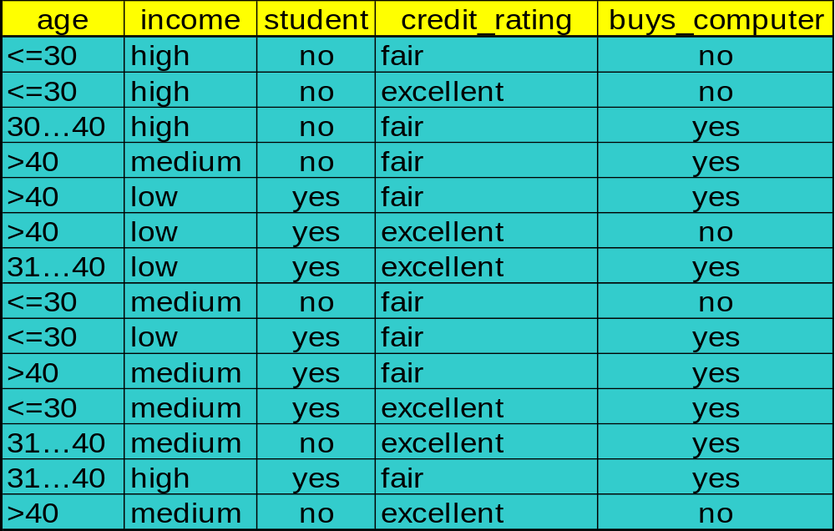
Clustering in Real Databases
Recall the database table from the Decision Tree example

Slide 22
Outline
What is Cluster Analysis?
Applications
Data Types and Distance Metrics
Clustering in Real Databases
Major Clustering Methods
Outlier Analysis
Summary

Slide 23
Clustering Requirements
Inputs:
  Set of attributes
  Maximum number of clusters
  Number of iterations
  Minimum number of elements in any cluster

Slide 24
Major Clustering Approaches
Partitioning algorithms: Divide the set of data objects into various partitions using some criterion
Hierarchy algorithms: Create a hierarchical decomposition of the set of data (or objects) using some criterion
Density-based: based on connectivity and density functions

Slide 25
Partitioning Algorithms: Basic Concept
Partitioning method: Construct a partition of a database D of n objects into a set of k clusters
Input: k
Goal: find a partition of k clusters that optimizes the chosen partitioning criterion[Squared error criterion]
  Global optimal: exhaustively enumerate all partitions
  Heuristic method:
    k-means (MacQueen 1967): Each cluster is represented by the center(mean) of the cluster
    Variants of the k-means for different data types – k-modes method, etc.

Slide 26
The K-Means Clustering Method
Given k, the k-means algorithm is implemented in 4 steps:
  Partition objects into k non-empty subsets
  Arbitrarily choose k points as initial centers.
  Assign each object to the cluster with the nearest seed point (center).
  Calculate the mean of the cluster and update the seed point.
  Go back to Step 3, stop when no more new assignment.

Slide 27
The k-means algorithm:
The basic step of k-means clustering is simple:
Iterate until stable (= no object move group):
Determine the centroid coordinate
Determine the distance of each object to the centroids
Group the object based on minimum distance

Slide 28


Slide 29
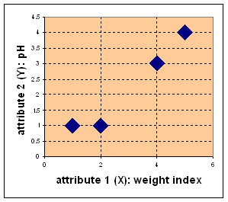
Simple k-means Example(k=2)
Object | attribute 1 (X): weight index | attribute 2 (Y): pH
Medicine A | 1 | 1
Medicine B | 2 | 1
Medicine C | 4 | 3
Medicine D | 5 | 4

Slide 30
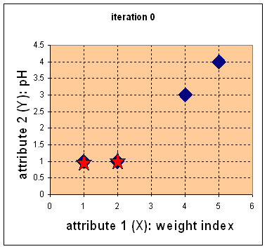
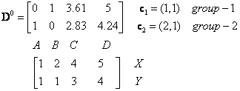
Suppose we use medicine A
and medicine B as the first
centroids.
Let c1 and c2 denote the two
centroids, then c1=(1,1) and
c2=(2,1).
We calculate the Euclidean
distance between each
objects.
The distance matrix:
For example: distance from c(4,3)
to c1(1,1) is
and c(4,3) to c2(2,1) is:

Slide 31
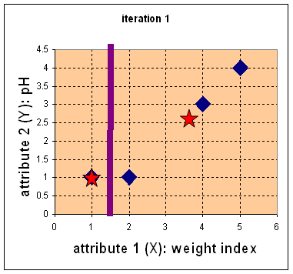


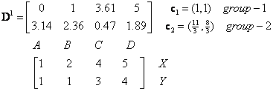

Now we assign groups based on distance:
Iteration 1: calculate
new mean:
Compute distance matrix and group

Slide 32
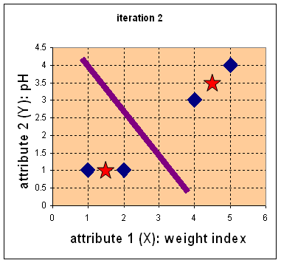


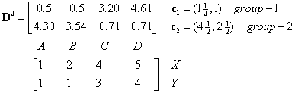

Iteration 2: calculate
new mean
Calculate distance
matrix and group
        After this iteration, G¹=G², we stop

Slide 33
Cluster of Objects
Object Feature 1 (X) Feature 2 (Y) Group (result)
weight index pH
Medicine A 1 1 1
Medicine B 2 1 1
Medicine C 4 3 2
Medicine D 5 4 2

Slide 34
Weaknesses of the K-Means Method
Unable to handle noisy data and outliers
Very large or very small values could skew the mean
Not suitable to discover clusters with non-convex shapes

Slide 35
Hierarchical Clustering
Use distance matrix as clustering criteria. This method does not require the number of clusters k as an input, but needs a termination condition.
Step 0
Step 1
Step 2
Step 3
Step 4
agglomerative
(AGNES)
a
a b
b
a b c d e
c
c d e
d
d e
e
divisive
(DIANA)
Step 4
Step 3
Step 2
Step 1
Step 0

Slide 36
AGNES-Explored
Given a set of N items to be clustered, and an NxN distance (or similarity) matrix, the basic process of Johnson's (1967) hierarchical clustering is this:
Start by assigning each item to its own cluster, so that if you have N items, you now have N clusters, each containing just one item. Let the distances (similarities) between the clusters equal the distances (similarities) between the items they contain.
Find the closest (most similar) pair of clusters and merge them into a single cluster, so that now you have one less cluster.

Slide 37
AGNES
Compute distances (similarities) between the new cluster and each of the old clusters.
Repeat steps 2 and 3 until all items are clustered into a single cluster of size N.
Step 3 can be done in different ways, which is what distinguishes single-link from complete-link and average-link clustering

Slide 38
Similarity/Distance metrics
single-link clustering, distance
= shortest distance
complete-link clustering, distance
  = longest distance
average-link clustering, distance
= average distance
from any member of one cluster to any member of the other cluster

Slide 39
Single Linkage Hierarchical Clustering
Say “Every point is its own cluster”

Slide 40
Single Linkage Hierarchical Clustering
Say “Every point is its own cluster”
Find “most similar” pair of clusters

Slide 41
Single Linkage Hierarchical Clustering
Say “Every point is its own cluster”
Find “most similar” pair of clusters
Merge it into a parent cluster

Slide 42
Single Linkage Hierarchical Clustering
Say “Every point is its own cluster”
Find “most similar” pair of clusters
Merge it into a parent cluster
Repeat

Slide 43
Single Linkage Hierarchical Clustering
Say “Every point is its own cluster”
Find “most similar” pair of clusters
Merge it into a parent cluster
Repeat

Slide 44

DIANA (Divisive Analysis)
Introduced in Kaufmann and Rousseeuw (1990)
Inverse order of AGNES
Eventually each node forms a cluster on its own

Slide 45
Overview
Divisive Clustering starts by placing all objects into a single group. Before we start the procedure, we need to decide on a threshold distance.
The procedure is as follows:
The distance between all pairs of objects within the same group is determined and the pair with the largest distance is selected.

Slide 46
Overview-contd
This maximum distance is compared to the threshold distance.
  If it is larger than the threshold, this group is divided in two. This is done by placing the selected pair into different groups and using them as seed points. All other objects in this group are examined, and are placed into the new group with the closest seed point. The procedure then returns to Step 1.
  If the distance between the selected objects is less than the threshold, the divisive clustering stops.
To run a divisive clustering, you simply need to decide upon a method of measuring the distance between two objects.

Slide 47
Density-Based Clustering Methods
Clustering based on density, such as density-connected points
Cluster = set of “density connected” points.
Major features:
  Discover clusters of arbitrary shape
  Handle noise
  Need “density parameters” as termination condition-
  (when no new objects can be added to the cluster.)
Example:
  DBSCAN (Ester, et al. 1996)
  OPTICS (Ankerst, et al 1999)
  DENCLUE (Hinneburg & D. Keim 1998)

Slide 48
Density-Based Clustering: Background
Two parameters:
  Eps: Maximum radius of the neighborhood
  MinPts: Minimum number of points in an Eps-neighborhood of that point
Directly density-reachable: A point p is directly density-reachable from a point q wrt. Eps, MinPts if
  1) p is within the Eps neighborhood of q
  2) q contains at least
  MinPts objects (also
  known as core point)
p
MinPts = 5
Eps = 1 cm
q

Slide 49
Density-Based Clustering: Background (II)
Density-reachable:
  A point p is density-reachable from a point q wrt. Eps, MinPts if there is a chain of points p₁, …, p_{n}, p₁ = q, p_{n} = p such that p_{i+1} is directly density-reachable from p_{i}
Density-connected
  A point p is density-connected to a point q wrt. Eps, MinPts if there is a point o such that both, p and q are density-reachable from o wrt. Eps and MinPts.
p
p₁
q
p
q
o

Slide 50
DBSCAN: The Algorithm
  Arbitrary select a point p
  Retrieve all points density-reachable from p wrt Eps and MinPts.
  If p is a core point, a cluster is formed.
  If p is a border point, no points are density-reachable from p and DBSCAN visits the next point of the database.
  Continue the process until all of the points have been processed.

Slide 51
DBSCAN: Density Based Spatial Clustering of Applications with Noise
Relies on a density-based notion of cluster: A cluster is defined as a maximal set of density-connected points
Every object not contained in any cluster is considered to be noise
Discovers clusters of arbitrary shape in spatial databases with noise
Outlier
Border
Eps = 1cm
MinPts = 5
Core

Slide 52
Grid-Based Clustering Method
Quantizes space into a finite number of cells that form a grid structure on which all of the operations for clustering are performed
Example
  CLIQUE (CLustering In QUEst) (Agrawal, et al. 1998)
  STING (a STatistical INformation Grid approach) (Wang, Yang and Muntz 1997)
  WaveCluster (Sheikholeslami, Chatterjee, and Zhang 1998)

Slide 53
CLIQUE (CLustering In QUEst)
CLIQUE can be considered as both density-based and grid-based
  It partitions each dimension into the same number of equal length interval
  It partitions an m-dimensional data space into non-overlapping rectangular units
  A unit is dense if the fraction of total data points contained in the unit exceeds the input model parameter
  A cluster is a maximal set of connected dense units within a subspace

Slide 54
CLIQUE: The Major Steps
Partition the data space and find the number of points that lie inside each cell of the partition.
Identify the subspaces that contain clusters using the Apriori principle
Identify clusters that have the highest density within all of the m dimensions of interest
Generate minimal description for the clusters
  Determine maximal regions that cover a cluster of connected dense units for each cluster
  Determination of minimal cover for each cluster

Slide 55
Salary (10,000)
Vacation(week)
7
7
6
6
5
5
4
4
3
3
2
2
1
1
0
age
0
age
20
30
40
50
60
20
30
40
50
60
τ = 3
Vacation
Salary
30
50
age

Slide 56
Strength and Weakness of CLIQUE
Strength
  It automatically finds subspaces of the highest dimensionality such that high density clusters exist in those subspaces
  It is insensitive to the order of records in input and does not presume some canonical data distribution
  It scales linearly with the size of input and has good scalability as the number of dimensions in the data increases
Weakness
  The accuracy of the clustering result may be degraded at the expense of simplicity of the method

Slide 57
Outline
What is Cluster Analysis?
Applications
Data Types and Distance Metrics
Clustering in Real Databases
Major Clustering Methods
Outlier Analysis
Summary

Slide 58
Outlier Discovery
What are outliers?
  The set of objects are considerably dissimilar from the remainder of the data
  Example: Sports: Michael Jordon, Wayne Gretzky, ...
Goal
  Given a set of n objects, find the top k objects that are dissimilar, exceptional, or inconsistent with respect to the remaining data
Applications:
  Credit card fraud detection
  Telecom fraud detection/Cell phone fraud detection.

Slide 59

Outlier Discovery: Statistical Approaches
Assume a model a distribution or probability model for a given data set (e.g. normal distribution)
Identify outliers using discordancy tests depending on
  data distribution
  distribution parameter (e.g., mean, variance)
  number of expected outliers
Drawbacks
  most tests are for single attribute
  In many cases, data distribution may not be known

Slide 60
Outlier Discovery: Distance-Based Approach
Introduced to counter the main limitations imposed by statistical methods
  We need multi-dimensional analysis without knowing data distribution.
Distance-based outlier: A DB(p, D)-outlier is an object O in a dataset T such that at least a fraction p of the objects in T lies at a distance greater than D from O

Slide 61
Outlier Discovery: Deviation-Based Approach
Identifies outliers by examining the main characteristics of objects in a group
Objects that “deviate” from this description are considered outliers

Slide 62
Outline
What is Cluster Analysis?
Applications
Data Types and Distance Metrics
Clustering in Real Databases
Major Clustering Methods
Outlier Analysis
Summary

Slide 63
Summary
Cluster analysis groups objects based on their similarity/dissimilarity
Clustering is a statistical method therefore preprocessing is necessary if data not in numerical format
Clustering is unsupervised learning
Clustering algorithms can be categorized into several categories including partitioning methods, hierarchical methods, density-based.
Outlier detection and analysis are very useful for fraud detection, etc. and can be performed by statistical, distance-based or deviation-based approaches
Clustering has a wide range of applications in the real world.

Slide 64
Thank you !!!
☺

