Slide 1
2IV10/2IV60 Computer graphics set 1 - Introduction
Jack van Wijk
TU/e

Slide 2
2IV60 Computer graphics
Aim:
Knowledge basic concepts 2D en 3D computer graphics
Able to implement a 3D graphics application

Slide 3
Topics 2IV60
Introduction
Basic math for graphics
Transformations
Viewing
Geometric modeling
Shading and illumination
Visible surfaces
ju
ju

Slide 4
Organizational matters
2IV10 / 2IV60
Lectures and instructions
Exercises and assignments
Exam

Slide 5
2IV60 / 2IV10
Generation 2012 (2IV60):
  Do everything
Generation 2011 (2IV10):
  Only exam, no assignment
Generation 2010 and earlier (2IV10):
  Either only exam, or exam + old assignment

Slide 6
2IV10
Option for generation 2011 and earlier:
Follow 2IV60 instead of 2IV10.
+ 5 ECTS instead of 3.
+ Much more insight
More work
Decide at last November 23 if you want to switch.
See appendix B of the Study Guide

Slide 7
Lectures
16 lectures of two hours (max.)
Overview of material
Details (esp. algorithms, math.)
Elaboration home-work exercises
Questions!
Demo’s

Slide 8
Home-work exercises
Each week a new set
Voluntarily, but recommended
Check if things are understood
Explanation later in lecture
Preparation for exam (60%)
Grade for exam should be at least 5.0 to pass

Slide 9
Instructions
16 instructions (max.)
Kasper Dinkla, Stef van den Elzen, Andrei Jalba, Roeland Scheepens, Huub van de Wetering + student assistants
Assignments and home-work exercises
Questions!

Slide 10
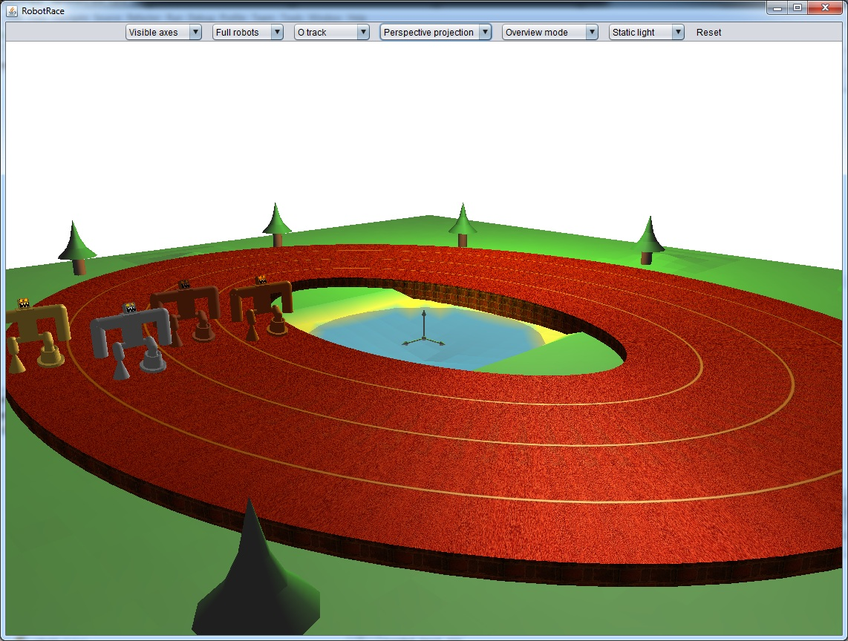
Assignments
Modeling and visualizing moving robots

Slide 11
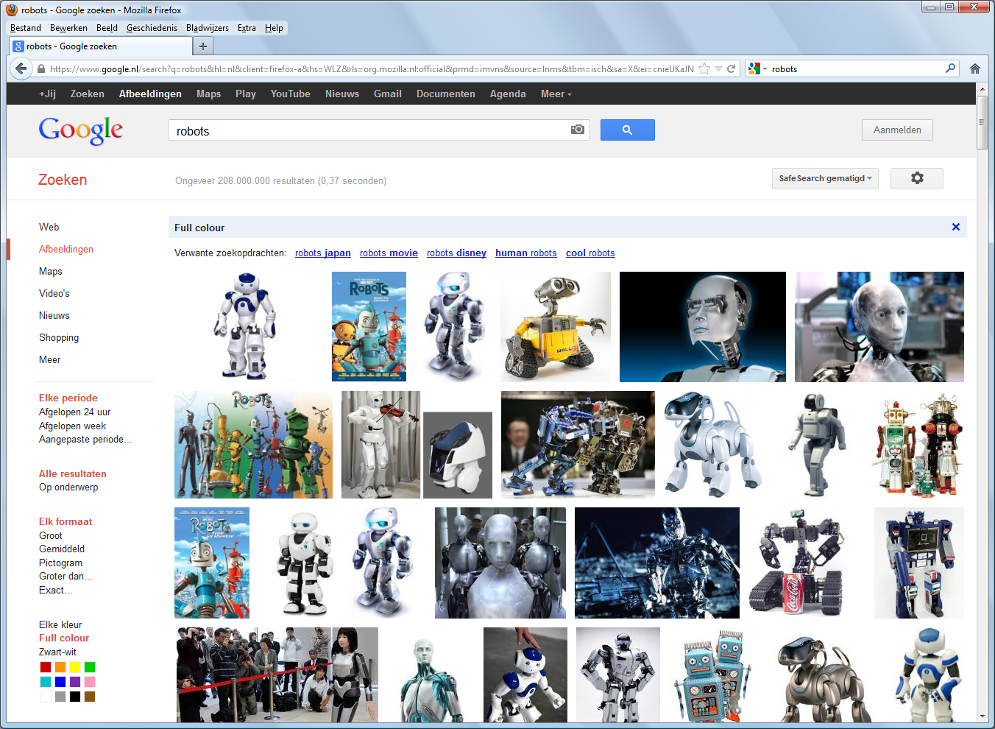

Slide 12
Assignments
Modeling and visualizing moving robots
Java + OpenGL
Three rounds
Deadlines: after week 3, 5, and 7:
3/12/2012, 17/12/2012, 14/1/2013.
To be done in pairs
Submit: source code via Peach
Judged: problem solved + explanation in comment source code
40% of final result

Slide 13
Course material
Book:
  Donald Hearn, M. Pauline Baker, Warren Carithers. Computer Graphics with OpenGL, 4th edition, Pearson Prentice Hall, paperback.
Study guide
Slides
Homework exercises and answers
Oase.tue.nl

Slide 14
Questions?
Ok, let’s have an overview of computer graphics…

Slide 15
Why computer graphics?
Fun! Visible!
Everywhere
Visual system offers:
  Parallel input
  Parallel processing
Computer graphics: ideal for human-computer communication

Slide 16
Applications
Graphs and charts
Computer-Aided Design
Virtual Reality
Data Visualization
Education and training
Computer Art
Movies
Games
Graphical User Interfaces
H&B 1:2-32

Slide 17
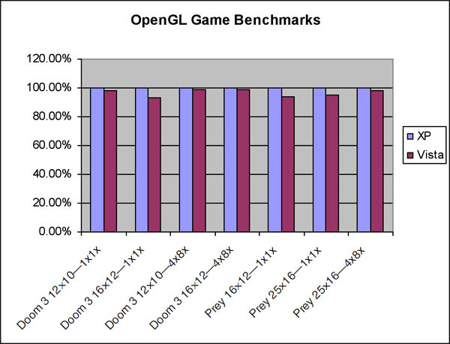
Business graphics
H&B 1:2-32

Slide 18
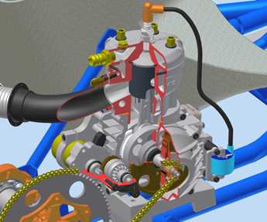
Computer-Aided Design
AutoDesk
IAME 2-stroke race kart engine

Slide 19
Visualization
Scientific visualization
Clip:
Golden Age of Scientific Computing
http://www.sci.utah.edu/
H&B 1:2-32

Slide 20

Gaming
H&B 1:2-32

Slide 21
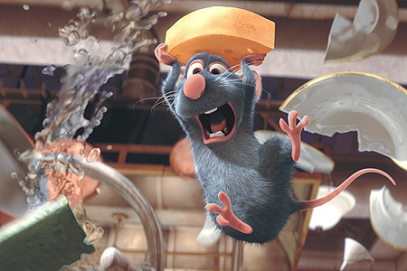
Movies
expression
depth of field
fracture
motion
water
hair
H&B 1:2-32
reflection

Slide 22
Hardware
Fast development
History: see book
Now: Graphics Processing Unit (GPU), LCD-screen

Slide 23
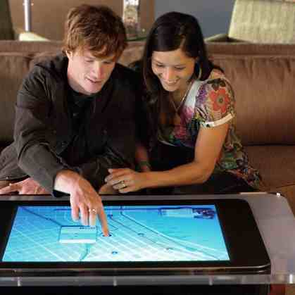

Beyond the laptop screen
Microsoft Surface
Apple iPad

Slide 24
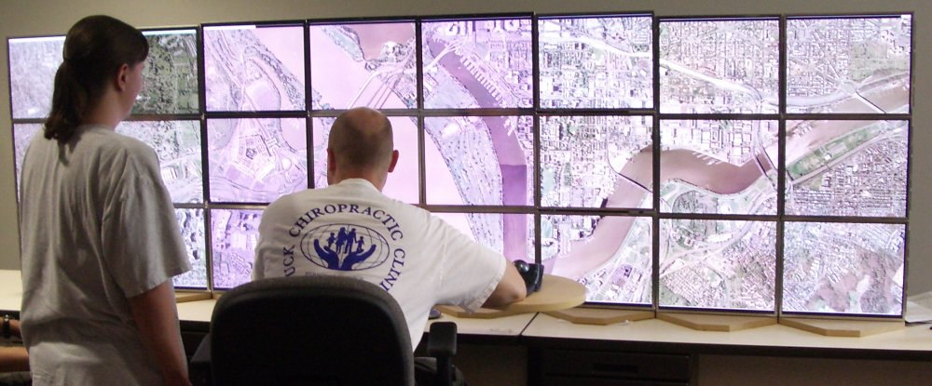
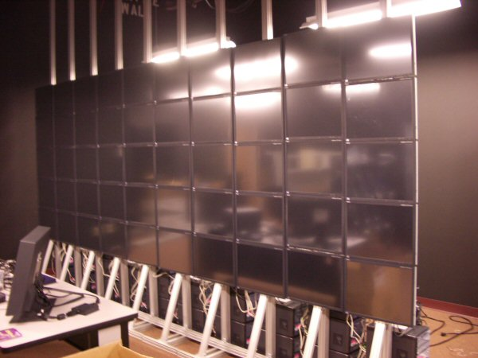
Beyond the laptop screen
24 screen configuration, Virginia Tech
Gigapixel display
50 LCD touchscreens

Slide 25
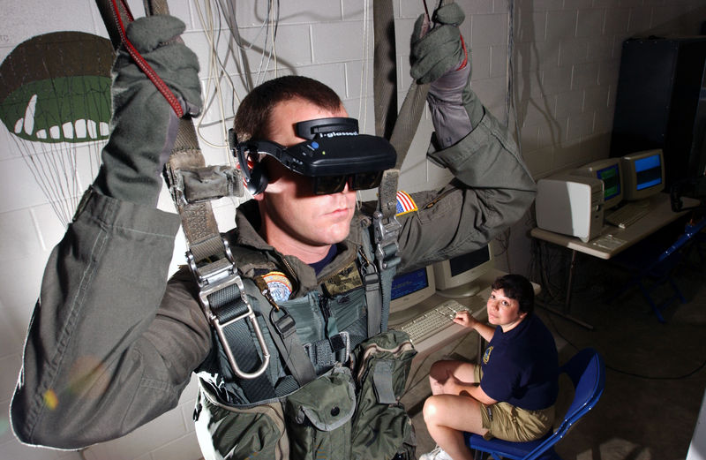
Beyond the laptop screen
Head mounted displays
Parachute trainer
US Navy

Slide 26
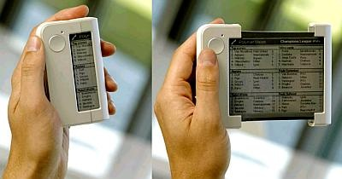
Beyond the laptop screen
Roll-up screen, Philips

Slide 27
Schematic
Display
Model
Image
interaction
User

Slide 28
Also…
Computer
Graphics
Model
Image
Pattern
Recognition
Image
Processing

Slide 29
Schematic
Display
Model
Image
interaction
User

Slide 30
From model to image
Model
World
View
NDC
Display
Graphics pipeline
Coordinates and transformations
H&B 3-1:60-61

Slide 31
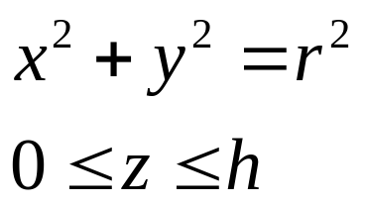
From model to image
Model
World
View
NDC
Display
Cylinder:
Local or modeling coordinates
Geometric modeling
H&B 3-1:60-61

Slide 32
From model to image
Model
World
View
NDC
Display
Position cylinders in scene:
World coordinates
H&B 3-1:60-61

Slide 33
From model to image
Model
World
View
NDC
Display
Look at cylinders:
Viewing coordinates
Visible surfaces, shading
H&B 3-1:60-61

Slide 34
From model to image
Model
World
View
NDC
Display
Display:
Normalized Device Coordinates
1
0
1
H&B 3-1:60-61

Slide 35
From model to image
Model
World
View
NDC
Display
Display on screen:
Device Coordinates
0
1024
768
Interaction
H&B 3-1:60-61

Slide 36
Generating graphics
Special-purpose programs
  Photoshop, Powerpoint, AutoCAD, StudioMax, Maya, Blender, PovRay, …
General graphics libraries and standards
  Windows API, OpenGL, Direct3D,…
H&B 3-2:61-62

Slide 37
CG standards
Set of graphics functions, to be called from programming language
Access to and abstract from hardware
Standardization
C, C++, Java, Delphi,…
CG API
Fortran, Pascal, …
Drivers
Display
Input dev.
Display
Input dev.
1975
2000

Slide 38
Functions
Graphics Output Primitives
  Line, polygon, sphere, …
Attributes
  Color, line width, texture, …
Geometric transformations
  Modeling, Viewing
Shading and illumination
Input functions
H&B 3-2:61-62

Slide 39
Software standards
GKS, PHIGS, PHIGS+ (1980-)
GL (Graphics Library, SGI)
OpenGL (early 1990s)
Direct3D (MS), Java3D, VRML,…
H&B 3-3:62-63

Slide 40
OpenGL
3D (and 2D)
Fast
Hardware, language, OS, company independent
OpenGL architecture review board
Broad support
Low-level (right level!)
Standard graphics terminology
H&B 3-5:64-72

Slide 41
Intro OpenGL
Few basic principles
No detailed questions asked at exam
Needed for assignments
Here: OpenGL 1.1
H&B 3-5:64-72

Slide 42
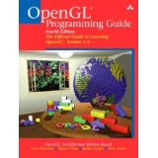
More info on OpenGL
http://www.opengl.org,
http://www.opengl.org/sdk/docs/man2/
The Red Book:
http://www.glprogramming.com/red/
Many other web-sites
No need to learn by head, aim at
being able to read manual pages

Slide 43
OpenGL, GLU and GLUT
OpenGL: basic functions
GLU: OpenGL Utility library:
GLUT: OpenGL Utility Toolkit library
GLU and GLUT:
  Handy functions for viewing and geometry
H&B 3-5:64-72

Slide 44
OpenGL and Java
C: glFunction(); gluFunction(); glutFunction();
Java: JOGL
  gl.glFunction();
  glu.gluFunction();
  glut.glutFunction();
No windowing functions offered by JOGL
Assignment: skeleton offered

Slide 45
OpenGL syntax
Functions:
  glFunction: glBegin, glClear, glVertex, …
Constants:
  GL_CONSTANT: GL_2D, GL_LINE
Datatypes:
  GLtype: GLbyte, GLint, GLfloat
H&B 3-5:64-72

Slide 46
Example

Slide 47
Example
glClearColor(1.0,1.0,1.0,0.0);// Background color
glMatrixMode(GL_PROJECTION); // Set transformation
glLoadIdentity;
gluOrtho2D(0, 200, 0, 150);
glClear(GL_COLOR_BUFFER_BIT); // Clear background
glColor3f(1.0, 0.0, 0.0); // Set color to red
glBegin(GL_LINES); // Draw line
glVertex2i(180, 15); // - first point
glVertex2i(10, 145); // - second point
glEnd; // Ready with line
glFlush; // Send
H&B 3-5:64-72

Slide 48
Example

Slide 49
Example 3D
Quick, minimal example
Lots of jargon and new material
Motivate studying theory
Enable quick start assignment
Here: viewing and modeling transformations
H&B 3-5:64-72

Slide 50
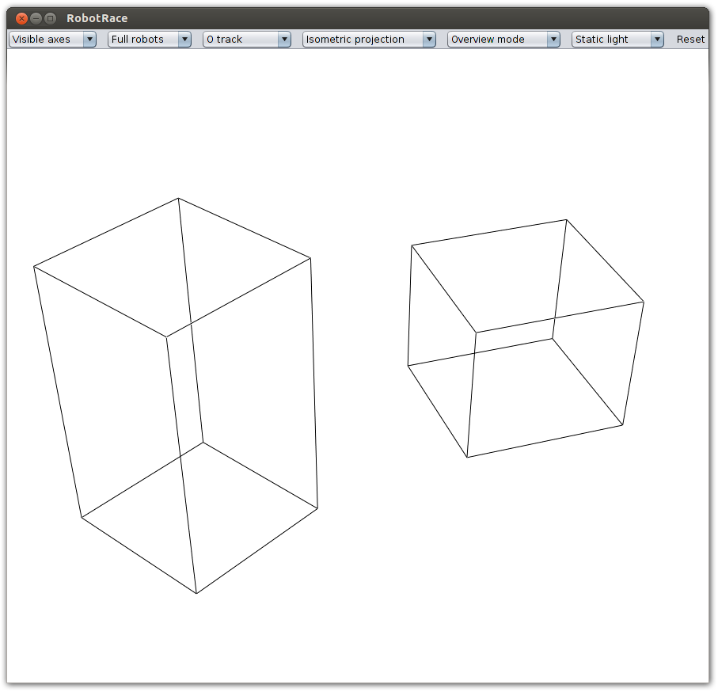

Slide 51
Example 3D
Aim: Draw two rectangular boxes
  Set up viewing transformation
  Specify the colors
  Draw the objects

Slide 52
Example 3D
// Set up viewing transformation
glViewport(0, 0, 500, 500); // Select part of window
glMatrixMode(GL_PROJECTION); // Set projection
glLoadIdentity();
glFrustum(-1.0, 1.0, -1.0, 1.0, 4.0, 20.0);
glMatrixMode(GL_MODELVIEW); // Set camera
glLoadIdentity();
gluLookAt(3.0, 6.0, 5.0, - eye point
1.0, 0.0, 0.0, - center point
0.0, 0.0, 1.0); - up axis

Slide 53
Example 3D
// Clear background
glClearColor(1.0,1.0,1.0,0.0);// Background color
glClear(GL_COLOR_BUFFER_BIT); // Clear background
// Set color
glColor3f(0.0, 0.0, 0.0); // Set color to black

Slide 54
Example 3D
// Draw two rectangular boxes
glutWireCube(1.0); // unit box around origin
glTranslatef(2.0, 0.0, 0.0); // move in x-direction
glRotatef(30, 0.0, 0.0, 1.0); // rotate 30 degrees
around z-axis
glScalef(1.0, 1.0, 2.0); // scale in z-direction
glutWireCube(1.0); // translated, rotated, scaled box

Slide 55
Example 3D
glutWireCube(1.0); // unit box around origin
glTranslatef(2.0, 0.0, 0.0); // move in x-direction
glRotatef(30, 0.0, 0.0, 1.0); // rotate 30 degrees
around z-axis
glScalef(1.0, 1.0, 2.0); // scale in z-direction
glutWireCube(1.0); // translated, rotated, scaled box
Note:
Objects are drawn in the current local axis-frame;
With transformations this frame can be changed.

Slide 57
Next
Have fun with the first assignments
Next lectures:
  Basic math
  2D and 3D transformation
  2D and 3D viewing

