Slide 1
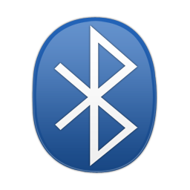



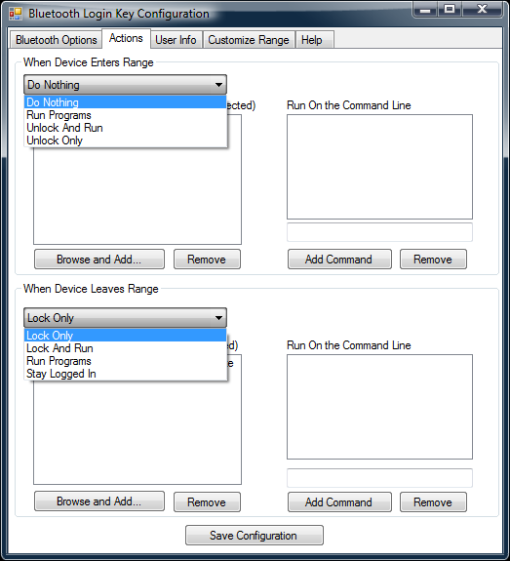
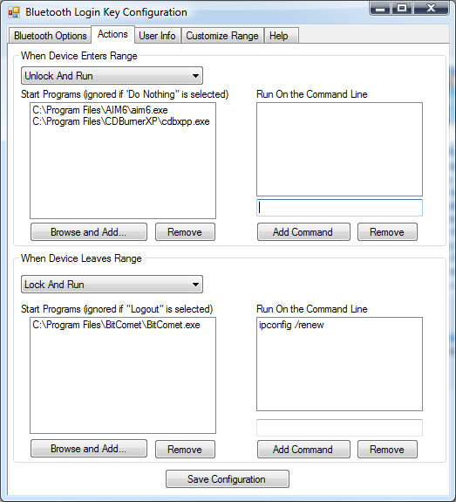
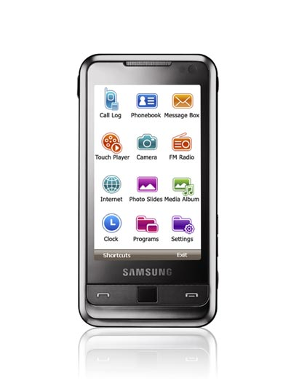
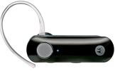
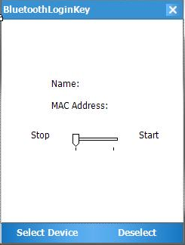
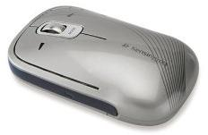
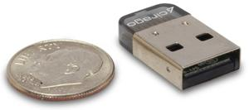
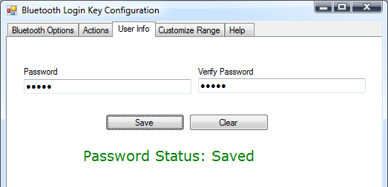

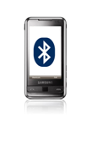


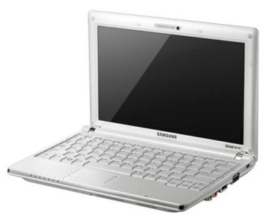

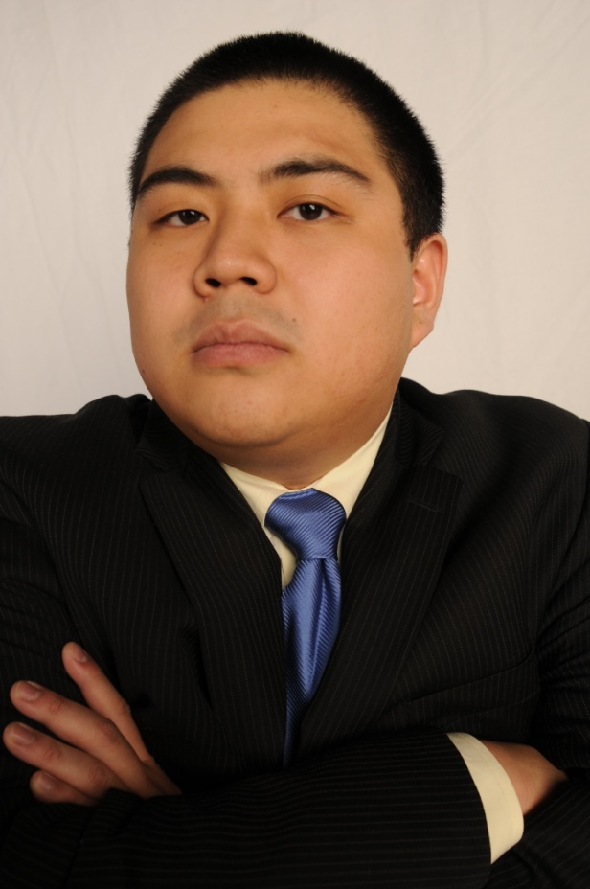

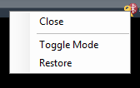
Bluetooth Login Key
RIT Computer Engineering Senior Design Project
Tim Wesley , Dan Chen
Spring 2009
Project Overview
Configuring Custom Actions
RSSI Range Detection
Materials and Costs
The Bluetooth login key provides an easy and convenient way for users to automatically secure their workstations. Depending on how users configure the software, a vast array of actions can be triggered automatically when users approach or leave their workstations. The Bluetooth login key is compatible with any Bluetooth device that users' computers can detect.
The Actions tab allows the user to specify what will happen when the selected Bluetooth device moves in or out of range.
The Range Signal Strength Indicator (RSSI) value of the Bluetooth signal is used to determine how far a Bluetooth device is from the host. In order to determine whether or not a Bluetooth device is in range, the RSSI value much be checked to see how far the device is from the host. The RSSI value is continuously checked and interpreted by the software.
The Bluetooth dongle is used to provide Bluetooth functionality to the systems on which the software is running. The Bluetooth headset and mouse were originally going to be used as locators, however the Samsung Omnia will be used as a locator instead. The Omnia runs the Windows Mobile OS, which runs software used to communicate to the host PC.
How it Works
Running the Windows Mobile Software
The configuration application runs on a PC allowing users to determine exactly what happens when a device moves in and out of range. There are three ranges to choose from: short, medium, and long. The phone is responsible for constantly sending out a signal indicating how strong of a signal it has with the host system. When the system determines that the signal strength is lower than the user has specified, the screen is locked. While the screen is locked the program is still searching for the Bluetooth device in the background. If communication is re-established, the screen is automatically unlocked. The user may also log in manually using a password.
A Windows Mobile phone is required to find the RSSI value. The WM operating system makes it possible to access this information. A WM application was developed to broadcast RSSI values and send them back to the software running on the computer.
The programs added to the left hand side will be started before the commands entered in the boxes on the right hand side. If a user enters, leaves, then re-enters range, then all of the commands that execute when a user enters range will be executed twice.
The “User Info” tab is where a user enters the password that will unlock the program when a lock option is executed. If no password is saved, any password will unlock the screen.
User action configuration screen
Top (left to right): Motorola H390 Bluetooth Headset, Samsung Omnia
Bottom: Cirago Bluetooth Dongle, Kensington Bluetooth Mouse,
The following table shows the costs of materials for all of the hardware used in this project. Items that have a logo were provided free of charge by the Department Of Computer Engineering.
Required Software
Microsoft Visual Studio
VS was used as the software to write all code, including the WM Application.
Windows Vista
Vista is the operating system in which all the software ran on (not including the WM Application).
32Feet.Net Bluetooth Library
This library provided all the Bluetooth
functionality used in this project.
Item | Quantity | Price | Total
Motorola H390 Black Bluetooth Headset | 1 | $24.99 | $24.99
Kensington Slim Blade Bluetooth mouse | 1 | $59.99 | $59.99
Cirago USB 2.0 Micro Bluetooth Dongle | 2 | $26.93 | $53.86
Samsung Omnia | 1 | $260.99 | $260.99
medium range
long range
Save password screen
Total: $399.83
short range
Activating the Hardware Monitor
The Team
The blue and red icons are shown when the program is active and inactive respectively. In active mode, the program will log users out when the Bluetooth device is no longer detected. To switch between modes, right click on the tray icon and select “Toggle mode”.
Active Icon, Inactive Icon, Tray Menu
Team Members from left to right: Tim Wesley, Dan Chen

