Slide 1
Scene Classification
Final Presentation
Karina Damico
Pauline Martial

Slide 2
Comparative study and Hybrid
Color Histogram
Gabor
CENTRIST

Slide 3
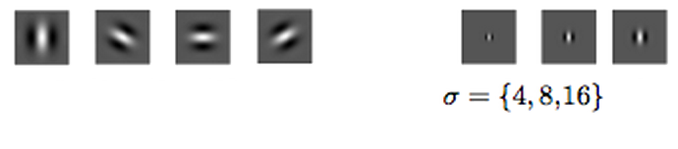
Gabor visual descriptor
Gabor Bank formation:
Scale: 3 scales
Orientation: 4 orientations
12 filter bank
Decision is made
through viewing papers, but mostly intuitively
counter clock in 45 degrees.
four directions: 0, 45, 90, 135

Slide 4
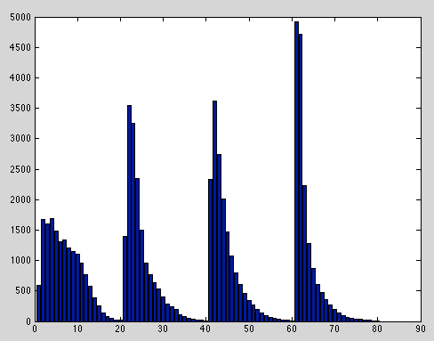
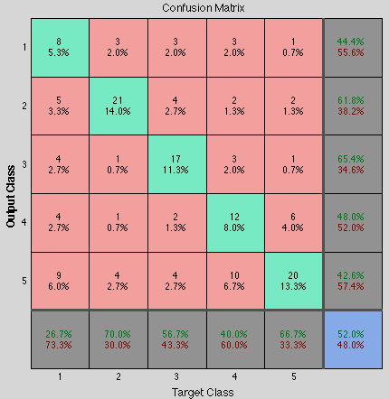
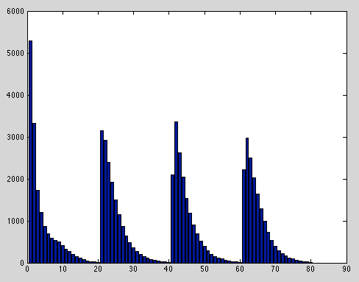
Gabor visual descriptor
Waste...

Slide 5
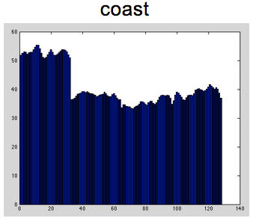
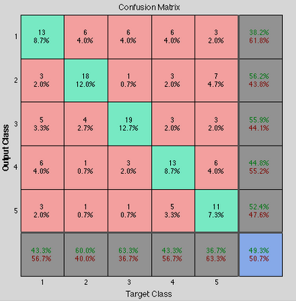
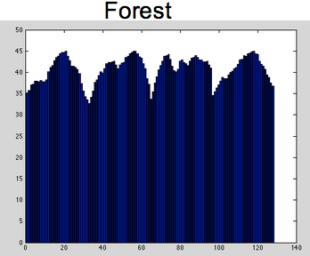
Gabor visual descriptor
Waste...even more

Slide 6
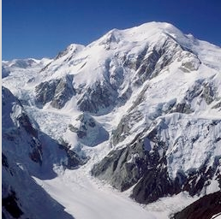
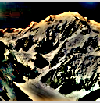
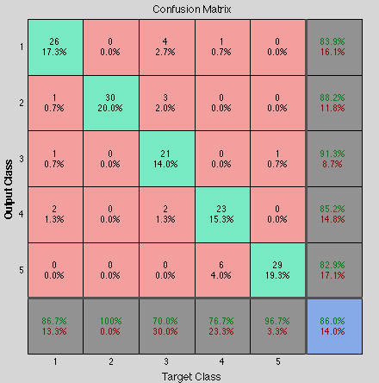
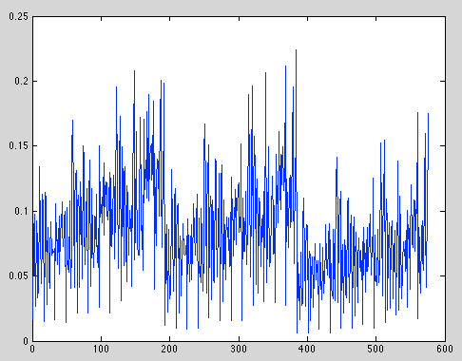
Gabor visual descriptor

Slide 7
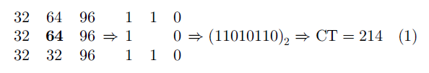
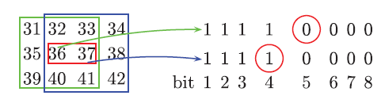
CENTRIST descriptor
A CENTRIST is a histogram of CT value...
What is a CT value?

Slide 8
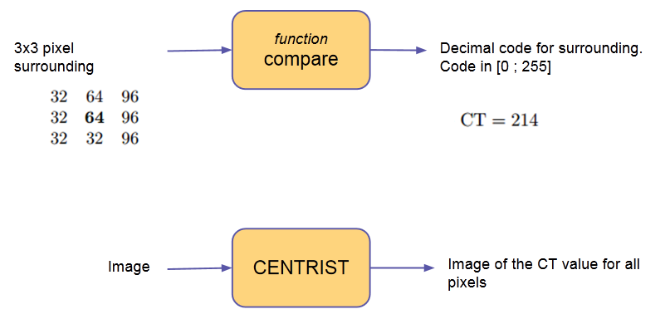
CENTRIST descriptor

Slide 9
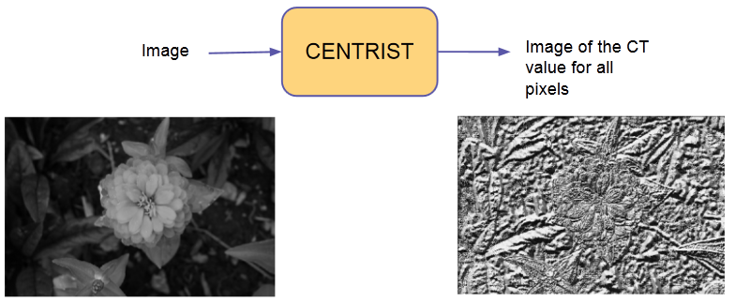
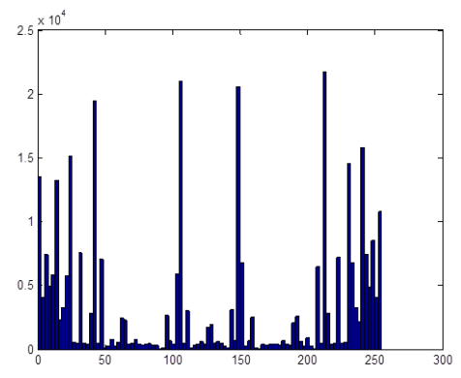
CENTRIST descriptor
Distribution of CT values histogram

Slide 10
CENTRIST descriptor
Images Database
CT Feature Vectors Database
CTfeatureVector
Parameters:
0.125 downsize
4 lines
Histogram Intersection Method
40 bins histograms

Slide 11
CENTRIST descriptor
Voting algorithm:
CT Gabor GIST
: high confidence (3)
: medium confidence (2)
: low confidence (1)
vote
vote
vote

Slide 12
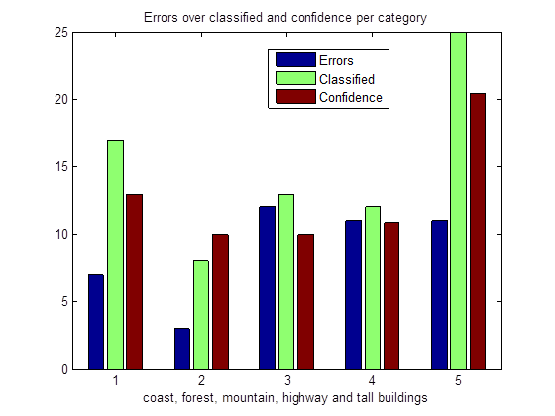
CENTRIST descriptor
Voting algorithm
Use randomly chosen images for training/ testing.
Results:

Slide 13
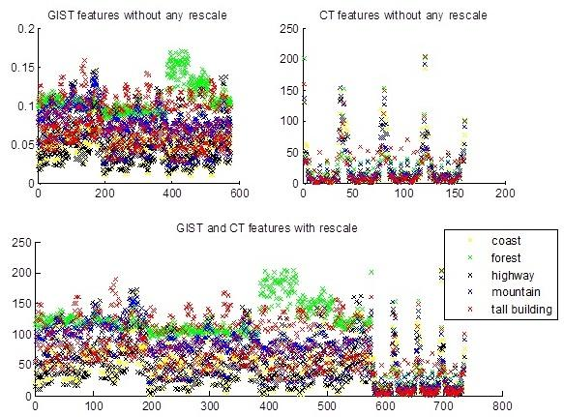
CENTRIST descriptor

Slide 14
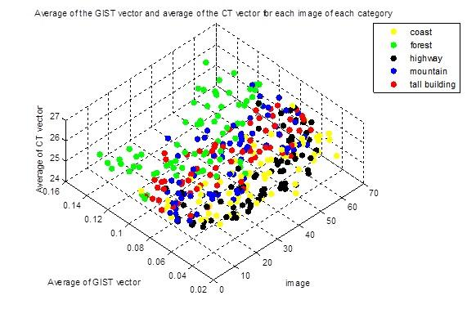
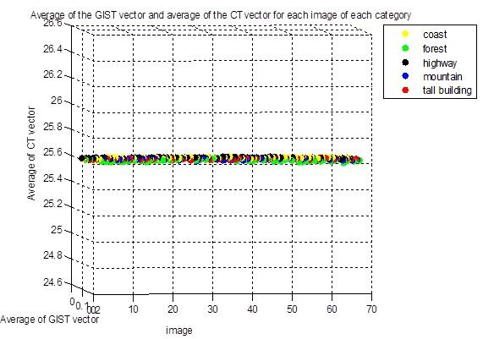
CENTRIST descriptor

Slide 15
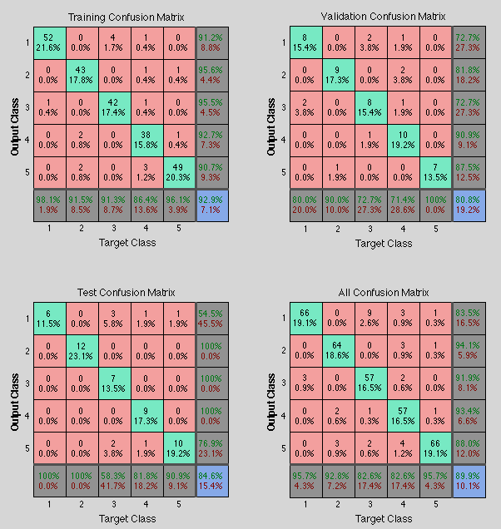
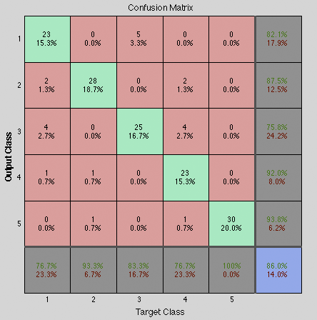
CENTRIST descriptor - 4 line

Slide 16
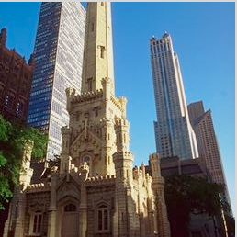
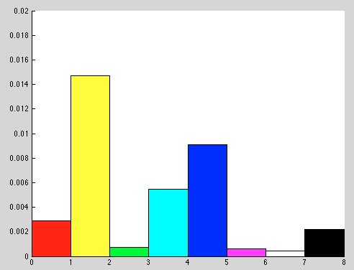

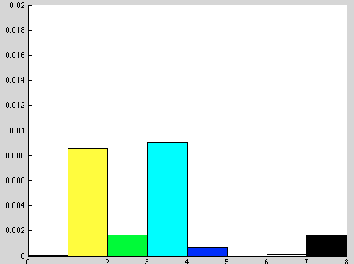
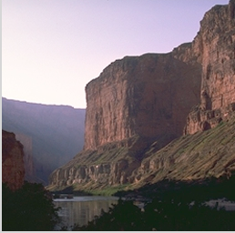
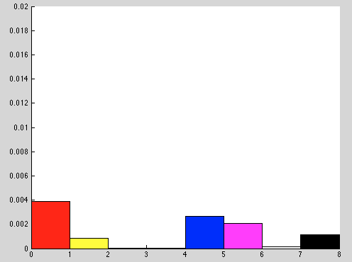
Color Histogram
Manually calculates a count for:
red
yellow
green
cyan
blue
magenta
white
black
through HSV color space
[1x8 feature vector]

Slide 17
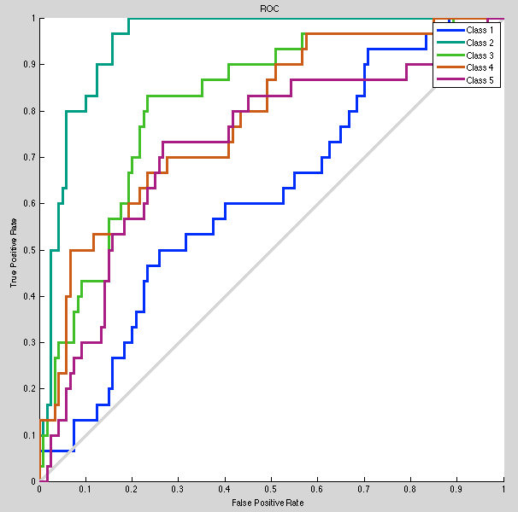
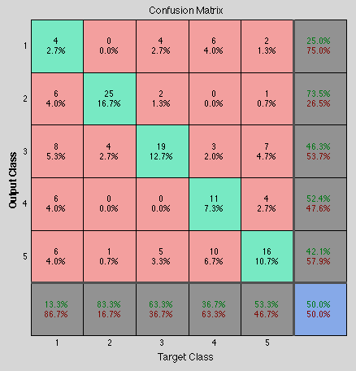
Color Histogram
8 neurons in hidden layer

Slide 18
Hybrid: Gabor + CENTRIST
Expected improvements:
coast
forest
highway
tall building

Slide 19
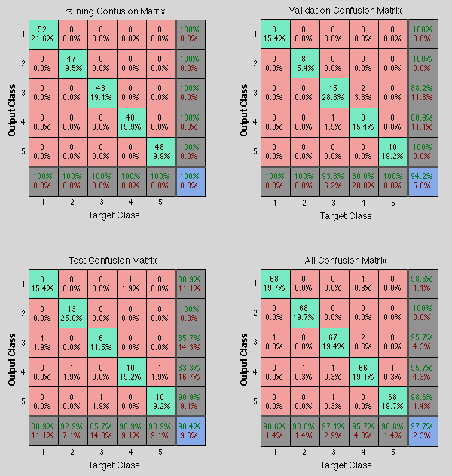
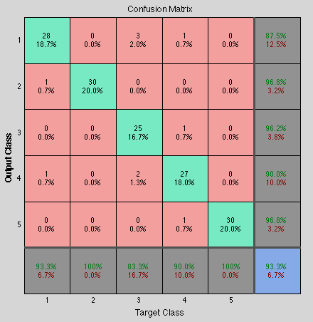
Hybrid: Gabor + CENTRIST
93.3 % accuracy

Slide 20
Hybrid: Gabor + Color Histogram
Expected improvements:
none
?

Slide 21
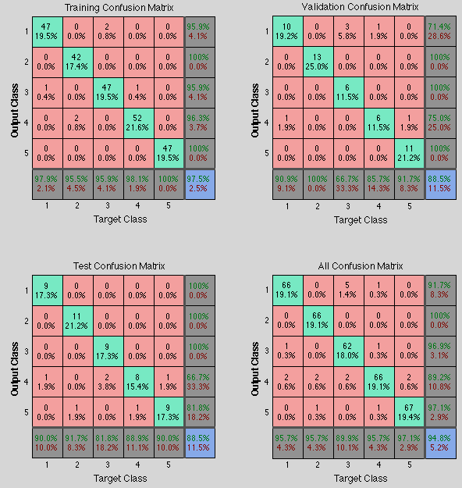
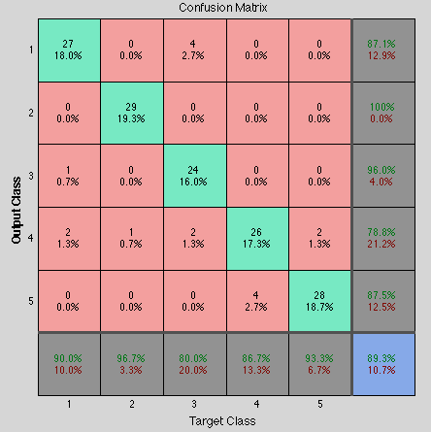
Hybrid: Gabor + Color Histogram
300 neurons: Some progress! - 86% => 89.3%

Slide 22
Hybrid: CENTRIST + Color Histogram
Expected improvements:
none
?

Slide 23
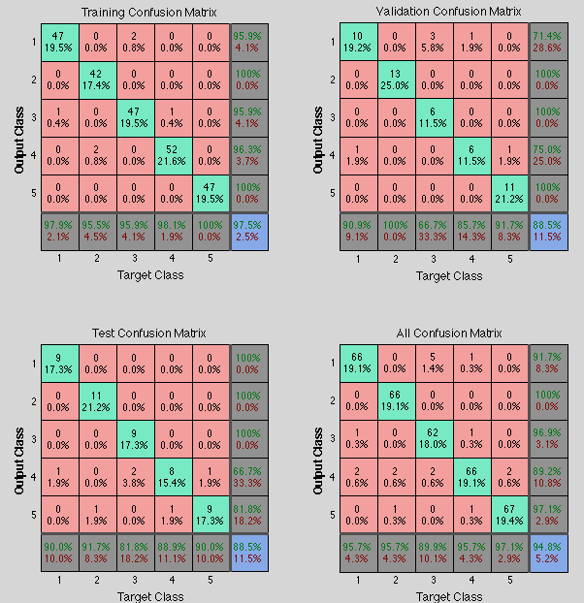
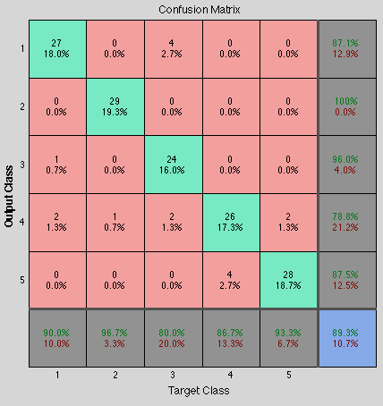
Hybrid: CENTRIST + Color Histogram
80 neurons: Some progress! - 86% => 89.3%

Slide 24
Hybrid: Gabor + CENTRIST + Color Histogram
?

Slide 25
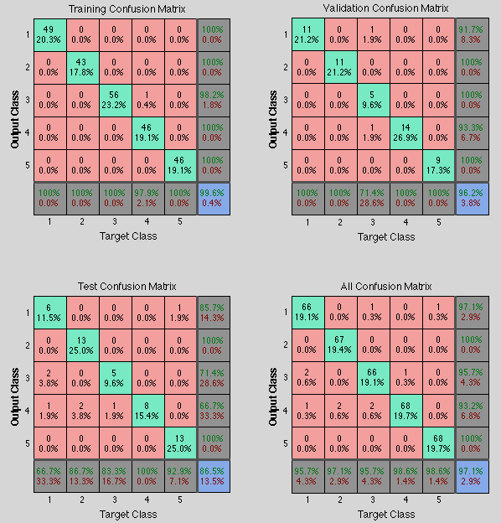
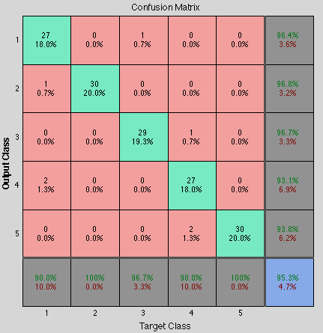
Hybrid: Gabor + CENTRIST + Color Histogram
744 => 210 => 5
95.3% accuracy :)

Slide 26

Conclusion
Good features + good features = even better features.
Good + bad = can create confusion somewhere, but can add improvements as well - test separately and check!
Overall, enjoyed experimenting and working on this project => satisfaction :) and, Ravdeep, 95.3% accuracy

