Slide 1
Scene Classification
Project Proposal Presentation
Authors:
Piter Garcia Karina Damico Pauline Martial

Slide 2
Outline
1. Introduction
2. Timeline
3. Results expected
4. Descriptors chosen
4.a. GABOR
4.b. CENTRIST
4.c. Color Histogram
5. Classifier

Slide 3
Introduction
Scene classification VS. object recognition
Better results: Multiple feature sets extracted.
1. Separate analysis.
2. Features combined.

Slide 4
Timeline
Date | Updates | Details
01/15 | FIRST Update Report | Start of 3 descriptors - Gabor: selection of optimal parameters, testing - Centrist: calculation of CT values - Color Histogram descriptor. Image dataset selection.
01/22 | SECOND Update Report | First results of 3 descriptors without particular improvements. - Gabor: formation of the Gabor filter bank, - Centrist: calculation of centrist values - Color Histogram descriptor
01/29 | THIRD Update Report | First results of 3 descriptors with improvements: - Gabor: feature vector formation, - Centrist - Color Histogram descriptor. Neural Network classifier implementation. Result examination of three approaches individually.
02/05 | FOURTH Update Report | Hybrid - combined feature vector of three descriptors. Result examination
02/12 | Final Project Report | Comparison of approaches. Conclusion.

Slide 5
Expected results
Achieve:
Create a Scene and Category development with each descriptor:
Gabor, Centrist, and Color Histogram .
Improve:
The Scene and Category development with a hybrid method
-combining all descriptors for a better image categorization.
Obtain:
A higher accuracy in image categorization with a hybrid method.
- Better than any of the descriptors accuracy used to combine.

Slide 6
Gabor descriptor
Gabor filters possess localization properties in both spatial and frequency domain.
Frequency and orientation representations of Gabor filters are similar to those of the human visual system
In the spatial domain, a 2D Gabor filter is a Gaussian kernel function modulated by a sinusoidal plane wave.
Texture as a feature (texture can be considered to be repeating patterns of local variation of pixel intensities.)
Gabor filter = texture descriptor

Slide 7
Gabor descriptor
Feature extraction using Gabor filters consist of the following steps:
1) configuring Gabor filters in the spatio-frequency domain - choosing optimal filter parameters (orientation, phase offset, aspect ration, number of directions)
2) combining Gabor filter bank that will be applied on images to form feature vectors

Slide 8

Centrist Visual Descriptor
- Calculate CT values by comparing neighborhood,
- Generate histogram = CENTRIST

Slide 9
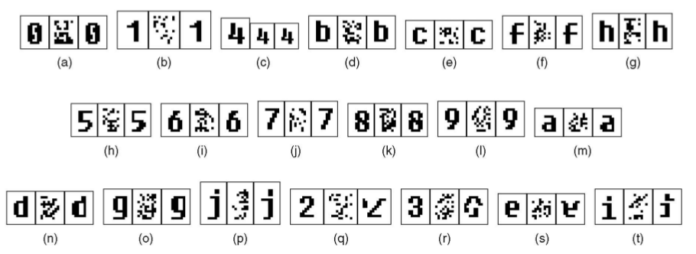
Centrist Visual Descriptor
Very good results!
Structure is encoded in the CENTRIST descriptor.

Slide 10
Color Histograms Descriptor
Bin-ratio provides important information that is collected from ratios between bin values of histograms that are used for scene and category classifications.
These advantages are as follows:
-BRD is robust to cluttering, partial occlusion and histogram normalization.
-BRD captures rich co-occurrence information, and has a linear computational complexity.
-BRD easy to combined with other methods to gather complementary information.

Slide 11
Color Histograms Descriptor
Histogram-based representation will capture rich information to be used within the bag-of-words models, where each image will be represented by its histogram of quantized visual words and combined with classifiers for categorization purpose.
Histogram Development and Approaches
- Partial matching information:
Avoid large amount of clutter that brings noises to the object-of-interest.
- Co-occurrence information:
captures the correlation information between pairs of histogram bins of visual words
Three recent matching algorithms with high-order statistics:
- Second-order programming,
- Matching
- High order matching.

Slide 12
Classifier
As a classifier Artificial Neural Network was selected.
Tool: Matlab Neural Network Toolbox
Neural Network using feed forward back propagation algorithm
Number of layers: to be determined (most probably 1 hidden layer)

Slide 13
Conclusion
Gabor, Centrist, and Color Histogram descriptors can be easily combined into one method. This combination will give place to a hybrid methodology to gather complementary information for a better categorization and scene classification tasks using a bag-of-words framework.

